Slide 1
Challenges in Hadron Spectroscopy
Alessandro Pilloni
Hampton University, April 26th, 2018

Slide 2
Outline
Laws of nature in a nutshell
Why the strong force is special
The S-Matrix principles
Complex numbers and amplitude analysis
Epilogue
A. Pilloni – Challenges in Hadron Spectroscopy
Notes:
2 slides su Zc, a Bes e a Belle
2 slide su tetraquark model: dall’hamiltoniana di Jaffe al calcolo delle masse
1 slide su molecular models, dove sono i carichi? (non in Tornqvist, si in Hanhart, vedere Braaten, citare Nefediev)
2 slides su decay channels, dove si dovrebbe vedere, e a seconda del modello, vedere qualche plot
1 slide su Y(4260), tetraquark? C’è lo strano (si vede la f0)
1 slide su Zc a cleo (anche il neutro)

Slide 3
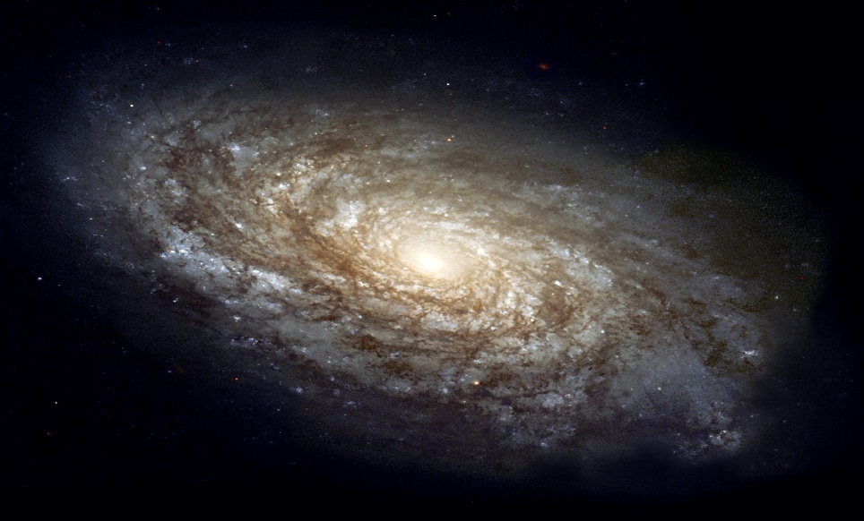
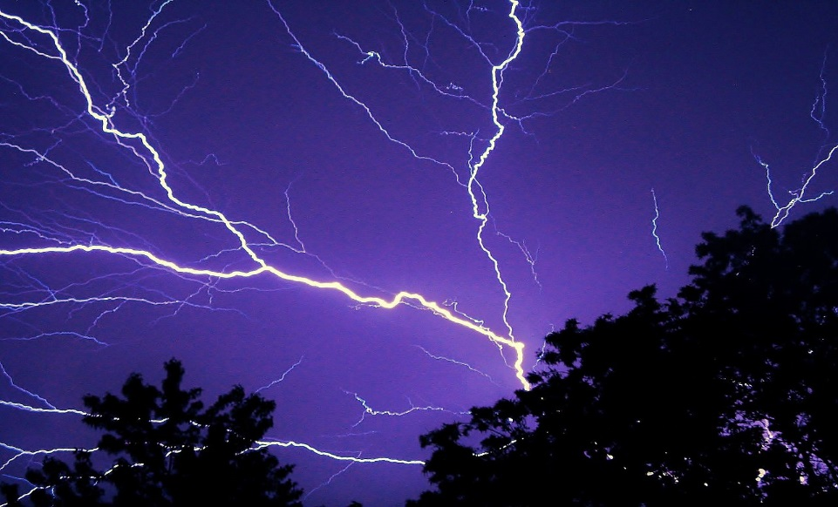
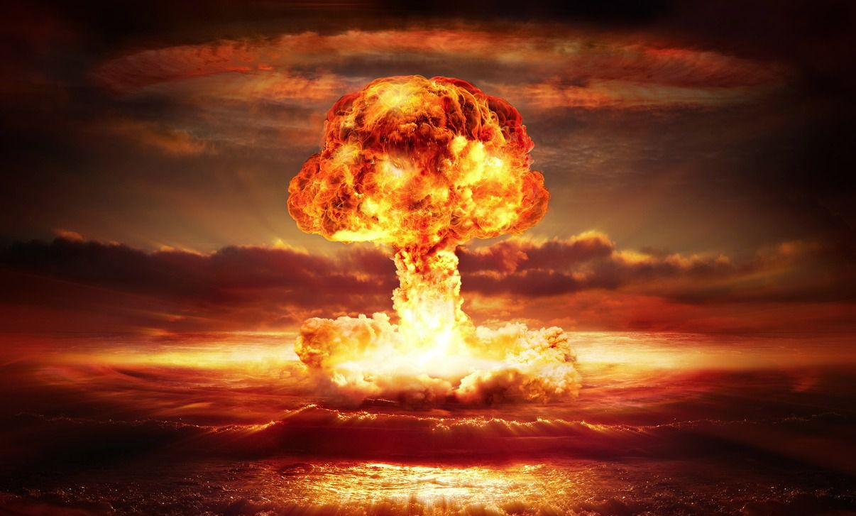
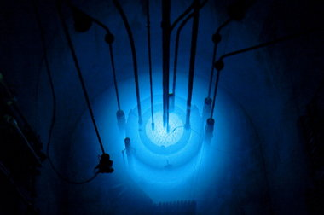
The four forces
$$U∼\frac{m_{1}m_{2}}{r}$$
$$U∼\frac{q_{1}q_{2}}{r}$$
$$U∼\frac{g_{s1}g_{s2}}{r}e^{−r/λ_{s}}$$
$$λ_{s}∼1.4 \text{fm}$$
$$U∼\frac{g_{w1}g_{w2}}{r}e^{−r/λ_{w}}$$
$$λ_{w}∼2.5×{10}^{−3} \text{fm}$$
A. Pilloni – Challenges in Hadron Spectroscopy
Notes:
2 slides su Zc, a Bes e a Belle
2 slide su tetraquark model: dall’hamiltoniana di Jaffe al calcolo delle masse
1 slide su molecular models, dove sono i carichi? (non in Tornqvist, si in Hanhart, vedere Braaten, citare Nefediev)
2 slides su decay channels, dove si dovrebbe vedere, e a seconda del modello, vedere qualche plot
1 slide su Y(4260), tetraquark? C’è lo strano (si vede la f0)
1 slide su Zc a cleo (anche il neutro)

Slide 4
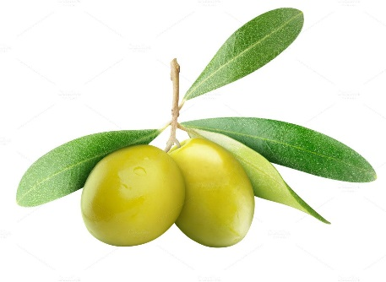
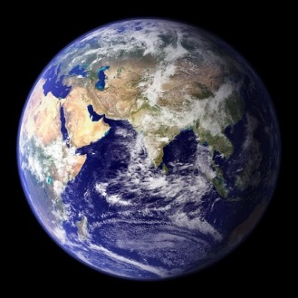
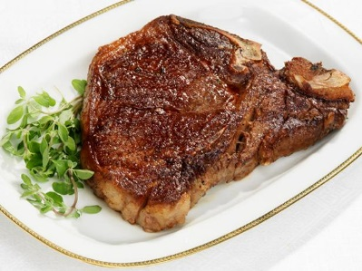
Reminder
$$1 \text{eV}\text{(/}c^{2}\text{)} =1.6×{10}^{−19} \text{J}\text{(/}c^{2}\text{)}=1.8×{10}^{−35} \text{kg}$$
1 proton = $\text{939 }\text{MeV}$
1 proton : 1 pound = 1 ounce : 1 Earth
In the following $ℏ=c=1$, [energy] = [mass] = [1/length]
A. Pilloni – Challenges in Hadron Spectroscopy

Slide 5
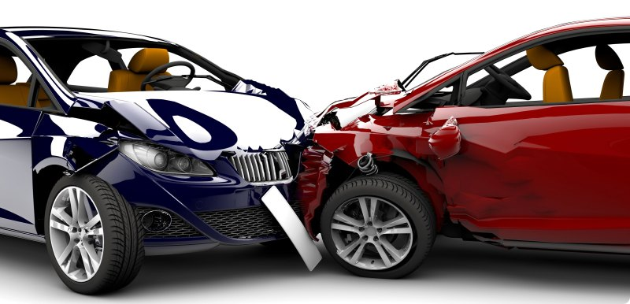
How we probe the forces
We smash particles against each other, the best way of creating new particles
It’s like if in a car accident, the pieces of the collision would create new fancy, expensive cars
(Do not try with your car. Believe me, it’s a bad idea)
A. Pilloni – Challenges in Hadron Spectroscopy

Slide 6
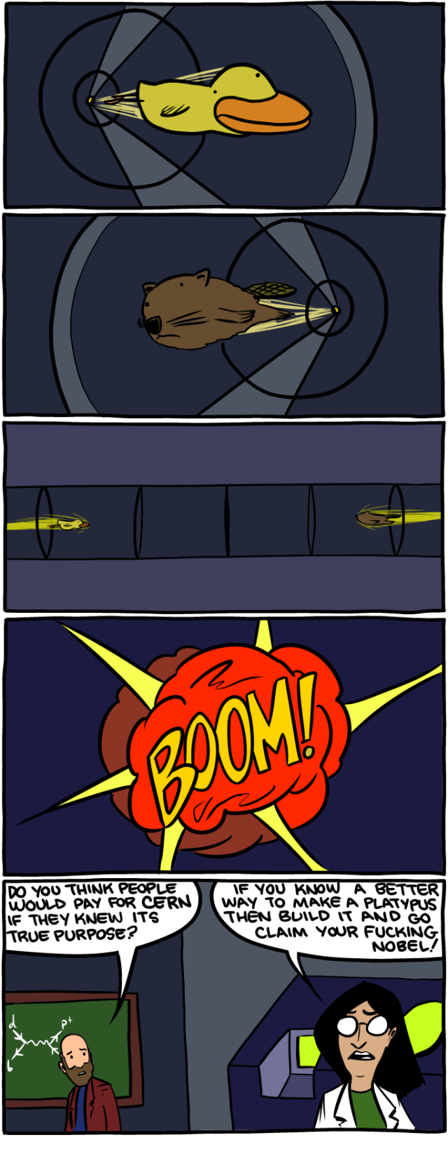
How we probe the forces at CERN
LHC collides protons at $13 \text{TeV}$ (kinetic energy of a mosquito)
A. Pilloni – Challenges in Hadron Spectroscopy

Slide 7
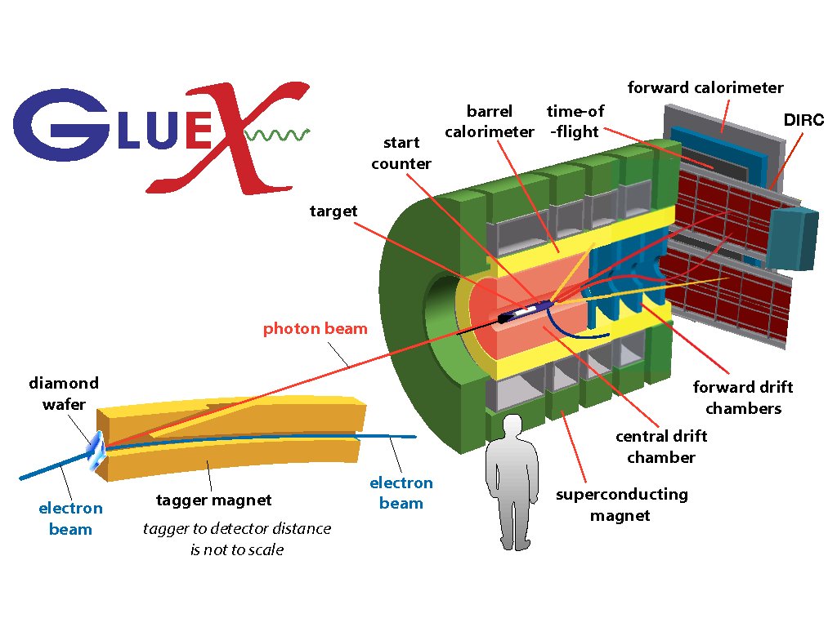
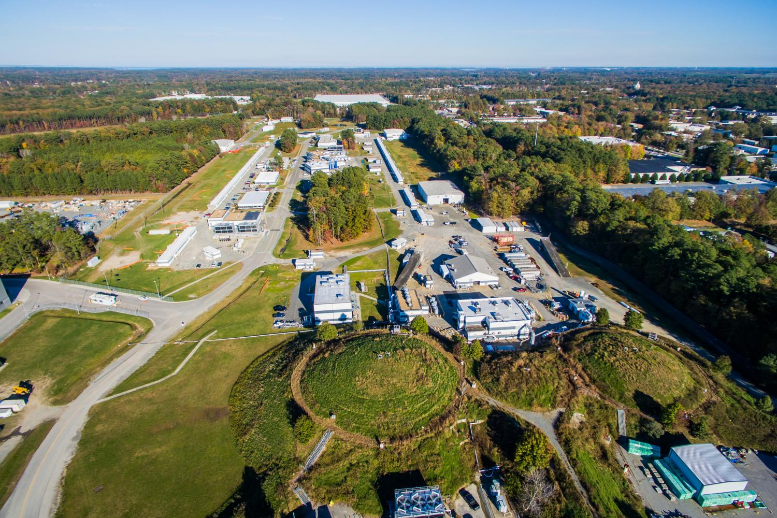
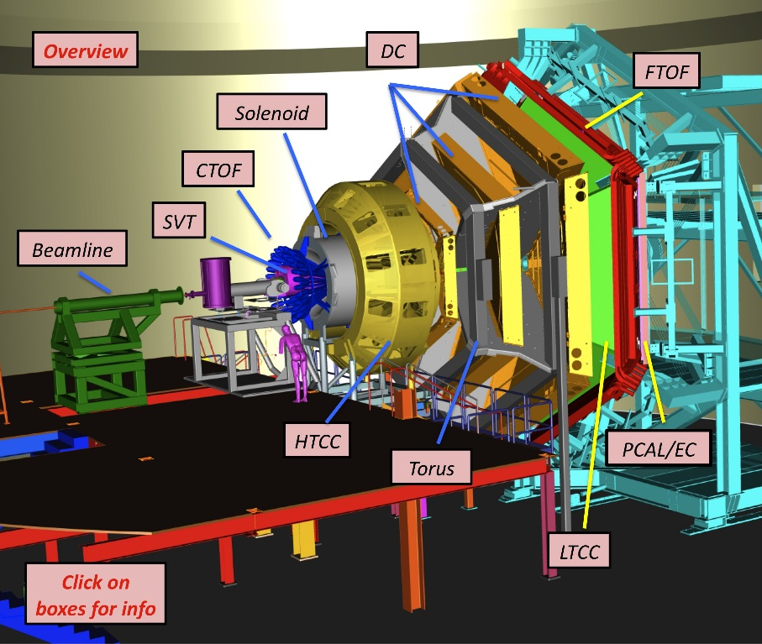
How we probe the forces at JLab
Electrons at $12 \text{GeV}$
$v=99.9999999\% c$
Hydrogen target (mostly),
Clean (?) physics
A. Pilloni – Challenges in Hadron Spectroscopy

Slide 8
Standard Model Constituents
Standard model is a remarkable simple theory
The particle in the spectrum can easily fit in a table
Lightest massive particle $<3 μ\text{eV}$
Heaviest particle $∼175 \text{GeV}$ (gold atom)
Masses span 17 orders of magnitude
H
Higgs
"Higgs interaction"
125,000
A. Pilloni – Challenges in Hadron Spectroscopy

Slide 9
Standard Model Constituents
According to relativity, the interaction cannot be instantaneous, but is mediated by fields that propagate with finite speed
In relativistic quantum mechanichs, these fields are quantized in particles
The range of the interaction depend on the mass of the mediator,
$λ∼\frac{ℏc}{m}$ (Compton wavelength)
H
Higgs
"Higgs interaction"
125,000
A. Pilloni – Challenges in Hadron Spectroscopy

Slide 10
Quantum ChromoDynamics (QCD)
Quarks appear in 6 flavors, with (very) different masses
Each quark can be in 3 identical colors
$$r,g,b$$
Each gluon can be in 8 colors
$r\overline{g},r\overline{b},b\overline{g}$, $b\overline{r}$,$g\overline{b}$, $g\overline{r}$, $$r\overline{r}−b\overline{b},r\overline{r}+b\overline{b}−2g\overline{g}$$
H
Higgs
"Higgs interaction"
125,000
Gluon is massless. Long range?
Have you ever observed a quark?
A. Pilloni – Challenges in Hadron Spectroscopy

Slide 11
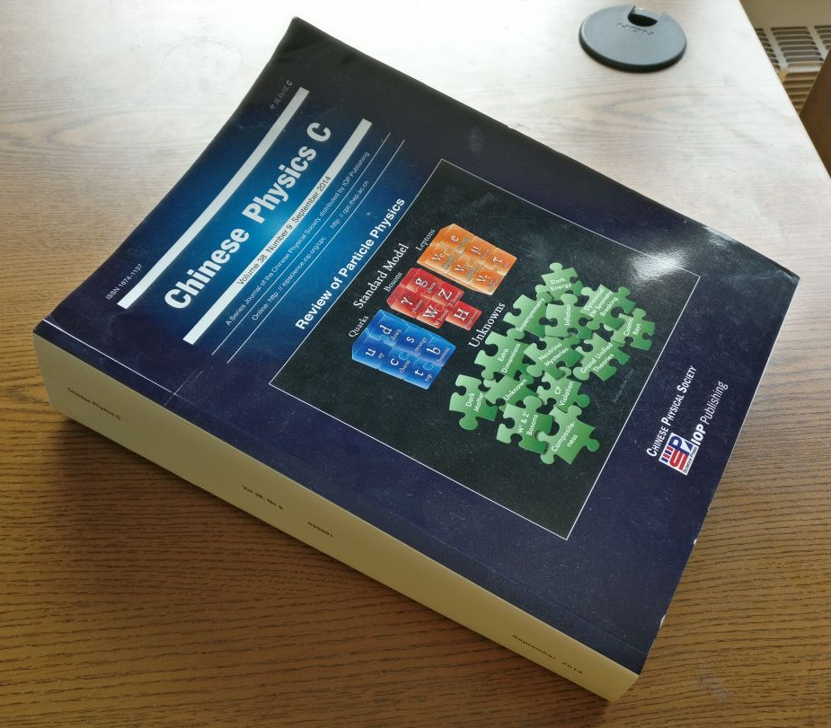
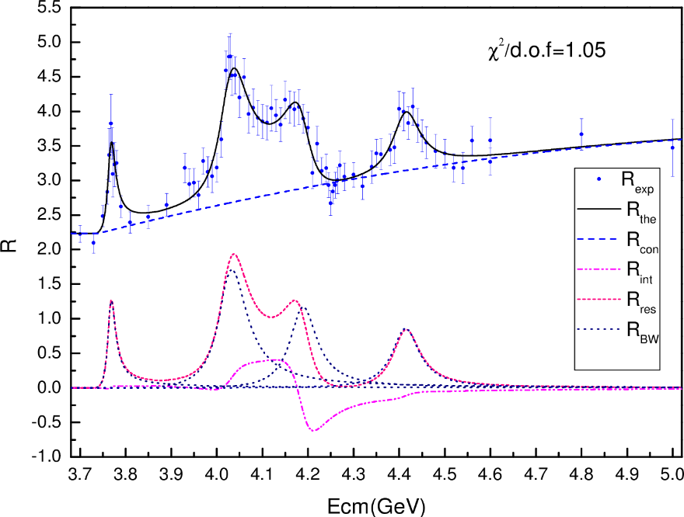
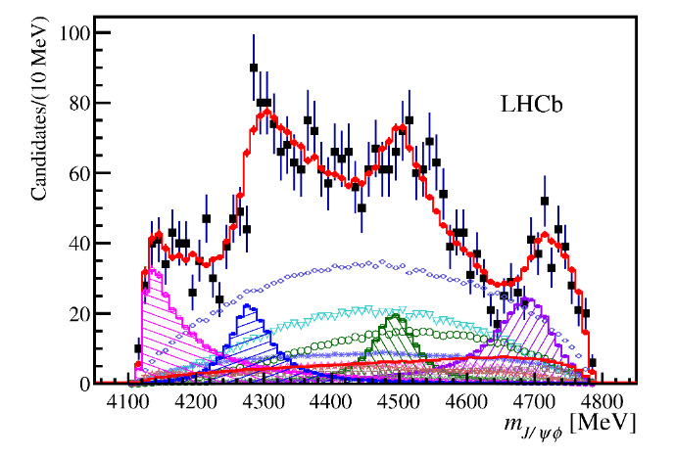
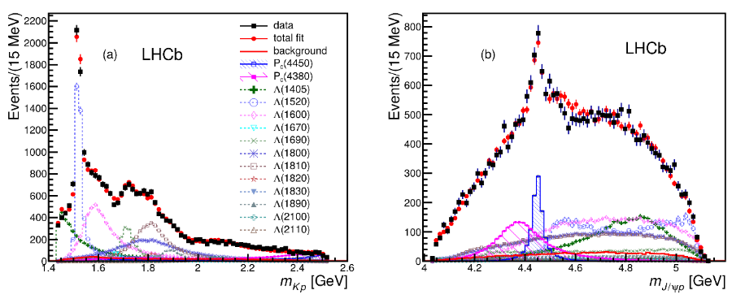
Welcome to Hell
Review of Particle Physics
Only white particles have been observed so far, forming an extremly rich zoo of hadrons
A. Pilloni – Challenges in Hadron Spectroscopy

Slide 12
Let’s step back: QED
$$\frac{e^{2}}{4π}=α∼\frac{1}{137}≪1$$
$$e$$
A. Pilloni – Challenges in Hadron Spectroscopy

Slide 13
Now QCD
A. Pilloni – Challenges in Hadron Spectroscopy

Slide 14
Asymptotic freedom
At high energies, the coupling $α_{s}=\frac{g_{s}^{2}}{4π}≪1$ perturbation theory works

Slide 15
At low energies?
At low energies, the coupling $α_{s}≫1$ thinking in terms of quarks and gluons make no sense anymore;
They «arrange» themselves in a incalculable way into colourless hadrons (confinement)
A. Pilloni – Challenges in Hadron Spectroscopy

Slide 16
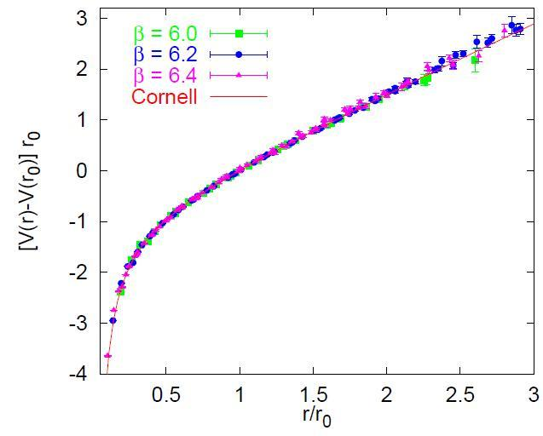
At low energies
$$V∼σ r$$
A. Pilloni – Challenges in Hadron Spectroscopy

Slide 17
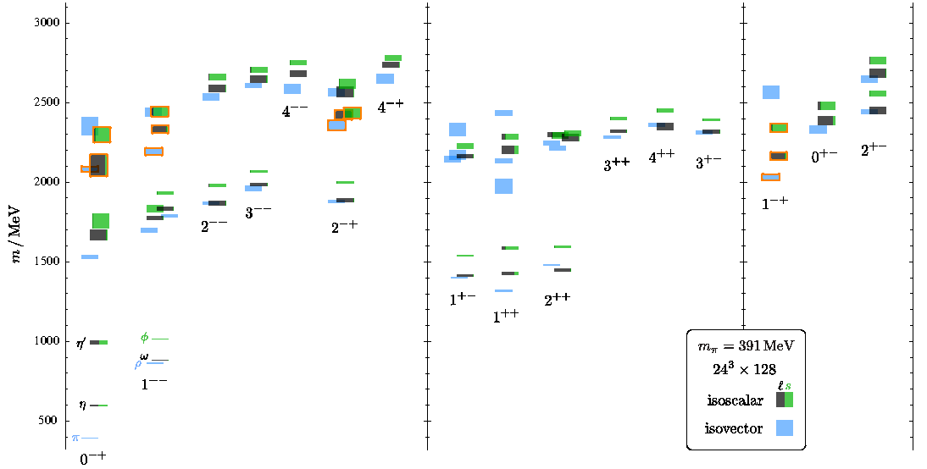
At low energies?
$$λ_{s}∼1/m_{π}$$
A. Pilloni – Challenges in Hadron Spectroscopy

Slide 18
Hadron Spectroscopy
Hybrids
Tetraquark
Meson
Baryon
Glueball
$$π$$
$$π$$
$$J/ψ$$
$$π$$
Hadroquarkonium
Molecule
Experiment
Data
Amplitude analysis
Properties,
Model building
Lattice QCD
With great statistics comes great responsibility!
Peter Parker, PhD
A. Pilloni – Challenges in Hadron Spectroscopy

Slide 19
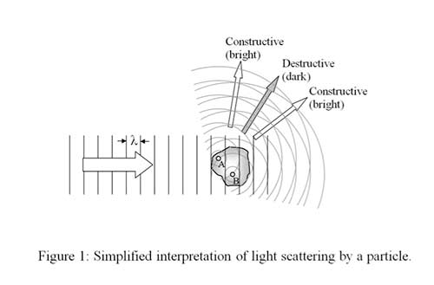
What is an amplitude?
$ψ_{in}\left(r\right)∼e^{i k z}$
$ψ_{out}\left(r\right)∼e^{i k z}+\frac{f\left(E\right)}{r} e^{ikr}$
$f\left(E\right)$ is the amplitude. Remember that I can measure only ${\left|f\left(E\right)\right|}^{2}$
The $S$-matrix is $S\left(E\right)=1+2ik f(E)$
A. Pilloni – Challenges in Hadron Spectroscopy

Slide 20
QCD has no solution. Don’t panic (yet)
When you are desperate, look for symmetries:
Symmetries are beautiful (and group theory is fun!)
Symmetries constrain your results no matter how complicated your theory is
Luckily, strong interactions are the ones with most symmetries:
Under Parity
Under Charge Conjugation
Under Time reversal
Conserve Flavor (isospin, strangeness...)
Conserve electric charge and baryonic number
Moreover, there are some generic properties that any interaction has to satisfy
A. Pilloni – Challenges in Hadron Spectroscopy

Slide 21
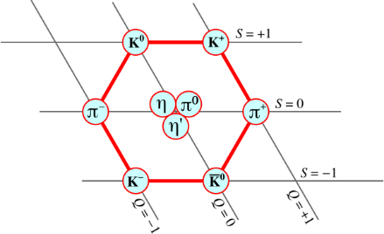
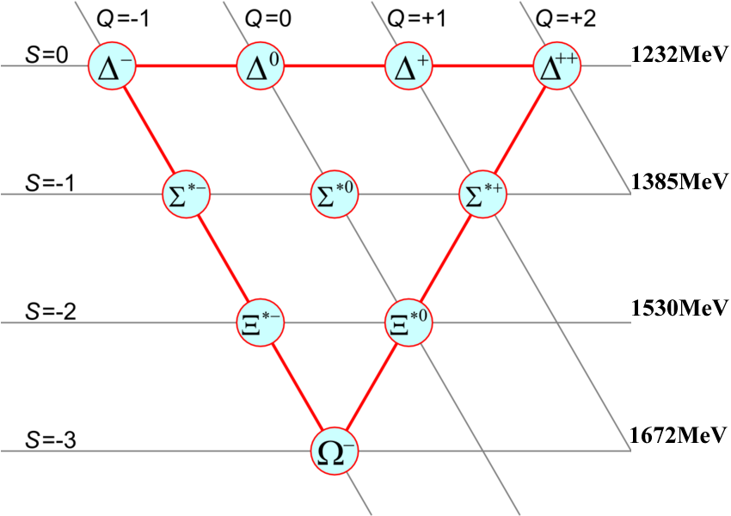
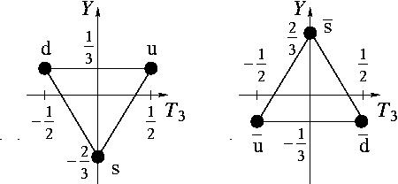
Flavor symmetry
Hadron appear in approximate degenerate multiplets (group theory needed)
This observation led to the discovery of quark constituents without observing a single quark!
Amplitudes of particles in the same multiplet are related (Wigner-Eckart theorem)
A. Pilloni – Challenges in Hadron Spectroscopy

Slide 22
The S-Matrix principles
Future cannot change the past
100%, something will happen
The anti-particle is an anti-particle and not just a different particle
(analyticity)
(unitarity)
(crossing symmetry)
Sherlock Holmes, QFT
Even though these look so obvious, there is no amplitude which is known to satisfy all these principles at the same time
In the ‘60s, people tried to guess how the real solution looks like, just by implementing these principles. It did not work. Now we have QCD, but it doesn’t work either
Imposing those in a clever way allow us to constrain as much as possible the arbitrariness of choosing a model to extract physics from experiments
Parametrize your ignorance. Build a reasonable model. Fit data. Have fun.
A. Pilloni – Challenges in Hadron Spectroscopy

Slide 23
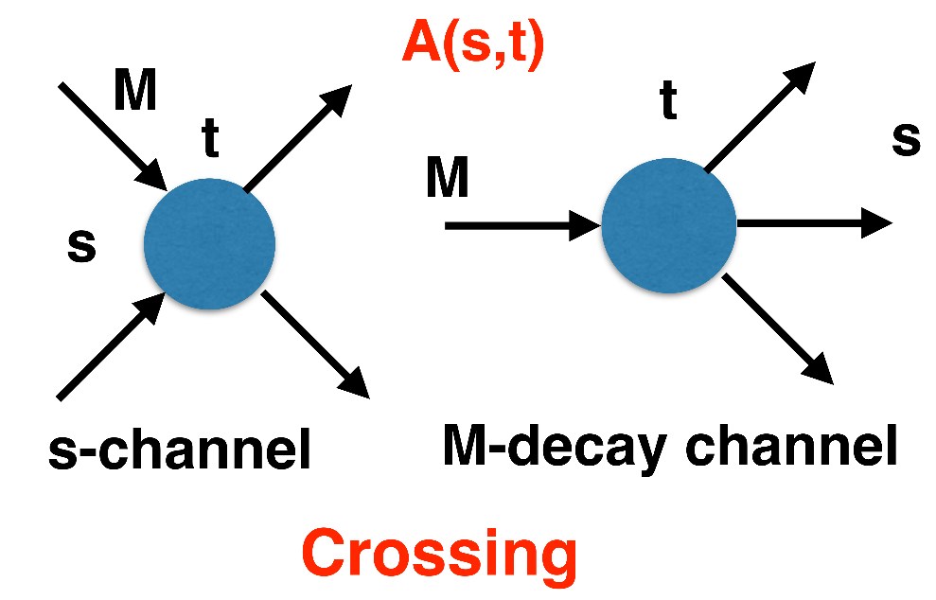
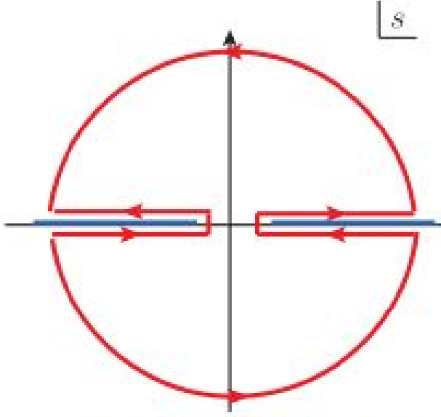
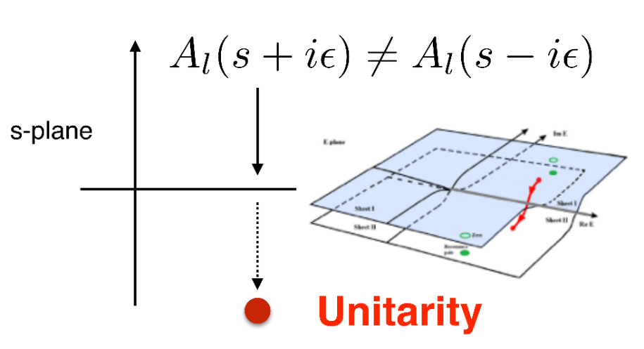
$S$-Matrix principles
$$f_{l}\left(E\right)=\lim_{ε→0}f_{l}(E+iε)⁡$$
Analyticity
These are constraints the amplitudes have to satisfy, but do not fix the dynamics
Need for complex analysis
+ Lorentz, discrete & global symmetries
A. Pilloni – Challenges in Hadron Spectroscopy
Notes:
Controlla la parte su Regge

Slide 24
Analyticity
Complex analytic functions are extremely regular and smooth
If you know the function in a region, you can extend it in a unique way everywhere
Complex functions are characterized by its non-analyticities (poles and cuts)
Analyticity
If I turn on an interaction at $t=0$, and I want nothing happens f$or t<0$, I cannot have singularities in the lower plane
Using crossing, no singularities in the upper plane either. Boring.
A. Pilloni – Challenges in Hadron Spectroscopy
Notes:
Controlla la parte su Regge

Slide 25
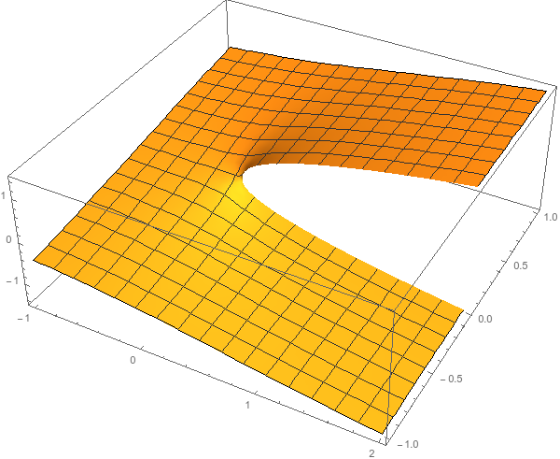
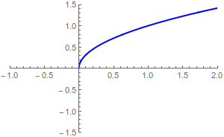
Unitarity
Probability conservation implies ${\left|S\left(E\right)\right|}^{2}=1$
For the amplitude, this turns into
$$Im f\left(E\right)=k{\left|f\left(E\right)\right|}^{2}$$
$$f\left(E+iε\right)−f\left(E−iε\right)≠0$$
Example: $i\sqrt{E}$...
$$i\sqrt{e^{iπ}}=−1$$
$$i\sqrt{1}=i$$
$$i\sqrt{e^{2iπ}}=−i$$
A. Pilloni – Challenges in Hadron Spectroscopy
Notes:
Controlla la parte su Regge

Slide 26
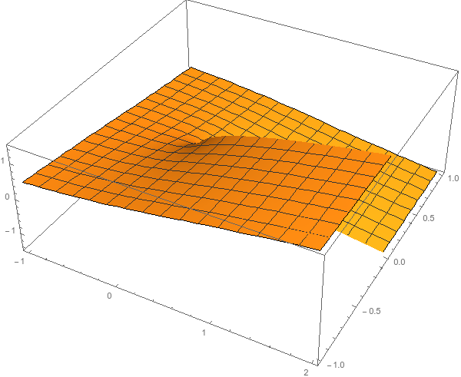
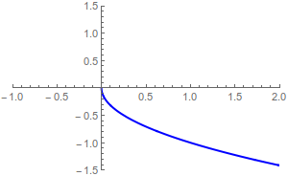
Unitarity
Probability conservation implies ${\left|S\left(E\right)\right|}^{2}=1$
For the amplitude, this turns into
$$Im f\left(E\right)=k{\left|f\left(E\right)\right|}^{2}$$
$$f\left(E+iε\right)−f\left(E−iε\right)≠0$$
Example: $i\sqrt{E}$...
$$i\sqrt{e^{iπ}}=1$$
...but I can decide to get the negative solution
$$i\sqrt{e^{2iπ}}=i$$
$$i\sqrt{1}=−i$$
A. Pilloni – Challenges in Hadron Spectroscopy
Notes:
Controlla la parte su Regge

Slide 27
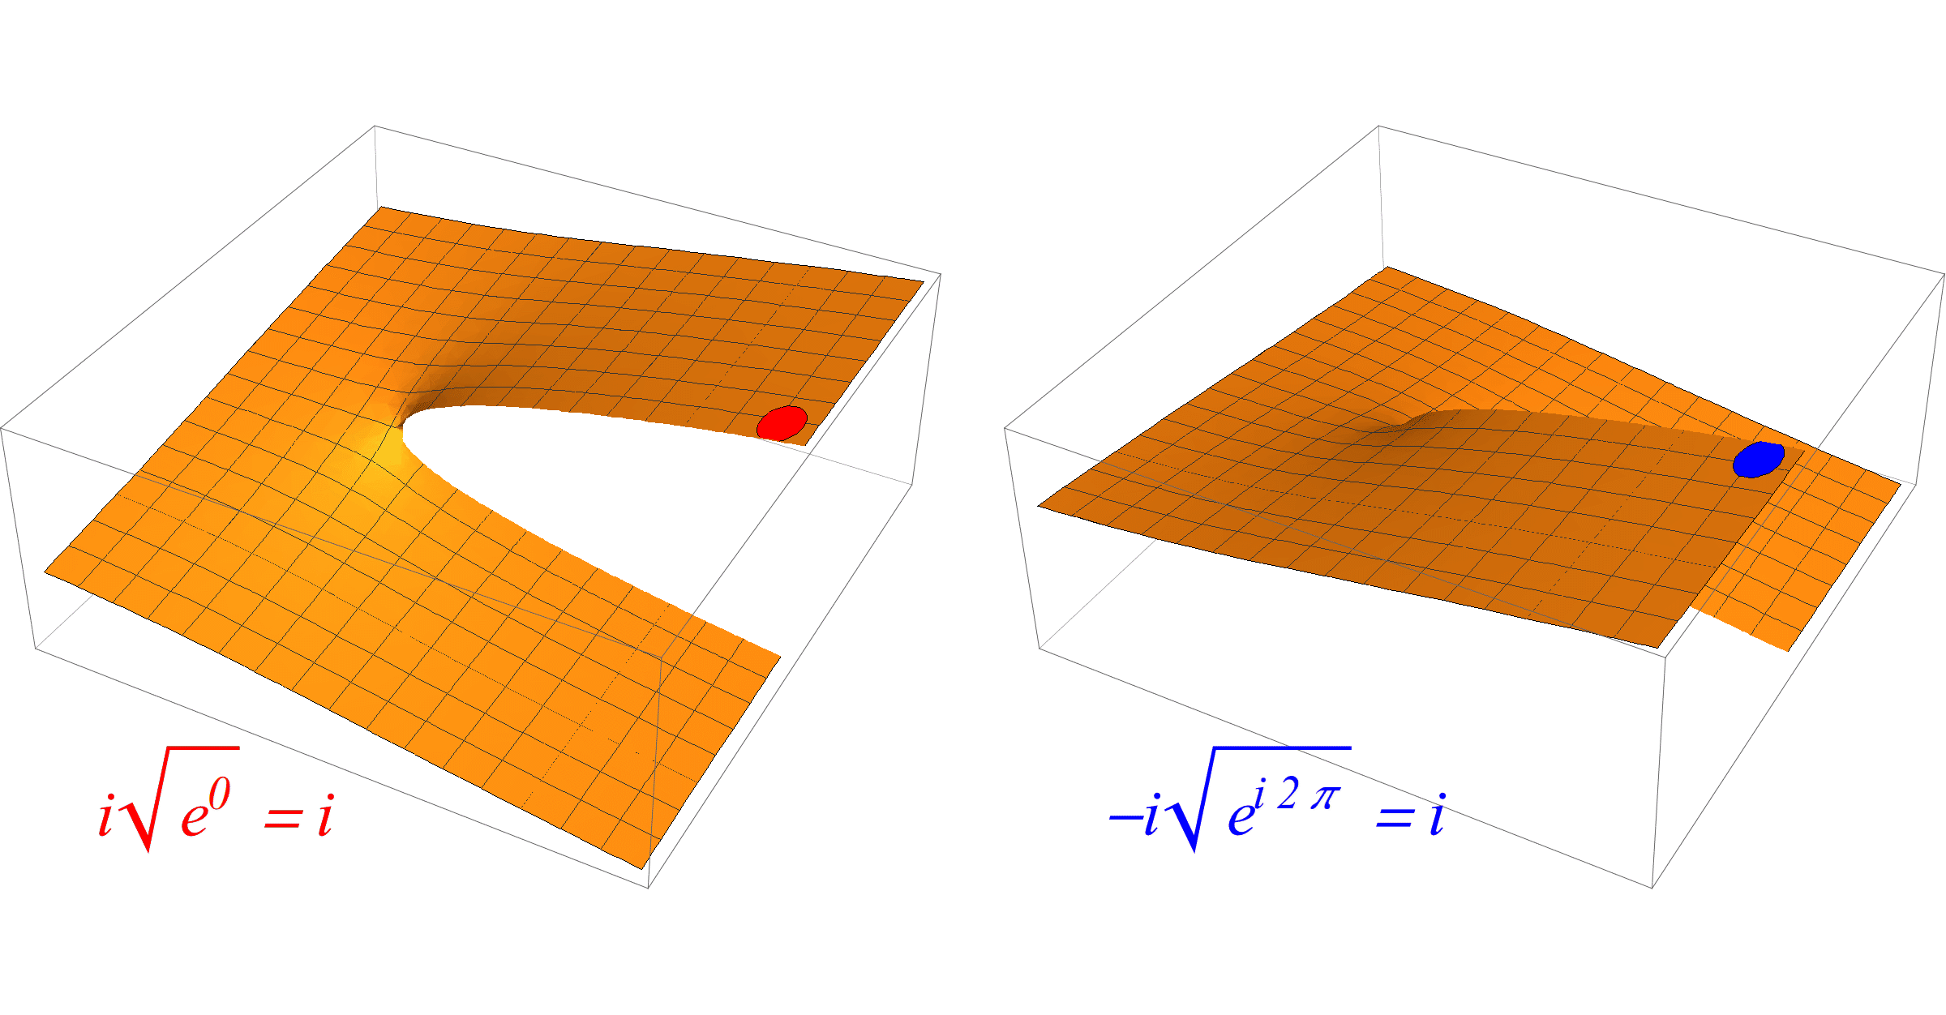
Unitarity
The two sheets are continuosly connected
A. Pilloni – Challenges in Hadron Spectroscopy
Notes:
Controlla la parte su Regge

Slide 28
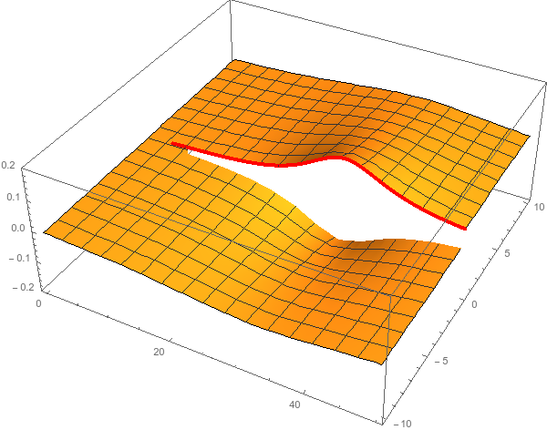
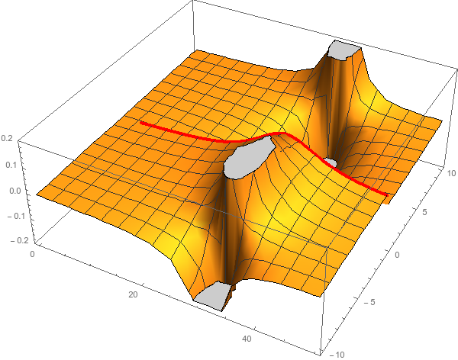
Pole hunting
I sheet
Bound states are poles (divergences) in $f(E)$
$ψ_{out}\left(r\right)∼e^{i k z}+\frac{f\left(E\right)}{r} e^{ikr}$
Resonances are poles in the complex plane
Mass and width are related to real and imaginary part of the pole position
II sheet
$$ψ_{res}(t)∼e^{−i\left(E −i\frac{Γ}{2}\right)t}$$
A. Pilloni – Challenges in Hadron Spectroscopy
Notes:
Controlla la parte su Regge

Slide 29
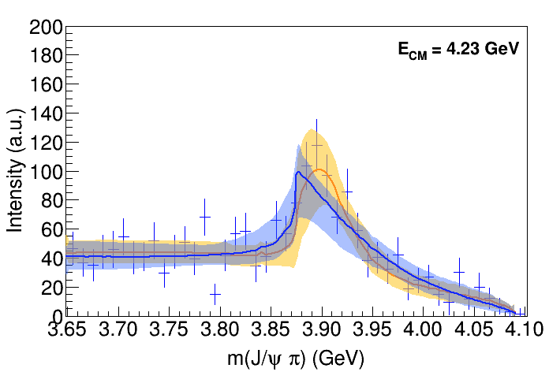
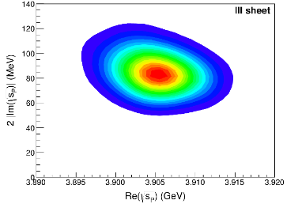
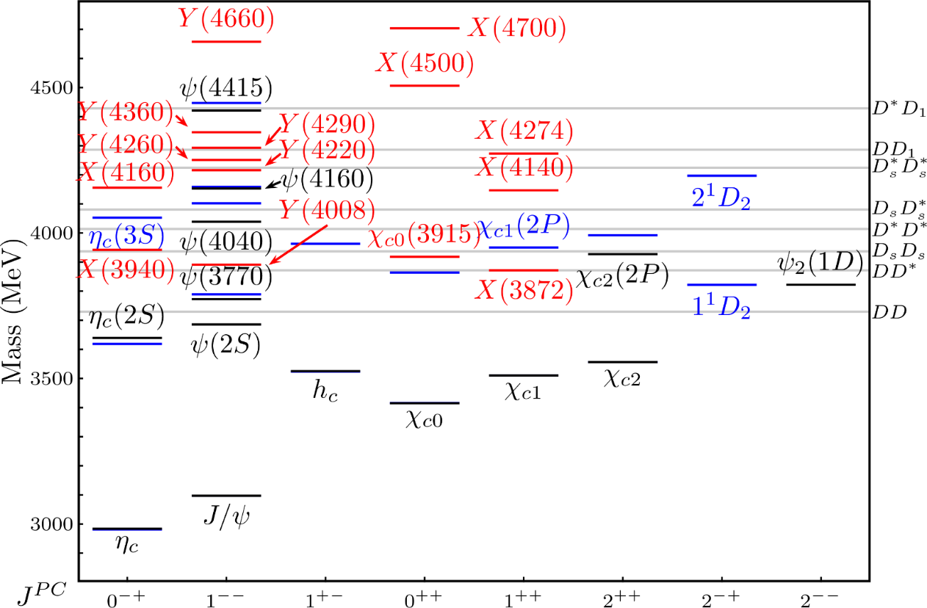
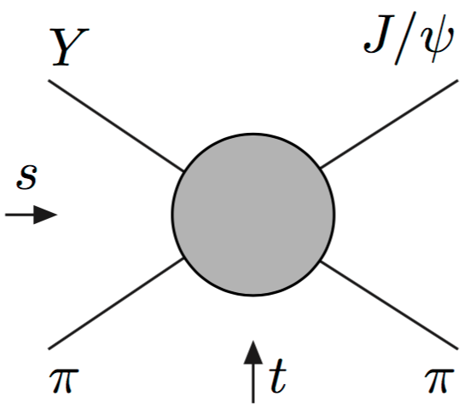
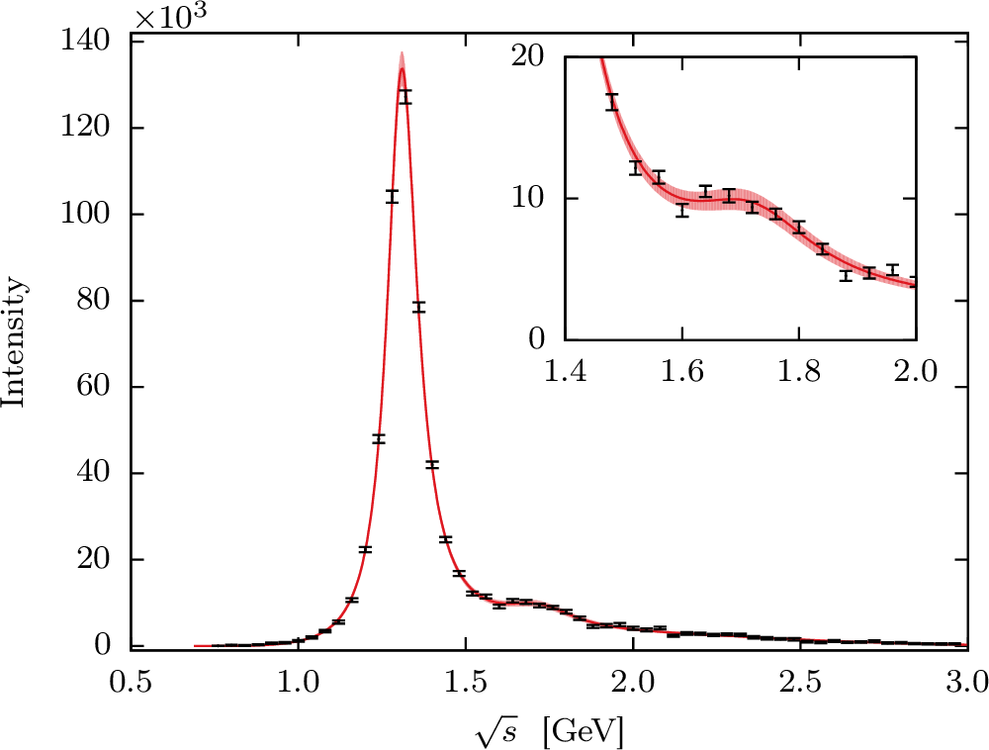
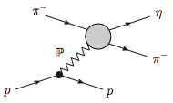
Have fun!
AP et al., Phys.Lett. B772, 200
Pole
Triangle
Esposito, AP, Polosa, Phys.Rept. 668
Jackura, AP et al., PLB779, 464
A. Pilloni – Challenges in Hadron Spectroscopy
Notes:
2 slides su Zc, a Bes e a Belle
2 slide su tetraquark model: dall’hamiltoniana di Jaffe al calcolo delle masse
1 slide su molecular models, dove sono i carichi? (non in Tornqvist, si in Hanhart, vedere Braaten, citare Nefediev)
2 slides su decay channels, dove si dovrebbe vedere, e a seconda del modello, vedere qualche plot
1 slide su Y(4260), tetraquark? C’è lo strano (si vede la f0)
1 slide su Zc a cleo (anche il neutro)

Slide 30
Epilogue
Why do we care about hadron spectroscopy?
Because it allows us to understand how the QCD degrees of freedom manifest in nature. The role of models is crucial
Because we need a better understanding of hadron amplitudes if we want to reduce the «hadronic uncertainties» in precision physics (e.g. $τ$ EDM, $g_{μ}−2$, CPV in hadronic $B$ decays...)
(the honest answer would be «because we are nerds and we like it», but we cannot reply like this to funding agencies)
A. Pilloni – Challenges in Hadron Spectroscopy
Notes:
2 slides su Zc, a Bes e a Belle
2 slide su tetraquark model: dall’hamiltoniana di Jaffe al calcolo delle masse
1 slide su molecular models, dove sono i carichi? (non in Tornqvist, si in Hanhart, vedere Braaten, citare Nefediev)
2 slides su decay channels, dove si dovrebbe vedere, e a seconda del modello, vedere qualche plot
1 slide su Y(4260), tetraquark? C’è lo strano (si vede la f0)
1 slide su Zc a cleo (anche il neutro)

Slide 31
Conclusions & prospects
We aim at developing new theoretical tools, to get insight on QCD using first principles of QFT (unitarity, analyticity, crossing symmetry, low and high energy constraints,…) to extract the physics out of the data
Many other ongoing projects (both for meson and baryon spectroscopy, and for high energy observables), with a particular attention to producing complete reaction models for the golden channels in exotic meson searches
A. Jackura, N. Sherrill, D. Winney, G. Fox, T. Londergan (IU), E. Passemar, A. Szczepaniak (IU/JLab)
R. Workman (GWU), M. Döring (GWU/JLab)
J. Nys (Ghent U.)
L. Bibzrycki, R. Kaminski (Krakow)
V. Mathieu, A. Pilloni, V. Mokeev (JLab)
M. Mikhasenko (Bonn U.) L. Dai (FZ Julich)
P. Guo (Cal. State U.)
I. Danilkin, A. Hiller Blin (Mainz U.)
A. Celentano (INFN-GE)
A. Rodas (Complutense)
J. Castro, C. Fernandez-Ramirez (UNAM)
M. Albaladejo (Murcia U.)
Students, Postdocs, Faculties
A. Pilloni – Challenges in Hadron Spectroscopy

Slide 32
Backup

Slide 33
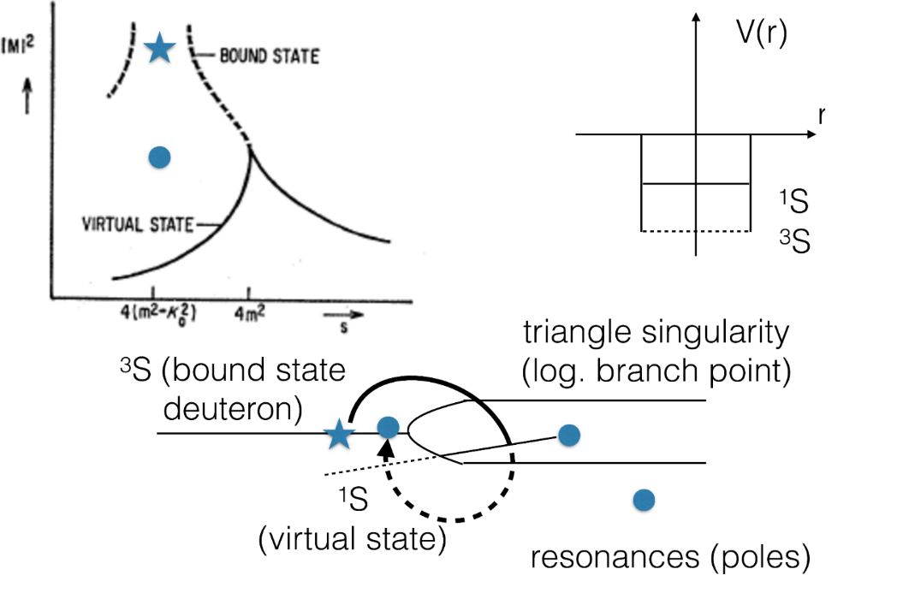
Pole hunting
I sheet
Bound states on the real axis 1st sheet
Not-so-bound (virtual) states on the real axis 2nd sheet
II sheet
A. Pilloni – Challenges in Hadron Spectroscopy
Notes:
Controlla la parte su Regge

Slide 34
Crossing symmetry
$$π^{+}$$
$$K^{+}$$
$$π^{+}$$
$$K^{−}$$
$$π^{+}$$
$$K^{+}$$
$$π^{−}$$
$$K^{−}$$
$$π^{+}$$
$$K^{−}$$
$$π^{+}$$
$$K^{+}$$
All these processes are not independent, but are described by the same amplitude!
Simplification – Complication!
A. Pilloni – Challenges in Hadron Spectroscopy
Notes:
Controlla la parte su Regge

Slide 35
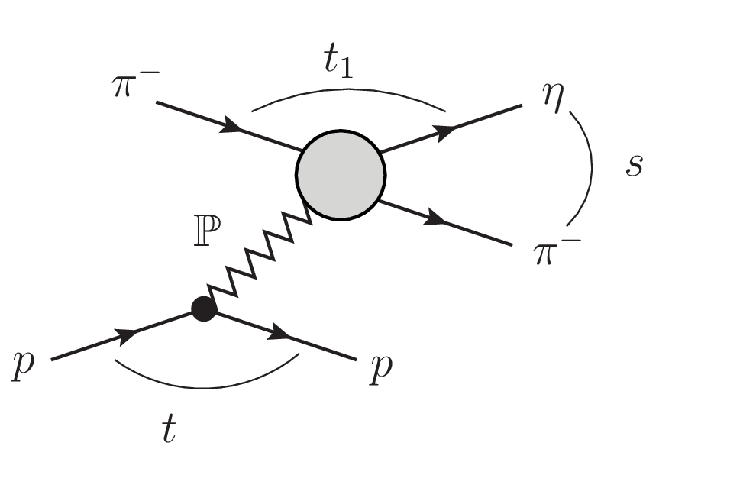
Searching for resonances in $ηπ$
The $ηπ$ system is one of the golden modes for hunting hybrid mesons
We test against the $D$-wave data, where the $a_{2}$ and the $a_{2}^{′}$ show up
A. Jackura, AP, et al. (JPAC & COMPASS), accepted on PLB
A. Pilloni – Challenges in Hadron Spectroscopy
Notes:
Controlla la parte su Regge

Slide 36
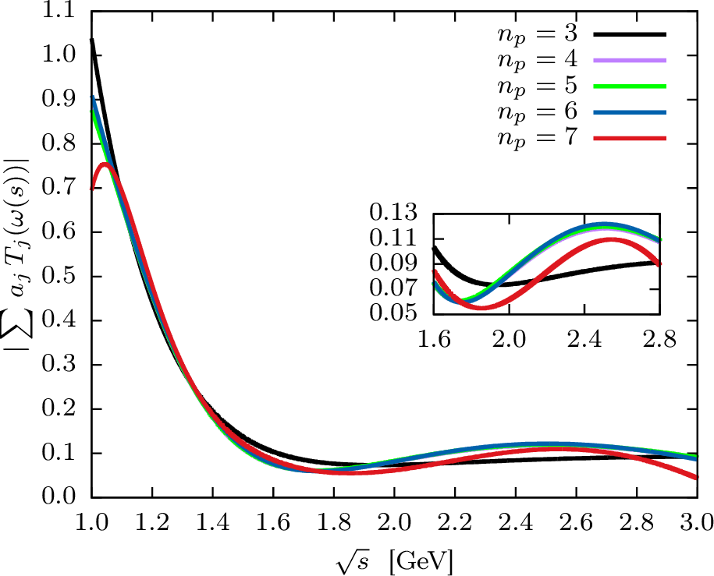
Searching for resonances in $ηπ$
Smooth «background»
Precise determination of pole position
Notes:
Controlla la parte su Regge

Slide 37
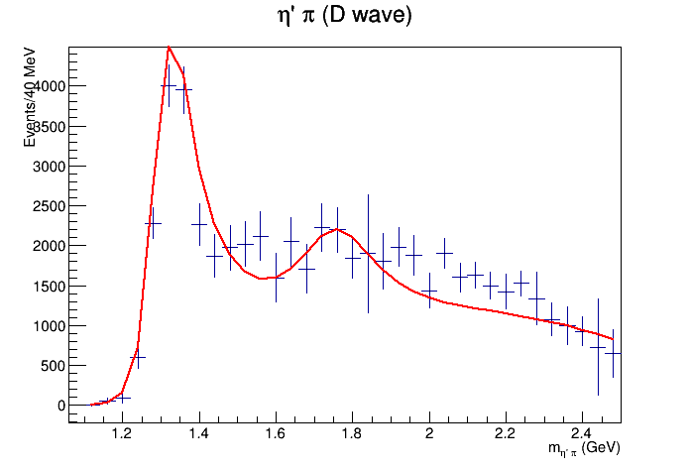
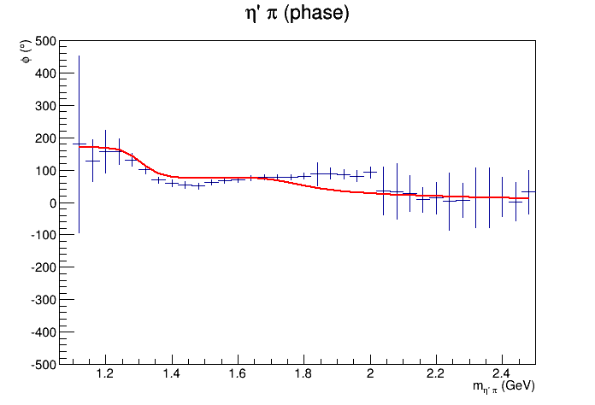
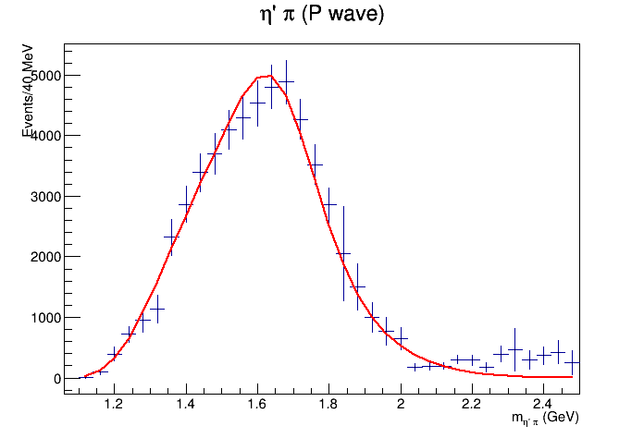
Searching for resonances in $ηπ$
$$a_{2}(1320)$$
$$π_{1}\left(1600\right)?$$
$$a_{2}^{′}(1700)$$
Preliminary
$$γ$$
The extention to the JLab production mechanism and kinematics is also ongoing
$$ρ,ω,b,h$$
A. Pilloni – Challenges in Hadron Spectroscopy
Notes:
Controlla la parte su Regge

Slide 38
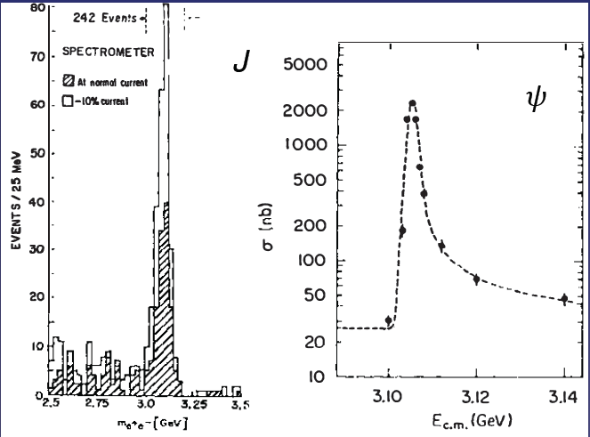
Quarkonium orthodoxy
$$Q$$
$$\overline{Q}$$
Potential models
(meaningful when $M_{Q}$ large)
$$α_{s}\left(M_{Q}\right)∼0.3$$
(perturbative regime)
Solve NR Schrödinger eq. → spectrum
A. Pilloni – Challenges in Hadron Spectroscopy
Notes:
2 slides su Zc, a Bes e a Belle
2 slide su tetraquark model: dall’hamiltoniana di Jaffe al calcolo delle masse
1 slide su molecular models, dove sono i carichi? (non in Tornqvist, si in Hanhart, vedere Braaten, citare Nefediev)
2 slides su decay channels, dove si dovrebbe vedere, e a seconda del modello, vedere qualche plot
1 slide su Y(4260), tetraquark? C’è lo strano (si vede la f0)
1 slide su Zc a cleo (anche il neutro)

Slide 39
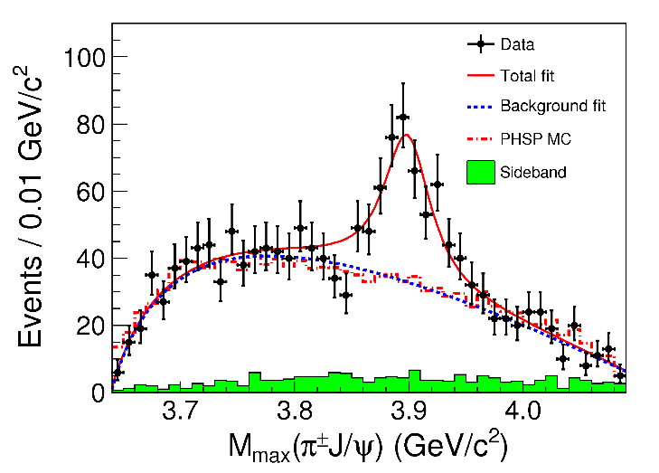
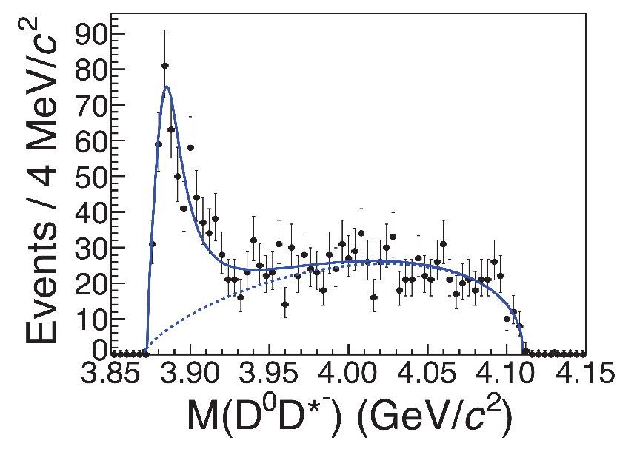
Example: The charged $Z_{c}\left(3900\right)$
A charged charmonium-like resonance has been claimed by BESIII in 2013.
$e^{+}e^{−}→Z_{c}{\left(3900\right)}^{+}π^{−}→J/ψ{ π}^{+}π^{−}$ and $→{\left(DD^{∗}\right)}^{+}π^{−}$ $M=3888.7±3.4$MeV, $Γ=35±7$ MeV
Such a state would require a minimal 4q content and would be manifestly exotic
A. Pilloni – Challenges in Hadron Spectroscopy
Notes:
Y(4260), M=4263 +- 5, Gamma = 95+-14
D_1(2420)^0, M=2421.3 ±0.6, Gamma =27.1 ±2.7
D_1(2420)^+-, M=2423.4 ±3.1, Gamma =25 ±6
I D_1 hanno J^P = 1^+
La molecola D_1 D sta 22 MeV sotto
Se la Y è D_1 D, il pione lega fortemente, come fa la Y a essere così larga?
Come funziona lo scambio del pione???

Slide 40
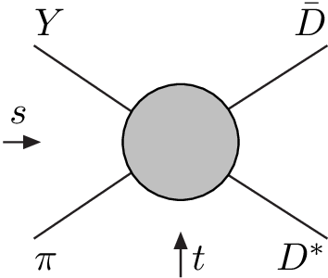
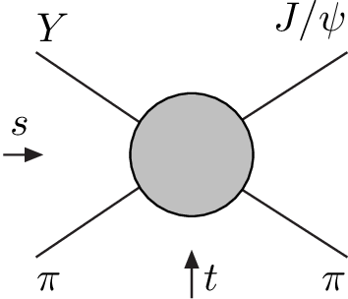
Amplitude analysis for $Z_{c}(3900)$
One can test different parametrizations of the amplitude, which correspond to different singularities → different natures
AP et al. (JPAC), PLB772, 200
$$Z_{c}\left(3900\right)?$$
$${u: D}_{0}(2400)$$
$${u:Z}_{c}\left(3900\right)?$$
$$"σ, f_{0}(980)"$$
$$D_{1}(2420)$$
Triangle rescattering, logarithmic branching point
(anti)bound state, II/IV sheet pole
(«molecule»)
Resonance, III sheet pole
(«compact state»)
$$π$$
$$D_{1}$$
$$Y$$
$$D^{∗}$$
$$π$$
$$\overline{D}$$
$$J/ψ$$
Tornqvist, Z.Phys. C61, 525
Swanson, Phys.Rept. 429
Hanhart et al. PRL111, 132003
Maiani et al., PRD71, 014028
Faccini et al., PRD87, 111102
Esposito et al., Phys.Rept. 668
Szczepaniak, PLB747, 410
A. Pilloni – Challenges in Hadron Spectroscopy
Notes:
Controlla la parte su Regge

Slide 41
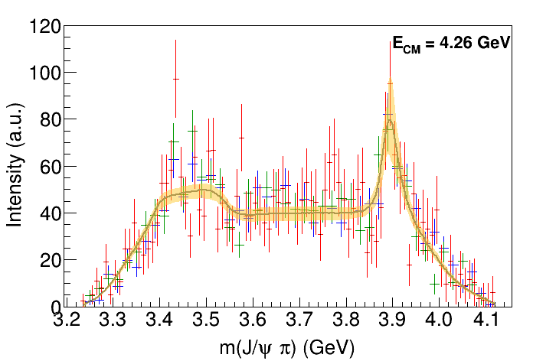
Fit: III
A. Pilloni – Challenges in Hadron Spectroscopy
Notes:
Controlla la parte su Regge

Slide 42
Fit: III+tr.
A. Pilloni – Challenges in Hadron Spectroscopy
Notes:
Controlla la parte su Regge

Slide 43
Fit: IV+tr.
A. Pilloni – Challenges in Hadron Spectroscopy
Notes:
Controlla la parte su Regge

Slide 44
Fit: tr.
A. Pilloni – Challenges in Hadron Spectroscopy
Notes:
Controlla la parte su Regge

Slide 45
Pole extraction
III
III+tr.
IV+tr.
A. Pilloni – Challenges in Hadron Spectroscopy
Not conclusive at this stage
Notes:
Controlla la parte su Regge

Slide 46
Finite energy sum rules
PWA in the low energy region
Resonance extraction
Analytically connected
Regge exchanges at high energy
A. Pilloni – Challenges in Hadron Spectroscopy
Notes:
Controlla la parte su Regge

Slide 47
Pole hunting
I sheet
Extracting physics information means to hunt for poles in the complex plane
Pole position → Mass and width
Residues → Couplings
Virtual state
II sheet
Bound state
Resonance
A. Pilloni – Challenges in Hadron Spectroscopy
Notes:
Controlla la parte su Regge

Slide 48
$X(3872)$
Discovered in $B→K X→K J/ψ ππ$
Quantum numbers $1^{++}$
Very close to $DD^{∗}$ threshold
Too narrow for an above-treshold charmonium
Isospin violation too big $\frac{Γ\left(X→J/ψ ω\right)}{Γ\left(X→J/ψ ρ\right)}\sim 0.8±0.3$
Mass prediction not compatible with $χ_{c1}(2P)$
$M=3871.68±0.17$MeV
$$M_{X}−M_{DD^{∗}}=−3±192 \text{keV}$$
$Γ<1.2 \text{MeV}\text{ @90\%}$
A. Pilloni – Challenges in Hadron Spectroscopy

Slide 49
$X(3872)$
Large prompt production at hadron colliders
$$σ_{B}/σ_{TOT}=\left(26.3±2.3±1.6\right)\%$$
$$σ_{PR}×B(X→J/ψππ)=\left(1.06±0.11±0.15\right) \text{nb}$$
CMS, JHEP 1304, 154
A. Pilloni – Challenges in Hadron Spectroscopy

Slide 50
Vector $Y$ states
Lots of unexpected ${J^{PC}=1}^{−−}$ states found in ISR/direct production (and nowhere else!)
Seen in few final states, mostly $J/ψ ππ$ and $ψ\left(2S\right) ππ$
Not seen decaying into open charm pairs
Large HQSS violation
Belle $J/ψππ$
BES $h_{c}ππ$
A. Pilloni – Challenges in Hadron Spectroscopy
Notes:
Y(4260), M=4263 +- 5, Gamma = 95+-14
D_1(2420)^0, M=2421.3 ±0.6, Gamma =27.1 ±2.7
D_1(2420)^+-, M=2423.4 ±3.1, Gamma =25 ±6
I D_1 hanno J^P = 1^+
La molecola D_1 D sta 22 MeV sotto
Se la Y è D_1 D, il pione lega fortemente, come fa la Y a essere così larga?
Come funziona lo scambio del pione???

Slide 51
Vector $Y$ states in BESIII
BESIII, PRL118, 092002 (2017)
BESIII, PRL118, 092001 (2017)
$$e^{+}e^{−}→J/ψ ππ$$
$$e^{+}e^{−}→h_{c} ππ$$
New BESIII data show a peculiar lineshape for the $Y(4260)$
The state appear lighter and narrower, compatible with the ones in $h_{c}ππ$ and $χ_{c0}ω$
A broader old-fashioned $Y(4260)$ is appearing in $\overline{D}D^{∗}π$, maybe indicating a ${\overline{D}D}_{1}$
dominance
$$e^{+}e^{−}→π^{+}D^{0}D^{∗−}$$
A. Pilloni – Challenges in Hadron Spectroscopy
Notes:
Y(4260), M=4263 +- 5, Gamma = 95+-14
D_1(2420)^0, M=2421.3 ±0.6, Gamma =27.1 ±2.7
D_1(2420)^+-, M=2423.4 ±3.1, Gamma =25 ±6
I D_1 hanno J^P = 1^+
La molecola D_1 D sta 22 MeV sotto
Se la Y è D_1 D, il pione lega fortemente, come fa la Y a essere così larga?
Come funziona lo scambio del pione???
Close propone che la Y è D_1 D^* col pione scambiato in onda S,
La Y però non va in Ds come se fosse tetraquark

Slide 52
Charged $Z$ states: $Z_{c}\left(3900\right), Z_{c}^{′}(4020)$
Charged quarkonium-like resonances have been found, 4q needed
Two states $J^{PC}=1^{+−}$ appear slightly above $D^{(∗)}D^{∗}$ thresholds
$e^{+}e^{−}→Z_{c}{\left(3900\right)}^{+}π^{−}→J/ψ{ π}^{+}π^{−}$ and $→{\left(DD^{∗}\right)}^{+}π^{−}$ $M=3888.7±3.4$MeV, $Γ=35±7$ MeV
$e^{+}e^{−}→Z_{c}^{′}{\left(4020\right)}^{+}π^{−}→h_{c}{ π}^{+}π^{−}$ and $→{\overline{D}}^{∗0}D^{∗+}π^{−}$
$M=4023.9±2.4$MeV, $Γ=10±6$ MeV
A. Pilloni – Challenges in Hadron Spectroscopy
Notes:
Y(4260), M=4263 +- 5, Gamma = 95+-14
D_1(2420)^0, M=2421.3 ±0.6, Gamma =27.1 ±2.7
D_1(2420)^+-, M=2423.4 ±3.1, Gamma =25 ±6
I D_1 hanno J^P = 1^+
La molecola D_1 D sta 22 MeV sotto
Se la Y è D_1 D, il pione lega fortemente, come fa la Y a essere così larga?
Come funziona lo scambio del pione???

Slide 53
Charged $Z$ states: $Z_{b}\left(10610\right), Z_{b}^{′}(10650)$
Anomalous dipion width in $Υ\left(5S\right)$,
2 orders of magnitude larger than $Υ\left(nS\right)$
Moreover, observed $Υ\left(5S\right)→h_{b}\left(nP\right)ππ$ which violates HQSS
$Υ\left(5S\right)→Z_{b}{\left(10610\right)}^{+}π^{−}→Υ\left(nS\right){ π}^{+}π^{−},h_{b}\left(nP\right){ π}^{+}π^{−}$ and $→{\left(BB^{∗}\right)}^{+}π^{−}$ $M=10607.2±2.0$MeV, $Γ=18.4±2.4$ MeV
$Υ\left(5S\right)→Z_{b}^{′}{\left(10650\right)}^{+}π^{−}→Υ\left(nS\right){ π}^{+}π^{−},h_{b}\left(nP\right){ π}^{+}π^{−}$ and $→{\overline{B}}^{∗0}B^{∗+}π^{−}$
$M=10652.2±1.5$MeV, $Γ=11.5±2.2$ MeV
2 twin resonances!
A. Pilloni – Challenges in Hadron Spectroscopy
Notes:
Y(4260), M=4263 +- 5, Gamma = 95+-14
D_1(2420)^0, M=2421.3 ±0.6, Gamma =27.1 ±2.7
D_1(2420)^+-, M=2423.4 ±3.1, Gamma =25 ±6
I D_1 hanno J^P = 1^+
La molecola D_1 D sta 22 MeV sotto
Se la Y è D_1 D, il pione lega fortemente, come fa la Y a essere così larga?
Come funziona lo scambio del pione???

Slide 54
Pentaquarks!
LHCb, PRL 115, 072001
LHCb, PRL 117, 082003
Two states seen in $Λ_{b}→\left(J/ψ p\right) K^{−}$,
evidence in $Λ_{b}→\left(J/ψ p\right) π^{−}$
$$M_{1}=4380±8±29 \text{MeV} \\ Γ_{1}=205±18±86 \text{MeV}$$
$$M_{2}=4449.8±1.7±2.5 \text{MeV} \\ Γ_{2}=39±5±19 \text{MeV}$$
Quantum numbers $$J^{P}=\left({\frac{3}{2}}^{−},{\frac{5}{2}}^{+}\right) \text{or}\left({\frac{3}{2}}^{+},{\frac{5}{2}}^{−}\right)\text{or}\left({\frac{5}{2}}^{+},{\frac{3}{2}}^{−}\right)$$
Opposite parities needed for the interference to correctly describe angular distributions, low mass region contaminated by $Λ^{∗}$ (model dependence?)
No obvious threshold nearby
A. Pilloni – Challenges in Hadron Spectroscopy
Notes:
Y(4260), M=4263 +- 5, Gamma = 95+-14
D_1(2420)^0, M=2421.3 ±0.6, Gamma =27.1 ±2.7
D_1(2420)^+-, M=2423.4 ±3.1, Gamma =25 ±6
I D_1 hanno J^P = 1^+
La molecola D_1 D sta 22 MeV sotto
Se la Y è D_1 D, il pione lega fortemente, come fa la Y a essere così larga?
Come funziona lo scambio del pione???

Slide 55
Pentaquarks!
LHCb, PRL 115, 072001
LHCb, PRL 117, 082003
Two states seen in $Λ_{b}→\left(J/ψ p\right) K^{−}$,
evidence in $Λ_{b}→\left(J/ψ p\right) π^{−}$
$$M_{1}=4380±8±29 \text{MeV} \\ Γ_{1}=205±18±86 \text{MeV}$$
$$M_{2}=4449.8±1.7±2.5 \text{MeV} \\ Γ_{2}=39±5±19 \text{MeV}$$
Quantum numbers $$J^{P}=\left({\frac{3}{2}}^{−},{\frac{5}{2}}^{+}\right) \text{or}\left({\frac{3}{2}}^{+},{\frac{5}{2}}^{−}\right)\text{or}\left({\frac{5}{2}}^{+},{\frac{3}{2}}^{−}\right)$$
Opposite parities needed for the interference to correctly describe angular distributions, low mass region contaminated by $Λ^{∗}$ (model dependence?)
No obvious threshold nearby
MC simul.
A. Pilloni – Challenges in Hadron Spectroscopy
Notes:
Y(4260), M=4263 +- 5, Gamma = 95+-14
D_1(2420)^0, M=2421.3 ±0.6, Gamma =27.1 ±2.7
D_1(2420)^+-, M=2423.4 ±3.1, Gamma =25 ±6
I D_1 hanno J^P = 1^+
La molecola D_1 D sta 22 MeV sotto
Se la Y è D_1 D, il pione lega fortemente, come fa la Y a essere così larga?
Come funziona lo scambio del pione???

Slide 56
$X(3872)$ on the lattice
There is only evidence (?) for the $X(3872)$ in the $I^{G}J^{PC}=0^{+}1^{++}$ channel
Caveats:
Small lattices, large artifacts
Three body dynamics may play a role
Interpretation of the overlap coefficients is questionable
Status of other XYZ on the lattice is even less clear
S. Prelovsek, L. Leskovec, PRL111, 192001
A. Pilloni – Challenges in Hadron Spectroscopy

Slide 57
Hadron Spectroscopy
Hybrids
Tetraquark
Meson
Baryon
Glueball
$$π$$
$$π$$
$$J/ψ$$
$$π$$
Hadroquarkonium
Molecule
Experiment
Data
Amplitude analysis
Properties,
Model building
Lattice QCD
Interpretations on the spectrum leads to understanding fundamental laws of nature

Slide 58
Why strong interactions are strong
We don’t experience strong interactions in everyday life*. They happen on much shorter scales
Gravity $V\left(r\right)=G\frac{M_{1}M_{2}}{r}, G∼{10}^{−39}m_{p}^{−2}$
Electromagnetism, $V\left(r\right)=α\frac{1}{r}, α∼\frac{1}{137}$
$NN$ interaction, $V\left(r\right)∼\frac{f_{πNN}^{2}}{4π}\frac{1}{r}\exp\left(−\frac{r}{r_{0}}\right),$ $\frac{f_{πNN}^{2}}{4π}∼0.075, r_{0}∼1 \text{fm}∼m_{π}^{−1}$ (Rutherford)
$πN$ interaction, $\frac{g_{πN}^{2}}{4π}∼14$
*At least, out of office/class/lab hours

Slide 59
Why strong interactions are strong
In nonrelativistic quantum mechanics I can define an interaction radius
$$f\left(k,θ\right)=\sum_{l}{\left(2l+1\right)f_{l}\left(k\right)P_{l}(\cos{θ})}$$
$$f_{l}\left(x\right)∼\left\{\begin{aligned}1, l∼kr_{0} \\ &0, l≫kr_{0}\end{aligned}\right.$$
$$r_{0}∼1 \text{fm}∼m_{π}^{−1}$$

Slide 60
Why strong interactions are strong
In nonrelativistic quantum mechanics I can define an interaction radius
$$f\left(k,θ\right)=\sum_{l}{\left(2l+1\right)f_{l}\left(k\right)P_{l}(\cos{θ})}$$
$$f_{l}\left(x\right)∼\left\{\begin{aligned}1, l∼kr_{0} \\ &0, l≫kr_{0}\end{aligned}\right.$$
$$r_{0}∼1 \text{fm}∼m_{π}^{−1}$$
$σ(νp)$ is $∼10 \text{f}\text{b}∼{10}^{−8} {\text{fm}}^{2}$; $σ(pp)$ is $∼50 \text{mb}∼5 {\text{fm}}^{2}$;
$$σ≪πr_{0}^{2}$$
Weak interaction
$$σ∼πr_{0}^{2}$$
Strong interaction

Slide 61
Symmetries of strong interactions
Discrete symmetries:
Parity
Charge conjugation
Time reversal
First two give rise to multiplicative quantum numbers which strong interaction conserve
They reduce the number of independent amplitudes we need
Continuous symmetries:
Poincaré transformations (translation, rotations, boosts)
Baryon number and Electric Charge
Flavor conservation
Isospin (or more), approximate
Internal $U\left(1\right)$ symmetries give rise to additive quantum numbers
Common to any interaction
Flavor conservation is a $U{\left(1\right)}^{6}$ symmetry,
Separate conservation of flavor quantum numbers
Consequence: particles with open flavor are created in pairs

Slide 62
Charge conjugation and $G$-parity
Totally neutral particles are eigenstate of charge conjugation
I can add a rotation of $π$ in isospin space
$$e^{−i π I_{y}}C\left|\left.π^{0}\right\rangle \right.=+e^{−i π I_{y}}\left|\left.π^{z}\right\rangle =\right.−\left|\left.π^{z}\right\rangle \right.=−\left|\left.π^{0}\right\rangle \right.$$
$$e^{−i π I_{y}}C\left|\left.π^{+}\right\rangle \right.=+e^{−i π I_{y}}\left|\left.π^{−}\right\rangle =\right.+e^{−i π I_{y}}\left(\left|\left.π^{x}\right\rangle \right.−i\left|\left.π^{y}\right\rangle \right.\right)=+e^{−i π I_{y}}\left(−\left|\left.π^{x}\right\rangle \right.−i\left|\left.π^{y}\right\rangle \right.\right)=−\left|\left.π^{+}\right\rangle \right.$$
$$e^{−i π I_{y}}C\left|\left.π^{−}\right\rangle \right.=+e^{−i π I_{y}}\left|\left.π^{+}\right\rangle =\right.+e^{−i π I_{y}}\left(\left|\left.π^{x}\right\rangle \right.+i\left|\left.π^{y}\right\rangle \right.\right)=+e^{−i π I_{y}}\left(−\left|\left.π^{x}\right\rangle \right.+i\left|\left.π^{y}\right\rangle \right.\right)=−\left|\left.π^{−}\right\rangle \right.$$
$$C\left|\left.π^{0}\right\rangle \right.=+\left|\left.π^{0}\right\rangle \right.$$
$$C\left|\left.π^{+}\right\rangle \right.=+\left|\left.π^{−}\right\rangle \right.$$
$$C\left|\left.π^{−}\right\rangle \right.=+\left|\left.π^{+}\right\rangle \right.$$
$$C\left|\left.ρ^{0}\right\rangle \right.=−\left|\left.ρ^{0}\right\rangle \right.$$
$$C\left|\left.ρ^{+}\right\rangle \right.=−\left|\left.ρ^{−}\right\rangle \right.$$
$$C\left|\left.{ρ }^{−}\right\rangle \right.=−\left|\left.ρ^{+}\right\rangle \right.$$
Unflavored mesons are eigenstates of $G$ parity
$$ρ^{0} \left(I^{G}=1^{+}\right)→π^{+}π^{−}$$
$$ω^{0} \left(I^{G}=0^{−}\right)→π^{+}π^{−}$$

Slide 63
Isospin breaking
Isospin violation is due to a) electromagnetic interactions, $Q\left(u\right)=\frac{2}{3},Q\left(d\right)=−1/3,$ b) unequal quark masses, $m_{u}≠m_{d}$
Mass corrections cancel out at lowest order, pure electromagnetic effect
$$m_{π^{+}}−m_{π^{0}}≃4 \text{MeV}$$
EM corrections cancel out at lowest order, pure mass difference effect
$$η→π^{+}π^{−}π^{0}$$
Both are present and give different sign contributions, mass difference roughly 2 times EM effect pure mass difference effect
$$m_{p}−m_{n}≃−1.3 \text{MeV}$$
(if you forget this sign, we all die)

Slide 64
Ingredients we need
First we need to define the states, and their transformation properties
We define the scattering problem and introduce the $S$-matrix
We relate the $S$-matrix to observables

Slide 65
Amplitude model
$$Z_{c}\left(3900\right)?$$
$${u: D}_{0}(2400)$$
$${u:Z}_{c}\left(3900\right)?$$
$$"σ, f_{0}(980)"$$
$$D_{1}(2420)$$
Khuri-Treiman
A. Pilloni – Challenges in Hadron Spectroscopy

Slide 66
Triangle singularity
$$π$$
$$D_{1}$$
$$Y(4260)$$
$$D^{∗}$$
$$π$$
$$\overline{D}$$
$$J/ψ$$
Logarithmic branch points due to exchanges in the cross channels can simulate a resonant behavior, only in very special kinematical conditions (Coleman and Norton, Nuovo Cim. 38, 438),
However, this effects cancels in Dalitz projections, no peaks (Schmid, Phys.Rev. 154, 1363)
Szczepaniak, PLB747, 410-416
Szczepaniak, PLB757, 61-64
Guo, Meissner, Wang, Yang PRD92, 071502
...but the cancellation can be spread in different channels, you might still see peaks in other channels only!
A. Pilloni – Challenges in Hadron Spectroscopy

Slide 67
Testing scenarios
We approximate all the particles to be scalar – this affects the value of couplings, which are not normalized anyway – but not the position of singularities. This also limits the number of free parameters
The scattering matrix is parametrized as ${\left(t^{−1}\right)}_{ij}=K_{ij}−i ρ_{i} δ_{ij}$
Four different scenarios considered:
«III»: the K matrix is $\frac{g_{i} g_{j}}{M^{2}−s}$, this generates a pole in the closest unphysical sheet the rescattering integral is set to zero
«III+tr.»: same, but with the correct value of the rescattering integral
«IV+tr.»: the K matrix is constant, this generates a pole in the IV sheet
«tr.»: same, but the pole is pushed far away by adding a penalty in the $χ^{2}$
A. Pilloni – Challenges in Hadron Spectroscopy

Slide 68
Singularities and lineshapes
Different lineshapes according to different singularities
III+tr.
III sheet pole
Triangle
IV+tr.
tr.
IV sheet pole
no pole
Triangle
Triangle
A. Pilloni – Challenges in Hadron Spectroscopy
Notes:
Controlla la parte su Regge

Slide 69
Three-Body Unitarity
Mai, Hu, Doring, AP, Szczepaniak, EPJA53, 9, 177
Original study by Amado, Aaron, Young (1968)
3-dimensional integral equation from unitarity constraint & BSE ansatz
valid below break-up energies ($E<3m$)
Analyticity constraints unclear
$v$ a general function with no right-hand singularities
Two-body interaction is parametrized by an «isobar», i.e. a runction with the correct right-hand singularities and definite quantum numbers
$S$ and $T$ are yet unknown functions
A. Pilloni – Challenges in Hadron Spectroscopy
Notes:
Controlla la parte su Regge

Slide 70
Three-Body Unitarity
We impose the Bethe-Salpeter ansatz for the Isobar-spectator interaction
$B$ and $τ$ are initially unknown
We plug the BS ansatz in the left hand side of the unitarity equation, then match!
A. Pilloni – Challenges in Hadron Spectroscopy
Notes:
Controlla la parte su Regge

Slide 71
Three-Body Unitarity
Product of disconnected terms are source for the connected amplitude
BS ansatz
A. Pilloni – Challenges in Hadron Spectroscopy
Notes:
Controlla la parte su Regge

Slide 72
Three-Body Unitarity
Product of disconnected terms are source for the connected amplitude
BS ansatz
A. Pilloni – Challenges in Hadron Spectroscopy
Notes:
Controlla la parte su Regge

Slide 73
Three-Body Unitarity
Imaginary parts of $B, τ, S$ are fixed by unitarity and matching
(for simplicity $v=λ$)
The freedom of adding real terms to $B$ allows us to use this solution as a flexible parametrization
Numerics in progress:
D. Sadasivan, M. Mai, AP, M. Doring, A. Szczepaniak for the $a_{1}(1260)$ and $a_{1}(1420)$
Alternative approach based on $N/D$:
A. Jackura, AP et al. (JPAC) for the $X(3872)$
J.M. Alarcon, E. Passemar, AP, C. Weiss for the nucleon isoscalar vector form factor
A. Pilloni – Challenges in Hadron Spectroscopy
Notes:
Controlla la parte su Regge

Slide 74
$P_{c}$ photoproduction
To exclude any rescattering mechanism, we propose to search the $P_{c}(4450)$ state in photoproduction.
Hadronic vertex
EM vertex
Hadronic part
3 independent helicity couplings, → approx. equal, $g_{λ_{ψ},λ_{p}′}∼g$
$g$ extracted from total width and (unknown) branching ratio
Vector meson dominance relates the radiative width to the hadronic width
Hiller Blin, AP et al. (JPAC), PRD94, 034002
A. Pilloni – Challenges in Hadron Spectroscopy
Notes:
Controlla la parte su Regge

Slide 75
Background parameterization
The background is described via an Effective Pomeron, whose parameters are fitted to high energy data from Hera
Asymptotic + Effective threshold
Helicity conservation
Hiller Blin, AP et al. (JPAC), PRD94, 034002
A. Pilloni – Challenges in Hadron Spectroscopy
Notes:
Controlla la parte su Regge

Slide 76
Pentaquark photoproduction
$$J^{P}={\left(3/2\right)}^{−}$$
Hiller Blin, AP et al. (JPAC), PRD94, 034002
A. Pilloni – Challenges in Hadron Spectroscopy
Notes:
Controlla la parte su Regge

Slide 77
Hadron Spectroscopy
Hybrids
Tetraquark
Meson
Baryon
Glueball
$$π$$
$$π$$
$$J/ψ$$
$$π$$
Hadroquarkonium
Molecule
Experiment
Data
Amplitude analysis
Properties,
Model building
Lattice QCD
Interpretations on the spectrum leads to understanding fundamental laws of nature

Slide 78
Diquarks
Attraction and repulsion in 1-gluon exchange approximation is given by
$$R=\frac{1}{2}\left(C_{2}\left(R_{12}\right)−C_{2}\left(R_{1}\right)−C_{2}\left(R_{2}\right)\right)$$
$$R_{1}=−\frac{4}{3}, R_{8}=+\frac{1}{6}$$
$$R_{3}=−\frac{2}{3}, R_{6}=+\frac{1}{3}$$
$$j$$
$$l$$
$$3_{c}×3_{c}∈{\overline{3}}_{c}$$
$$T_{ij}^{a}$$
$$T_{kl}^{a}$$
$$i$$
$$k$$
The singlet $1_{c}$ is attractive
A diquark in ${\overline{3}}_{c}$is attractive
Evidence (?) of diquarks in LQCD,
Alexandrou, de Forcrand, Lucini, PRL 97, 222002
H-shape with a 4 quark system
Cardoso, Cardoso, Bicudo, PRD84, 054508
A. Pilloni – Challenges in Hadron Spectroscopy

Slide 79
Tetraquark
$${\overline{3}}_{c}$$
$$\overline{c}$$
$$c$$
In a constituent (di)quark model, we can think of a
diquark-antidiquark compact state
$${\left[cq\right]}_{S=0}{\left[\overline{c}\overline{q}\right]}_{S=1}+h.c.$$
$$3_{c}$$
$$q$$
$$\overline{q}$$
Maiani, Piccinini, Polosa, Riquer PRD71 014028
Faccini, Maiani, Piccinini, AP, Polosa, Riquer PRD87 111102
Maiani, Piccinini, Polosa, Riquer PRD89 114010
Spectrum according to color-spin hamiltonian
(all the terms of the Breit-Fermi hamiltonian are absorbed into a constant diquark mass):
$$H=\sum_{dq}{m_{dq}}+2\sum_{i<j}{κ_{ij} \vec{S_{i}}∙\vec{S_{j}} \frac{λ_{i}^{a}}{2}\frac{λ_{j}^{a}}{2}}$$
Decay pattern mostly driven by HQSS ✓
Fair understanding of existing spectrum ✓
A full nonet for each level is expected ✗
New ansatz: the diquarks are compact objects spacially separated from each other, only $κ_{cq}≠0$
Existing spectrum is fitted if $κ_{cq}=67 \text{MeV}$
A. Pilloni – Challenges in Hadron Spectroscopy
Notes:
Y(4260), M=4263 +- 5, Gamma = 95+-14
D_1(2420)^0, M=2421.3 ±0.6, Gamma =27.1 ±2.7
D_1(2420)^+-, M=2423.4 ±3.1, Gamma =25 ±6
I D_1 hanno J^P = 1^+
La molecola D_1 D sta 22 MeV sotto
Se la Y è D_1 D, il pione lega fortemente, come fa la Y a essere così larga?
Come funziona lo scambio del pione???
Close propone che la Y è D_1 D^* col pione scambiato in onda S,
La Y però non va in Ds come se fosse tetraquark

Slide 80
Tetraquark
Maiani, Piccinini, Polosa, Riquer PRD89 114010
Ali, Maiani, et al. arXiv:1708.04650
Two different mass scenarios
Prediction for a high $Y_{5}$
A. Pilloni – Challenges in Hadron Spectroscopy
Notes:
Y(4260), M=4263 +- 5, Gamma = 95+-14
D_1(2420)^0, M=2421.3 ±0.6, Gamma =27.1 ±2.7
D_1(2420)^+-, M=2423.4 ±3.1, Gamma =25 ±6
I D_1 hanno J^P = 1^+
La molecola D_1 D sta 22 MeV sotto
Se la Y è D_1 D, il pione lega fortemente, come fa la Y a essere così larga?
Come funziona lo scambio del pione???
Close propone che la Y è D_1 D^* col pione scambiato in onda S,
La Y però non va in Ds come se fosse tetraquark

Slide 81
Other models: Molecule
Tornqvist, Z.Phys. C61, 525
Braaten and Kusunoki, PRD69 074005
Swanson, Phys.Rept. 429 243-305
$$D^{0}$$
$$X\left(3872\right)∼{\overline{D}}^{0}D^{∗0}$$
$$Z_{c}\left(3900\right)∼{\overline{D}}^{0}D^{∗+}$$
$$Z_{c}^{′}\left(4020\right)∼{\overline{D}}^{∗0}D^{∗+}$$
$$Y\left(4260\right)∼\overline{D}D_{1}$$
$$π^{0}$$
$$\overline{D^{0∗}}$$
A deuteron-like meson pair, the interaction is mediated by the exchange of light mesons
Some model-independent relations (Weinberg’s theorem) ✓
Good description of decay patterns (mostly to constituents) and $X\left(3872\right)$ isospin violation ✓
States appear close to thresholds ✓ (but $Z\left(4430\right)$ ✗)
Lifetime of costituents has to be $≫1/m_{π}$
Binding energy varies from $−70$to $−0.1 \text{MeV}$, or even positive (repulsive interaction) ✗
Unclear spectrum (a state for each threshold?) – depends on potential models ✗
$$V_{π}\left(r\right)=\frac{g_{πN}^{2}}{3}\left(\vec{τ_{1}}⋅\vec{τ_{2}}\right)\left\{\left[3\left(\vec{σ_{1}}⋅\hat{r}\right)\left(\vec{σ_{2}}⋅\hat{r}\right)−\left(\vec{σ_{1}}⋅\vec{σ_{2}}\right)\right]\left(1+\frac{3}{{\left(m_{π}r\right)}^{2}}+\frac{3}{m_{π}r}\right)+\left(\vec{σ_{1}}⋅\vec{σ_{2}}\right)\right\}\frac{e^{−m_{π}r}}{r}$$
Needs regularization, cutoff dependence
A. Pilloni – Challenges in Hadron Spectroscopy

Slide 82
Weinberg theorem
Resonant scattering amplitude
$$f\left(ab→c→ab\right)=−\frac{1}{8π E_{CM}}g^{2}\frac{1}{{\left(p_{a}+p_{b}\right)}^{2}−m_{c}^{2}}$$
with $m_{c}=m_{a}+m_{b}−B$, and $B,T≪m_{a,b}$
$$f\left(ab→c→ab\right)=−\frac{1}{16π{\left(m_{a}+m_{b}\right)}^{2}}g^{2}\frac{1}{B+T}$$
This has to be compared with the potential scattering for slow particles ($kR≪1$, being $R∼1/m_{π}$ the range of interaction) in an attractive potential $U$ with a superficial level at $−B$
$$f\left(ab→ab\right)=−\frac{1}{\sqrt{2μ}}\frac{\sqrt{B}−i\sqrt{T}}{B+T},B=\frac{g^{4}}{512π^{2}}\frac{μ^{5}}{{\left(m_{a}m_{b}\right)}^{2}}$$
Weinberg, PR 130, 776
Weinberg, PR 137, B672
Polosa, PLB 746, 248
This corresponds to the pure molecular interpretation of the $X(3872)$
A. Pilloni – Amplitude analysis and exotic states

Slide 83
Weinberg and amplitudes
$$\overline{D}$$
$${\overline{D}}^{∗}$$
$$\overline{D}$$
$${\overline{D}}^{∗}$$
$$\overline{D}$$
$$\overline{D}$$
$$π$$
$$D^{∗}$$
$$D$$
$$D^{∗}$$
$$D$$
$$D^{∗}$$
$$D^{∗}$$
This means that IF you can consider the pion exchange as a contact interaction, the amplitude is determined by the pole close to threshold
This loop is now divergent, I need to renormalize the integral I can put the pole where I want
Complex $s$
A. Pilloni – Amplitude analysis and exotic states

Slide 84
Weinberg and amplitudes
A. Jackura, AP et al., in progress
$$\overline{D}$$
$$\overline{D}$$
$${\overline{D}}^{∗}$$
BUT the $D^{∗}$ actually decays into $Dπ$ and the system is constrained by 3-body unitarity
$$D$$
$$π$$
$$π$$
$$D^{∗}$$
$$D$$
The position of the pole can be calculated given a model for the simple pion exchange
$$π$$
The simplest model leads to a convergent dispersion relation, the pole position is determined One can check whether this purely molecular amplitude is consistent or not with data
Complex $s$
Short cut of real pion exchange
pole?
A. Pilloni – Amplitude analysis and exotic states

Slide 85
Prompt production of $X(3872)$
$X(3872)$ is the Queen of exotic resonances, the most popular interpretation is a $D^{0}{\overline{D}}^{0∗}$ molecule (bound state, pole in the 1st Riemann sheet?) but it is copiously promptly produced at hadron colliders
However, the applicability of Watson theorem is challenged by the presence of pions that interfere with $DD^{∗}$ propagation
$$D^{∗}$$
$$π$$
$$π$$
(CDF acceptance)
$$π$$
$$π$$
$$π$$
$$\overline{D^{0}}$$
A solution can be FSI (rescattering of $DD^{∗}$), which allow $k_{max}$ to be as large as $5m_{π}$, $σ\left(p\overline{p}→DD^{∗}|k<k_{max}\right)≈230 \text{nb}$
Artoisenet and Braaten, PRD81, 114018
However, the rescattering is flawed by the presence of pions that interfere with $DD^{∗}$ propagation. Estimating the effect of these pions increases $σ$, but not enough
Bignamini et al. PLB684, 228-230
Esposito, Piccinini, AP, Polosa, JMP 4, 1569
Guerrieri, Piccinini, AP, Polosa, PRD90, 034003
$$σ_{MC}\left(p\overline{p}→DD^{∗}|k<k_{max}\right)≈0.1 \text{nb}$$
$σ_{exp}\left(p\overline{p}→X(3872)\right)≈30−70 \text{nb}$!!!
Bignamini et al. PRL103 (2009) 162001
Notes:
2 slides su Zc, a Bes e a Belle
2 slide su tetraquark model: dall’hamiltoniana di Jaffe al calcolo delle masse
1 slide su molecular models, dove sono i carichi? (non in Tornqvist, si in Hanhart, vedere Braaten, citare Nefediev)
2 slides su decay channels, dove si dovrebbe vedere, e a seconda del modello, vedere qualche plot
1 slide su Y(4260), tetraquark? C’è lo strano (si vede la f0)
1 slide su Zc a cleo (anche il neutro)

Slide 86
Nuclear modification factors
What happens to molecules in heavy ion collisions?
We can use deuteron data to extract the values of the nuclear modification factors
$$R_{CP}=\frac{N_{coll}^{P}{\left(\frac{dN}{dp_{T}}\right)}_{\text{C}}}{N_{coll}^{C}{\left(\frac{dN}{dp_{T}}\right)}_{P}}$$
$$R_{AA}=\frac{{\left(\frac{dN}{dp_{T}}\right)}_{\text{Pb}\text{−}\text{Pb}}}{N_{coll}{\left(\frac{dN}{dp_{T}}\right)}_{pp}}$$
Larger than 1 at $p_{T}>2\text{.5 }\text{GeV}$
A. Pilloni – Challenges in Hadron Spectroscopy
Notes:
2 slides su Zc, a Bes e a Belle
2 slide su tetraquark model: dall’hamiltoniana di Jaffe al calcolo delle masse
1 slide su molecular models, dove sono i carichi? (non in Tornqvist, si in Hanhart, vedere Braaten, citare Nefediev)
2 slides su decay channels, dove si dovrebbe vedere, e a seconda del modello, vedere qualche plot
1 slide su Y(4260), tetraquark? C’è lo strano (si vede la f0)
1 slide su Zc a cleo (anche il neutro)

Slide 87
Light nuclei at ALICE vs. $X(3872)$
Esposito, Guerrieri, Maiani, Piccinini, AP, Polosa, Riquer, PRD92, 034028
We assume a pure Glauber model (RAA = 1) and a value RAA = 5 to rescale Pb-Pb data to pp
The $X\left(3872\right)$ is way larger than the extrapolated cross section
Are they similar objects?
Exponential extr.
Blast-wave extr.
A. Pilloni – Challenges in Hadron Spectroscopy
Notes:
2 slides su Zc, a Bes e a Belle
2 slide su tetraquark model: dall’hamiltoniana di Jaffe al calcolo delle masse
1 slide su molecular models, dove sono i carichi? (non in Tornqvist, si in Hanhart, vedere Braaten, citare Nefediev)
2 slides su decay channels, dove si dovrebbe vedere, e a seconda del modello, vedere qualche plot
1 slide su Y(4260), tetraquark? C’è lo strano (si vede la f0)
1 slide su Zc a cleo (anche il neutro)

Slide 88
Production of $Y(4260)$ and $P_{c}(4450)$
Given the new lineshape by BESIII, we need to rethink the binding energy of the $Y(4260)$
J. Nys and AP, to appear
 | Constituents | Bind. Energy | Bind. Mom. | Mediator
$$X(3872)$$ | $${\overline{D}}^{0}D^{∗0}$$ | $$\sim 100 \text{keV}$$ | $$\sim 50 \text{MeV}$$ | $$1π (\sim 300 \text{MeV}\text{)}$$
$$Y(4260)$$ | $$\overline{D}D_{1}$$ | $$\sim 70 \text{MeV}$$ | $$\sim 400 \text{MeV}$$ | $$2π (\sim 600 \text{MeV}\text{)}$$
$$P_{c}(4450)$$ | $${\overline{D}}^{∗}Σ_{c}$$ | $$\sim 10 \text{MeV}$$ | $$\sim 150 \text{MeV}$$ | $$1π (\sim 300 \text{MeV}\text{)}$$
If the states are purely hadron molecule, all the properties depend on the position of the pole with respect to threshold – all the features are universal
What does the production of $X(3872)$ implies for the other states?
A. Pilloni – Challenges in Hadron Spectroscopy
Notes:
2 slides su Zc, a Bes e a Belle
2 slide su tetraquark model: dall’hamiltoniana di Jaffe al calcolo delle masse
1 slide su molecular models, dove sono i carichi? (non in Tornqvist, si in Hanhart, vedere Braaten, citare Nefediev)
2 slides su decay channels, dove si dovrebbe vedere, e a seconda del modello, vedere qualche plot
1 slide su Y(4260), tetraquark? C’è lo strano (si vede la f0)
1 slide su Zc a cleo (anche il neutro)

Slide 89
Production of $Y(4260)$ and $P_{c}(4450)$
We can use Pythia to simulate the production of event, and calculate the relative production of $Y(4260)$ and $P_{c}(4450)$ with respect to the $X(3872)$
J. Nys and AP, to appear
We tune our MC on charm pair production
For baryons we can double check with LHCb data
CDF data, $\sqrt{s}=1.96 \text{TeV}$
$D^{0},D^{∗−}$: ${\left|y\right|<1, 5.5<p}_{T}<20 \text{GeV}$
Pythia
LHCb, $\sqrt{s}=7 \text{TeV}$, JHEP 1206, 141
$all$: ${2<y<4, 3<p}_{T}<12 \text{GeV}$
A. Pilloni – Challenges in Hadron Spectroscopy
Notes:
2 slides su Zc, a Bes e a Belle
2 slide su tetraquark model: dall’hamiltoniana di Jaffe al calcolo delle masse
1 slide su molecular models, dove sono i carichi? (non in Tornqvist, si in Hanhart, vedere Braaten, citare Nefediev)
2 slides su decay channels, dove si dovrebbe vedere, e a seconda del modello, vedere qualche plot
1 slide su Y(4260), tetraquark? C’è lo strano (si vede la f0)
1 slide su Zc a cleo (anche il neutro)

Slide 90
Production of $Y(4260)$ and $P_{c}(4450)$
Naively, the fragmentation function of the $D_{1}$ is 1/10 of the $D^{∗}$, but the cross section scales as $k_{max}^{3}$
J. Nys and AP, to appear
Pythia $p\overline{p}$, $\sqrt{s}=1.96 \text{TeV}$
$${\left|y\right|<0.6, 5<p}_{T}<20 \text{GeV}$$
 | No FSI | With FSI
$$Y(4260)/X$$ | $$23$$ | $$0.75$$
$P_{c}(4450)$/X | $$1.0$$ | $$0.01$$
$$X(3872)$$
$$Y(4260)$$
$$P_{c}(4450)$$
The production of $Y(4260)$ is expected to be at worse comparable with the $X(3872)$
A. Pilloni – Challenges in Hadron Spectroscopy
Notes:
2 slides su Zc, a Bes e a Belle
2 slide su tetraquark model: dall’hamiltoniana di Jaffe al calcolo delle masse
1 slide su molecular models, dove sono i carichi? (non in Tornqvist, si in Hanhart, vedere Braaten, citare Nefediev)
2 slides su decay channels, dove si dovrebbe vedere, e a seconda del modello, vedere qualche plot
1 slide su Y(4260), tetraquark? C’è lo strano (si vede la f0)
1 slide su Zc a cleo (anche il neutro)

Slide 91
Hybridized tetraquarks
Esposito, AP, Polosa, PLB758, 292
The absence of many of the predicted states might point to the need for selection rules
It is unlikely that the many close-by thresholds play no role whatsoever
All the well assessed 4-quark resonances lie close and above some meson-meson thresholds:
We introduce a mechanism that might provide “dynamical selection rules” to explain the presence/absence of resonances from the experimental data
$V_{Q}$ (tetraquark)
Let $P$ and $Q$ be orthogonal subspaces of the Hilbert space
$H=H_{PP}+H_{QQ}$
We have the (weak) scattering length $a_{P}$ in the open channel.
We add an off-diagonal $H_{QP}$ which connects the two subspaces
$V_{P}$ (meson-meson)
A. Pilloni – Challenges in Hadron Spectroscopy
Notes:
2 slides su Zc, a Bes e a Belle
2 slide su tetraquark model: dall’hamiltoniana di Jaffe al calcolo delle masse
1 slide su molecular models, dove sono i carichi? (non in Tornqvist, si in Hanhart, vedere Braaten, citare Nefediev)
2 slides su decay channels, dove si dovrebbe vedere, e a seconda del modello, vedere qualche plot
1 slide su Y(4260), tetraquark? C’è lo strano (si vede la f0)
1 slide su Zc a cleo (anche il neutro)

Slide 92
Hybridized tetraquarks
Esposito, AP, Polosa, PLB758, 292
$$Γ=−16π^{3} ρ ℑ\left(T\right)∼16π^{4} ρ {\left|H_{PQ}\right|}^{2}δ\left(\frac{p_{1}^{2}}{2M}+\frac{p_{2}^{2}}{2M}−δ\right)$$
The expected width is the average over momenta that allow for the existence of a tetraquark $p<\overline{p}=50÷100 \text{MeV}$
$$Γ∼A\sqrt{δ}$$
We therefore expect to see a level if:
$δ>0$ the state lies above threshold
$δ<\frac{{\overline{p}}^{2}}{2M}$, only the closest threshold contributes
The states $ψ_{Q}$ and $ψ_{P}$ are orthogonal
$X{\left(3872\right)}^{+}$ falls below threshold, $M\left(1^{++}\right)<M(D^{+∗}{\overline{D}}^{0})$
$δ<0$, so $a>0$ → Repulsive interaction
No charged partners of the $X(3872)$!
A. Pilloni – Challenges in Hadron Spectroscopy
Notes:
2 slides su Zc, a Bes e a Belle
2 slide su tetraquark model: dall’hamiltoniana di Jaffe al calcolo delle masse
1 slide su molecular models, dove sono i carichi? (non in Tornqvist, si in Hanhart, vedere Braaten, citare Nefediev)
2 slides su decay channels, dove si dovrebbe vedere, e a seconda del modello, vedere qualche plot
1 slide su Y(4260), tetraquark? C’è lo strano (si vede la f0)
1 slide su Zc a cleo (anche il neutro)

Slide 93
Hybridized tetraquarks
Esposito, AP, Polosa, PLB758, 292
The model works only if no direct transition between closed channel levels can occur
This prevents the straightforward generalization to $L=1$ and radially excited states (like the $Ys$ or the $Z(4430)$)
In this picture, a $\left[bu\right][\overline{s}\overline{d}]$ state with resonance parameters of the $X(5568)$ observed by D0 is not likely
Very good agreement
Not included in the model
Also, one has to ensure the orthogonality between the two Hilbert subspaces $P$ and $Q$.
This might affect the estimate for the X$(4140)$
Unconfirmed
All the resonances can be fitted with
$$A=\left(10.3±1.3\right) {\text{MeV}}^{1/2}$$
$$χ^{2}/\text{DOF}=1.2/5$$
A. Pilloni – Challenges in Hadron Spectroscopy
Notes:
2 slides su Zc, a Bes e a Belle
2 slide su tetraquark model: dall’hamiltoniana di Jaffe al calcolo delle masse
1 slide su molecular models, dove sono i carichi? (non in Tornqvist, si in Hanhart, vedere Braaten, citare Nefediev)
2 slides su decay channels, dove si dovrebbe vedere, e a seconda del modello, vedere qualche plot
1 slide su Y(4260), tetraquark? C’è lo strano (si vede la f0)
1 slide su Zc a cleo (anche il neutro)

Slide 94
Conclusions & prospects
The discovery of exotic states has challenged the well established Charmonium framework
Experiments are (too) prolific! Constant feedback on predictions
Thorough amplitude anlyses might shed some light on the microscopic nature of the new states
The implementation of 3-body unitarity will be a major step to understand several of these phenomena
Some fantasy needed, many phenomenological models introduced.
Nuclei observation at hadron colliders can give an unexpected help in testing some phenomenological hypotheses for the XYZP states
Search for exotic states in prompt production is a necessary step to improve our understanding of the sector
Hybridization mechanisms might be effective in reducing the number of states predicted by the tetraquark picture
Thank you
A. Pilloni – Challenges in Hadron Spectroscopy
Notes:
2 slides su Zc, a Bes e a Belle
2 slide su tetraquark model: dall’hamiltoniana di Jaffe al calcolo delle masse
1 slide su molecular models, dove sono i carichi? (non in Tornqvist, si in Hanhart, vedere Braaten, citare Nefediev)
2 slides su decay channels, dove si dovrebbe vedere, e a seconda del modello, vedere qualche plot
1 slide su Y(4260), tetraquark? C’è lo strano (si vede la f0)
1 slide su Zc a cleo (anche il neutro)

Slide 95
Dictionary – Quark model
$L=$orbital angular momentum
$S=$spin $q+\overline{q}$
$J=$total angular momentum
= exp. measured spin
$I=$isospin = 0 for quarkonia
$$q$$
$$L−S≤J≤L+S$$
$$P={\left(−1\right)}^{L+1}, C={\left(−1\right)}^{L+S}$$
$$G={\left(−1\right)}^{L+S+I}$$
$$\overline{q}$$
A. Pilloni – Challenges in Hadron Spectroscopy
Notes:
2 slides su Zc, a Bes e a Belle
2 slide su tetraquark model: dall’hamiltoniana di Jaffe al calcolo delle masse
1 slide su molecular models, dove sono i carichi? (non in Tornqvist, si in Hanhart, vedere Braaten, citare Nefediev)
2 slides su decay channels, dove si dovrebbe vedere, e a seconda del modello, vedere qualche plot
1 slide su Y(4260), tetraquark? C’è lo strano (si vede la f0)
1 slide su Zc a cleo (anche il neutro)

Slide 96
Charged $Z$ states: $Z(4430)$
$$Z{\left(4430\right)}^{+}→ψ(2S){ π}^{+} \\ {I^{G}J}^{PC}=1^{+}1^{+−}$$
$M=4475±7_{−25}^{+15}$MeV
$Γ=172±{13}_{−34}^{+37}$MeV
Far from open charm thresholds
If the amplitude is a free complex number, in each bin of $m_{ψ^{′}π^{−}}^{2}$, the resonant behaviour appears as well
A. Pilloni – Challenges in Hadron Spectroscopy
Notes:
Y(4260), M=4263 +- 5, Gamma = 95+-14
D_1(2420)^0, M=2421.3 ±0.6, Gamma =27.1 ±2.7
D_1(2420)^+-, M=2423.4 ±3.1, Gamma =25 ±6
I D_1 hanno J^P = 1^+
La molecola D_1 D sta 22 MeV sotto
Se la Y è D_1 D, il pione lega fortemente, come fa la Y a essere così larga?
Come funziona lo scambio del pione???

Slide 97
Other beasts
$X(3915)$, seen in $B→X K→J/ψ ω$ and $γγ→X→J/ψ ω$
$J^{PC}=0^{++}$, candidate for $χ_{c0}(2P)$
But $X\left(3915\right)→D\overline{D}$ as expected, and the hyperfine splitting $M\left(2^{++}\right)−M\left(0^{++}\right)$ too small
One/two peaks seen in $B→XK→J/ψ φ K$, close to threshold
A. Pilloni – Challenges in Hadron Spectroscopy
Notes:
Y(4260), M=4263 +- 5, Gamma = 95+-14
D_1(2420)^0, M=2421.3 ±0.6, Gamma =27.1 ±2.7
D_1(2420)^+-, M=2423.4 ±3.1, Gamma =25 ±6
I D_1 hanno J^P = 1^+
La molecola D_1 D sta 22 MeV sotto
Se la Y è D_1 D, il pione lega fortemente, come fa la Y a essere così larga?
Come funziona lo scambio del pione???

Slide 98
$Y\left(4260\right)→\overline{D}D_{1}?$
A. Pilloni – Challenges in Hadron Spectroscopy
Notes:
Y(4260), M=4263 +- 5, Gamma = 95+-14
D_1(2420)^0, M=2421.3 ±0.6, Gamma =27.1 ±2.7
D_1(2420)^+-, M=2423.4 ±3.1, Gamma =25 ±6
I D_1 hanno J^P = 1^+
La molecola D_1 D sta 22 MeV sotto
Se la Y è D_1 D, il pione lega fortemente, come fa la Y a essere così larga?
Come funziona lo scambio del pione???
Close propone che la Y è D_1 D^* col pione scambiato in onda S,
La Y però non va in Ds come se fosse tetraquark

Slide 99
Flavored $X(5568)$
A flavored state seen in $B_{s}^{0} π$ invariant mass by D0 (both $B_{s}^{0}→J/ψ φ$ and $→D_{s}μν$),
not confermed by LHCb or CMS
(different kinematics? Compare differential distributions)
Controversy to be solved
A. Pilloni – Challenges in Hadron Spectroscopy
Notes:
Y(4260), M=4263 +- 5, Gamma = 95+-14
D_1(2420)^0, M=2421.3 ±0.6, Gamma =27.1 ±2.7
D_1(2420)^+-, M=2423.4 ±3.1, Gamma =25 ±6
I D_1 hanno J^P = 1^+
La molecola D_1 D sta 22 MeV sotto
Se la Y è D_1 D, il pione lega fortemente, come fa la Y a essere così larga?
Come funziona lo scambio del pione???

Slide 100
Tetraquark: the $c\overline{c}s\overline{s}$ states
Good description of the spectrum but one has to assume the axial assignment for the $X\left(4274\right)$ to be incorrect (two unresolved states with $0^{++}$ and $2^{++}$)
Maiani, Polosa and Riquer, PRD 94, 054026
Much narrower than LHCb! Look for prompt!
Notes:
Y(4260), M=4263 +- 5, Gamma = 95+-14
D_1(2420)^0, M=2421.3 ±0.6, Gamma =27.1 ±2.7
D_1(2420)^+-, M=2423.4 ±3.1, Gamma =25 ±6
I D_1 hanno J^P = 1^+
La molecola D_1 D sta 22 MeV sotto
Se la Y è D_1 D, il pione lega fortemente, come fa la Y a essere così larga?
Come funziona lo scambio del pione???
Close propone che la Y è D_1 D^* col pione scambiato in onda S,
La Y però non va in Ds come se fosse tetraquark

Slide 101
Guerrieri, AP, Piccinini, Polosa,
IJMPA 30, 1530002
A. Pilloni – Challenges in Hadron Spectroscopy
Notes:
Y(4260), M=4263 +- 5, Gamma = 95+-14
D_1(2420)^0, M=2421.3 ±0.6, Gamma =27.1 ±2.7
D_1(2420)^+-, M=2423.4 ±3.1, Gamma =25 ±6
I D_1 hanno J^P = 1^+
La molecola D_1 D sta 22 MeV sotto
Se la Y è D_1 D, il pione lega fortemente, come fa la Y a essere così larga?
Come funziona lo scambio del pione???

Slide 102
Joint Physics Analysis Center
Joint effort between theorists and experimentalists to work together to make the best use of the next generation of very precise data taken at JLab and in the world
Created in 2013 by JLab & IU agreement
It is engaged in education of further generations of hadron physics practitioners
Insight on QCD dynamics
Effective Field Theories Analyticity+Unitarity
Dispersion Relations Regge Theory
Fundamental parameters Resonances, exotic states
Experiments CLAS, GlueX, BESIII, COMPASS, LHCb, BaBar, Belle II, KLOE, MAMI Lattice
A. Pilloni – JPAC program for Hadron Spectroscopy

Slide 103
Joint Physics Analysis Center
L. Bibzrycki, R. Kaminski (Krakow)
A. Jackura, N. Sherrill, G. Fox, T. Londergan (IU), E. Passemar, A. Szczepaniak (IU/JLab)
J. Nys (Ghent U.)
M. Mikhasenko (Bonn U.) L. Dai (FZ Julich)
R. Workman (GWU), M. Döring (GWU/JLab)
I. Danilkin, A. Hiller Blin (Mainz U.)
V. Mathieu, V. Pauk, A. Pilloni, V. Mokeev (JLab)
A. Celentano (INFN-GE)
P. Guo (Cal. State U.)
M. Albaladejo (Valencia U.)
J. Castro, C. Fernandez-Ramirez (UNAM)
Students, Postdocs, Faculties
A. Pilloni – JPAC program for Hadron Spectroscopy

Slide 104
Interactive tools
Completed projects are fully documented on interactive portals
These include description on physics, conventions, formalism, etc.
The web pages contain source codes with detailed explanation how to use them. Users can run codes online, change parameters, display results.
http://www.indiana.edu/~jpac/
A. Pilloni – Challenges in Hadron Spectroscopy
Notes:
2 slides su Zc, a Bes e a Belle
2 slide su tetraquark model: dall’hamiltoniana di Jaffe al calcolo delle masse
1 slide su molecular models, dove sono i carichi? (non in Tornqvist, si in Hanhart, vedere Braaten, citare Nefediev)
2 slides su decay channels, dove si dovrebbe vedere, e a seconda del modello, vedere qualche plot
1 slide su Y(4260), tetraquark? C’è lo strano (si vede la f0)
1 slide su Zc a cleo (anche il neutro)

Slide 105
Strategy
AP et al. (JPAC), arXiv:1612.06490
We fit the following invariant mass distributions:
BESIII PRL110, 252001 $J/ψ π^{+}$, $J/ψ π^{−}$, $π^{+}π^{−}$ at $E_{CM}=4.26 \text{GeV}$
BESIII PRL110, 252001 $J/ψ π^{0}$ at $E_{CM}=4.23, 4.26, 4.36 \text{GeV}$
BESIII PRD92, 092006 $\overline{D^{0}}D^{∗+}$, $\overline{D^{∗0}}D^{+}$ (double tag) at $E_{CM}=4.23, 4.26 \text{GeV}$
BESIII PRL115, 222002 $\overline{D^{0}}D^{∗0}$, $\overline{D^{∗0}}D^{0}$ at $E_{CM}=4.23, 4.26 \text{GeV}$
BESIII PRL112, 022001 $\overline{D^{0}}D^{∗+}$, $\overline{D^{∗0}}D^{+}$ (single tag) at $E_{CM}=4.26 \text{GeV}$
Belle PRL110, 252002 $J/ψ π^{±}$ at $E_{CM}=4.26 \text{GeV}$
CLEO-c data PLB727, 366 $J/ψ π^{±}$, $J/ψ π^{0}$ at at $E_{CM}=4.17 \text{GeV}$
Published data are not efficiency/acceptance corrected, → we are not able to give the absolute normalization of the amplitudes
No given dependence on $E_{CM}$ is assumed – the couplings at different $E_{CM}$ are independent parameters
A. Pilloni – Challenges in Hadron Spectroscopy
Notes:
Controlla la parte su Regge

Slide 106
Strategy
AP et al. (JPAC), arXiv:1612.06490
Reducible (incoherent) backgrounds are pretty flat and do not influence the analysis, except the peaking background in $\overline{D^{0}}D^{∗0}$, $\overline{D^{∗0}}D^{0}$ (subtracted)
Some information about angular distributions has been published, but it’s not constraining enough → we do not include in the fit
Because of that, we approximate all the particles to be scalar – this affects the value of couplings, which are not normalized anyway – but not the position of singularities. This also limits the number of free parameters
A. Pilloni – Challenges in Hadron Spectroscopy
Notes:
Controlla la parte su Regge

Slide 107
Lineshapes at 4260
A. Pilloni – Challenges in Hadron Spectroscopy
Notes:
Controlla la parte su Regge

Slide 108
Lineshapes at 4230
A. Pilloni – Challenges in Hadron Spectroscopy
Notes:
Controlla la parte su Regge

Slide 109
Statistical analysis
Toy experiments according to the different hypotheses, to estimate the relative rejection of various scenarios
Not conclusive at this stage
A. Pilloni – Challenges in Hadron Spectroscopy
Notes:
Controlla la parte su Regge

Slide 110
Searching for resonances in $ηπ$
The $ηπ$ system is one of the golden modes for hunting hybrid mesons
We build the partial waves amplitude according to the $N/D$ method
A. Jackura, et al. (JPAC & COMPASS), 1707.02848
Production amplitude
$$D(s)$$
$$n(s)$$
Scattering amplitude
The denominator $D(s)$ contains all the Final State Interactions constrained by unitarity → universal
The numerator $n(s)$ depends on the exchanges → process-dependent, smooth
$$D(s)$$
$$N(s)$$
A. Pilloni – Challenges in Hadron Spectroscopy
Notes:
Controlla la parte su Regge

Slide 111
Searching for resonances in $ηπ$
The denominator $D(s)$ contains all the FSI constrained by unitarity → universal
Standard K matrix, with usual trick for vanishing determinant
The numerator $n(s)$ depends on the exchanges → process-dependent, smooth
A. Pilloni – Challenges in Hadron Spectroscopy
Notes:
Controlla la parte su Regge

Slide 112
Searching for resonances in $ηπ$
Smooth «background»
Precise determination of pole position
Notes:
Controlla la parte su Regge

Slide 113
Searching for resonances in $ηπ$
The coupled channel analysis involving the $ηπ$ and $η′π$ for $P$- and $D$-wave is ongoing
$$a_{2}(1320)$$
$$π_{1}\left(1600\right)?$$
$$a_{2}^{′}(1700)$$
Preliminary
$$γ$$
The extention to the GlueX production mechanism and kinematics is also ongoing
Same $D(s)$, different numerator
$$ρ,ω,b,h$$
A. Pilloni – Challenges in Hadron Spectroscopy
Notes:
Controlla la parte su Regge

Slide 114
Hadro-charmonium
Dubynskiy, Voloshin, PLB 666, 344
Dubynskiy, Voloshin, PLB 671, 82
Li, Voloshin, MPLA29, 1450060
$$π$$
$$π$$
$$J/ψ$$
Born in the context of QCD multipole expansion
$$H_{eff}=−\frac{1}{2}a_{ψ}E_{i}^{a}E_{i}^{a}$$
$$a_{ψ}=\left\langle \left.ψ\right|\left(t_{c}^{a}−t_{\overline{c}}^{a}\right)r_{i} G r_{i}\left(t_{c}^{a}−t_{\overline{c}}^{a}\right)\left|\left.ψ\right\rangle \right.\right.$$
the chromoelectric field interacts with soft light matter (highly excited light hadrons)
$$π$$
A bound state can occur via Van der Waals-like interactions
Expected to decay into core charmonium + light hadrons,
Decay into open charm exponentially suppressed
A. Pilloni – Challenges in Hadron Spectroscopy

Slide 115
Counting rules
Brodsky, Lebed PRD91, 114025
Exotic states can be produced in threshold regions in $e^{+}e^{−}$, electroproduction, hadronic beam facilities and are best characterized by cross section ratios
Two examples:
$\frac{σ(e^{+}e^{−}→Z_{c}^{+} π^{−})}{σ(e^{+}e^{−}→μ^{+}μ^{−})}∝\frac{1}{s^{6}}$ as $s→∞$
$\frac{σ(e^{+}e^{−}→Z_{c}^{+}\left(\overline{c}c\overline{d}u\right)+π^{−}\left(\overline{u}d\right))}{σ(e^{+}e^{−}→Λ_{c}\left(cud\right)+{\overline{Λ}}_{c}\left(\overline{c} \overline{u}\overline{d}\right))}→const$as $s→∞$
Ratio numerically smaller if Z_{c} behaves like weakly-bound dimeson molecule instead of diquark-antidiquark bound state due to weaker meson color van der Waals forces
Different estimates close to thesholds, and in presence of annihilating $q \overline{q}$
Guo, Meissner, Wang, Yang, 1607.04020
Voloshin PRD94, 074042
A. Pilloni – Challenges in Hadron Spectroscopy
$$\left\langle r_{J/ψ}\right\rangle =0.39 fm$$

Slide 116
Tetraquark: the $Y(4220)$
A state apparently breaking HQSS has been observed
Compatible to be the $Y_{3}$ state
Faccini, Filaci, Guerrieri, AP, Polosa, PRD 91, 117501
A. Pilloni – Challenges in Hadron Spectroscopy
Notes:
Y(4260), M=4263 +- 5, Gamma = 95+-14
D_1(2420)^0, M=2421.3 ±0.6, Gamma =27.1 ±2.7
D_1(2420)^+-, M=2423.4 ±3.1, Gamma =25 ±6
I D_1 hanno J^P = 1^+
La molecola D_1 D sta 22 MeV sotto
Se la Y è D_1 D, il pione lega fortemente, come fa la Y a essere così larga?
Come funziona lo scambio del pione???
Close propone che la Y è D_1 D^* col pione scambiato in onda S,
La Y però non va in Ds come se fosse tetraquark

Slide 117
Tetraquark: the $b$ sector
Ali, Maiani, Piccinini, Polosa, Riquer PRD91 017502
$$M\left(Z_{b}^{′}\right)−M\left(Z_{b}\right)=2κ_{b}$$
$$M\left(Z_{c}^{′}\right)−M\left(Z_{c}\right)=2κ_{c}∼120 \text{MeV}$$
$$κ_{b} :κ_{c}=M_{c} :M_{b}∼0.30$$
$${2κ}_{b} ∼36 \text{MeV}\text{, }\text{vs}\text{. 45 }\text{MeV}\text{ (}\text{exp}\text{.)}$$
$$Z_{b}=\frac{α \left|\left.1_{q\overline{q}}0_{b\overline{b}}\right\rangle \right.−β \left|\left.0_{q\overline{q}}1_{b\overline{b}}\right\rangle \right.}{\sqrt{2}}$$
$$Z_{b}^{′}=\frac{α \left|\left.1_{q\overline{q}}0_{b\overline{b}}\right\rangle \right.+β \left|\left.0_{q\overline{q}}1_{b\overline{b}}\right\rangle \right.}{\sqrt{2}}$$
Data on $Υ\left(5S\right)→Υ\left(nS\right)ππ$ and $Υ\left(5S\right)→h_{b}\left(nP\right)ππ$ strongly favor $α=β$
A. Pilloni – Challenges in Hadron Spectroscopy
Notes:
Y(4260), M=4263 +- 5, Gamma = 95+-14
D_1(2420)^0, M=2421.3 ±0.6, Gamma =27.1 ±2.7
D_1(2420)^+-, M=2423.4 ±3.1, Gamma =25 ±6
I D_1 hanno J^P = 1^+
La molecola D_1 D sta 22 MeV sotto
Se la Y è D_1 D, il pione lega fortemente, come fa la Y a essere così larga?
Come funziona lo scambio del pione???
Close propone che la Y è D_1 D^* col pione scambiato in onda S,
La Y però non va in Ds come se fosse tetraquark

Slide 118
$Z_{c}\left(3900\right)→η_{c}ρ$
Esposito, Guerrieri, AP, PLB 746, 194-201
If tetraquark
Kinematics with HQSS, dynamics estimated according to Brodsky et al., PRL113, 112001
$$A=\left\langle χ_{c\overline{c}} | χ_{c}⊗χ_{\overline{c}}\right\rangle \left\langle φ_{c\overline{c}} | {\hat{T}}_{⊥HQS} | φ\left[cq\right][\overline{c}\overline{q}]\right\rangle +O\left(\frac{Λ_{QCD}}{m_{c}}\right)$$
Uncertainty
$$∼25\%$$
Clebsch-Gordan
Reduced matrix element
approximated as a constant
or $∝ψ_{c\overline{c}}(r_{Z})$
A. Pilloni – Challenges in Hadron Spectroscopy
Notes:
Y(4260), M=4263 +- 5, Gamma = 95+-14
D_1(2420)^0, M=2421.3 ±0.6, Gamma =27.1 ±2.7
D_1(2420)^+-, M=2423.4 ±3.1, Gamma =25 ±6
I D_1 hanno J^P = 1^+
La molecola D_1 D sta 22 MeV sotto
Se la Y è D_1 D, il pione lega fortemente, come fa la Y a essere così larga?
Come funziona lo scambio del pione???
Close propone che la Y è D_1 D^* col pione scambiato in onda S,
La Y però non va in Ds come se fosse tetraquark

Slide 119
$Z_{c}\left(3900\right)→η_{c}ρ$
Esposito, Guerrieri, AP, PLB 746, 194-201
If molecule
Non-Relativistic Effective Theory, HQET+NRQCD and Hidden gauge Lagrangian
Uncertainty estimated with power counting at NLO
Molecule
Tetraquark
A. Pilloni – Challenges in Hadron Spectroscopy
Notes:
Y(4260), M=4263 +- 5, Gamma = 95+-14
D_1(2420)^0, M=2421.3 ±0.6, Gamma =27.1 ±2.7
D_1(2420)^+-, M=2423.4 ±3.1, Gamma =25 ±6
I D_1 hanno J^P = 1^+
La molecola D_1 D sta 22 MeV sotto
Se la Y è D_1 D, il pione lega fortemente, come fa la Y a essere così larga?
Come funziona lo scambio del pione???
Close propone che la Y è D_1 D^* col pione scambiato in onda S,
La Y però non va in Ds come se fosse tetraquark

Slide 120
Dynamical movie
Z⁺(4430)
c̄ d̄
Ψ(2S)
c u
π⁺
Brodsky, Hwang, Lebed PRL 113 112001
Since this is still a $3⟷\overline{3}$ color interaction, just use the Cornell potential: $V\left(r\right)=−\frac{4}{3}\frac{α_{s}}{r}+br+\frac{32πα_{s}}{9m_{cq}^{2} }{\left(\frac{σ}{\sqrt{π}}\right)}^{3}e^{−σ^{2}r^{2}}S_{cq}∙S_{\overline{cq}},$
e.g. Barnes et al., PRD 72, 054026
Use that the kinetic energy released in ${\overline{B}}^{0}⟶K^{−}Z^{+}(4430)$ converts into potential energy until the diquarks come to rest
Hadronization most effective at this point (WKB turning point)
$$\frac{B\left(Z^{+}(4430)→ψ(2S)π^{+}\right)}{B\left(Z^{+}\left(4430\right)→J/ψ π^{+}\right)}∼72$$
$$(>10 \text{exp}\text{.)}$$
$$r_{Z}=1.16 fm,\left\langle r_{ψ(2S)}\right\rangle =0.80 fm,\left\langle r_{J/ψ}\right\rangle =0.39 fm$$
A. Pilloni – Challenges in Hadron Spectroscopy
$$\left\langle r_{J/ψ}\right\rangle =0.39 fm$$

Slide 121
Towards hybridized tetraquarks
Esposito, AP, Polosa, PLB758, 292
The absence of many of the predicted states might point to the need for selection rules
It is unlikely that the many close-by thresholds play no role whatsoever
All the well assessed 4-quark resonances lie close and above some meson-meson thresholds:
We introduce a mechanism that might provide “dynamical selection rules” to explain the presence/absence of resonances from the experimental data
We introduce a mechanism that might provide “dynamical selection rules” to explain the presence/absence of resonances from the experimental data.
A. Pilloni – Challenges in Hadron Spectroscopy
Notes:
2 slides su Zc, a Bes e a Belle
2 slide su tetraquark model: dall’hamiltoniana di Jaffe al calcolo delle masse
1 slide su molecular models, dove sono i carichi? (non in Tornqvist, si in Hanhart, vedere Braaten, citare Nefediev)
2 slides su decay channels, dove si dovrebbe vedere, e a seconda del modello, vedere qualche plot
1 slide su Y(4260), tetraquark? C’è lo strano (si vede la f0)
1 slide su Zc a cleo (anche il neutro)

Slide 122
Barionio
Baryonium
C. Sabelli
a structure $\left[cq\right][\overline{c}\overline{q}]$ can explain the dominance of baryon channel
Isospin violation expected,
$$α_{s}\left(m_{c}\right)≪1$$
Rossi, Veneziano, NPB 123, 507;
Phys.Rept. 63, 149;
PLB70, 255
$$\frac{B\left(Y\left(4660\right)→Λ_{c}^{+}Λ_{c}^{−}\right)}{B\left(Y\left(4660\right)→ψ\left(2S\right)ππ\right)}=25±7$$
Cotugno, Faccini, Polosa, Sabelli,
PRL 104, 132005
A. Pilloni – Challenges in Hadron Spectroscopy
Notes:
2 slides su Zc, a Bes e a Belle
2 slide su tetraquark model: dall’hamiltoniana di Jaffe al calcolo delle masse
1 slide su molecular models, dove sono i carichi? (non in Tornqvist, si in Hanhart, vedere Braaten, citare Nefediev)
2 slides su decay channels, dove si dovrebbe vedere, e a seconda del modello, vedere qualche plot
1 slide su Y(4260), tetraquark? C’è lo strano (si vede la f0)
1 slide su Zc a cleo (anche il neutro)

Slide 123
$Y\left(4260\right)→γX\left(3872\right)$
F. Piccinini
A. Pilloni – Challenges in Hadron Spectroscopy
Notes:
Y(4260), M=4263 +- 5, Gamma = 95+-14
D_1(2420)^0, M=2421.3 ±0.6, Gamma =27.1 ±2.7
D_1(2420)^+-, M=2423.4 ±3.1, Gamma =25 ±6
I D_1 hanno J^P = 1^+
La molecola D_1 D sta 22 MeV sotto
Se la Y è D_1 D, il pione lega fortemente, come fa la Y a essere così larga?
Come funziona lo scambio del pione???

Slide 124
Tuning of MC
A. Esposito
Such distributions of charm mesons are available at Tevatron
No distribution has been published (yet) at LHC
A. Pilloni – Challenges in Hadron Spectroscopy
Notes:
2 slides su Zc, a Bes e a Belle
2 slide su tetraquark model: dall’hamiltoniana di Jaffe al calcolo delle masse
1 slide su molecular models, dove sono i carichi? (non in Tornqvist, si in Hanhart, vedere Braaten, citare Nefediev)
2 slides su decay channels, dove si dovrebbe vedere, e a seconda del modello, vedere qualche plot
1 slide su Y(4260), tetraquark? C’è lo strano (si vede la f0)
1 slide su Zc a cleo (anche il neutro)

Slide 125
Prompt production of $X(3872)$
The estimate of the $k_{max}$ has been brought back
Albaladejo et al. arXiv:1709.09101
The essence of the argument is that one has to look at the integral of the wave function
$$\int_{R}{d^{3}k}ψ(k)$$
Esposito et al. arXiv:1709.09631
W. Wang arXiv:1709.10382
Notes:
2 slides su Zc, a Bes e a Belle
2 slide su tetraquark model: dall’hamiltoniana di Jaffe al calcolo delle masse
1 slide su molecular models, dove sono i carichi? (non in Tornqvist, si in Hanhart, vedere Braaten, citare Nefediev)
2 slides su decay channels, dove si dovrebbe vedere, e a seconda del modello, vedere qualche plot
1 slide su Y(4260), tetraquark? C’è lo strano (si vede la f0)
1 slide su Zc a cleo (anche il neutro)

Slide 126
Prompt production of $X(3872)$
However, the integral of the wave function may not be well defined. For example, if one considers the wave function in the scattering length approximation,
$$ψ\left(k\right)=\frac{1}{π}\frac{a^{3/2}}{a^{2}k^{2}+1}$$
Esposito et al. arXiv:1709.09631
it’s not integrable
A physical value should rather be based on expectation values which involve $|ψ\left(k\right){\left.​\right|}^{2}$
For example, an estimate using the virial theorem gives $k∼100 \text{MeV}$ for the deuteron
Moreover, the wave function may change sign, which makes the integral nonmonotone.
What’s the right R then?
Notes:
2 slides su Zc, a Bes e a Belle
2 slide su tetraquark model: dall’hamiltoniana di Jaffe al calcolo delle masse
1 slide su molecular models, dove sono i carichi? (non in Tornqvist, si in Hanhart, vedere Braaten, citare Nefediev)
2 slides su decay channels, dove si dovrebbe vedere, e a seconda del modello, vedere qualche plot
1 slide su Y(4260), tetraquark? C’è lo strano (si vede la f0)
1 slide su Zc a cleo (anche il neutro)

Slide 127
The argument is about the value of a nonnormalizable wave function.
Any argument about where the wave function is localized must be calculated for the modulus square
A. Pilloni – Challenges in Hadron Spectroscopy
Notes:
2 slides su Zc, a Bes e a Belle
2 slide su tetraquark model: dall’hamiltoniana di Jaffe al calcolo delle masse
1 slide su molecular models, dove sono i carichi? (non in Tornqvist, si in Hanhart, vedere Braaten, citare Nefediev)
2 slides su decay channels, dove si dovrebbe vedere, e a seconda del modello, vedere qualche plot
1 slide su Y(4260), tetraquark? C’è lo strano (si vede la f0)
1 slide su Zc a cleo (anche il neutro)

Slide 128
Tuning pions
This picture could spoil existing meson distributions used to tune MC We verify this is not the case up to an overall $K$ factor
Guerrieri, Piccinini, AP, Polosa, PRD90, 034003
$$0π$$
$$1π$$
$$0π$$
Neither at CDF...
$$1π$$
$$1π$$
$$0π$$
...nor at ATLAS
$$0π$$
$$1π$$
A. Pilloni – Challenges in Hadron Spectroscopy
Notes:
2 slides su Zc, a Bes e a Belle
2 slide su tetraquark model: dall’hamiltoniana di Jaffe al calcolo delle masse
1 slide su molecular models, dove sono i carichi? (non in Tornqvist, si in Hanhart, vedere Braaten, citare Nefediev)
2 slides su decay channels, dove si dovrebbe vedere, e a seconda del modello, vedere qualche plot
1 slide su Y(4260), tetraquark? C’è lo strano (si vede la f0)
1 slide su Zc a cleo (anche il neutro)

Slide 129
$$Z_{c}(3900)$$
mysterious particle
A. Pilloni – Challenges in Hadron Spectroscopy
Notes:
Y(4260), M=4263 +- 5, Gamma = 95+-14
D_1(2420)^0, M=2421.3 ±0.6, Gamma =27.1 ±2.7
D_1(2420)^+-, M=2423.4 ±3.1, Gamma =25 ±6
I D_1 hanno J^P = 1^+
La molecola D_1 D sta 22 MeV sotto
Se la Y è D_1 D, il pione lega fortemente, come fa la Y a essere così larga?
Come funziona lo scambio del pione???

Slide 130
Doubly charmed states
For example, we proposed to look for doubly charmed states, which in tetraquark model are ${\left[cc\right]}_{S=1}{\left[\overline{q}\overline{q}\right]}_{S=0,1}$
These states could be observed in $B_{c}$ decays @LHC and sought on the lattice
Esposito, Papinutto, AP, Polosa, Tantalo, PRD88 (2013) 054029
Preliminary results on spectrum for $m_{π}=490 \text{MeV}$, ${32}^{3}×64$ lattice, $a=0.075 \text{fm}$
Guerrieri, Papinutto, AP, Polosa, Tantalo, PoS LATTICE2014 106
A. Pilloni – Challenges in Hadron Spectroscopy
Notes:
2 slides su Zc, a Bes e a Belle
2 slide su tetraquark model: dall’hamiltoniana di Jaffe al calcolo delle masse
1 slide su molecular models, dove sono i carichi? (non in Tornqvist, si in Hanhart, vedere Braaten, citare Nefediev)
2 slides su decay channels, dove si dovrebbe vedere, e a seconda del modello, vedere qualche plot
1 slide su Y(4260), tetraquark? C’è lo strano (si vede la f0)
1 slide su Zc a cleo (anche il neutro)

Slide 131
$T$ states production
$$\overline{D^{0}},D^{−},D_{s}^{−}$$
$$T_{s}^{+},T_{s}^{++},T_{ss}^{++}$$
$$T^{0},T^{+},T_{s}^{+}$$
$$p,n,Λ,Σ,Ξ…$$
A. Pilloni – Challenges in Hadron Spectroscopy
Notes:
2 slides su Zc, a Bes e a Belle
2 slide su tetraquark model: dall’hamiltoniana di Jaffe al calcolo delle masse
1 slide su molecular models, dove sono i carichi? (non in Tornqvist, si in Hanhart, vedere Braaten, citare Nefediev)
2 slides su decay channels, dove si dovrebbe vedere, e a seconda del modello, vedere qualche plot
1 slide su Y(4260), tetraquark? C’è lo strano (si vede la f0)
1 slide su Zc a cleo (anche il neutro)

Slide 132
Prompt production of $X(3872)$
$X(3872)$ is the Queen of exotic resonances, the most popular interpretation is a $D^{0}{\overline{D}}^{0∗}$ molecule (bound state, pole in the 1st Riemann sheet?)
We aim to evaluate prompt production cross section at hadron colliders via Monte-Carlo simulations
Q. What is a molecule in MC? A. «Coalescence» model
$$D^{0}$$
Potential
$$D^{0}$$
$$X(3872)$$
All pairs with $k<k_{max}$
$$X(3872)$$
$${\overline{D}}^{0∗}$$
Real world
$${\overline{D}}^{0∗}$$
Monte-Carlo
$$σ\left(p\overline{p}→X\left(3872\right)\right)∼\int{d^{3}k {\left|\left\langle X | D{\overline{D}}^{∗}\right\rangle \left\langle D{\overline{D}}^{∗} | p\overline{p}\right\rangle \right|}^{2}<}\int_{k<k_{max}}^{ }{d^{3}k {\left|\left\langle D{\overline{D}}^{∗} | p\overline{p}\right\rangle \right|}^{2}}$$
This should provide an upper bound for the cross section
Bignamini, Piccinini, Polosa, Sabelli PRL103 (2009) 162001
Kadastic, Raidan, Strumia PLB683 (2010) 248
Notes:
2 slides su Zc, a Bes e a Belle
2 slide su tetraquark model: dall’hamiltoniana di Jaffe al calcolo delle masse
1 slide su molecular models, dove sono i carichi? (non in Tornqvist, si in Hanhart, vedere Braaten, citare Nefediev)
2 slides su decay channels, dove si dovrebbe vedere, e a seconda del modello, vedere qualche plot
1 slide su Y(4260), tetraquark? C’è lo strano (si vede la f0)
1 slide su Zc a cleo (anche il neutro)

Slide 133
Estimating $k_{max}$
The binding energy is $E_{B}≈−0.16±0.31 \text{MeV}$: very small! In a simple square well model this corresponds to:
$\sqrt{\left\langle k^{2}\right\rangle }≈50 \text{MeV}$, $\sqrt{\left\langle r^{2}\right\rangle }≈10 \text{fm}$
binding energy reported in Kamal Seth’s talk is $E_{B}≈−0.013±0.192 \text{MeV}$: $\sqrt{\left\langle k^{2}\right\rangle }≈30 \text{MeV}$, $\sqrt{\left\langle r^{2}\right\rangle }≈30 \text{fm}$
to compare with deuteron: $E_{B}=−2.2 \text{MeV}$
$\sqrt{\left\langle k^{2}\right\rangle }≈80 \text{MeV}$, $\sqrt{\left\langle r^{2}\right\rangle }≈4 \text{fm}$
We assume $k_{max}∼\sqrt{\left\langle k^{2}\right\rangle }≈50 \text{MeV}$, some other choices are commented later
A. Pilloni – Challenges in Hadron Spectroscopy
Notes:
2 slides su Zc, a Bes e a Belle
2 slide su tetraquark model: dall’hamiltoniana di Jaffe al calcolo delle masse
1 slide su molecular models, dove sono i carichi? (non in Tornqvist, si in Hanhart, vedere Braaten, citare Nefediev)
2 slides su decay channels, dove si dovrebbe vedere, e a seconda del modello, vedere qualche plot
1 slide su Y(4260), tetraquark? C’è lo strano (si vede la f0)
1 slide su Zc a cleo (anche il neutro)

Slide 134
2009 results
We tune our MC to reproduce CDF distribution of $\frac{dσ}{dΔφ}(p\overline{p}→D^{0}D^{∗−})$ We get $σ\left(p\overline{p}→DD^{∗}|k<k_{max}\right)≈0.1 \text{nb}$ @$\sqrt{s}=1.96 \text{TeV}$
Experimentally $σ\left(p\overline{p}→X(3872)\right)≈30−70 \text{nb}$!!!
Bignamini, Piccinini, Polosa, Sabelli PRL103 (2009) 162001
A. Pilloni – Challenges in Hadron Spectroscopy
Notes:
2 slides su Zc, a Bes e a Belle
2 slide su tetraquark model: dall’hamiltoniana di Jaffe al calcolo delle masse
1 slide su molecular models, dove sono i carichi? (non in Tornqvist, si in Hanhart, vedere Braaten, citare Nefediev)
2 slides su decay channels, dove si dovrebbe vedere, e a seconda del modello, vedere qualche plot
1 slide su Y(4260), tetraquark? C’è lo strano (si vede la f0)
1 slide su Zc a cleo (anche il neutro)

Slide 135
Estimating $k_{max}$
$$D^{∗}$$
A solution can be FSI (rescattering of $DD^{∗}$) , which allow $k_{max}$ to be as large as $5m_{π}∼700 \text{MeV}$
$σ\left(p\overline{p}→DD^{∗}|k<k_{max}\right)≈230 \text{nb}$
Artoisenet and Braaten, PRD81, 114018
$$π$$
$$π$$
$$π$$
$$π$$
$$π$$
$$\overline{D^{0}}$$
However, the applicability of Watson theorem is challenged by the presence of pions that interfere with $DD^{∗}$ propagation
Bignamini, Grinstein, Piccinini, Polosa, Riquer, Sabelli, PLB684, 228-230
FSI saturate unitarity bound? Influence of pions small?
Artoisenet and Braaten, PRD83, 014019
Guo, Meissner, Wang, Yang, JHEP 1405, 138; EPJC74 9, 3063; CTP 61 354 use $E_{max}=M_{X}+Γ_{X}$ for above-threshold unstable states
With different choices, 2 orders of magnitude uncertainty, limits on predictive power
A. Pilloni – Challenges in Hadron Spectroscopy
Notes:
2 slides su Zc, a Bes e a Belle
2 slide su tetraquark model: dall’hamiltoniana di Jaffe al calcolo delle masse
1 slide su molecular models, dove sono i carichi? (non in Tornqvist, si in Hanhart, vedere Braaten, citare Nefediev)
2 slides su decay channels, dove si dovrebbe vedere, e a seconda del modello, vedere qualche plot
1 slide su Y(4260), tetraquark? C’è lo strano (si vede la f0)
1 slide su Zc a cleo (anche il neutro)

Slide 136
A new mechanism?
In a more billiard-like point of view, the comoving pions can elastically interact with $D(D^{∗})$, and slow down the pairs $DD^{∗}$
Esposito, Piccinini, AP, Polosa, JMP 4, 1569
Guerrieri, Piccinini, AP, Polosa, PRD90, 034003
The mechanism also implies: $D$ mesons actually “pushed” inside the potential well (the classical 3-body problem!)
$X(3872)$ is a real, negative energy bound state (stable)
It also explains a small width $Γ_{X}∼Γ_{D^{∗}}∼100 \text{keV}$
$$3π$$
By comparing hadronization times of heavy and light mesons, we estimate up to $∼3$ collisions can occur before the heavy pair to fly apart
$$1π$$
$$0π$$
We get $σ\left(p\overline{p}→X\left(3872\right)\right)∼5 \text{nb}$, still not sufficient to explain all the experimental cross section
A. Pilloni – Challenges in Hadron Spectroscopy
Notes:
2 slides su Zc, a Bes e a Belle
2 slide su tetraquark model: dall’hamiltoniana di Jaffe al calcolo delle masse
1 slide su molecular models, dove sono i carichi? (non in Tornqvist, si in Hanhart, vedere Braaten, citare Nefediev)
2 slides su decay channels, dove si dovrebbe vedere, e a seconda del modello, vedere qualche plot
1 slide su Y(4260), tetraquark? C’è lo strano (si vede la f0)
1 slide su Zc a cleo (anche il neutro)

Slide 137
Hybridized tetraquarks – Selection rules
A. Esposito
A. Pilloni – Challenges in Hadron Spectroscopy
Notes:
2 slides su Zc, a Bes e a Belle
2 slide su tetraquark model: dall’hamiltoniana di Jaffe al calcolo delle masse
1 slide su molecular models, dove sono i carichi? (non in Tornqvist, si in Hanhart, vedere Braaten, citare Nefediev)
2 slides su decay channels, dove si dovrebbe vedere, e a seconda del modello, vedere qualche plot
1 slide su Y(4260), tetraquark? C’è lo strano (si vede la f0)
1 slide su Zc a cleo (anche il neutro)

Slide 138
Production of hybridized tetraquarks
Going back to $pp(\overline{p})$ collisions, we can imagine hadronization to produce a state
$$\left|\left.ψ\right\rangle \right.=α{\left|\left.\left[qQ\right][\overline{q}\overline{Q}]\right\rangle \right.}_{C}+β{\left|\left.(\overline{q}q)(\overline{Q}Q)\right\rangle \right.}_{O}+γ{\left|\left.(\overline{q}Q)(\overline{Q}q)\right\rangle \right.}_{O}$$
If $β,γ≫α$, an initial tetraquark state is not likely to be produced
The open channel mesons fly apart (see MC simulations)
If hybridization mechanism is at work, an open state can resonate in a closed one
$α$ expected to be small in Large N limit, Maiani, Polosa, Riquer JHEP 1606, 160
No prompt production without hybridization mechanism!
Note that only the $X(3872)$ has been observed promptly so far...
...and a narrow $X(4140)$ not compatible with the LHCb one → needs confirmation
A. Pilloni – Challenges in Hadron Spectroscopy
Notes:
2 slides su Zc, a Bes e a Belle
2 slide su tetraquark model: dall’hamiltoniana di Jaffe al calcolo delle masse
1 slide su molecular models, dove sono i carichi? (non in Tornqvist, si in Hanhart, vedere Braaten, citare Nefediev)
2 slides su decay channels, dove si dovrebbe vedere, e a seconda del modello, vedere qualche plot
1 slide su Y(4260), tetraquark? C’è lo strano (si vede la f0)
1 slide su Zc a cleo (anche il neutro)

