Slide 1
Notes:
2 slides su Zc, a Bes e a Belle
2 slide su tetraquark model: dall’hamiltoniana di Jaffe al calcolo delle masse
1 slide su molecular models, dove sono i carichi? (non in Tornqvist, si in Hanhart, vedere Braaten, citare Nefediev)
2 slides su decay channels, dove si dovrebbe vedere, e a seconda del modello, vedere qualche plot
1 slide su Y(4260), tetraquark? C’è lo strano (si vede la f0)
1 slide su Zc a cleo (anche il neutro)

Slide 2
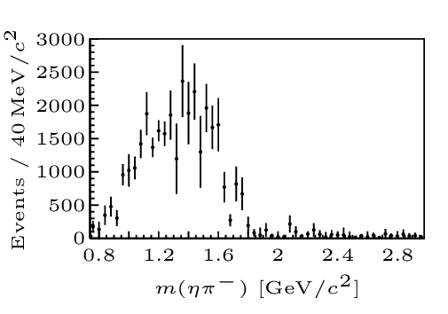
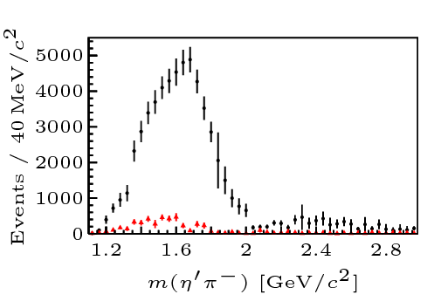
Two hybrid states???
Notes:
2 slides su Zc, a Bes e a Belle
2 slide su tetraquark model: dall’hamiltoniana di Jaffe al calcolo delle masse
1 slide su molecular models, dove sono i carichi? (non in Tornqvist, si in Hanhart, vedere Braaten, citare Nefediev)
2 slides su decay channels, dove si dovrebbe vedere, e a seconda del modello, vedere qualche plot
1 slide su Y(4260), tetraquark? C’è lo strano (si vede la f0)
1 slide su Zc a cleo (anche il neutro)

Slide 3
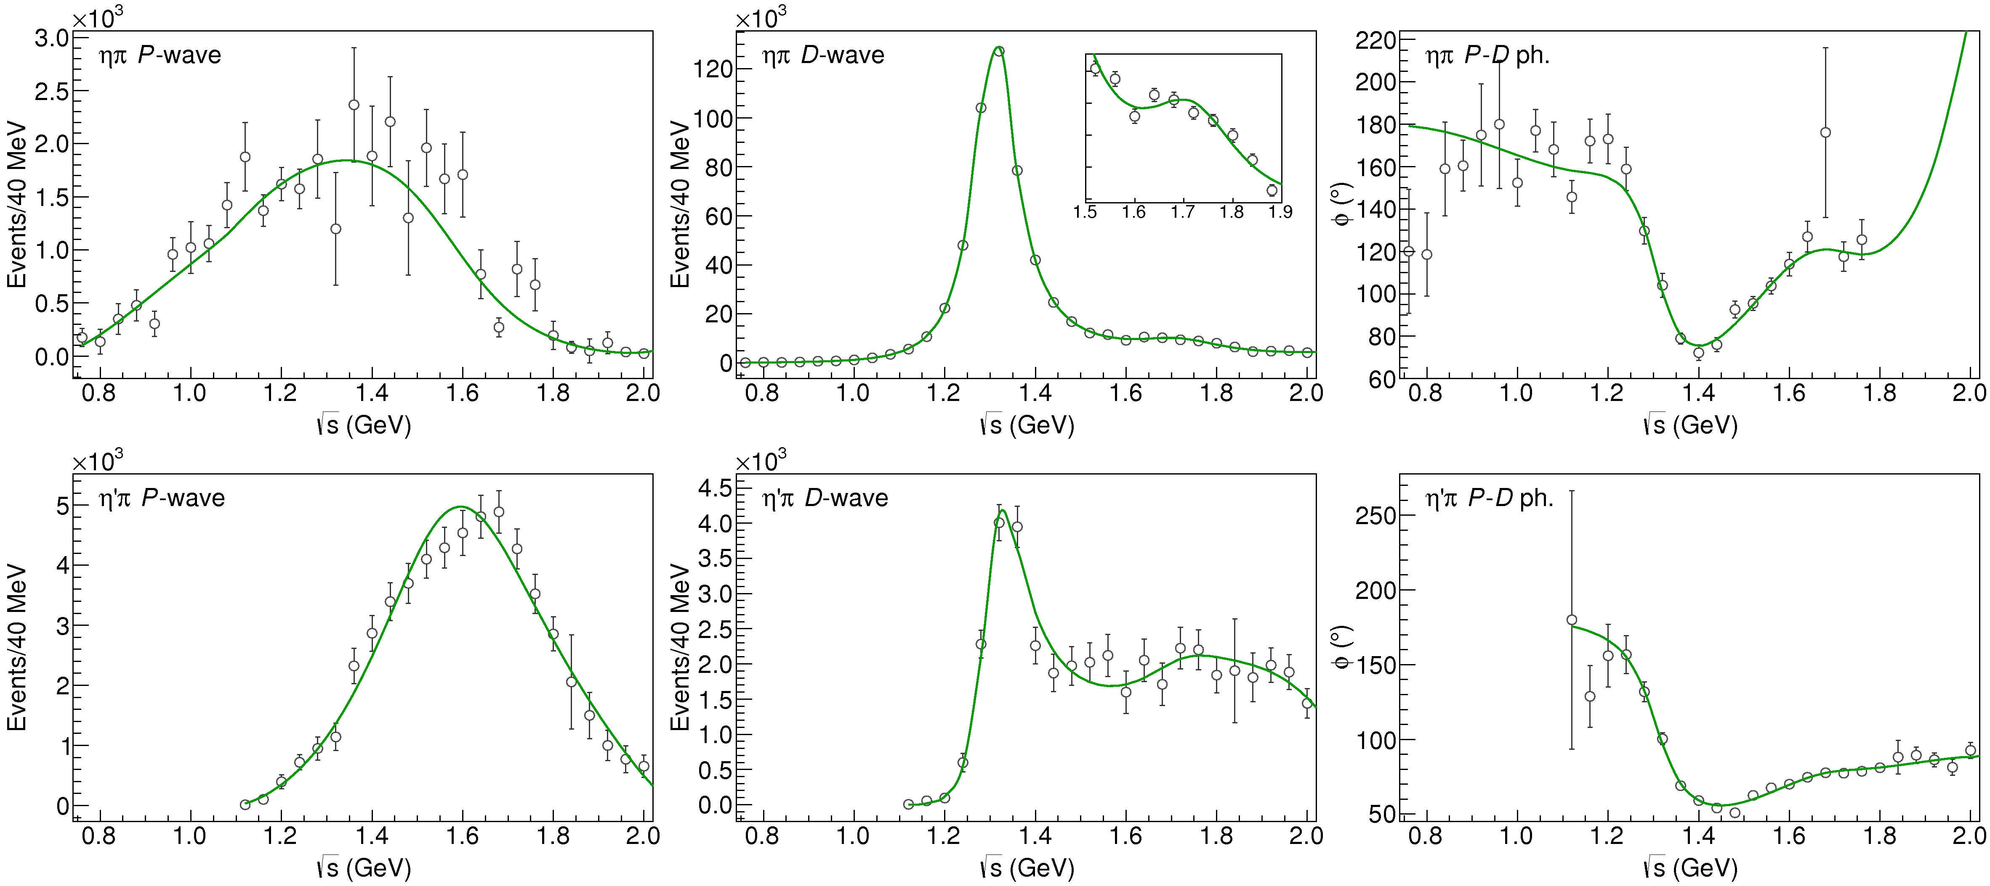
Fit to $η^{(′)}π$
$$χ^{2}∼1.3$$
( data)
$$π_{1}\left(1400\right)?$$
$$a_{2}\left(1320\right)$$
$$a_{2}^{′}\left(1700\right)$$
$$π_{1}\left(1600\right)?$$
$$a_{2}\left(1320\right)$$
$$a_{2}^{′}\left(1700\right)$$
$$J^{PC}=1^{−+}$$
$$J^{PC}=2^{++}$$
Notes:
Controlla la parte su Regge

Slide 4
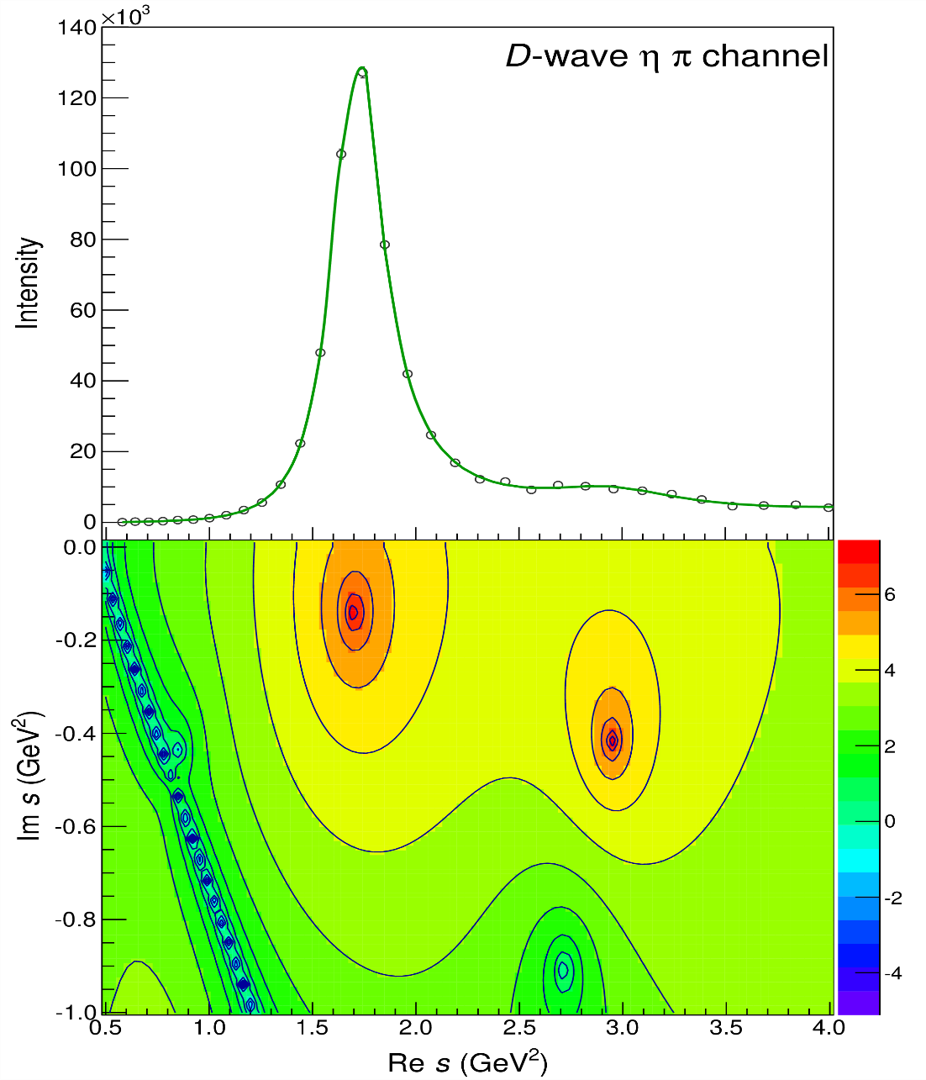
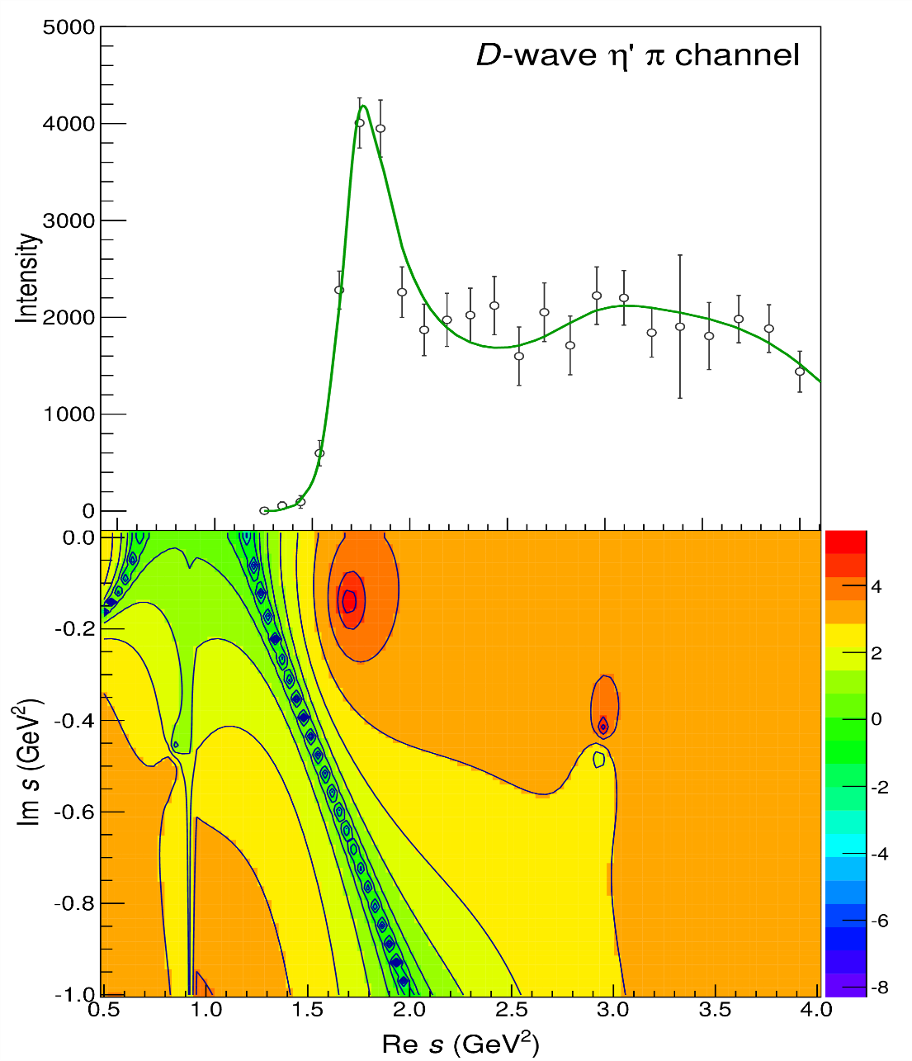
Pole hunting
( data)
$$a_{2}^{′}\left(1700\right)$$
$$a_{2}^{′}\left(1700\right)$$
$$a_{2}\left(1320\right)$$
$$a_{2}\left(1320\right)$$
A. Pilloni – From S-Matrix to data
Notes:
Controlla la parte su Regge

Slide 5
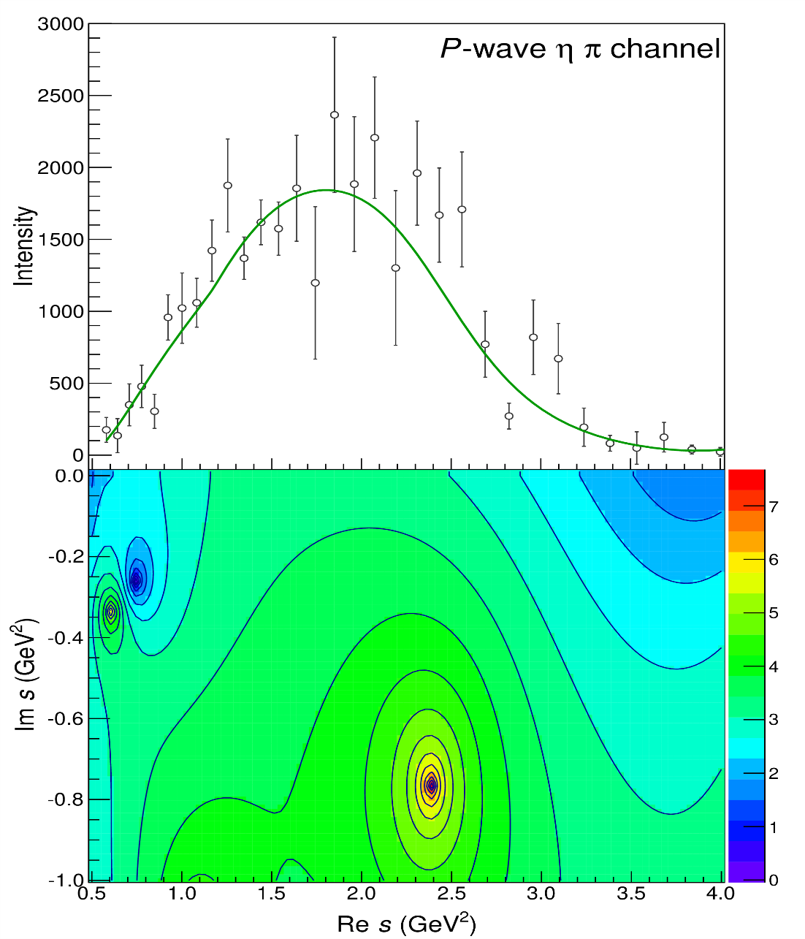
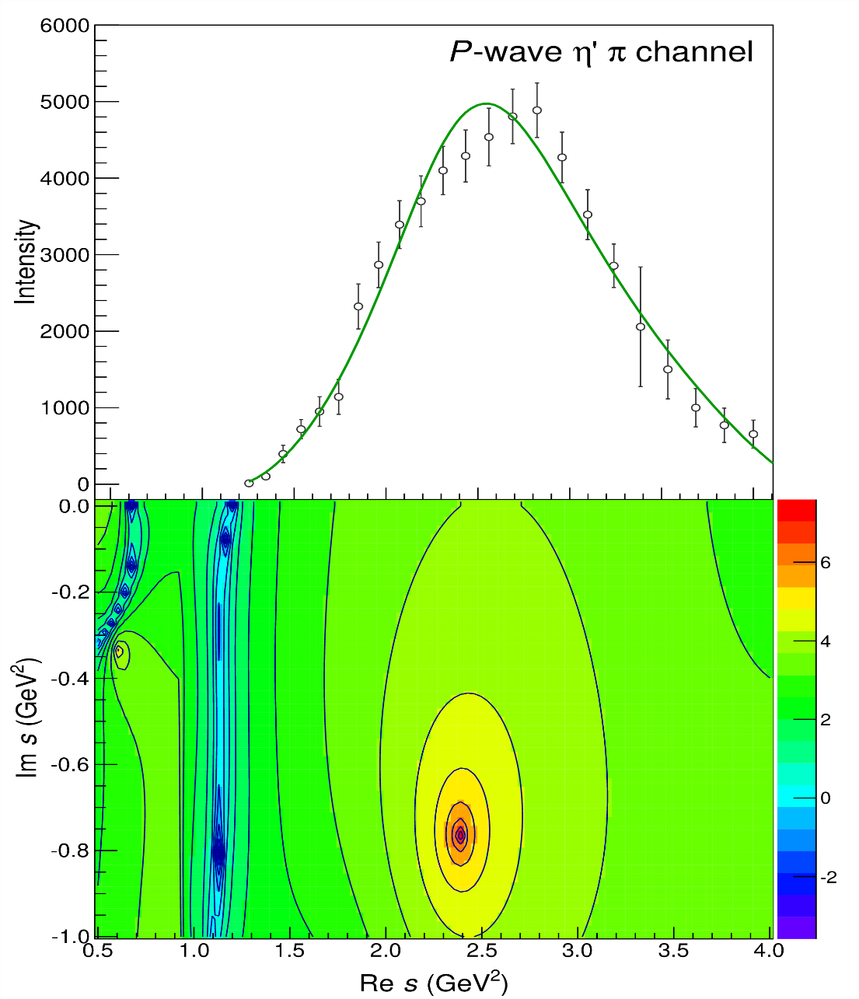
Pole hunting
( data)
$$π_{1}$$
$$π_{1}$$
A. Pilloni – From S-Matrix to data
Notes:
Controlla la parte su Regge

Slide 6
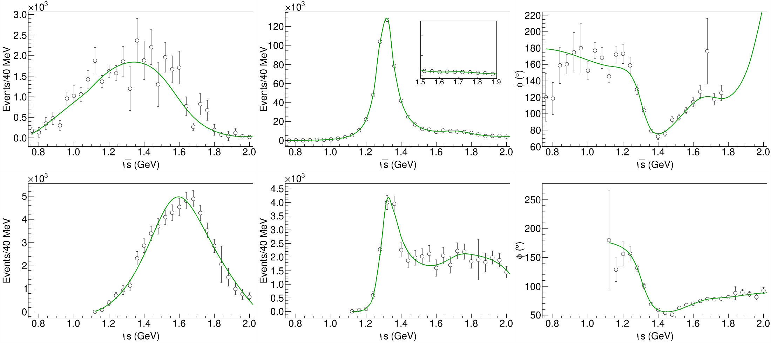
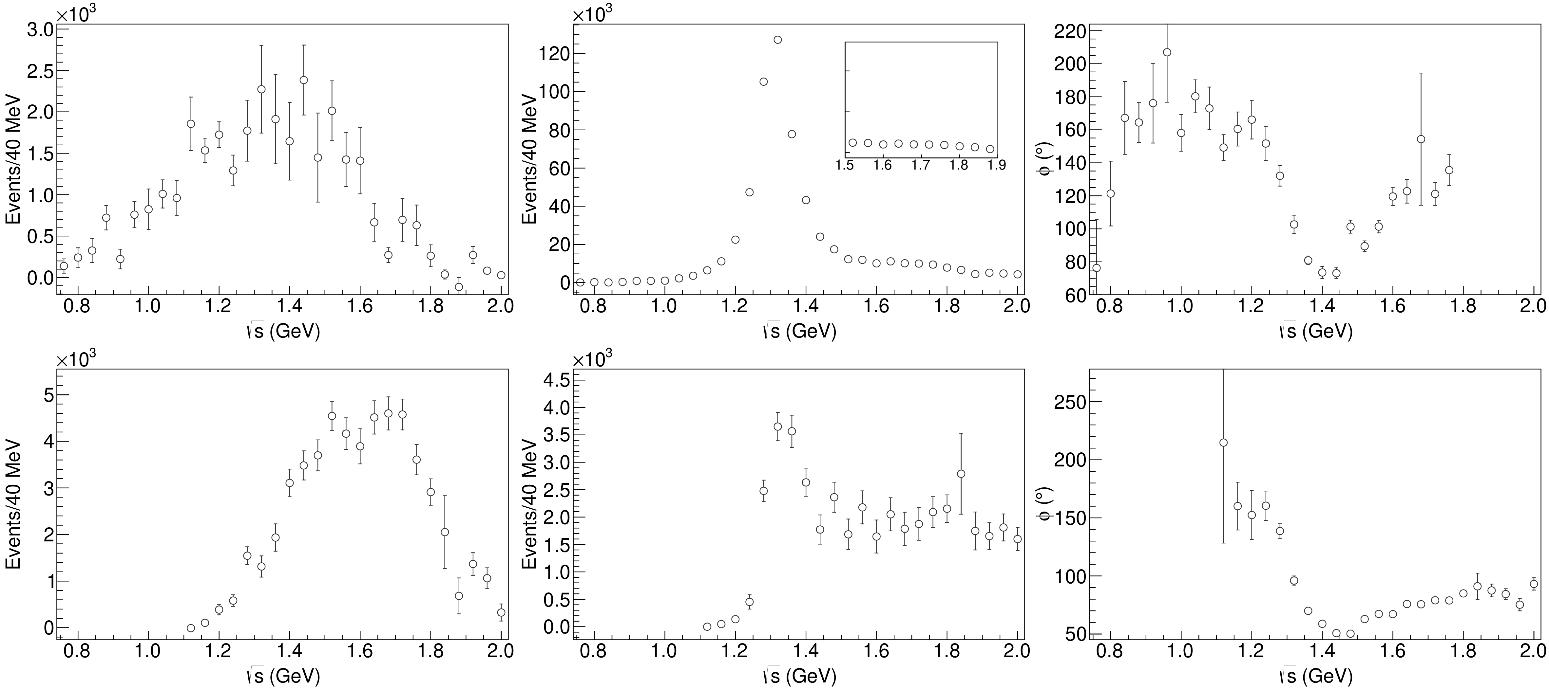
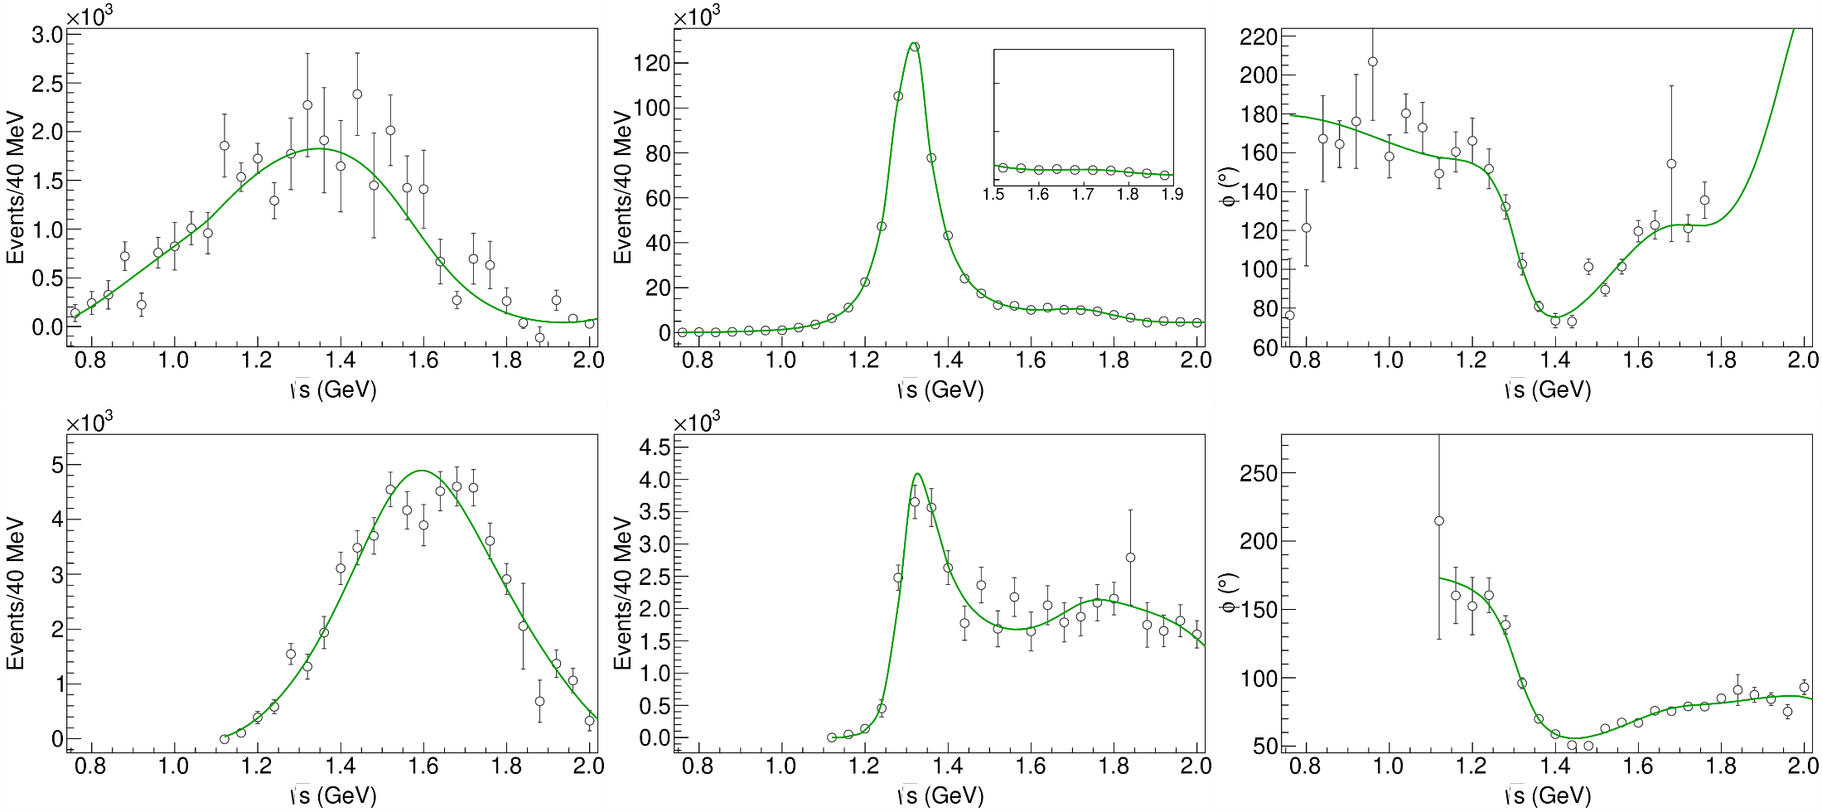
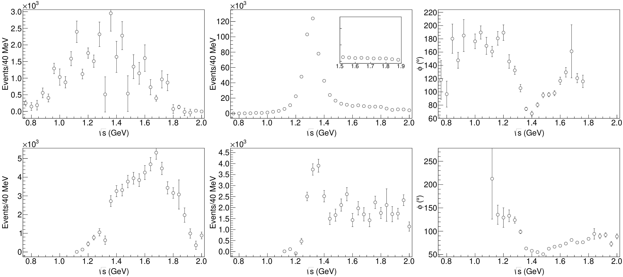
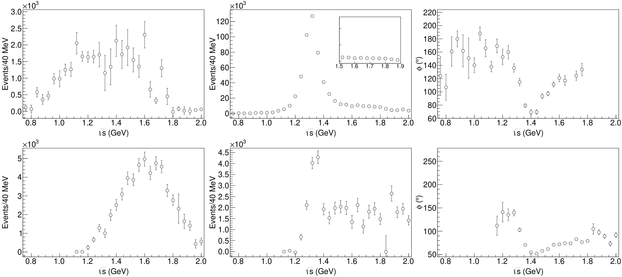
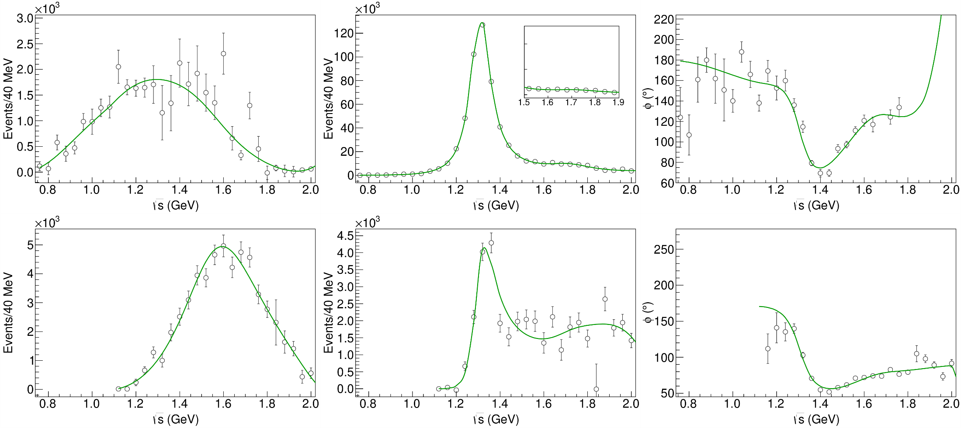
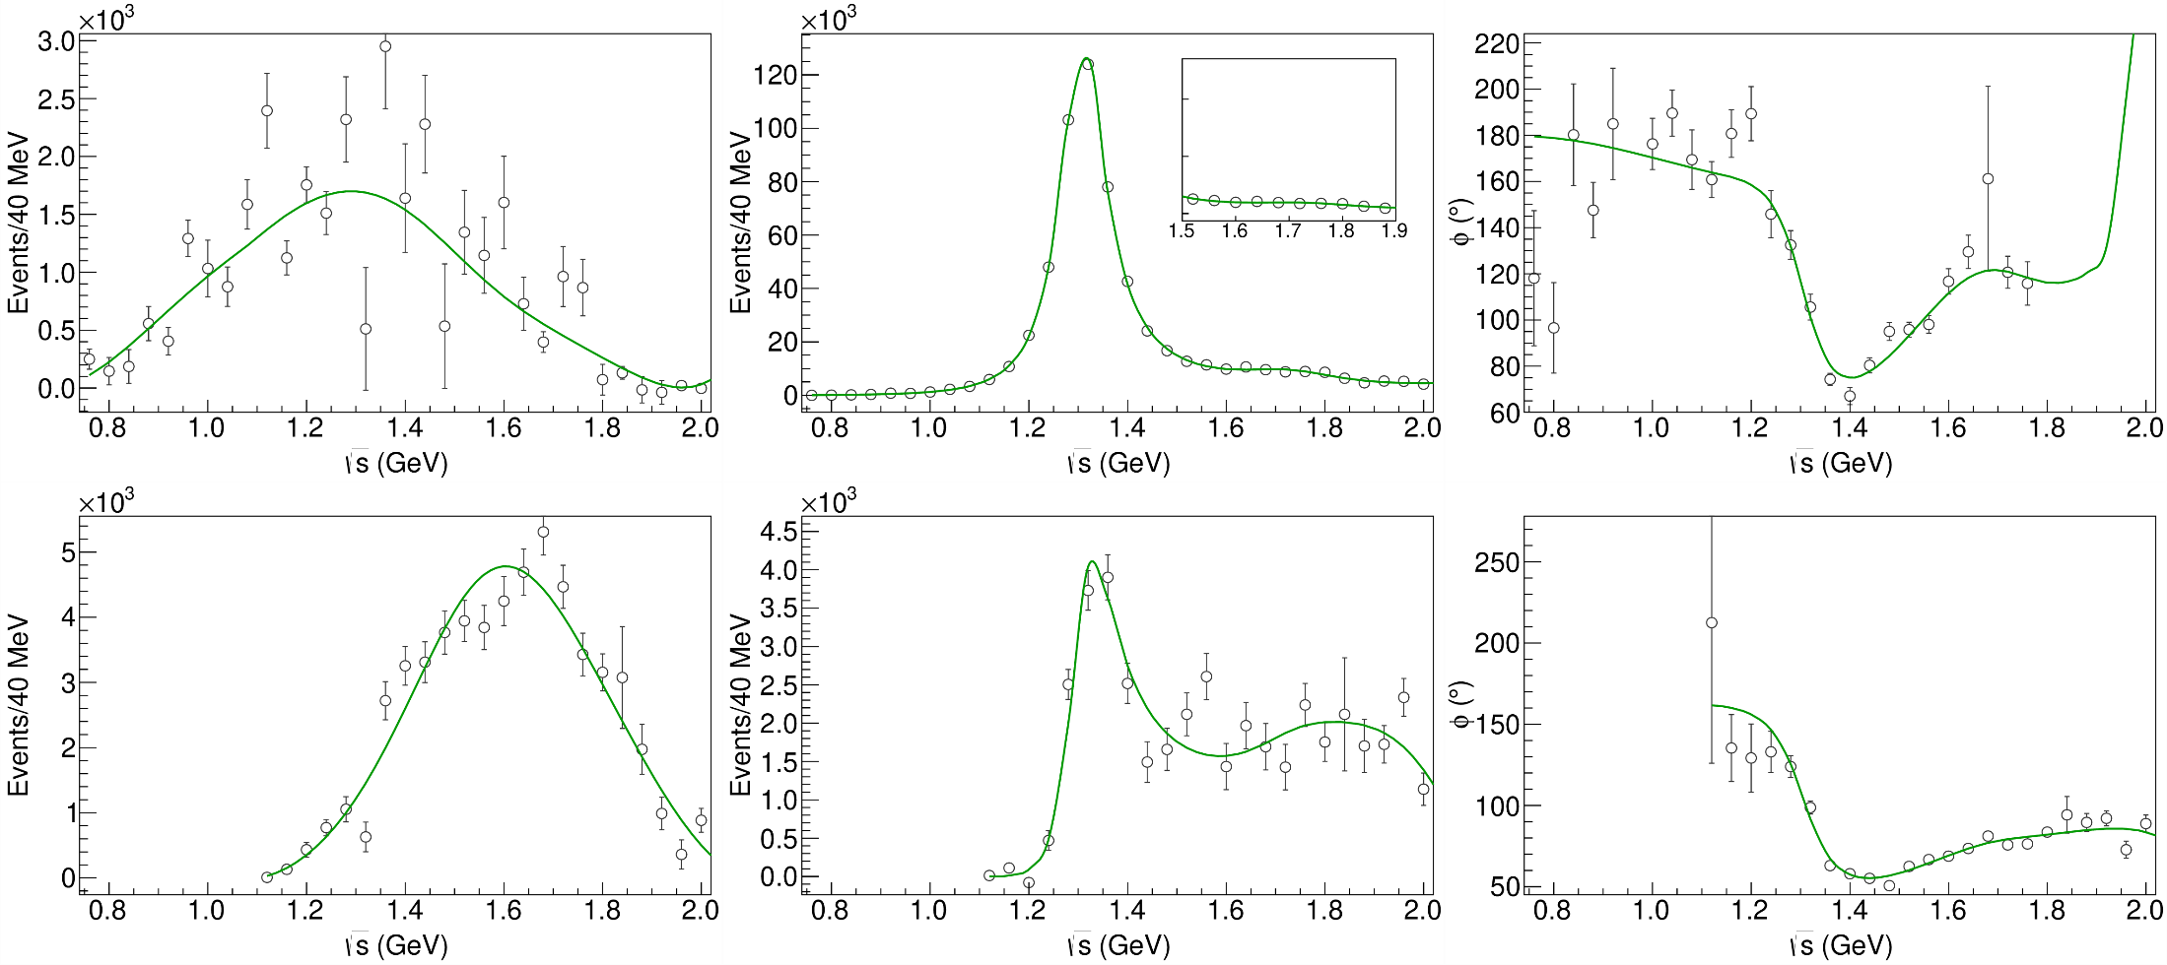
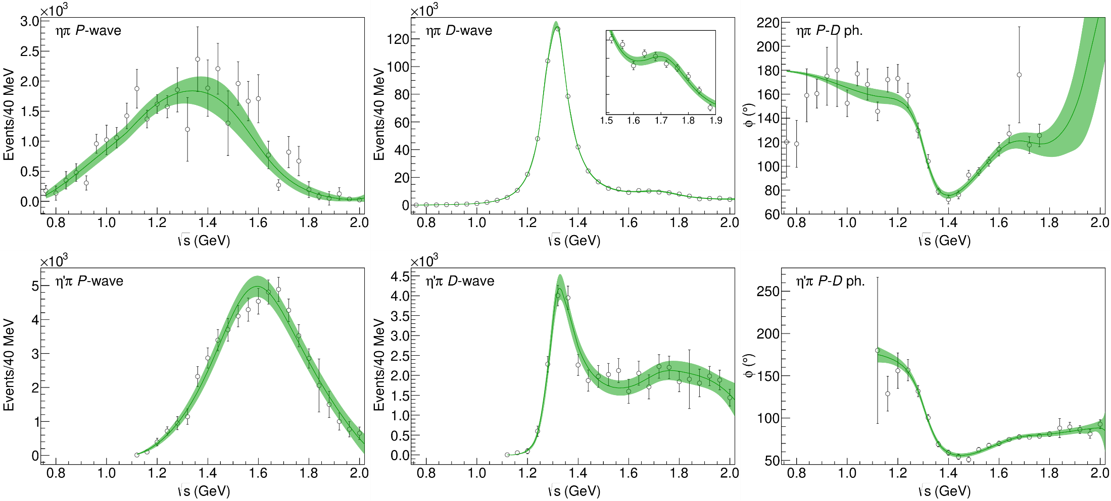
Statistical Bootstrap
A. Pilloni – From S-Matrix to data
Notes:
Controlla la parte su Regge

Slide 7
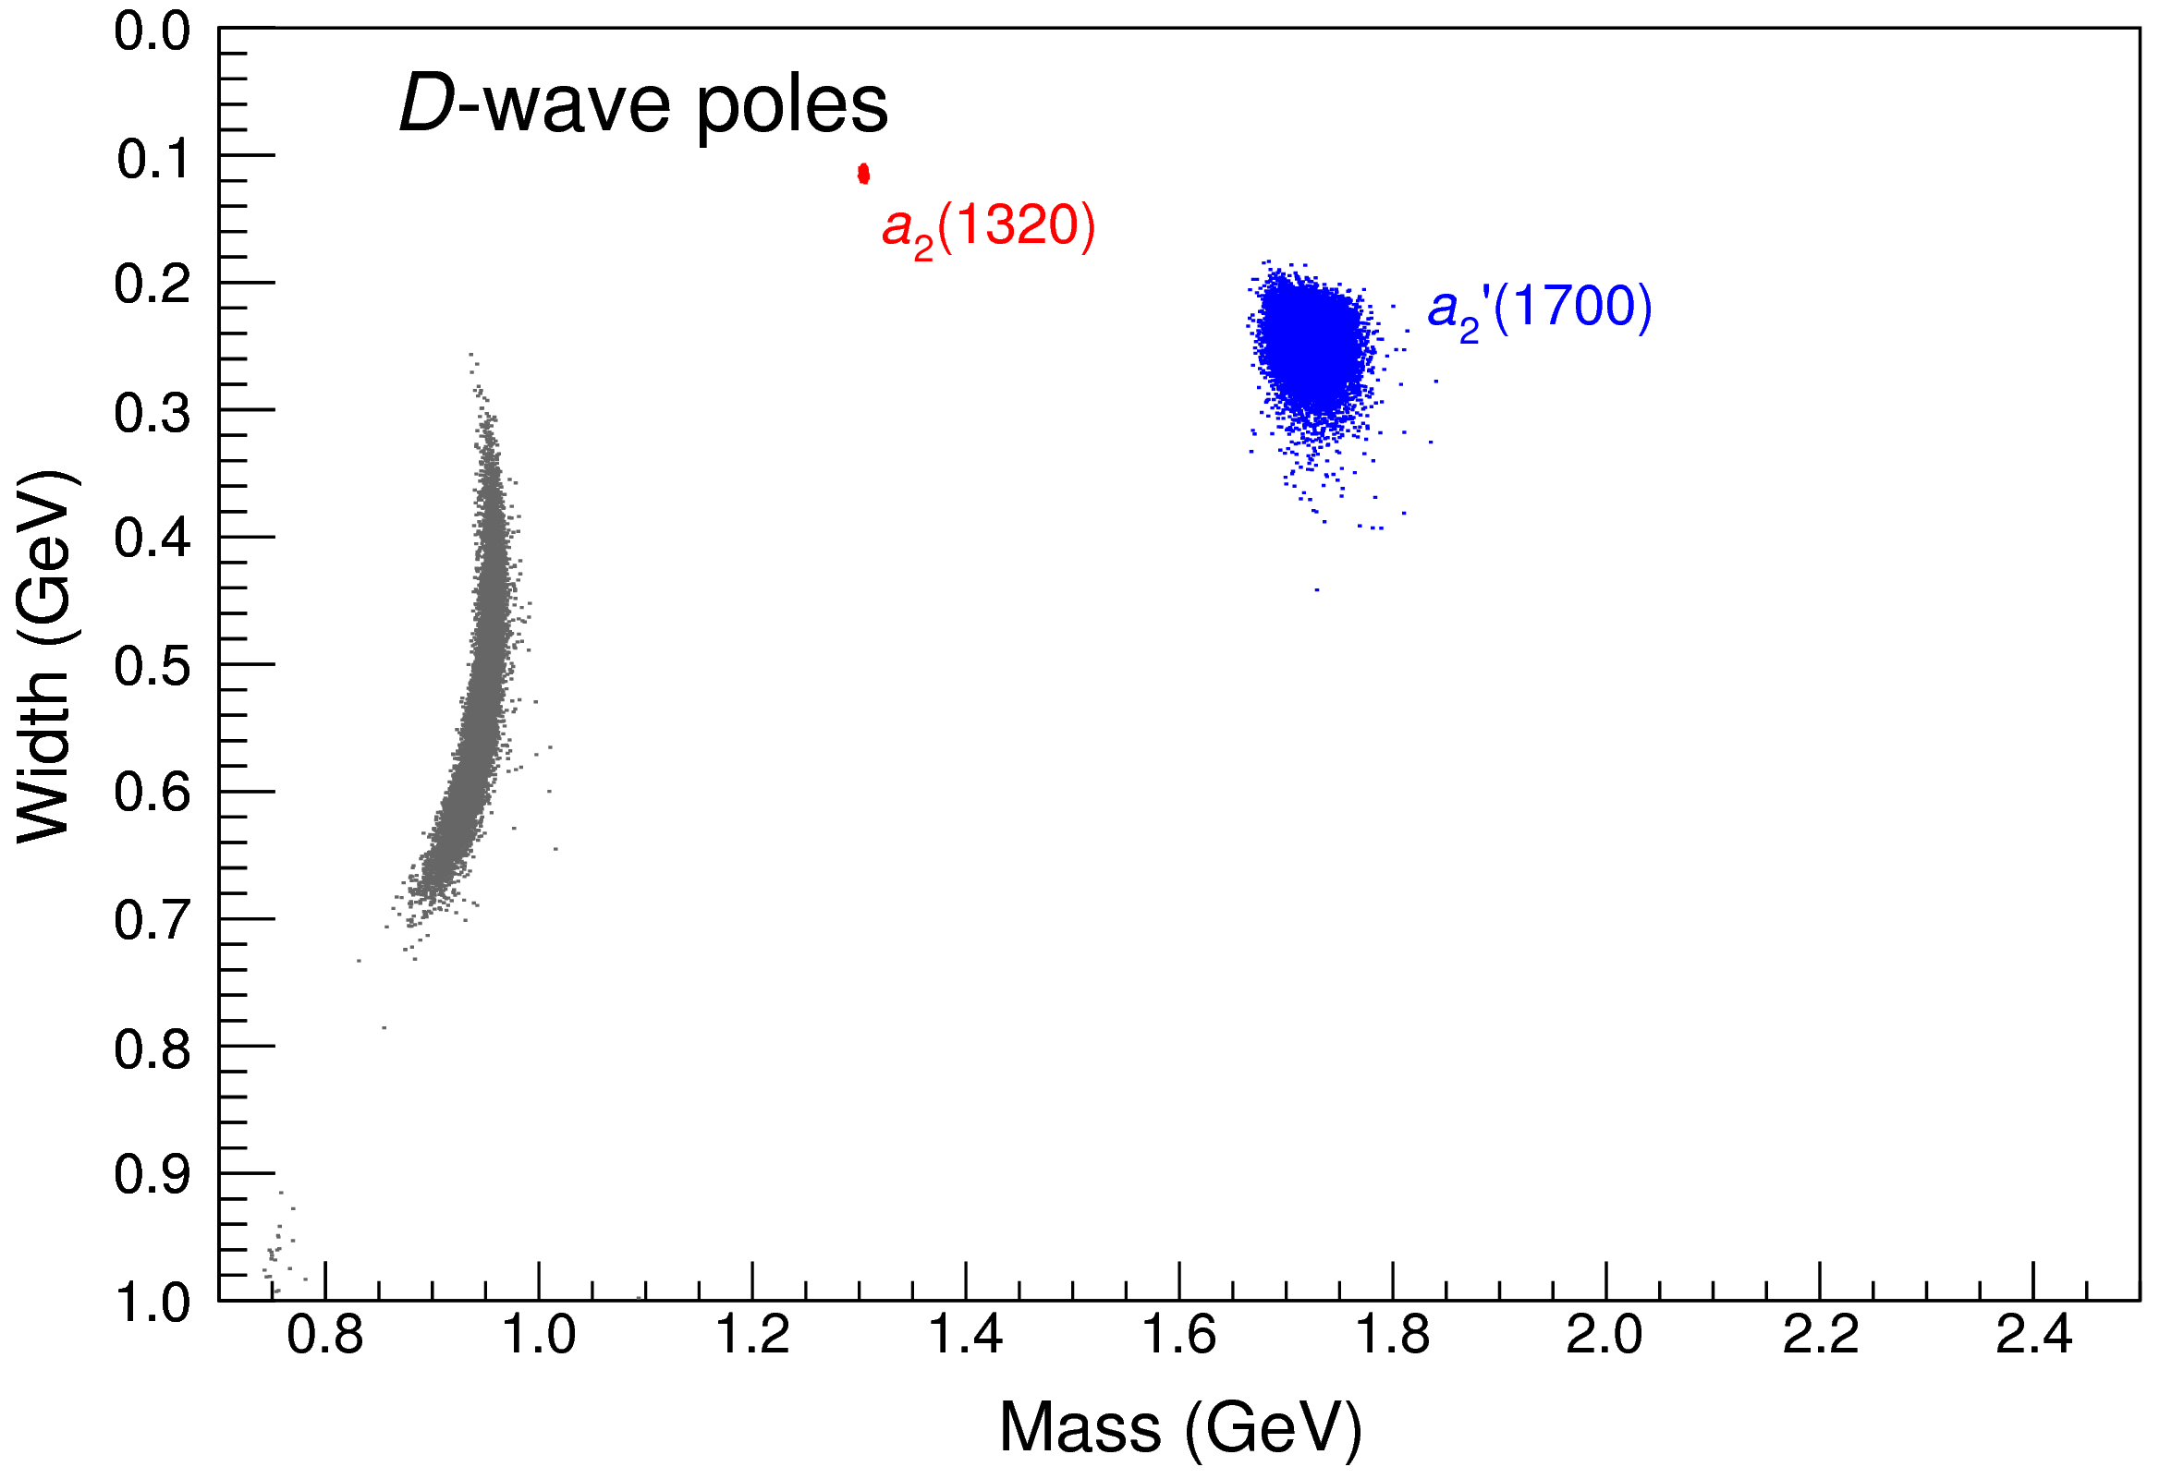
Statistical Bootstrap
For each fit, we search poles: two clusters in D-wave: $a_{2}\left(1320\right)$ and $a_{2}^{′}\left(1700\right)$
A. Pilloni – From S-Matrix to data
Notes:
Controlla la parte su Regge

Slide 8
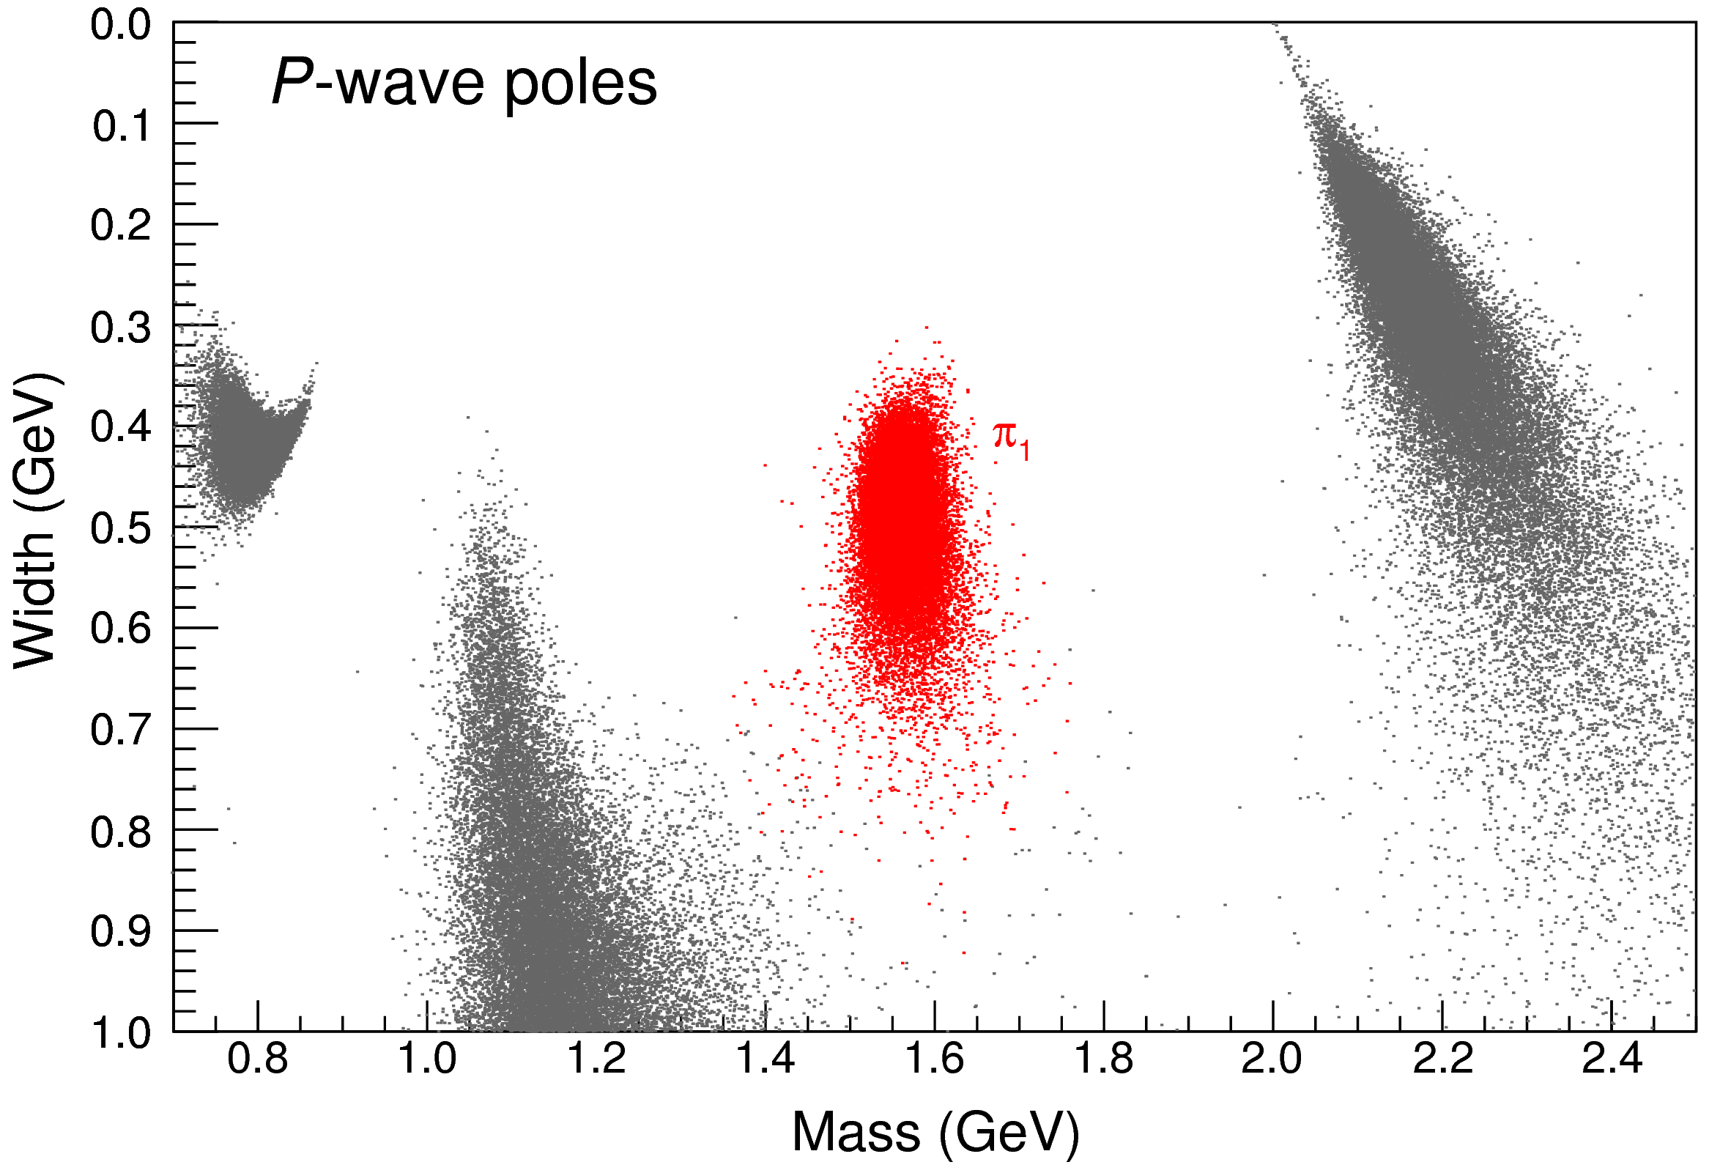
Statistical Bootstrap
Only one stable cluster in $P$-wave: a single $π_{1}$
A. Pilloni – From S-Matrix to data
Notes:
Controlla la parte su Regge

Slide 9
Final results
A. Pilloni – From S-Matrix to data
Notes:
Controlla la parte su Regge

Slide 10
Backup

Slide 11
Systematic studies
Change of functional form and parameters in the denominator
Default: $s_{R}=1 {\text{GeV}}^{2}$. We try $s_{R}=0.8, 1.8 {\text{GeV}}^{2}$
Default: $α=2$. We try $α=1$
We also try a different function: with $α=2, 1.5, 1$
Change of parameters in the numerator
Default: $t_{\text{eff}}=−0.1 {\text{GeV}}^{2}$. We try$t_{\text{eff}}=−0.5 {\text{GeV}}^{2}$
Default: 3rd order polynomial. We try 4th
A. Pilloni – From S-Matrix to data
Notes:
Controlla la parte su Regge

Slide 12
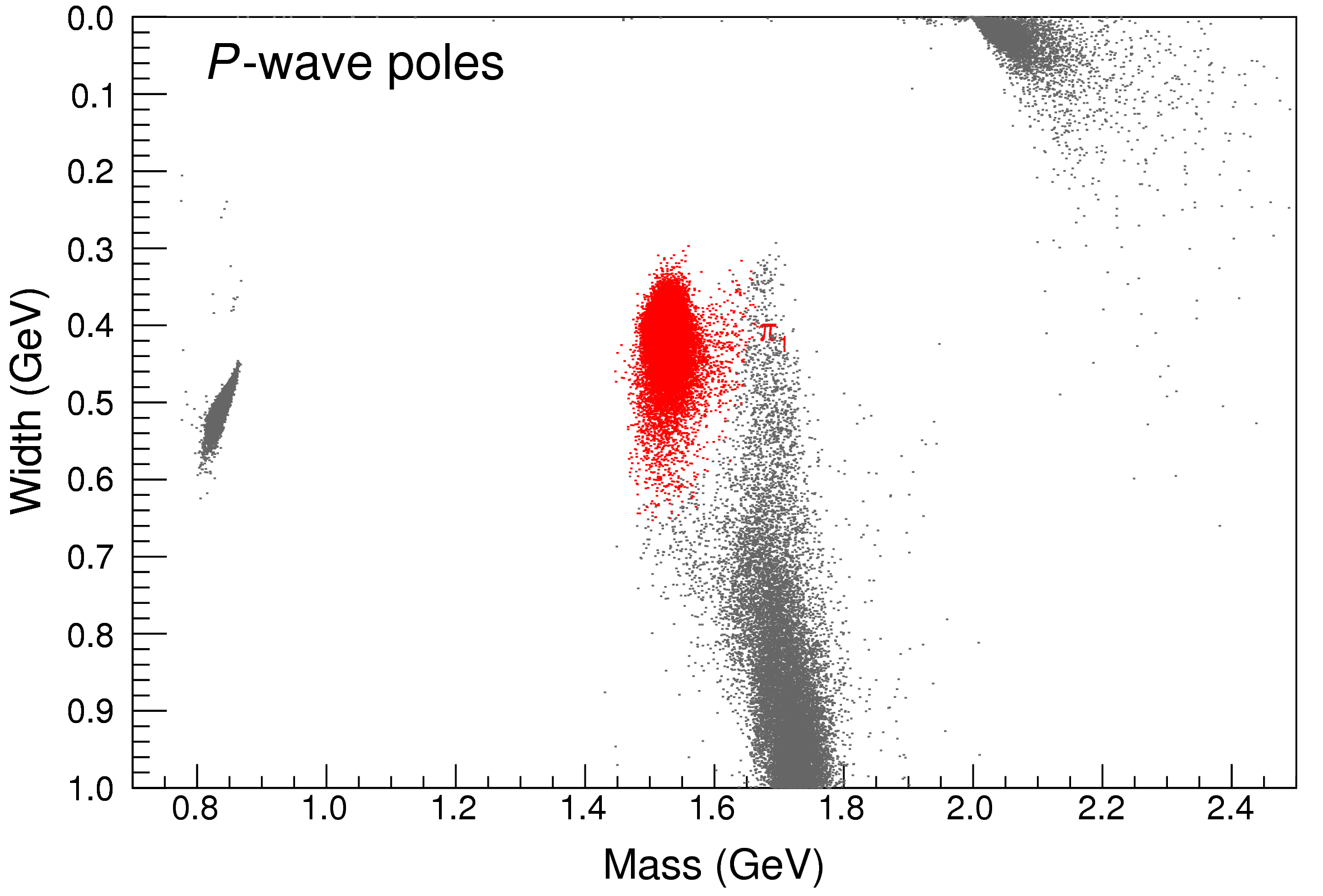
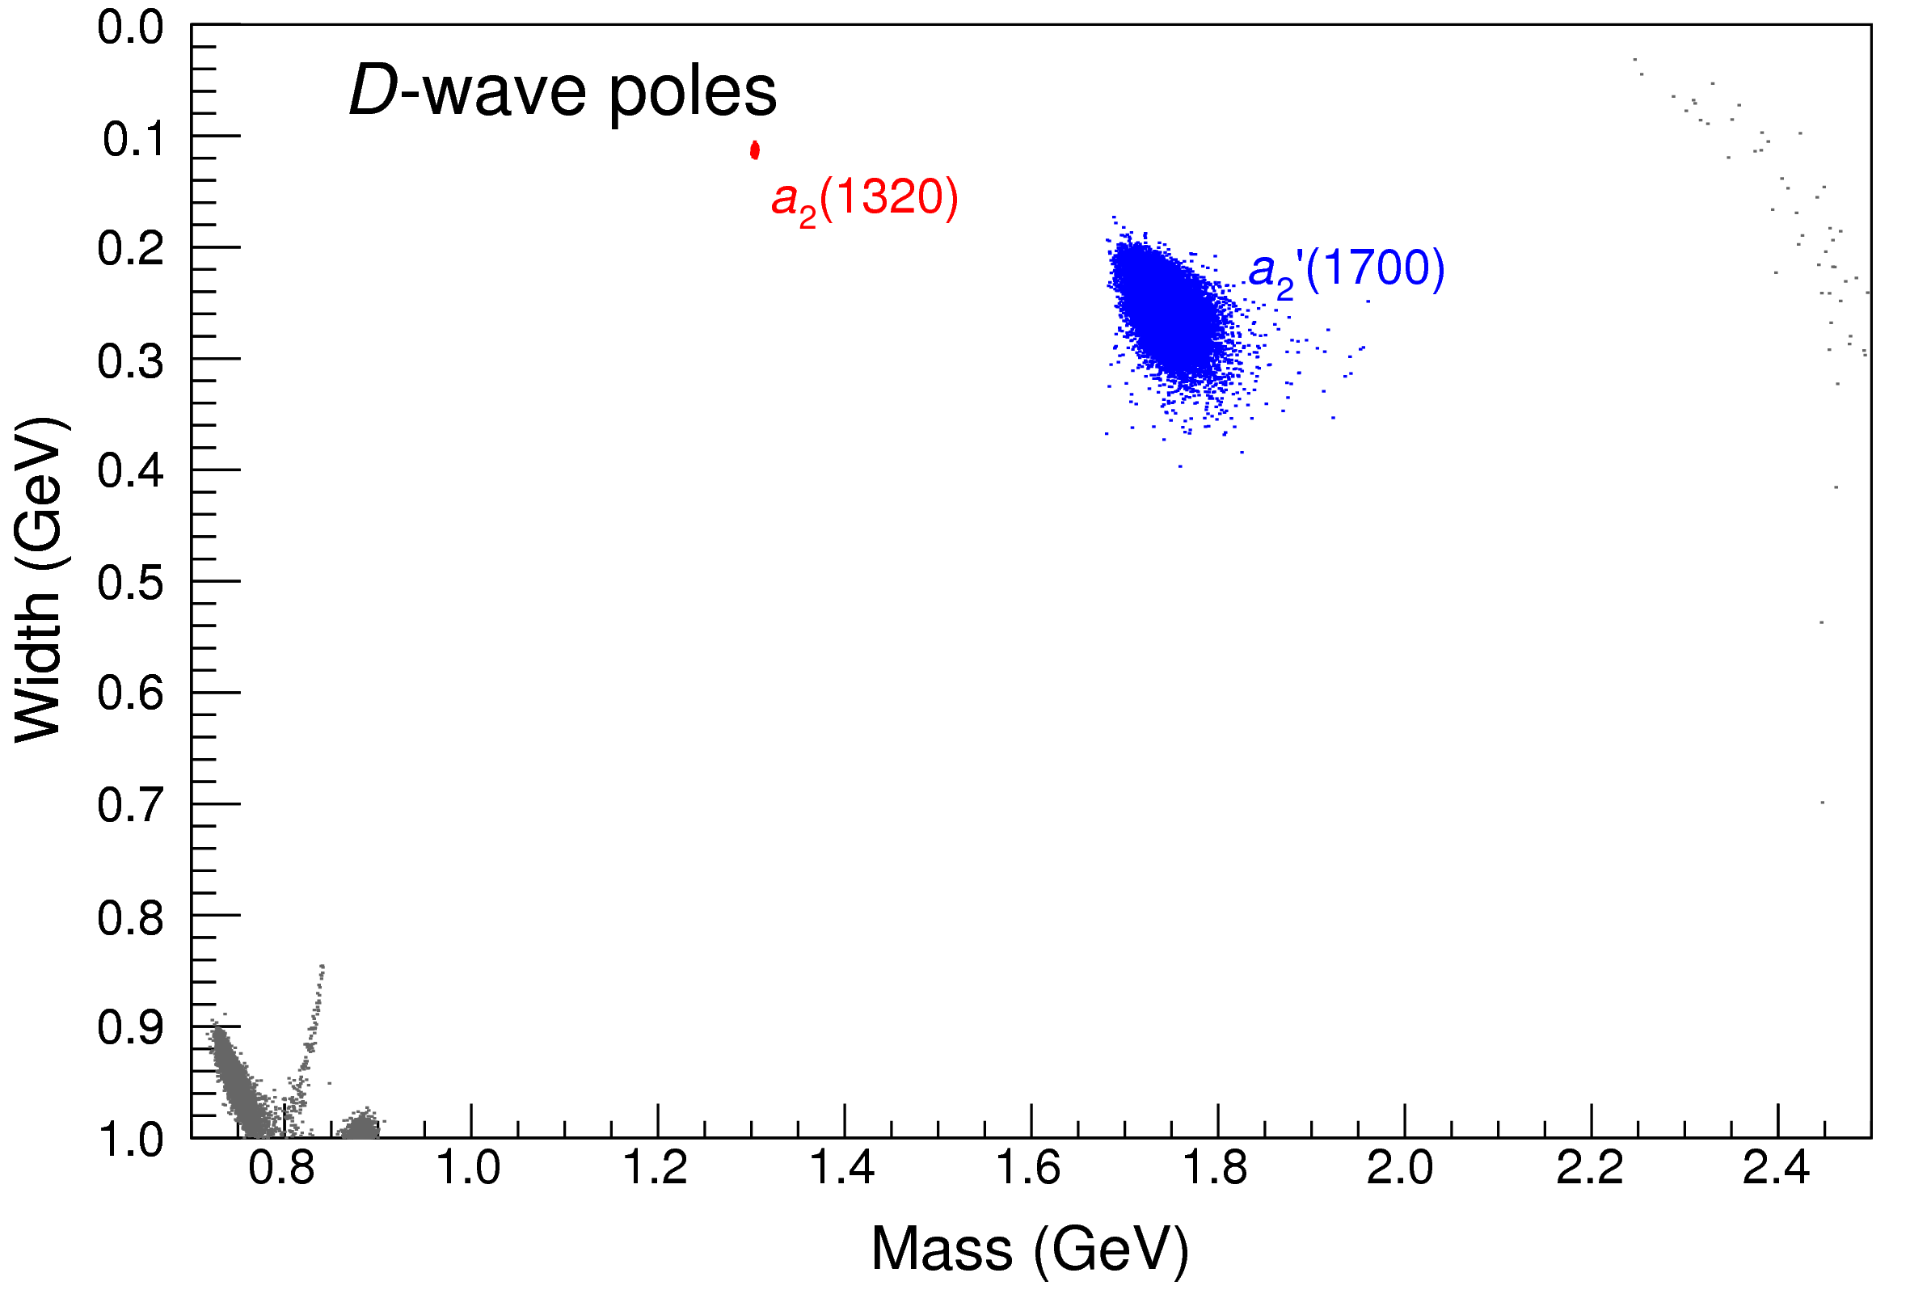
Bootstrap for $s_{R}=1.8 {\text{GeV}}^{2}$
Our skepticism about a second pole in the relevant region is confirmed:
It is unstable and not trustable
A. Pilloni – From S-Matrix to data
Notes:
Controlla la parte su Regge

Slide 13
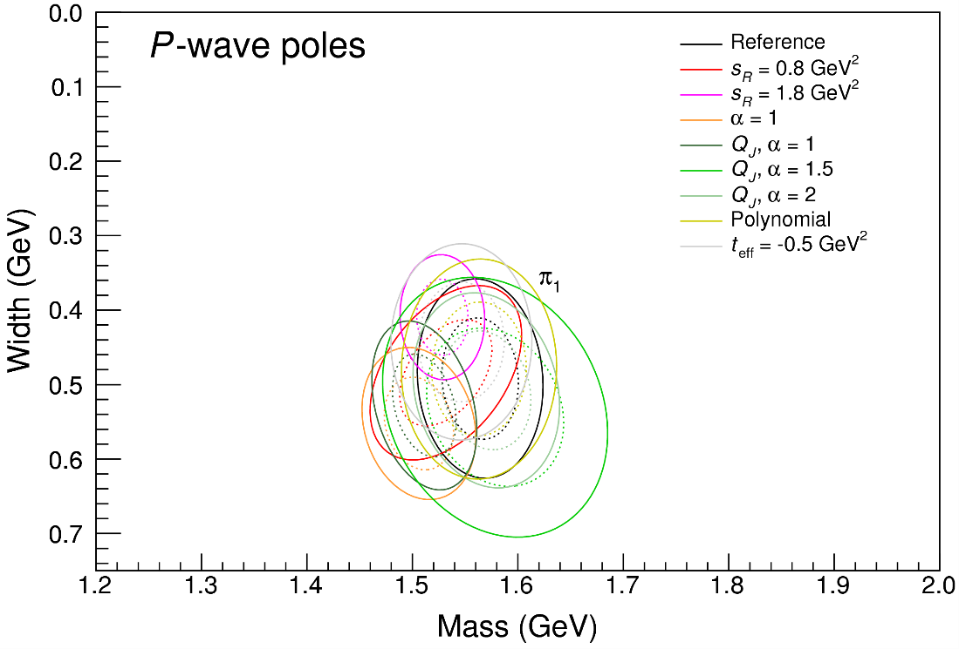
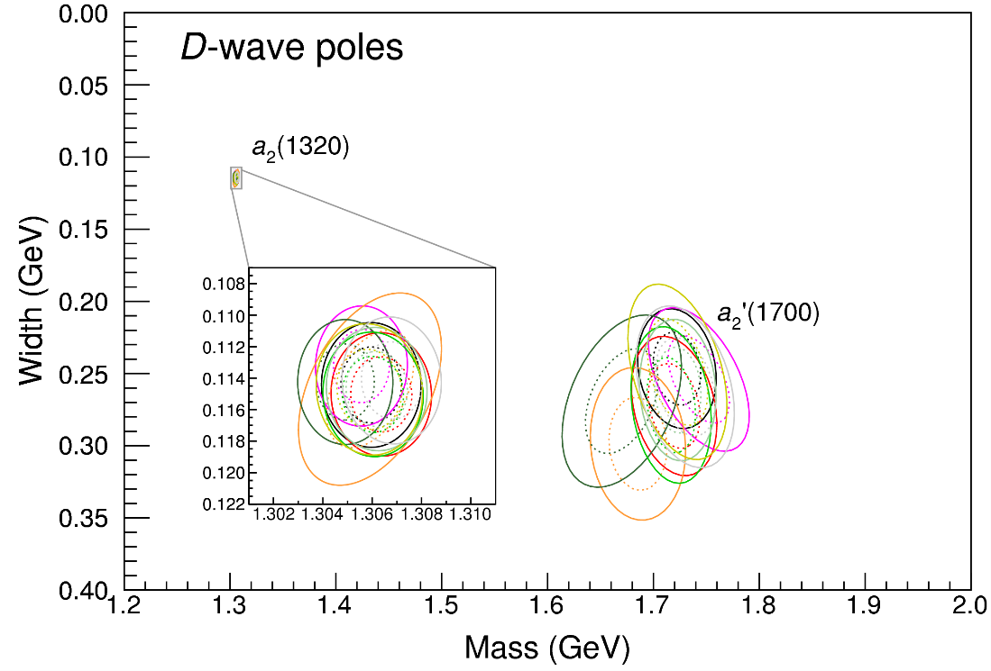
Systematic studies
For each class, the maximum deviation of mass and width is taken as a systematic error Deviation smaller than the statistical error are neglected Systematic of different classes are summed in quadrature
A. Pilloni – From S-Matrix to data
Notes:
Controlla la parte su Regge

Slide 14
Systematic studies
For each class, the maximum deviation of mass and width is taken as a systematic error Deviation smaller than the statistical error are neglected Systematic of different classes are summed in quadrature
A. Pilloni – From S-Matrix to data
Notes:
Controlla la parte su Regge

Slide 15
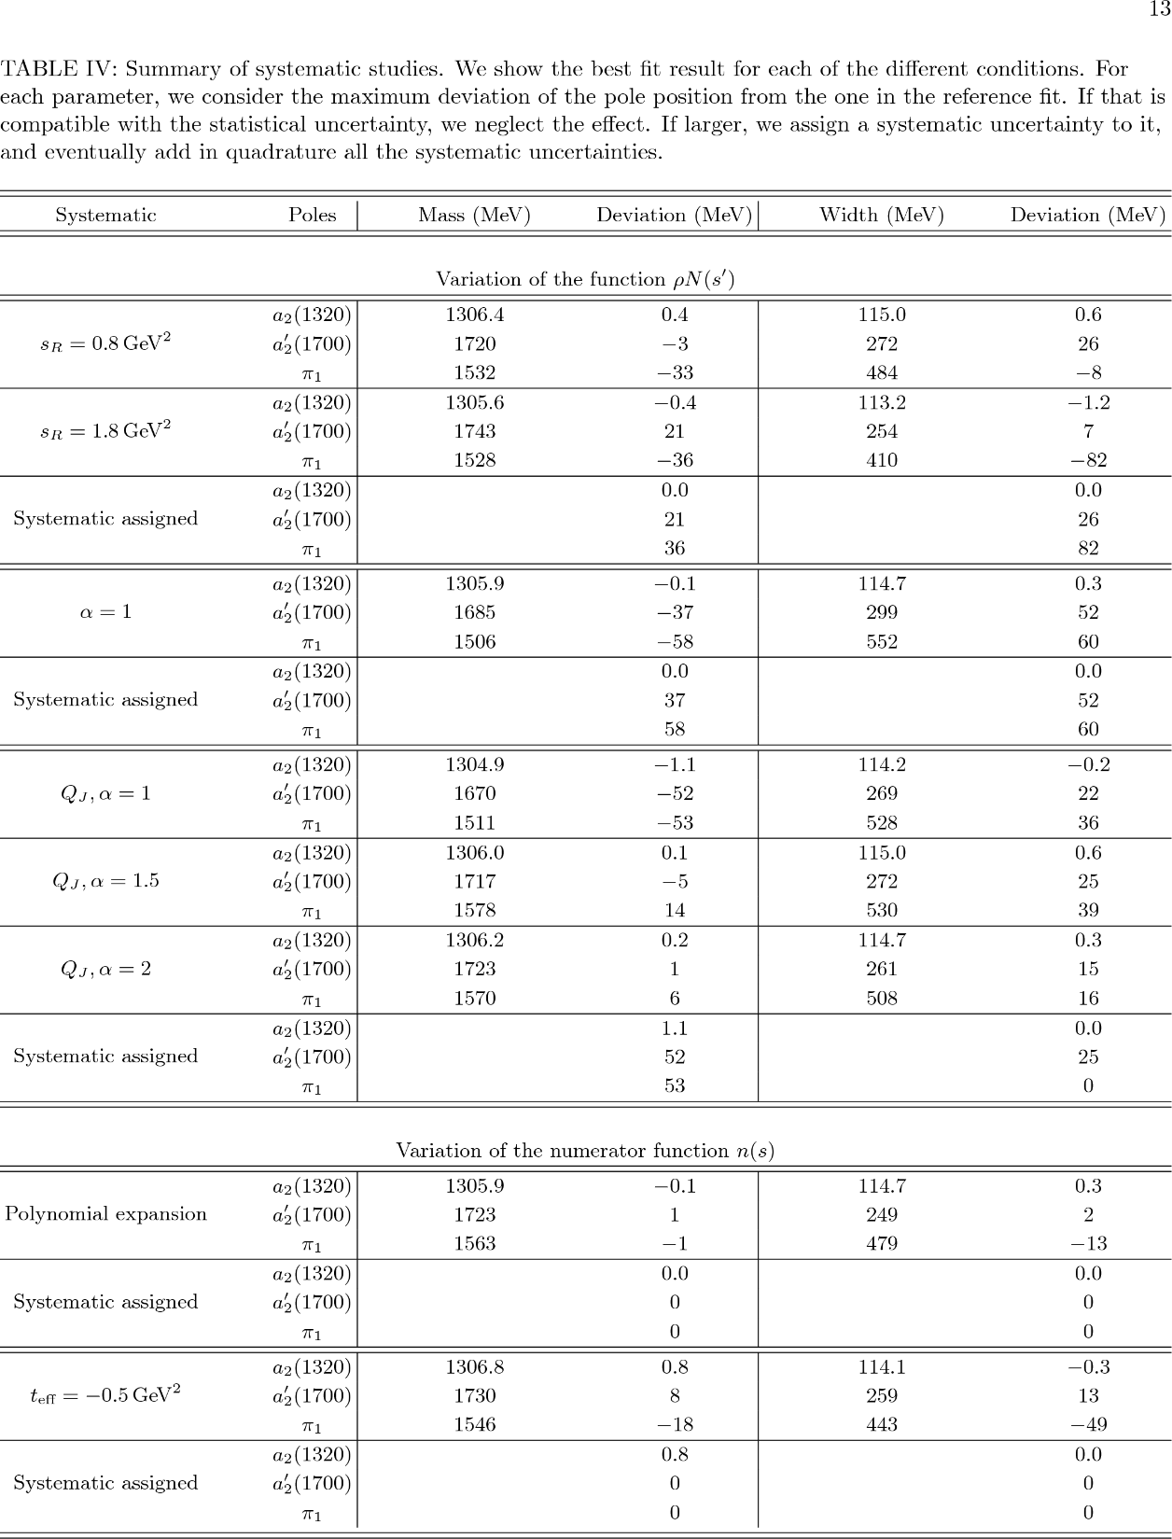
Systematic studies
A. Pilloni – From S-Matrix to data
Notes:
Controlla la parte su Regge

Slide 16
Systematic studies
A. Pilloni – From S-Matrix to data
Notes:
Controlla la parte su Regge

