Slide 1
Exotic hadron spectroscopy III: Heavy exotics
Alessandro Pilloni
DTP, May 6th, 2022

Slide 2
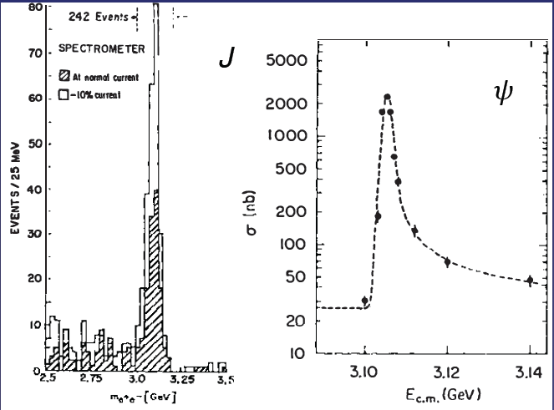
Quarkonium orthodoxy
$$Q$$
$$\overline{Q}$$
Potential models
(meaningful when $M_{Q}→∞$)
$$V\left(r\right)=−\frac{C_{F}α_{s}}{r}+σr$$
(Cornell potential)
$$α_{s}\left(M_{Q}\right)∼0.3$$
(perturbative regime)
OZI-rule, QCD multipole
Solve NR Schrödinger eq. → spectrum
Effective theories
(HQET, NRQCD, pNRQCD...)
Heavy quark spin flip suppressed by quark mass, approximate heavy quark spin symmetry (HQSS)
Integrate out heavy DOF
↓
(spectrum), decay & production rates
A. Pilloni – Exotic hadron spectroscopy
Notes:
2 slides su Zc, a Bes e a Belle
2 slide su tetraquark model: dall’hamiltoniana di Jaffe al calcolo delle masse
1 slide su molecular models, dove sono i carichi? (non in Tornqvist, si in Hanhart, vedere Braaten, citare Nefediev)
2 slides su decay channels, dove si dovrebbe vedere, e a seconda del modello, vedere qualche plot
1 slide su Y(4260), tetraquark? C’è lo strano (si vede la f0)
1 slide su Zc a cleo (anche il neutro)

Slide 3
Multiscale system
Systematically integrate out the heavy scale,
$$m_{Q}≫Λ_{QCD}$$
$$m_{Q}≫m_{Q}v≫m_{Q}v^{2}$$
$$m_{b}∼5 \text{GeV}, m_{c}∼1.5 \text{GeV}$$
$$v_{b}^{2}∼0.1, v_{c}^{2}∼0.3$$
Full QCD
NRQCD
pNRQCD
Factorization (to be proved) of universal LDMEs
Good description of many production channels, some known puzzles (polarizations)
A. Pilloni – Exotic hadron spectroscopy
Notes:
2 slides su Zc, a Bes e a Belle
2 slide su tetraquark model: dall’hamiltoniana di Jaffe al calcolo delle masse
1 slide su molecular models, dove sono i carichi? (non in Tornqvist, si in Hanhart, vedere Braaten, citare Nefediev)
2 slides su decay channels, dove si dovrebbe vedere, e a seconda del modello, vedere qualche plot
1 slide su Y(4260), tetraquark? C’è lo strano (si vede la f0)
1 slide su Zc a cleo (anche il neutro)

Slide 4
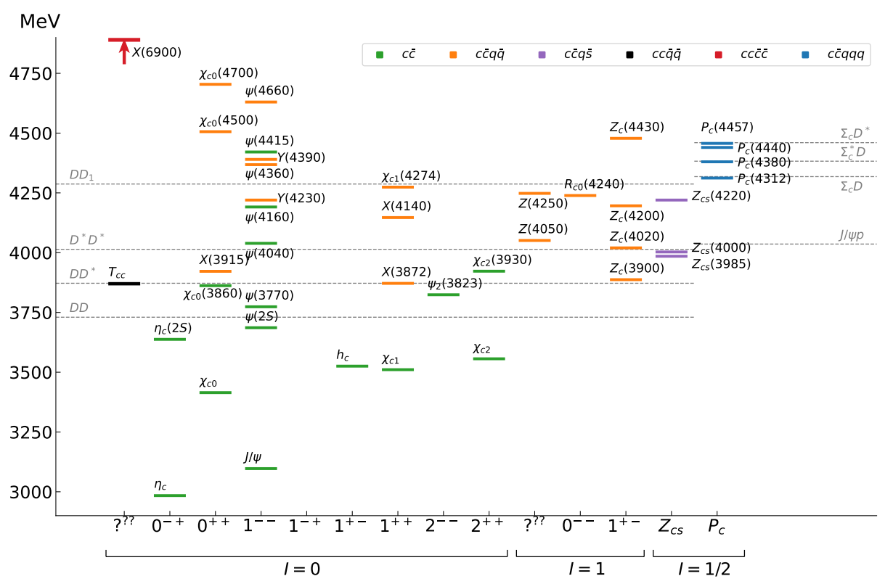
Exotic landscape in $c\overline{c}$
Esposito, AP, Polosa, Phys.Rept. 668
JPAC, arXiv:2112.13436
A host of unexpected resonances have appeared
decaying mostly into charmonium + light Hardly reconciled with usual $q\overline{q}$ pheno
A. Pilloni – Exotic hadron spectroscopy
Notes:
2 slides su Zc, a Bes e a Belle
2 slide su tetraquark model: dall’hamiltoniana di Jaffe al calcolo delle masse
1 slide su molecular models, dove sono i carichi? (non in Tornqvist, si in Hanhart, vedere Braaten, citare Nefediev)
2 slides su decay channels, dove si dovrebbe vedere, e a seconda del modello, vedere qualche plot
1 slide su Y(4260), tetraquark? C’è lo strano (si vede la f0)
1 slide su Zc a cleo (anche il neutro)

Slide 5
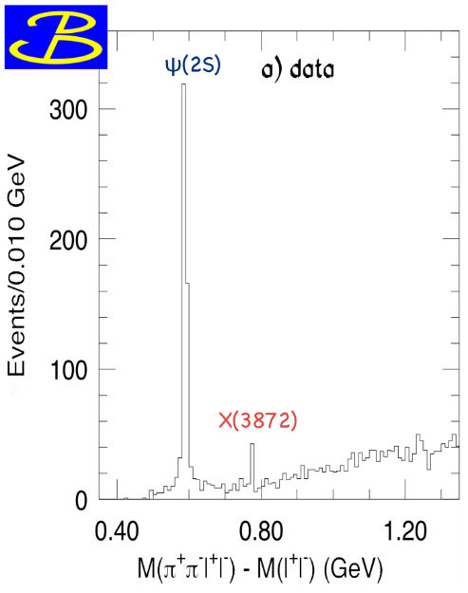
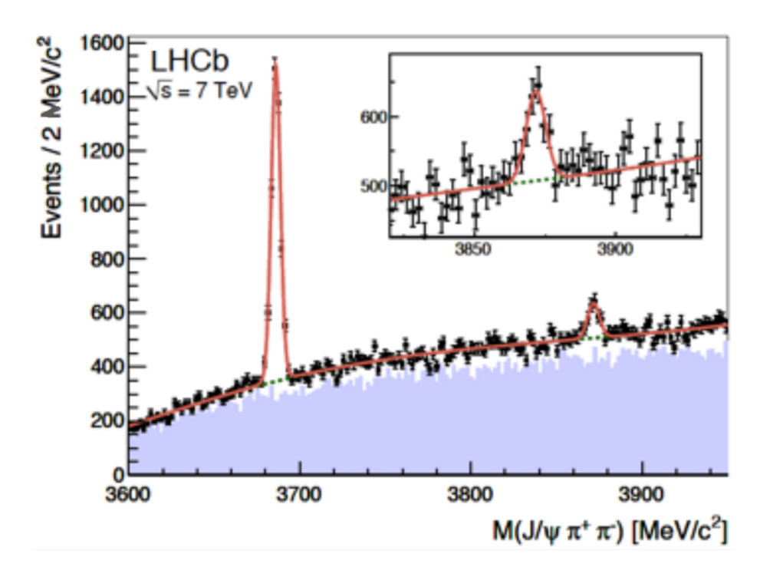
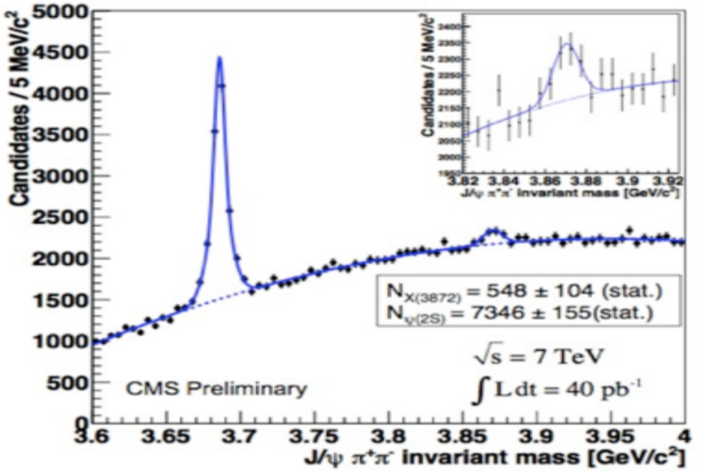
$X(3872)$
Discovered in $B→K X→K J/ψ ππ$
Quantum numbers $1^{++}$
Very close to $DD^{∗}$ threshold
Too narrow for an above-treshold charmonium
Isospin violation too big $\frac{Γ\left(X→J/ψ ω\right)}{Γ\left(X→J/ψ ρ\right)}\sim 1.1±0.4$
Mass prediction not compatible with $χ_{c1}(2P)$
$M=3871.65±0.06$MeV
$$M_{X}−M_{DD^{∗}}=−3±192 \text{keV}$$
$Γ=1.19±0.2\text{1 }\text{MeV}$
A. Pilloni – Exotic hadron spectroscopy

Slide 6
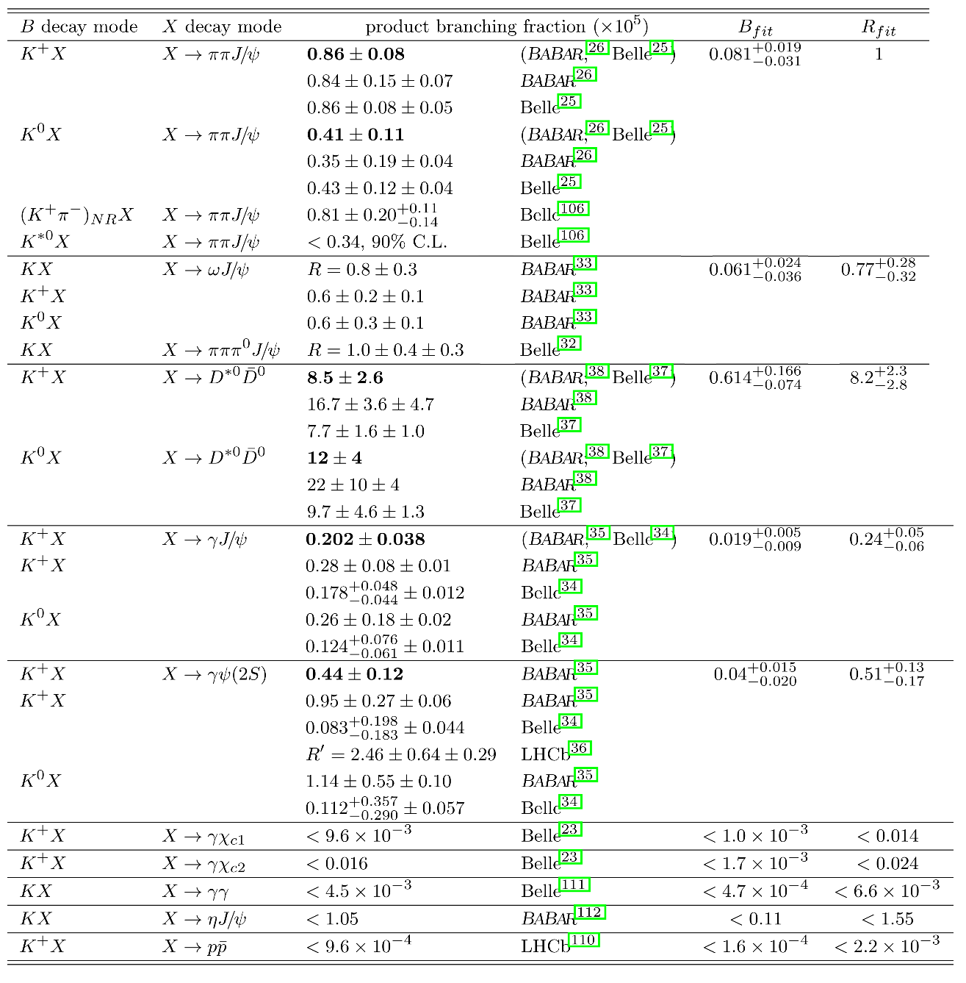
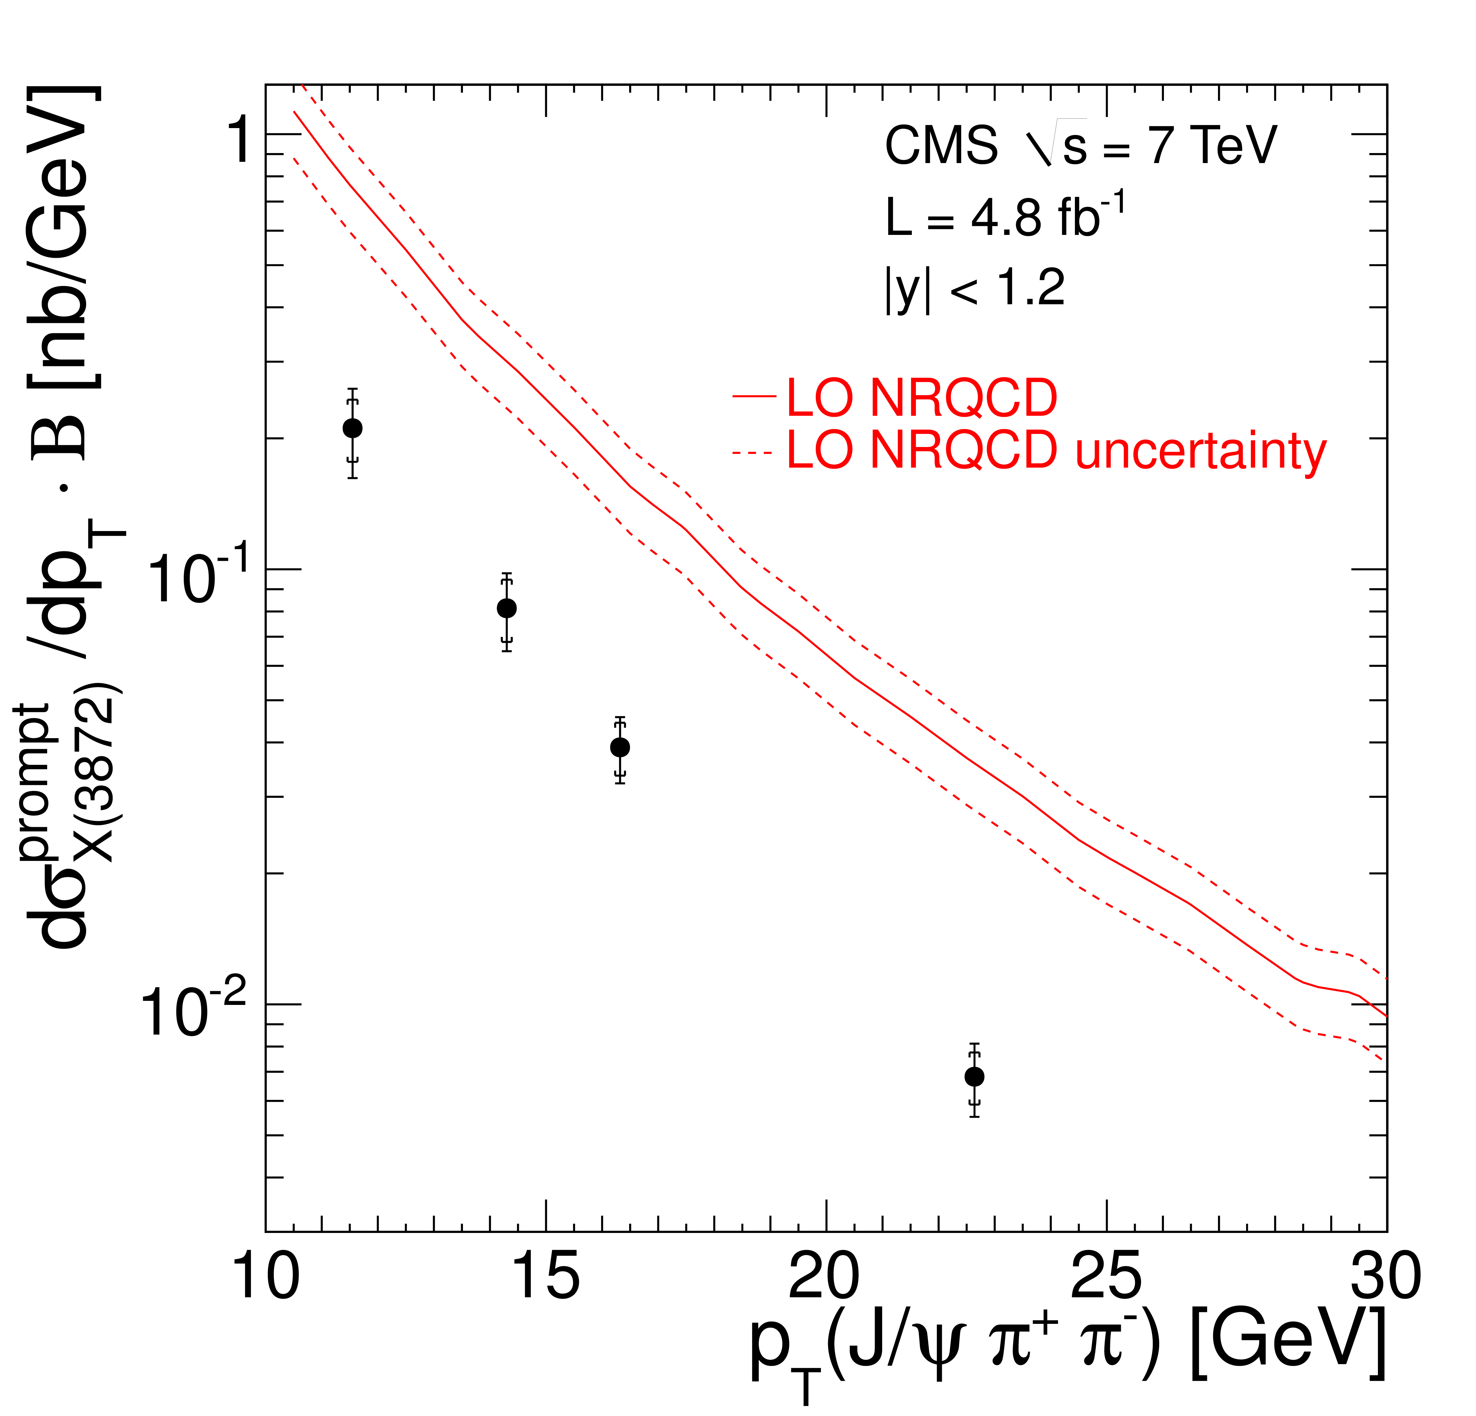
$X(3872)$
Large prompt production at hadron colliders
$$σ_{B}/σ_{TOT}=\left(26.3±2.3±1.6\right)\%$$
$$σ_{PR}×B(X→J/ψππ)=\left(1.06±0.11±0.15\right) \text{nb}$$
CMS, JHEP 1304, 154
A. Pilloni – Exotic hadron spectroscopy

Slide 7
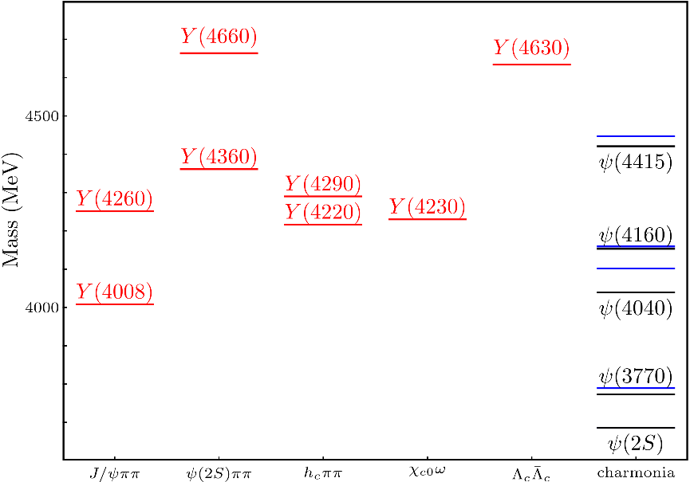
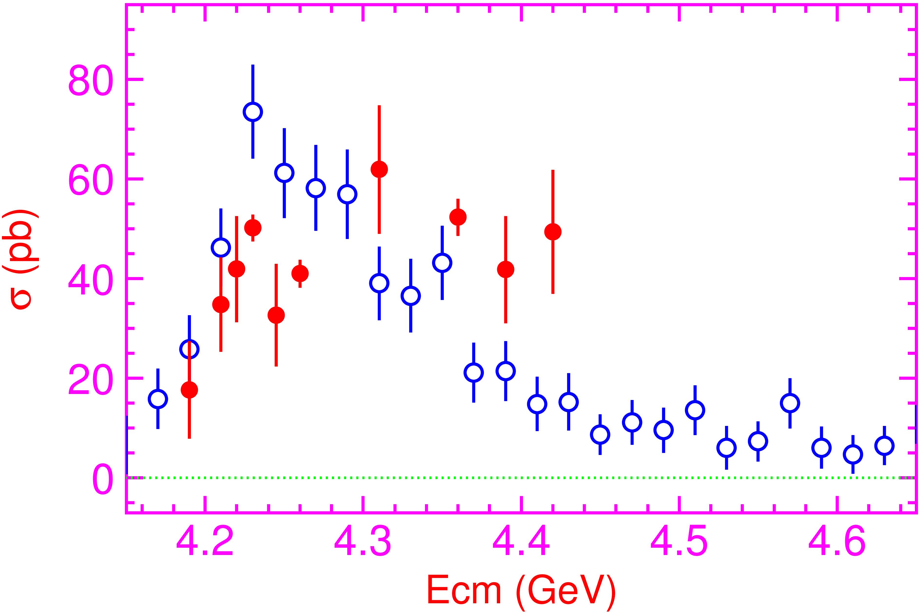
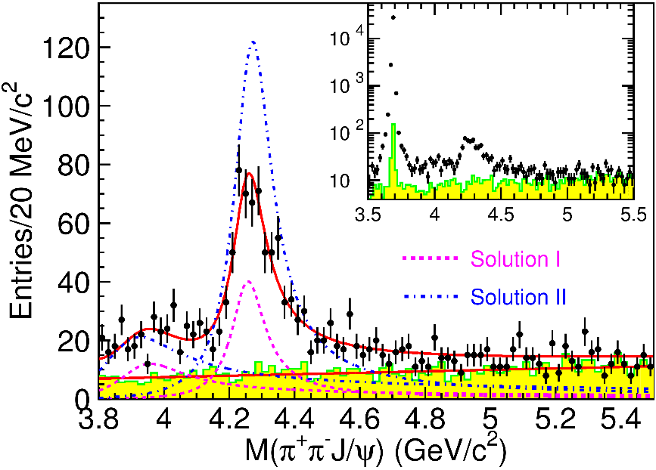
Vector $Y$ states
Lots of unexpected ${J^{PC}=1}^{−−}$ states found in ISR/direct production (and nowhere else!)
Seen in few final states, mostly $J/ψ ππ$ and $ψ\left(2S\right) ππ$
Not seen decaying into open charm pairs
Large HQSS violation
Belle $J/ψππ$
BES $h_{c}ππ$
A. Pilloni – Exotic hadron spectroscopy
Notes:
Y(4260), M=4263 +- 5, Gamma = 95+-14
D_1(2420)^0, M=2421.3 ±0.6, Gamma =27.1 ±2.7
D_1(2420)^+-, M=2423.4 ±3.1, Gamma =25 ±6
I D_1 hanno J^P = 1^+
La molecola D_1 D sta 22 MeV sotto
Se la Y è D_1 D, il pione lega fortemente, come fa la Y a essere così larga?
Come funziona lo scambio del pione???

Slide 8
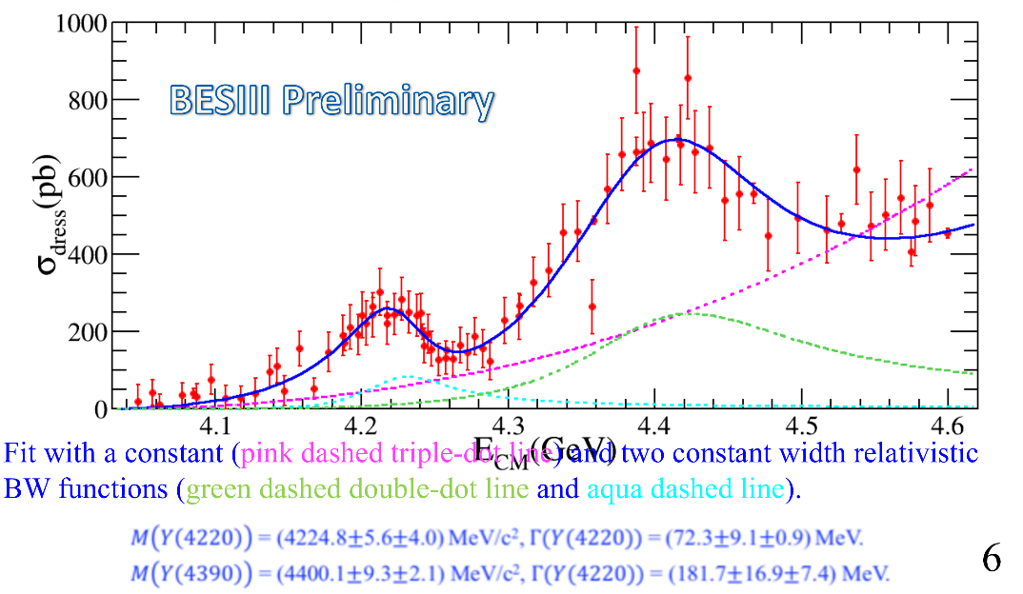
Vector $Y$ states in BESIII
BESIII, PRL118, 092002 (2017)
BESIII, PRL118, 092001 (2017)
$$e^{+}e^{−}→J/ψ ππ$$
New BESIII data show a peculiar lineshape for the $Y(4260)$
The state appear lighter and narrower, compatible with the ones in $h_{c}ππ$ and $χ_{c0}ω$
A broader old-fashioned $Y(4260)$ is appearing in $\overline{D}D^{∗}π$, maybe indicating a ${\overline{D}D}_{1}$
dominance
$$e^{+}e^{−}→π^{+}D^{0}D^{∗−}$$
A. Pilloni – Exotic hadron spectroscopy
Notes:
Y(4260), M=4263 +- 5, Gamma = 95+-14
D_1(2420)^0, M=2421.3 ±0.6, Gamma =27.1 ±2.7
D_1(2420)^+-, M=2423.4 ±3.1, Gamma =25 ±6
I D_1 hanno J^P = 1^+
La molecola D_1 D sta 22 MeV sotto
Se la Y è D_1 D, il pione lega fortemente, come fa la Y a essere così larga?
Come funziona lo scambio del pione???
Close propone che la Y è D_1 D^* col pione scambiato in onda S,
La Y però non va in Ds come se fosse tetraquark

Slide 9
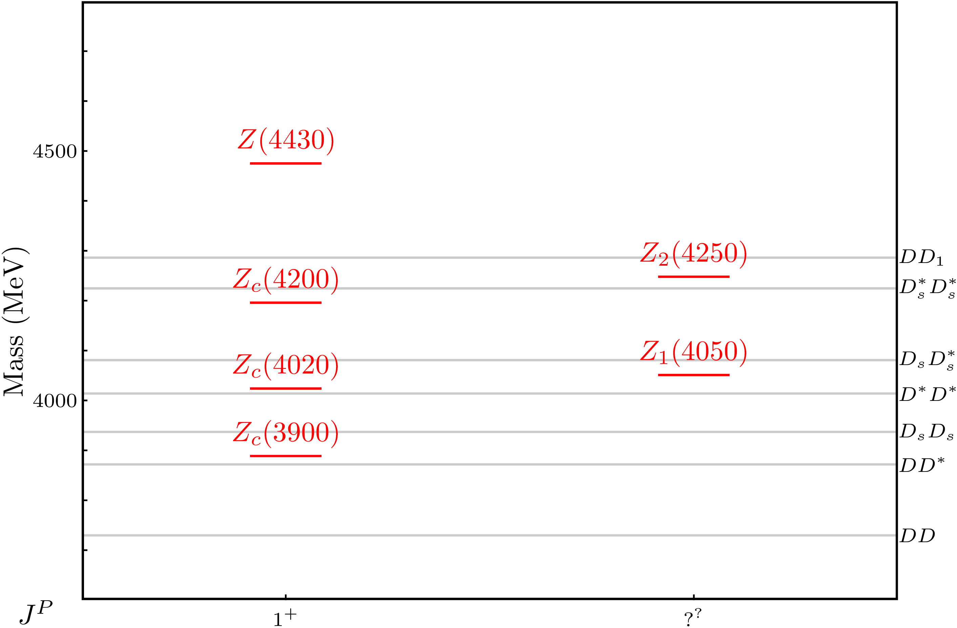
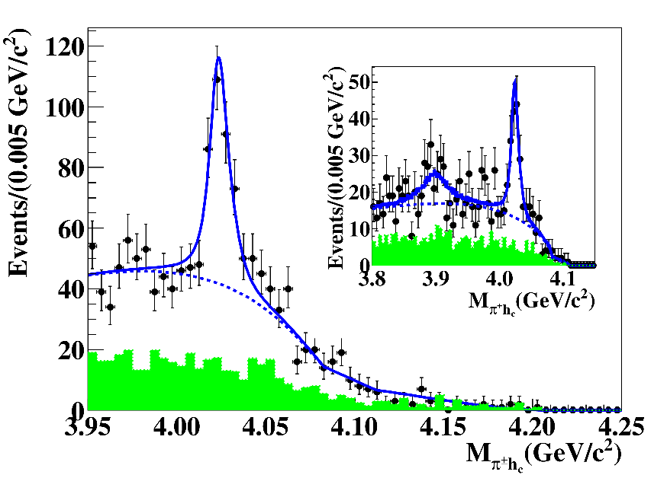
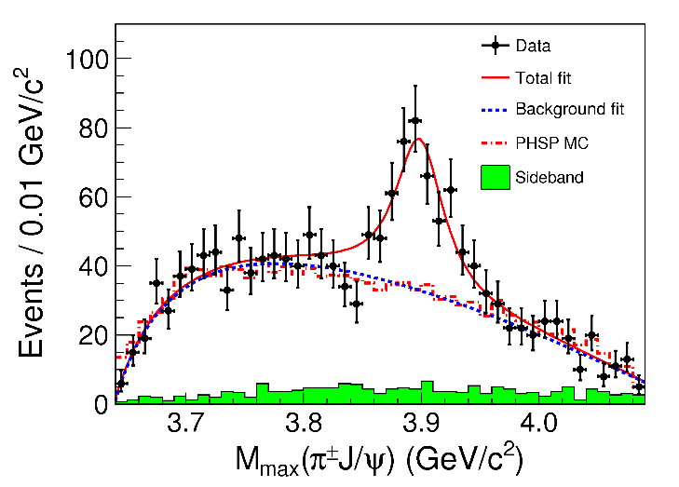
Charged $Z$ states: $Z_{c}\left(3900\right), Z_{c}^{′}(4020)$
Charged quarkonium-like resonances have been found, 4q needed
Two states $J^{PC}=1^{+−}$ appear slightly above $D^{(∗)}D^{∗}$ thresholds
$e^{+}e^{−}→Z_{c}{\left(3900\right)}^{+}π^{−}→J/ψ{ π}^{+}π^{−}$ and $→{\left(DD^{∗}\right)}^{+}π^{−}$ $M=3888.7±3.4$MeV, $Γ=35±7$ MeV
$e^{+}e^{−}→Z_{c}^{′}{\left(4020\right)}^{+}π^{−}→h_{c}{ π}^{+}π^{−}$ and $→{\overline{D}}^{∗0}D^{∗+}π^{−}$
$M=4023.9±2.4$MeV, $Γ=10±6$ MeV
A. Pilloni – Exotic hadron spectroscopy
Notes:
Y(4260), M=4263 +- 5, Gamma = 95+-14
D_1(2420)^0, M=2421.3 ±0.6, Gamma =27.1 ±2.7
D_1(2420)^+-, M=2423.4 ±3.1, Gamma =25 ±6
I D_1 hanno J^P = 1^+
La molecola D_1 D sta 22 MeV sotto
Se la Y è D_1 D, il pione lega fortemente, come fa la Y a essere così larga?
Come funziona lo scambio del pione???

Slide 10
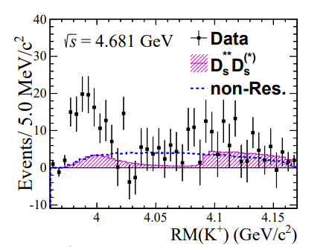
A Strange partner : $Z_{cs}\left(3985\right)$
A strange partner of the $Z_{c}\left(3900\right)$seems to appear in open charm decays
$$e^{+}e^{−}→Z_{cs}{\left(3985\right)}^{+}K^{−}→D_{s}^{+}\overline{D^{∗0}}{ K}^{−}$$ $M={3982.5}_{−2.6}^{+1.8}±2.1$MeV, $Γ={12.8}_{−4.4}^{+5.3}±3.0$ MeV
A. Pilloni – Exotic hadron spectroscopy
Notes:
Y(4260), M=4263 +- 5, Gamma = 95+-14
D_1(2420)^0, M=2421.3 ±0.6, Gamma =27.1 ±2.7
D_1(2420)^+-, M=2423.4 ±3.1, Gamma =25 ±6
I D_1 hanno J^P = 1^+
La molecola D_1 D sta 22 MeV sotto
Se la Y è D_1 D, il pione lega fortemente, come fa la Y a essere così larga?
Come funziona lo scambio del pione???

Slide 11
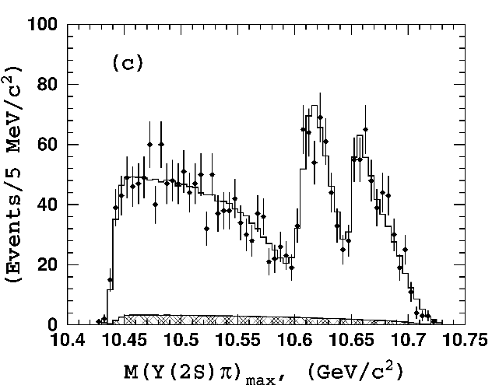
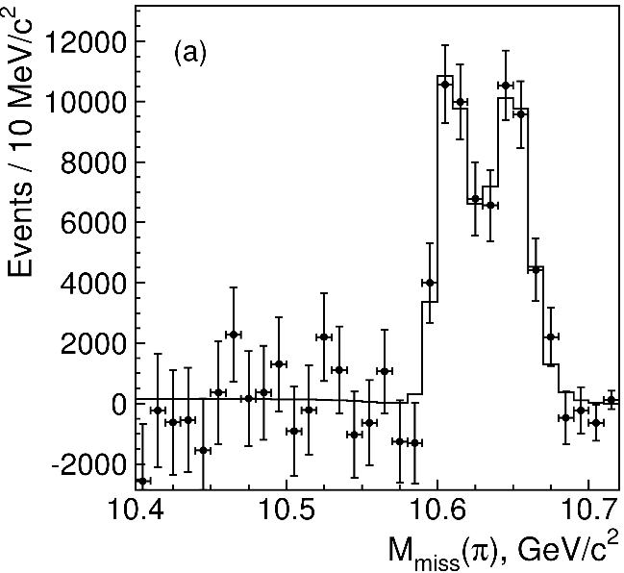
Charged $Z$ states: $Z_{b}\left(10610\right), Z_{b}^{′}(10650)$
Anomalous dipion width in $Υ\left(5S\right)$,
2 orders of magnitude larger than $Υ\left(nS\right)$
Moreover, observed $Υ\left(5S\right)→h_{b}\left(nP\right)ππ$ which violates HQSS
$Υ\left(5S\right)→Z_{b}{\left(10610\right)}^{+}π^{−}→Υ\left(nS\right){ π}^{+}π^{−},h_{b}\left(nP\right){ π}^{+}π^{−}$ and $→{\left(BB^{∗}\right)}^{+}π^{−}$ $M=10607.2±2.0$MeV, $Γ=18.4±2.4$ MeV
$Υ\left(5S\right)→Z_{b}^{′}{\left(10650\right)}^{+}π^{−}→Υ\left(nS\right){ π}^{+}π^{−},h_{b}\left(nP\right){ π}^{+}π^{−}$ and $→{\overline{B}}^{∗0}B^{∗+}π^{−}$
$M=10652.2±1.5$MeV, $Γ=11.5±2.2$ MeV
2 twin resonances!
A. Pilloni – Exotic hadron spectroscopy
Notes:
Y(4260), M=4263 +- 5, Gamma = 95+-14
D_1(2420)^0, M=2421.3 ±0.6, Gamma =27.1 ±2.7
D_1(2420)^+-, M=2423.4 ±3.1, Gamma =25 ±6
I D_1 hanno J^P = 1^+
La molecola D_1 D sta 22 MeV sotto
Se la Y è D_1 D, il pione lega fortemente, come fa la Y a essere così larga?
Come funziona lo scambio del pione???

Slide 12
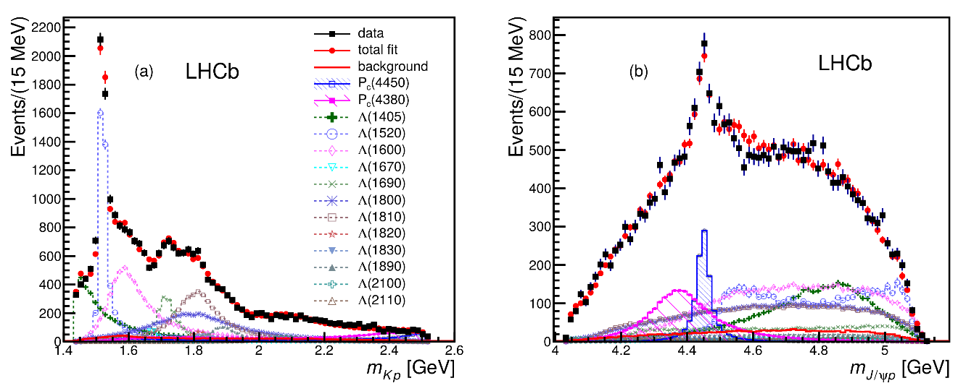
Pentaquarks!
LHCb, PRL 115, 072001
LHCb, PRL 117, 082003
Two states seen in $Λ_{b}→\left(J/ψ p\right) K^{−}$,
evidence in $Λ_{b}→\left(J/ψ p\right) π^{−}$
$$M_{1}=4380±8±29 \text{MeV} \\ Γ_{1}=205±18±86 \text{MeV}$$
$$M_{2}=4449.8±1.7±2.5 \text{MeV} \\ Γ_{2}=39±5±19 \text{MeV}$$
Quantum numbers $$J^{P}=\left({\frac{3}{2}}^{−},{\frac{5}{2}}^{+}\right) \text{or}\left({\frac{3}{2}}^{+},{\frac{5}{2}}^{−}\right)\text{or}\left({\frac{5}{2}}^{+},{\frac{3}{2}}^{−}\right)$$
Opposite parities needed for the interference to correctly describe angular distributions, low mass region contaminated by $Λ^{∗}$ (model dependence?)
No obvious threshold nearby
A. Pilloni – Exotic hadron spectroscopy
Notes:
Y(4260), M=4263 +- 5, Gamma = 95+-14
D_1(2420)^0, M=2421.3 ±0.6, Gamma =27.1 ±2.7
D_1(2420)^+-, M=2423.4 ±3.1, Gamma =25 ±6
I D_1 hanno J^P = 1^+
La molecola D_1 D sta 22 MeV sotto
Se la Y è D_1 D, il pione lega fortemente, come fa la Y a essere così larga?
Come funziona lo scambio del pione???

Slide 13
New pentaquarks discovered
LHCb, PRL 122, 222001
A higher statistics 1D analysis is able to resolve the fine structure of the $P_{c}(4450)$ peak.
Moreover, a new isolated $P_{c}(4312)$ at the $Σ_{c}^{+}{\overline{D}}^{0}$ threshold appears
The old assignment of quantum numbers might be jeopardized by this new finding
A. Pilloni – Exotic hadron spectroscopy
Notes:
Controlla la parte su Regge

Slide 14
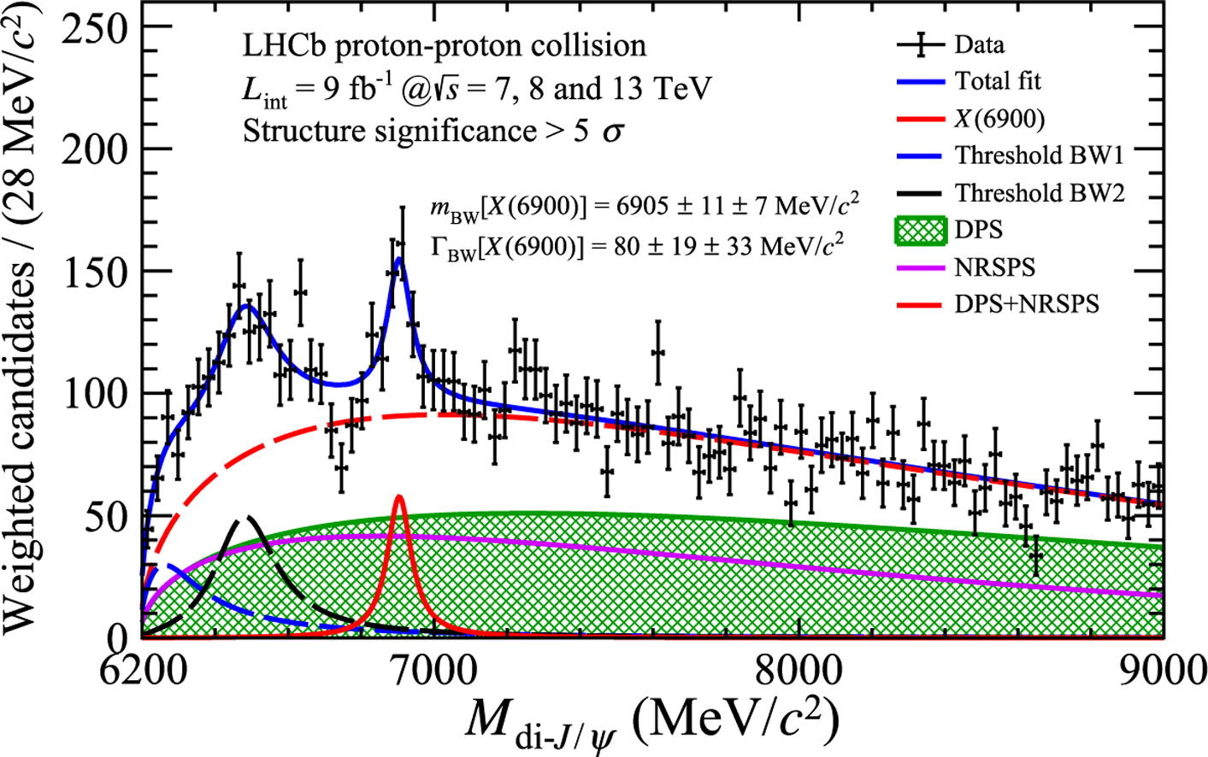
Fully charm: the $X(6900)$
Two structures are seen in the $J/ψ J/ψ$ spectrum
The heavier one is narrower and well assessed
The nature of the lighter one is unclear
A. Pilloni – Exotic hadron spectroscopy
Notes:
Y(4260), M=4263 +- 5, Gamma = 95+-14
D_1(2420)^0, M=2421.3 ±0.6, Gamma =27.1 ±2.7
D_1(2420)^+-, M=2423.4 ±3.1, Gamma =25 ±6
I D_1 hanno J^P = 1^+
La molecola D_1 D sta 22 MeV sotto
Se la Y è D_1 D, il pione lega fortemente, come fa la Y a essere così larga?
Come funziona lo scambio del pione???

Slide 15
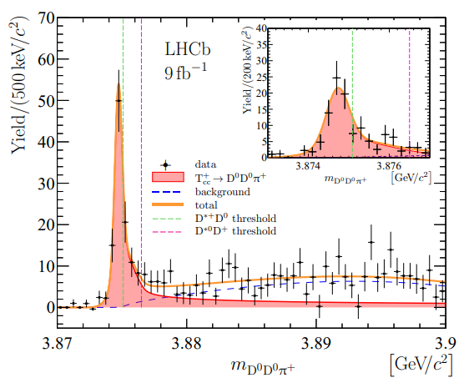
Very open charm: the $T_{cc}^{+}$
A supernarrow state is seen at the $D^{∗+}D^{0}$ threshold
BW parameters give
$δm_{BW}=−273±61 \text{keV}$
$Γ_{BW}=410±65 \text{keV}$
It cannot mix with ordinary charmonia It does not have lighter open channels
A. Pilloni – Exotic hadron spectroscopy
Notes:
Y(4260), M=4263 +- 5, Gamma = 95+-14
D_1(2420)^0, M=2421.3 ±0.6, Gamma =27.1 ±2.7
D_1(2420)^+-, M=2423.4 ±3.1, Gamma =25 ±6
I D_1 hanno J^P = 1^+
La molecola D_1 D sta 22 MeV sotto
Se la Y è D_1 D, il pione lega fortemente, come fa la Y a essere così larga?
Come funziona lo scambio del pione???

Slide 16
Broad exotics in $B$ decays
Lots of new exotics have been seen by LHCb with multidimensional amplitude analyses of $B→$ 3+ body
Most of these are broad, and the precise determination can crucially depend on the amplitude model, so that the resonant nature cannot be assessed with the same strong statements as for the narrow guys
A. Pilloni – Exotic hadron spectroscopy
Notes:
Y(4260), M=4263 +- 5, Gamma = 95+-14
D_1(2420)^0, M=2421.3 ±0.6, Gamma =27.1 ±2.7
D_1(2420)^+-, M=2423.4 ±3.1, Gamma =25 ±6
I D_1 hanno J^P = 1^+
La molecola D_1 D sta 22 MeV sotto
Se la Y è D_1 D, il pione lega fortemente, come fa la Y a essere così larga?
Come funziona lo scambio del pione???

Slide 17
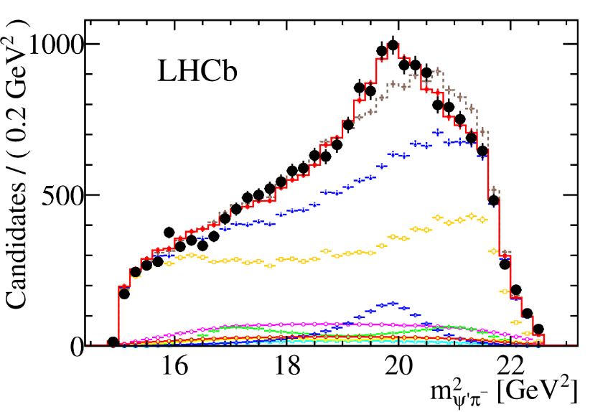
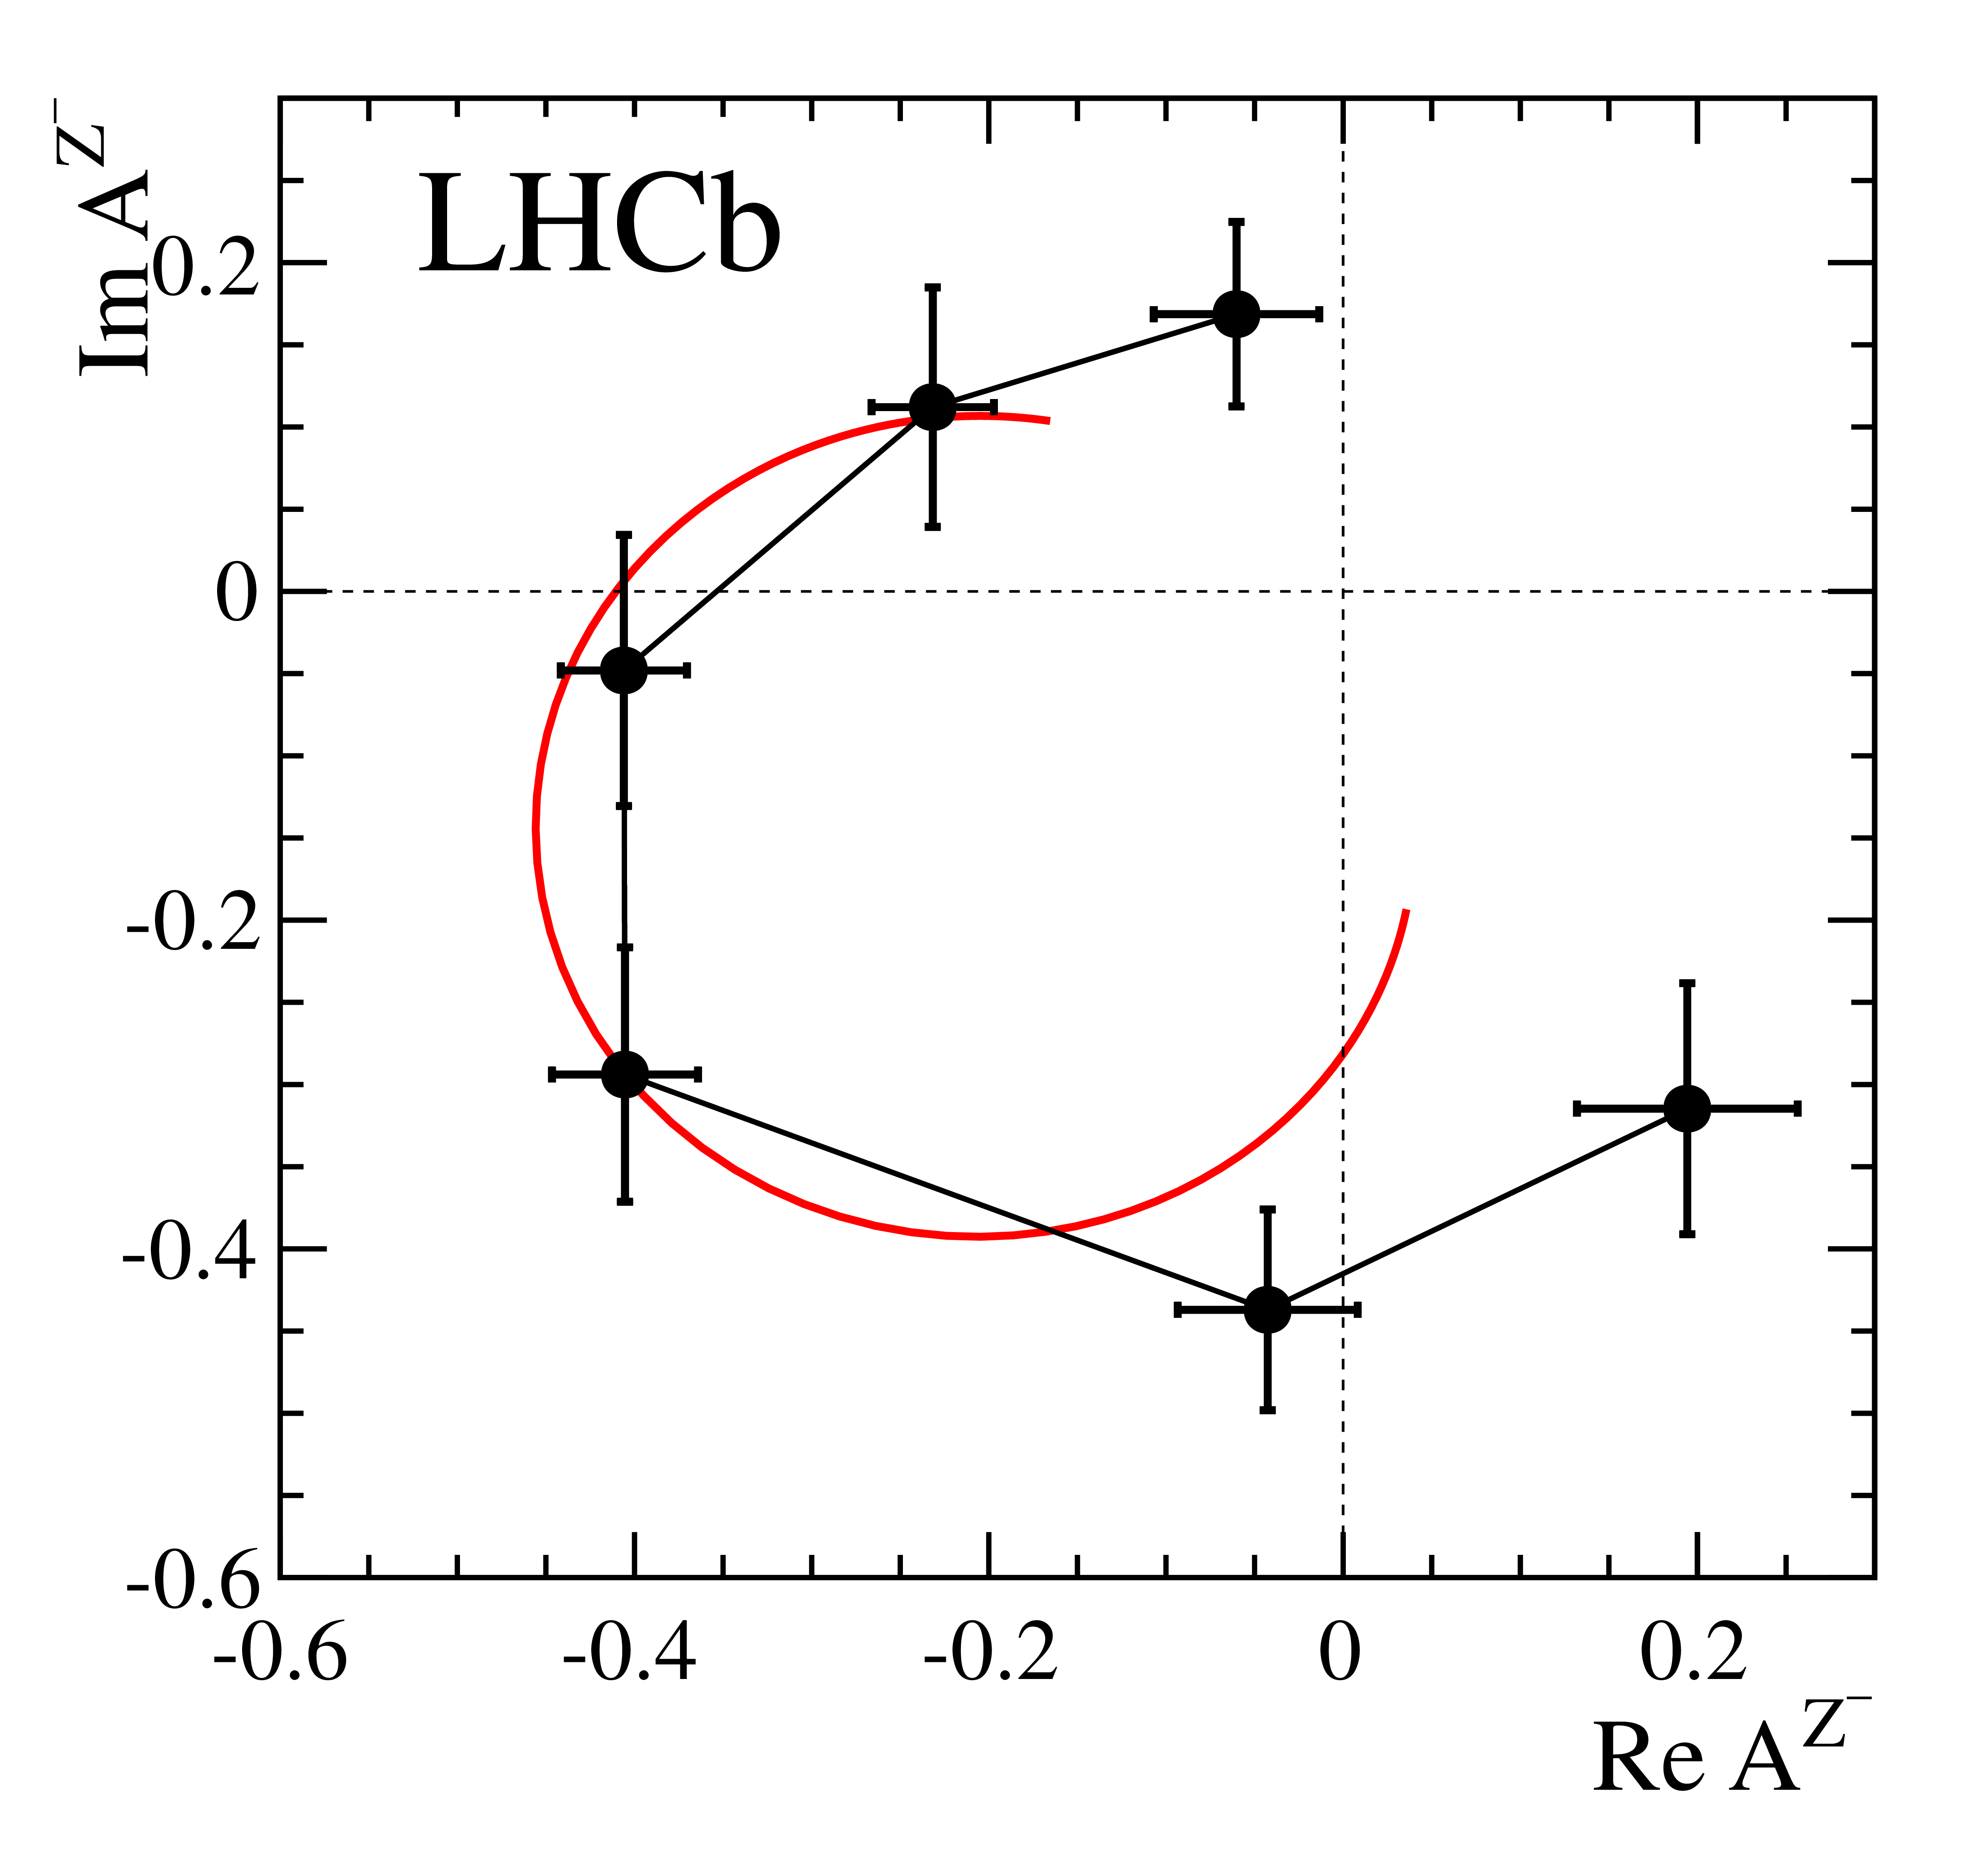
Charged $Z$ states: $Z(4430)$
$$Z{\left(4430\right)}^{+}→ψ(2S){ π}^{+} \\ {I^{G}J}^{PC}=1^{+}1^{+−}$$
$M=4475±7_{−25}^{+15}$MeV
$Γ=172±{13}_{−34}^{+37}$MeV
Far from open charm thresholds
If the amplitude is a free complex number, in each bin of $m_{ψ^{′}π^{−}}^{2}$, the resonant behaviour appears as well
A. Pilloni – Exotic hadron spectroscopy
Notes:
Y(4260), M=4263 +- 5, Gamma = 95+-14
D_1(2420)^0, M=2421.3 ±0.6, Gamma =27.1 ±2.7
D_1(2420)^+-, M=2423.4 ±3.1, Gamma =25 ±6
I D_1 hanno J^P = 1^+
La molecola D_1 D sta 22 MeV sotto
Se la Y è D_1 D, il pione lega fortemente, come fa la Y a essere così larga?
Come funziona lo scambio del pione???

Slide 18
Tetraquarks: the $B^{+}→J/ψ φ K^{+}$ decay
$$\text{In} J/ψ φ: \left\{\begin{aligned}\text{1}× 1^{−+} \\ \text{2}× 0^{++} \\ 3× 1^{++}\end{aligned}\right.$$
$$In J/ψ K^{+}:2×1^{+}$$
Widths from 50 to 230 MeV
A. Pilloni – Exotic hadron spectroscopy
Notes:
Y(4260), M=4263 +- 5, Gamma = 95+-14
D_1(2420)^0, M=2421.3 ±0.6, Gamma =27.1 ±2.7
D_1(2420)^+-, M=2423.4 ±3.1, Gamma =25 ±6
I D_1 hanno J^P = 1^+
La molecola D_1 D sta 22 MeV sotto
Se la Y è D_1 D, il pione lega fortemente, come fa la Y a essere così larga?
Come funziona lo scambio del pione???
Close propone che la Y è D_1 D^* col pione scambiato in onda S,
La Y però non va in Ds come se fosse tetraquark

Slide 19
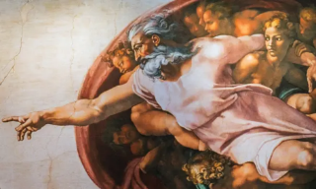
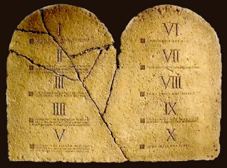
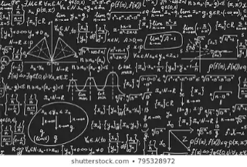
How to proceed?
Top-down: you study models, and verify predictions
Bottom-up: you study data (lineshapes), and try and infer the physics
$$f(s)$$
A. Pilloni – Exotic hadron spectroscopy
Notes:
Y(4260), M=4263 +- 5, Gamma = 95+-14
D_1(2420)^0, M=2421.3 ±0.6, Gamma =27.1 ±2.7
D_1(2420)^+-, M=2423.4 ±3.1, Gamma =25 ±6
I D_1 hanno J^P = 1^+
La molecola D_1 D sta 22 MeV sotto
Se la Y è D_1 D, il pione lega fortemente, come fa la Y a essere così larga?
Come funziona lo scambio del pione???

Slide 20
Models
Meson/Baryon+continuum
Ferretti et al., PRC88, 015207
Ferretti et al., PRD90, 094022
Ferretti et al., 1806.02489
Diquark-Antidiquark
Maiani, et al. PRD71, 014028
Faccini, AP, et al. PRD87, 111102
Maiani, et al. PRD89, 114010
Maiani, et al., PLB778, 247
Hybrids/BO tetraquarks
Kou and Pene, PLB631, 164
Braaten, PRL111, 162003
Berwein et al., PRD92, 114019
Kinematical effects
Szczepaniak, PLB747, 410
Szczepaniak, PLB757, 61
Guo et al., PRD92, 071502
Swanson, IJMPE25, 1642010
Molecule
Tornqvist, Z.Phys. C61, 525
Braaten and Kusunoki, PRD69 074005
Swanson, Phys.Rept. 429 243-305
Hadroquarkonium
Dubynskiy et al., PLB 666, 344
Dubynskiy and Voloshin, PLB 671, 82
Li and Voloshin, MPLA29, 1450060
+ Lattice + Functional methods
$$π$$
$$π$$
$$J/ψ$$
$$π$$
A. Pilloni – Exotic hadron spectroscopy

Slide 21
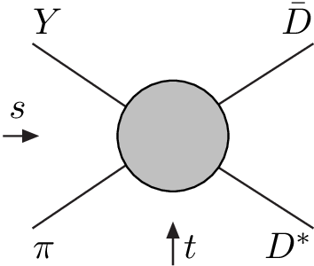
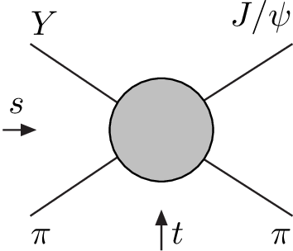
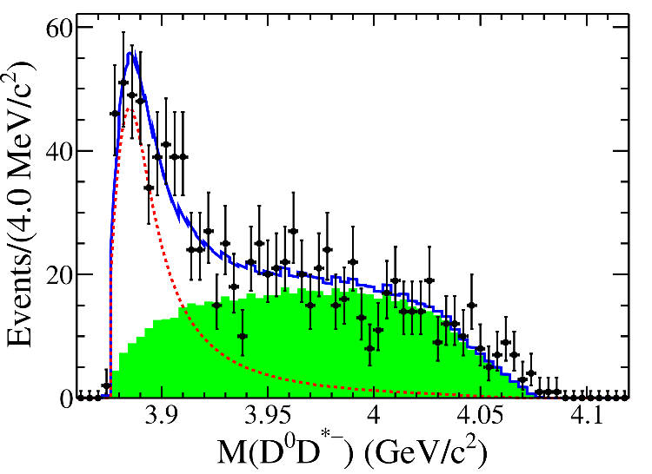
Amplitude analysis for $Z_{c}(3900)$
One can test different parametrizations of the amplitude, different singularities → different natures
AP et al. (JPAC), PLB772, 200
A. Pilloni – Exotic hadron spectroscopy
Notes:
Controlla la parte su Regge

Slide 22
Amplitude model
$$Z_{c}\left(3900\right)?$$
$${u: D}_{0}(2400)$$
$${u:Z}_{c}\left(3900\right)?$$
$$"σ, f_{0}(980)"$$
$$D_{1}(2420)$$
Logarithmic branch points simulate resonant behavior, only in special kinematics
Coleman and Norton, Nuovo Cim. 38, 438
Schmid, Phys.Rev. 154, 1363
Szczepaniak, PLB747, 410-416
Szczepaniak, PLB757, 61-64
Guo, Nucl.Phys.Rev.37, 406
$$π$$
Isobars
Rescattering
$$D_{1}$$
$$Y(4260)$$
$$D^{∗}$$
$$π$$
$$\overline{D}$$
$$J/ψ$$
Triangle singularity?
A. Pilloni – Exotic hadron spectroscopy

Slide 23
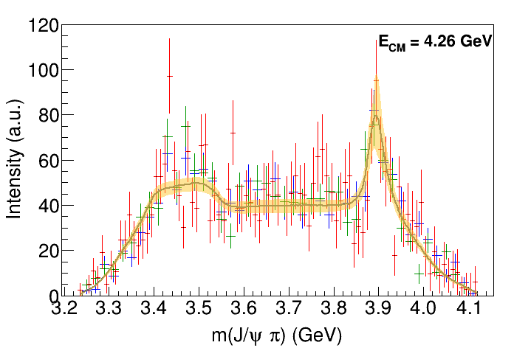
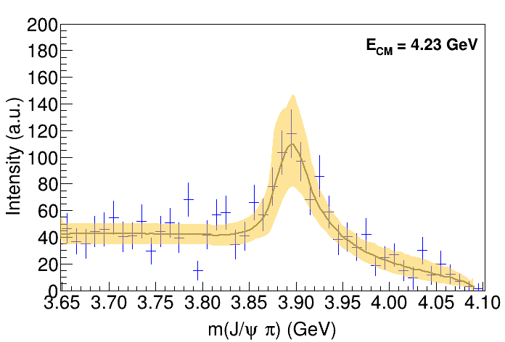
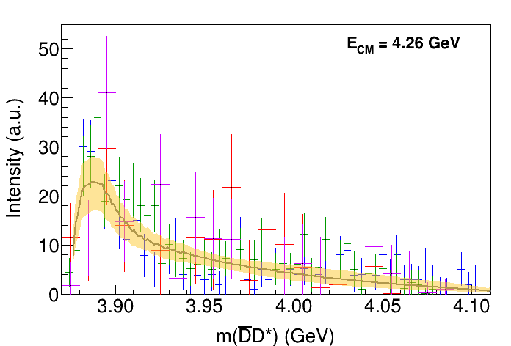
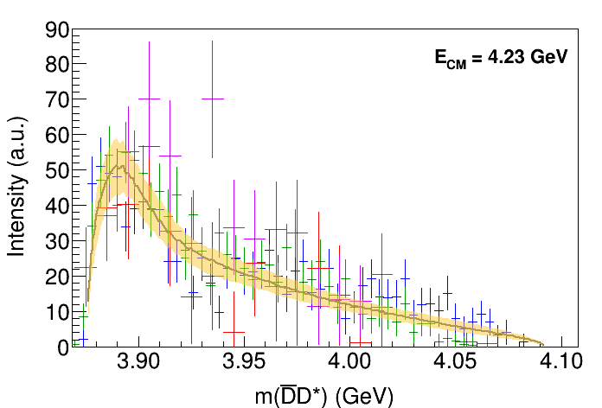
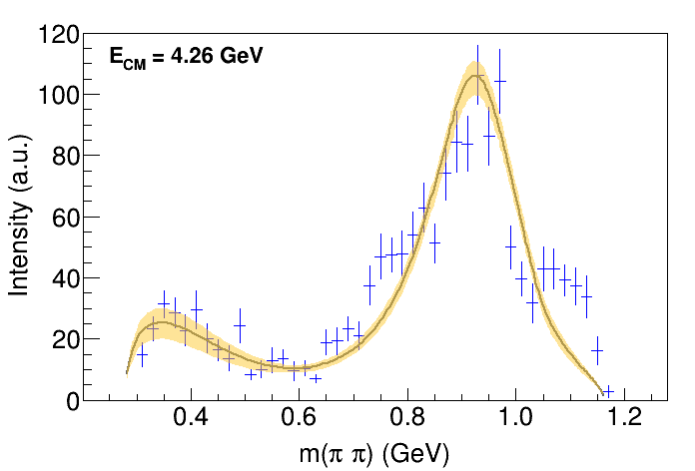
Fit: III
( data)
A. Pilloni – Exotic hadron spectroscopy
Notes:
Controlla la parte su Regge

Slide 24
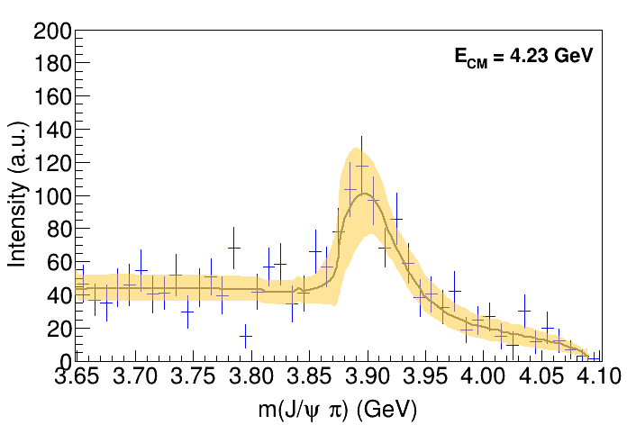
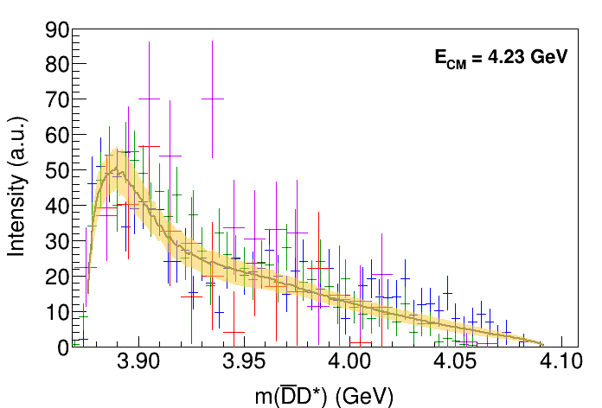
Fit: III+tr.
( data)
A. Pilloni – Exotic hadron spectroscopy
Notes:
Controlla la parte su Regge

Slide 25
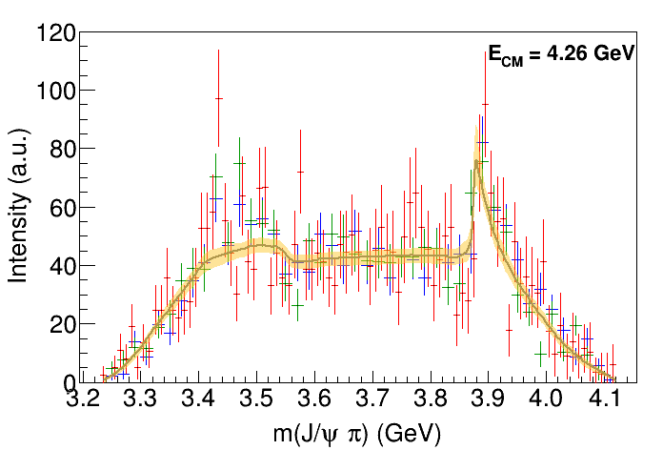
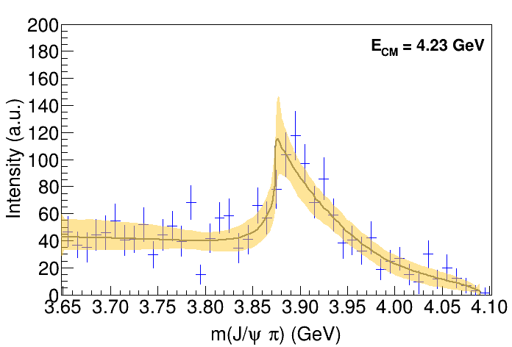
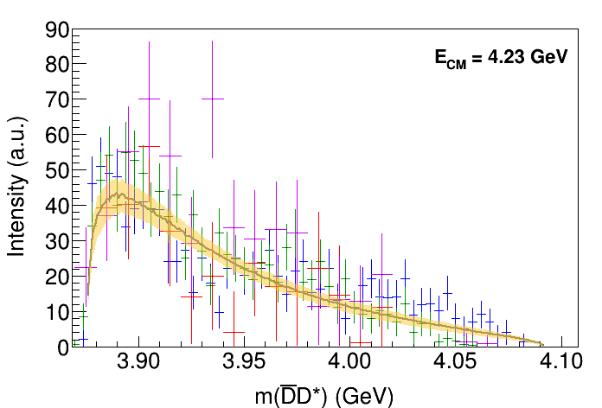
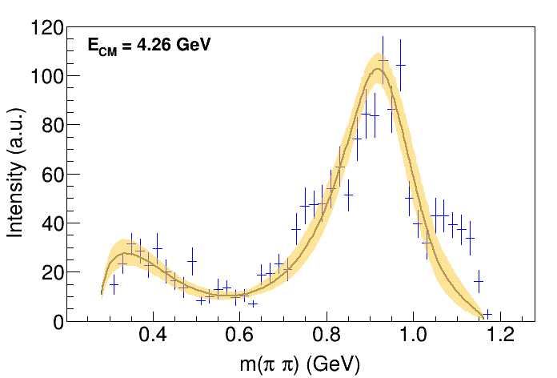
Fit: IV+tr.
( data)
A. Pilloni – Exotic hadron spectroscopy
Notes:
Controlla la parte su Regge

Slide 26
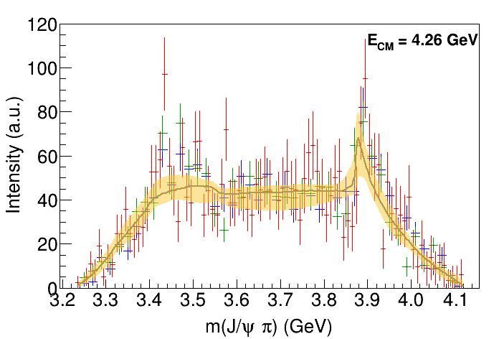
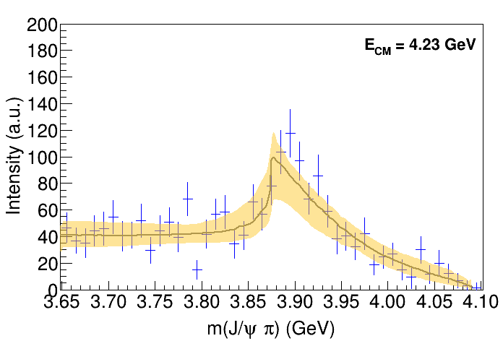
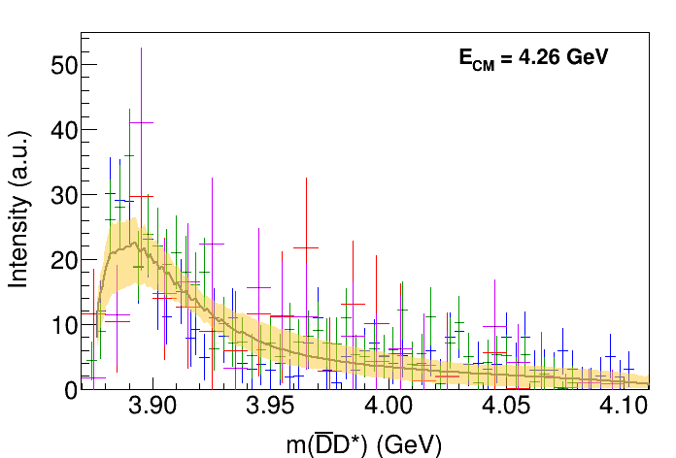
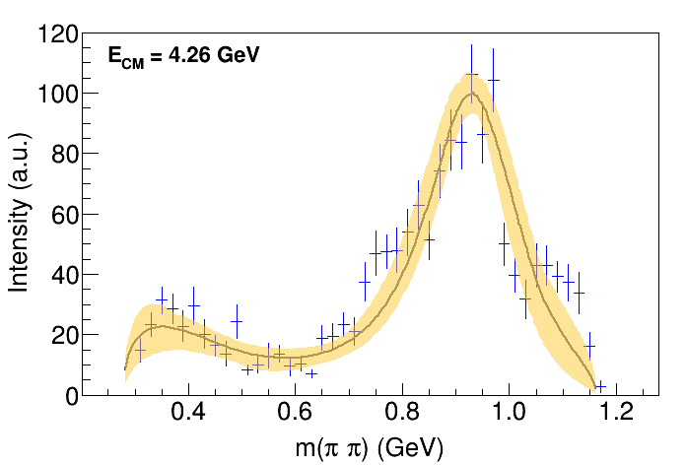
Fit: tr.
( data)
A. Pilloni – Exotic hadron spectroscopy
Notes:
Controlla la parte su Regge

Slide 27
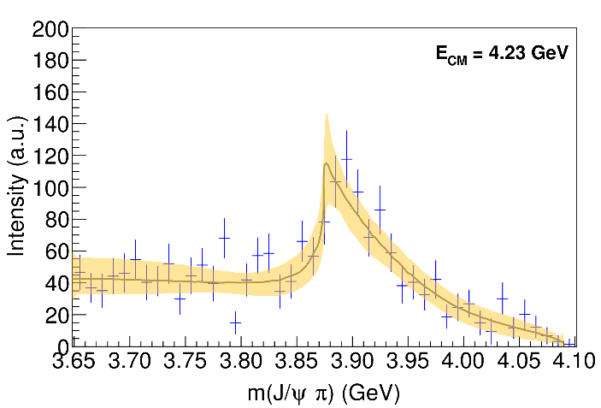
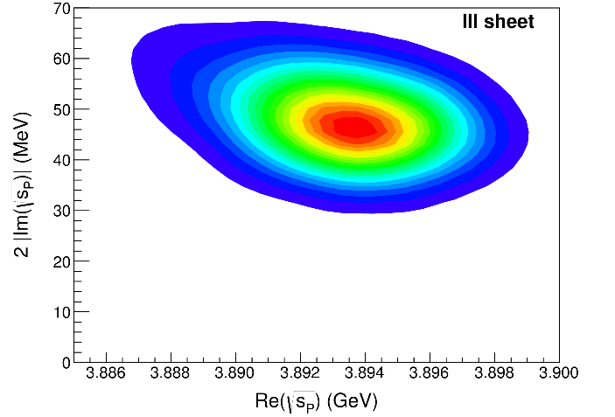
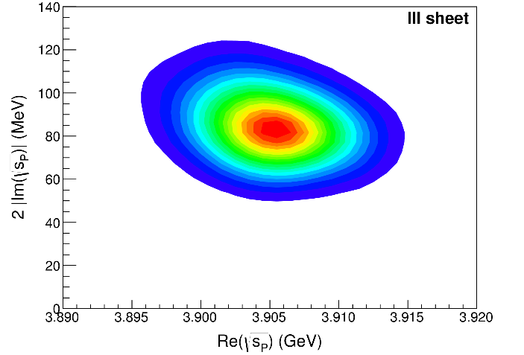
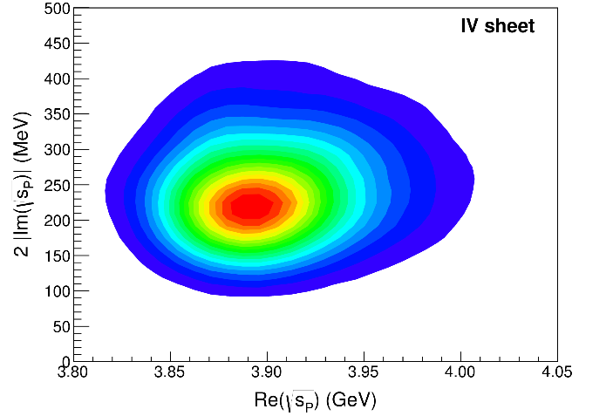
Pole extraction
III
III+tr.
IV+tr.
A. Pilloni – Exotic hadron spectroscopy
Not conclusive at this stage
Notes:
Controlla la parte su Regge

Slide 28
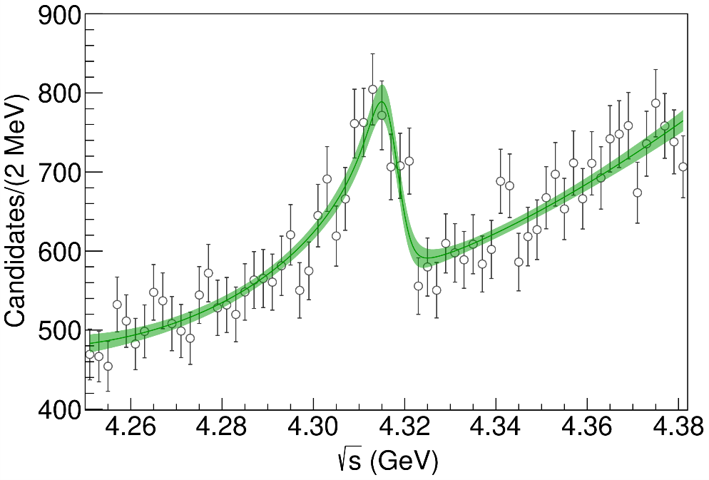
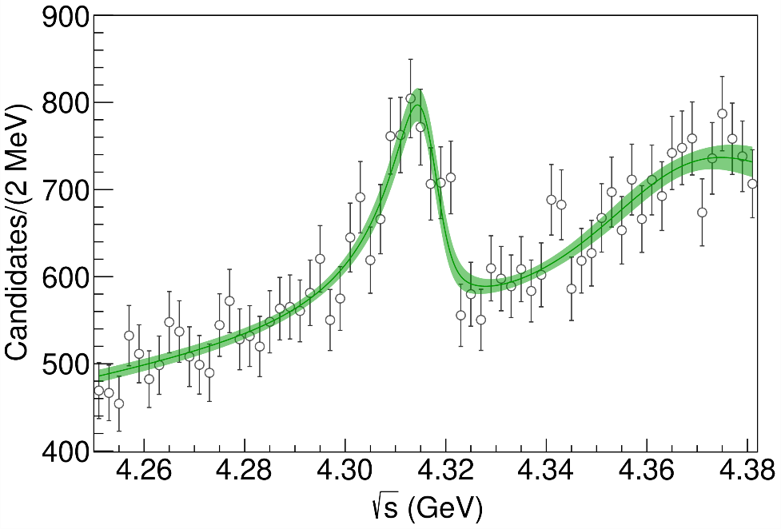
Minimal(istic) model for $P_{c}(4312)$
( data)
Fernandez-Ramirez, AP et al. (JPAC), PRL 123, 092001
Effective range expansion We can set $c_{ii}=0$ to reduce to the scattering length approximation
$$c_{ii}=0$$
Finite $c_{ii}$
A. Pilloni – Exotic hadron spectroscopy
Notes:
2 slides su Zc, a Bes e a Belle
2 slide su tetraquark model: dall’hamiltoniana di Jaffe al calcolo delle masse
1 slide su molecular models, dove sono i carichi? (non in Tornqvist, si in Hanhart, vedere Braaten, citare Nefediev)
2 slides su decay channels, dove si dovrebbe vedere, e a seconda del modello, vedere qualche plot
1 slide su Y(4260), tetraquark? C’è lo strano (si vede la f0)
1 slide su Zc a cleo (anche il neutro)

Slide 29
Minimal(istic) model for $P_{c}(4312)$
Effective range expansion We can set $c_{ii}=0$ to reduce to the scattering length approximation
$$c_{ii}=0$$
Finite $c_{ii}$
A. Pilloni – Exotic hadron spectroscopy
Notes:
2 slides su Zc, a Bes e a Belle
2 slide su tetraquark model: dall’hamiltoniana di Jaffe al calcolo delle masse
1 slide su molecular models, dove sono i carichi? (non in Tornqvist, si in Hanhart, vedere Braaten, citare Nefediev)
2 slides su decay channels, dove si dovrebbe vedere, e a seconda del modello, vedere qualche plot
1 slide su Y(4260), tetraquark? C’è lo strano (si vede la f0)
1 slide su Zc a cleo (anche il neutro)

Slide 30
Minimal(istic) model for $P_{c}(4312)$
Effective range expansion We can set $c_{ii}=0$ to reduce to the scattering length approximation
Points to a virtual state
$$c_{ii}=0$$
Finite $c_{ii}$
A. Pilloni – Exotic hadron spectroscopy
Notes:
2 slides su Zc, a Bes e a Belle
2 slide su tetraquark model: dall’hamiltoniana di Jaffe al calcolo delle masse
1 slide su molecular models, dove sono i carichi? (non in Tornqvist, si in Hanhart, vedere Braaten, citare Nefediev)
2 slides su decay channels, dove si dovrebbe vedere, e a seconda del modello, vedere qualche plot
1 slide su Y(4260), tetraquark? C’è lo strano (si vede la f0)
1 slide su Zc a cleo (anche il neutro)

Slide 31
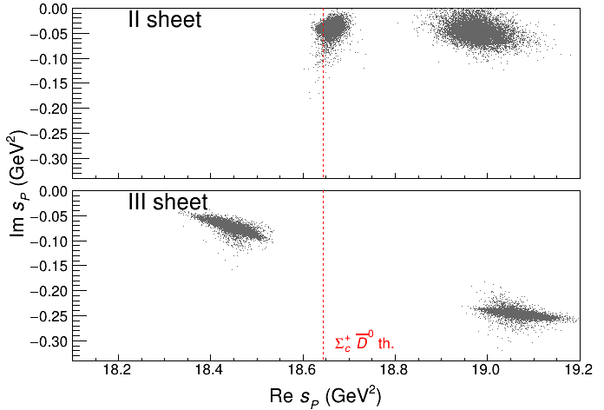
Minimal(istic) model for $P_{c}(4312)$
Effective range expansion We can set $c_{ii}=0$ to reduce to the scattering length approximation
Points to a virtual state
Doesn’t point to a resonance
$$c_{ii}=0$$
Finite $c_{ii}$
A. Pilloni – Exotic hadron spectroscopy
Notes:
2 slides su Zc, a Bes e a Belle
2 slide su tetraquark model: dall’hamiltoniana di Jaffe al calcolo delle masse
1 slide su molecular models, dove sono i carichi? (non in Tornqvist, si in Hanhart, vedere Braaten, citare Nefediev)
2 slides su decay channels, dove si dovrebbe vedere, e a seconda del modello, vedere qualche plot
1 slide su Y(4260), tetraquark? C’è lo strano (si vede la f0)
1 slide su Zc a cleo (anche il neutro)

Slide 32
Minimal(istic) model for $P_{c}(4312)$
Effective range expansion We can set $c_{ii}=0$ to reduce to the scattering length approximation
Points to a virtual state
Doesn’t point to a resonance
$$c_{ii}=0$$
Finite $c_{ii}$
A. Pilloni – Exotic hadron spectroscopy
Notes:
2 slides su Zc, a Bes e a Belle
2 slide su tetraquark model: dall’hamiltoniana di Jaffe al calcolo delle masse
1 slide su molecular models, dove sono i carichi? (non in Tornqvist, si in Hanhart, vedere Braaten, citare Nefediev)
2 slides su decay channels, dove si dovrebbe vedere, e a seconda del modello, vedere qualche plot
1 slide su Y(4260), tetraquark? C’è lo strano (si vede la f0)
1 slide su Zc a cleo (anche il neutro)

Slide 33
The lineshape of the $X(3872)$
Blue line is $D^{0}\overline{D^{∗0}}$,
$D^{+}D^{∗−}$ is $δ=8.2 \text{MeV}$
heavier
Because of experimental resolution, different lineshapes are indistinguishable
Unitary parametrizations tend to be narrower, $Γ_{BW}=1.39±0.24±0.10 \text{MeV}$, $Γ_{fl}={0.22}_{−0.06−0.13}^{+0.07+0.11} \text{MeV}$
A. Pilloni – Exotic hadron spectroscopy
Notes:
Controlla la parte su Regge

Slide 34
The lineshape of the $X(3872)$
Esposito, Maiani, AP, Polosa, Riquer, PRD 105 (2022) 3, L031503
LHCb data is fitted with the Flatte’ parametrization
The $D^{0}\overline{D^{∗0}}$ threshold
Two options: a) I set $δ=0$ b) I expand at threshold
The $D^{+}D^{∗−}$ threshold
The $J/ψ ρ,ω,$ and other unknown channels
This considers coupled channel, but Weinberg’s criterion applies to single channel bound states only
A. Pilloni – Exotic hadron spectroscopy
Notes:
Controlla la parte su Regge

Slide 35
The lineshape of the $X(3872)$
Esposito, Maiani, AP, Polosa, Riquer, PRD 105 (2022) 3, L031503
Option b)
Option a)
According to Weinberg’s, the first result points to a sizeable short-range structure of the X(3872)
Still disagreement on how to perform the extraction though
A. Pilloni – Exotic hadron spectroscopy
Notes:
Controlla la parte su Regge

Slide 36
An Electron Ion Collider @BNL
A. Pilloni – Exotic hadron spectroscopy

Slide 37
Exclusive (quasi-real) photoproduction
XYZ have so far not been seen in photoproduction: independent confirmation
Not affected by 3-body dynamics: determination of resonant nature
Experiments with high luminosity in the appropriate energy range are promising
We study near-threshold (LE) and high energies (HE)
Couplings extracted from data as much as possible, not relying on the nature of XYZ
M. Albaladejo et al. [JPAC], PRD
$$<λ_{𝒬}λ_{N}^{′}|T|λ_{γ}λ_{N}>=\underset{V,ℰ}{∑}\frac{ef_{V}}{m_{V}}𝒯_{λ_{V}=λ_{γ},λ_{𝒬}}^{α_{1}⋯α_{j}}𝒫_{α_{1}⋯α_{j};β_{1}⋯β_{j}}ℬ_{λ_{N}λ_{N}^{′}}^{β_{1}⋯β_{j}}$$
Bottom vertex from standard photoproduction pheno, exponential form factors to further suppress large t
VMD is used to couple the incoming photon to a vector quarkonium V
Top vertex from measured $𝒬→Vℰ$ decay width
A. Pilloni – Exotic hadron spectroscopy

Slide 38
$Z$ photoproduction
The $Zs$ are charged charmoniumlike $1^{+−}$ states close to open flavor thresholds
Focus on $Z_{c}{\left(3900\right)}^{+}→J/ψ π^{+}$, $Z_{b}{\left(10610\right)}^{+},Z_{b}^{′}{\left(10650\right)}^{+}→Υ(nS) π^{+}$
The pion is exchanged in the $t$-channel
Sizeable cross sections especially at LE
A. Pilloni – Exotic hadron spectroscopy

Slide 39
$X$ photoproduction
Focus on the famous $1^{++} X\left(3872\right)→J/ψ ρ,ω$
Studying also $X\left(6900\right)→J/ψ J/ψ$ (assumed $0^{++}$)
𝛚 and 𝛒 exchanges give main contributions: need to assume the existence of a OZI-suppressed $X\left(6900\right)→J/ψ ω$
Extremely suppressed cross sections at HE: LE most promising
A. Pilloni – Exotic hadron spectroscopy

Slide 40
$Y$ (vector) photoproduction
Diffractive production, dominated by Pomeron (2-gluon) exchange
Existing data allow to put a 95% upper limit on the ratio of $ψ′/Y(4260)$ yields
Assuming previous formula, one gets: $Γ_{ee}^{Y}=930 eV$
(cfr. hep-ex/0603024, 2002.05641)
$BR\left(Y→J/ψππ\right)=0.96\%$
$R_{Y}=0.84$
$$R_{Y}=\frac{ef_{ψ}}{m_{ψ}}\sqrt{\frac{g^{2}(Y→ψππ)}{g^{2}(ψ→γgg)}\frac{g^{2}(ψ^{′}→ψgg)}{g^{2}(ψ^{′}→ψππ)}}$$
A. Pilloni – Exotic hadron spectroscopy

Slide 41
$Y$ (vector) photoproduction
Diffractive production, dominated by Pomeron (2-gluon) exchange
Existing data allow to put a 95% upper limit on the ratio of $ψ′/Y(4260)$ yields
Assuming previous formula, one gets: $Γ_{ee}^{Y}=930 eV$
(cfr. hep-ex/0603024, 2002.05641)
$BR\left(Y→J/ψππ\right)=0.96\%$
$R_{Y}=0.84$
$$R_{Y}=\frac{ef_{ψ}}{m_{ψ}}\sqrt{\frac{g^{2}(Y→ψππ)}{g^{2}(ψ→γgg)}\frac{g^{2}(ψ^{′}→ψgg)}{g^{2}(ψ^{′}→ψππ)}}$$
A. Pilloni – Exotic hadron spectroscopy

Slide 42
Prompt production of $X(3872)$
However, the applicability of Watson theorem is challenged by the presence of pions that interfere with $DD^{∗}$ propagation
$$D^{∗}$$
$$π$$
$$π$$
(CDF acceptance)
$$π$$
$$π$$
$$π$$
$$\overline{D^{0}}$$
A solution can be FSI (rescattering of $DD^{∗}$), which allow $k_{max}$ to be as large as $5m_{π}$, $σ\left(p\overline{p}→DD^{∗}|k<k_{max}\right)≈230 \text{nb}$
Artoisenet and Braaten, PRD81, 114018
However, this is controversial because of the presence of comover that interfere with $DD^{∗}$ propagation
Bignamini et al. PLB684, 228-230
Esposito, Piccinini, AP, Polosa, JMP 4, 1569
Guerrieri, Piccinini, AP, Polosa, PRD90, 034003
$$σ_{MC}\left(p\overline{p}→DD^{∗}|k<k_{max}\right)≈0.1 \text{nb}$$
$σ_{exp}\left(p\overline{p}→X(3872)\right)≈30−70 \text{nb}$!!!
The comparison of production of other light nuclei suggests a different behavior
Esposito, Guerrieri, Maiani, Piccinini, AP, Polosa, Riquer, PRD92 (2015) 3, 034028
Bignamini et al. PRL103 (2009) 162001
A. Pilloni – Exotic hadron spectroscopy
Notes:
2 slides su Zc, a Bes e a Belle
2 slide su tetraquark model: dall’hamiltoniana di Jaffe al calcolo delle masse
1 slide su molecular models, dove sono i carichi? (non in Tornqvist, si in Hanhart, vedere Braaten, citare Nefediev)
2 slides su decay channels, dove si dovrebbe vedere, e a seconda del modello, vedere qualche plot
1 slide su Y(4260), tetraquark? C’è lo strano (si vede la f0)
1 slide su Zc a cleo (anche il neutro)

Slide 43
Multiplicity dependence
The $X(3872)$is more and more suppressed wrt $ψ(2S)$when more comovers are present Does it make the $X(3872)$a fragile molecule?
The $X(3872)$is more and more suppressed wrt $ψ(2S)$when more comovers are present Does it make the $X(3872)$a fragile molecule? No.
LHCb 2009.06619
Deuteron is a molecule, but it increases
CMS JHEP04(2014), 103
ALICE EPJC80, 9, 889
$Υ(2S)$ and $Υ\left(3S\right)$ are not molecules, but they decrease
$Υ(2S)$ and $Υ\left(3S\right)$ are not molecules, but they decrease
A. Pilloni – Exotic hadron spectroscopy
Notes:
2 slides su Zc, a Bes e a Belle
2 slide su tetraquark model: dall’hamiltoniana di Jaffe al calcolo delle masse
1 slide su molecular models, dove sono i carichi? (non in Tornqvist, si in Hanhart, vedere Braaten, citare Nefediev)
2 slides su decay channels, dove si dovrebbe vedere, e a seconda del modello, vedere qualche plot
1 slide su Y(4260), tetraquark? C’è lo strano (si vede la f0)
1 slide su Zc a cleo (anche il neutro)

Slide 44
The comover model
The interaction with final state comoving particles can help create/destroy a hadron
Baym PLB138, 18
For a compact state in 𝑝𝑝 collisions the number evolves following
hadron yield
destruction cross section
$$τ\frac{dN_{𝒬}}{dτ}=−⟨vσ⟩_{𝒬}ρ_{c}N_{𝒬}$$
comover density at initial time (Glauber model) $∝N_{ch}$
In the Comover Interaction Model one takes $⟨vσ⟩_{𝒬}∼πr_{𝒬}^{2}$
This has proved to be successful at describing 𝑝Pb and PbPb data
Ferreiro PLB749, 98
Ferreiro, Lansberg JHEP10(2018), 94
A. Pilloni – Exotic hadron spectroscopy
Notes:
2 slides su Zc, a Bes e a Belle
2 slide su tetraquark model: dall’hamiltoniana di Jaffe al calcolo delle masse
1 slide su molecular models, dove sono i carichi? (non in Tornqvist, si in Hanhart, vedere Braaten, citare Nefediev)
2 slides su decay channels, dove si dovrebbe vedere, e a seconda del modello, vedere qualche plot
1 slide su Y(4260), tetraquark? C’è lo strano (si vede la f0)
1 slide su Zc a cleo (anche il neutro)

Slide 45
Bottomonia & $X(3872)$
Further validate the model using CMS $pp$ data Using same cross sections as in 𝑝Pb and PbPb
Same model for a compact $X(3872)$
Esposito, Ferreiro, AP, Polosa, Salgado EPJC 81 (2021) 7, 669
A. Pilloni – Exotic hadron spectroscopy
Notes:
2 slides su Zc, a Bes e a Belle
2 slide su tetraquark model: dall’hamiltoniana di Jaffe al calcolo delle masse
1 slide su molecular models, dove sono i carichi? (non in Tornqvist, si in Hanhart, vedere Braaten, citare Nefediev)
2 slides su decay channels, dove si dovrebbe vedere, e a seconda del modello, vedere qualche plot
1 slide su Y(4260), tetraquark? C’è lo strano (si vede la f0)
1 slide su Zc a cleo (anche il neutro)

Slide 46
Deuteron in coalescence model
Solution of the evolution equation with recombination
$$\frac{N_{m}}{N_{h}}=\frac{{\left\langle vσ\right\rangle }_{m}}{{\left\langle vσ\right\rangle }_{m}+{\left\langle vσ\right\rangle }_{hh}}+\left(\frac{N_{m}^{0}}{N_{h}^{0}}−\frac{{\left\langle vσ\right\rangle }_{m}}{{\left\langle vσ\right\rangle }_{m}+{\left\langle vσ\right\rangle }_{hh}}\right)e^{−\left({\left\langle vσ\right\rangle }_{m}+{\left\langle vσ\right\rangle }_{hh}\right)ρ_{c}\ln\left(ρ_{c}/ρ_{c}^{pp}\right)}$$
Numbers of molecule at $t=0$,
$≈0$ in Pythia
The coalescence momentum for deuteron is known to be $Λ=50 ÷200 \text{MeV}$
Cross sections calculated from scattering of constituents
A. Pilloni – Exotic hadron spectroscopy
Notes:
2 slides su Zc, a Bes e a Belle
2 slide su tetraquark model: dall’hamiltoniana di Jaffe al calcolo delle masse
1 slide su molecular models, dove sono i carichi? (non in Tornqvist, si in Hanhart, vedere Braaten, citare Nefediev)
2 slides su decay channels, dove si dovrebbe vedere, e a seconda del modello, vedere qualche plot
1 slide su Y(4260), tetraquark? C’è lo strano (si vede la f0)
1 slide su Zc a cleo (anche il neutro)

Slide 47
$X(3872)$ again
The coalescence momentum for the $X(3872)$ is $Λ=30 ÷300 \text{MeV}$
Controversies for $N_{m}/N_{h}$: How is the 𝑋 produced?
Through ${\overline{D}}^{0}D^{∗0}$: $N_{m}/N_{h}≈0$
Through $χ_{c1}(2P)$: $N_{m}/N_{h}≈1$
The difference shown with a green band
A. Pilloni – Exotic hadron spectroscopy
Notes:
2 slides su Zc, a Bes e a Belle
2 slide su tetraquark model: dall’hamiltoniana di Jaffe al calcolo delle masse
1 slide su molecular models, dove sono i carichi? (non in Tornqvist, si in Hanhart, vedere Braaten, citare Nefediev)
2 slides su decay channels, dove si dovrebbe vedere, e a seconda del modello, vedere qualche plot
1 slide su Y(4260), tetraquark? C’è lo strano (si vede la f0)
1 slide su Zc a cleo (anche il neutro)

Slide 48
Conclusions
Lots of unexpected stuff happening!
Needs rigorous methods, as well as fantasy
Thank you
A. Pilloni – Exotic hadron spectroscopy
Notes:
2 slides su Zc, a Bes e a Belle
2 slide su tetraquark model: dall’hamiltoniana di Jaffe al calcolo delle masse
1 slide su molecular models, dove sono i carichi? (non in Tornqvist, si in Hanhart, vedere Braaten, citare Nefediev)
2 slides su decay channels, dove si dovrebbe vedere, e a seconda del modello, vedere qualche plot
1 slide su Y(4260), tetraquark? C’è lo strano (si vede la f0)
1 slide su Zc a cleo (anche il neutro)

Slide 49
Backup

Slide 50
A new look to $X(3872)$
Maiani, Polosa, Riquer PLB 778, 247
Size of the diquark-antidiquark bound state: $R$
Size of the diquark: $r$
There are two possible descriptions of the $X(3872)$
$$X_{u}=\left[cu\right][\overline{c}\overline{u}]$$
$$X_{d}=\left[cd\right][\overline{c}\overline{d}]$$
We introduce the ratio $λ=R/r≥1$
For appropriate values of $λ$, these two states can be quasi-degenerate in mass!
$$M(X_{u})−M(X_{d}) =f(λ)$$
degeneracy occurs for $λ∼3$
A. Pilloni – Exotic hadron spectroscopy
Notes:
2 slides su Zc, a Bes e a Belle
2 slide su tetraquark model: dall’hamiltoniana di Jaffe al calcolo delle masse
1 slide su molecular models, dove sono i carichi? (non in Tornqvist, si in Hanhart, vedere Braaten, citare Nefediev)
2 slides su decay channels, dove si dovrebbe vedere, e a seconda del modello, vedere qualche plot
1 slide su Y(4260), tetraquark? C’è lo strano (si vede la f0)
1 slide su Zc a cleo (anche il neutro)

Slide 51
$B→X K$
Maiani, Polosa, Riquer PLB 778, 247
$$B^{0}\left(\overline{b}d\right)→\overline{s}\overline{c}c+\left(u\overline{u} \text{or} d\overline{d}\right)+d$$
The final state kaon can be formed with a $d$ from the sea ($K^{0}$), with a $u$ from the sea ($K^{+}$), or with the spectator $d$ ($K^{0}$). Let’s name the sea amplitude $A_{2}$ and the other $A_{1}$
$$A\left(B^{0}→X_{d}K^{0}\right)∼A_{1}+A_{2}$$
$$A\left(B^{0}→X_{u}K^{0}\right)∼A_{1}$$
$$A\left(B^{0}→X^{−}K^{+}\right)∼A_{2}$$
$$A\left(B^{+}→X_{u}K^{+}\right)∼A_{1}+A_{2}$$
$$A\left(B^{+}→X_{d}K^{+}\right)∼A_{1}$$
$$A\left(B^{+}→X^{+}K^{0}\right)∼A_{2}$$
$2A_{1}+A_{2}=2α$ has $I=0$
$A_{2}=2β$ has $I=1$
$$X_{1}^{0}=X_{u}\cos{φ}+X_{d}\sin{φ}$$
$$X_{2}^{0}={−X}_{u}\sin{φ}+X_{d}\cos{φ}$$
A. Pilloni – Exotic hadron spectroscopy
Notes:
2 slides su Zc, a Bes e a Belle
2 slide su tetraquark model: dall’hamiltoniana di Jaffe al calcolo delle masse
1 slide su molecular models, dove sono i carichi? (non in Tornqvist, si in Hanhart, vedere Braaten, citare Nefediev)
2 slides su decay channels, dove si dovrebbe vedere, e a seconda del modello, vedere qualche plot
1 slide su Y(4260), tetraquark? C’è lo strano (si vede la f0)
1 slide su Zc a cleo (anche il neutro)

Slide 52
$B→X K$
Maiani, Polosa, Riquer PLB 778, 247
(Slide by A. Polosa)
It is still possible to find room in the parameter space to comply with the experimental upper limits on $B→X^{−}K^{+}$
A. Pilloni – Exotic hadron spectroscopy
Notes:
2 slides su Zc, a Bes e a Belle
2 slide su tetraquark model: dall’hamiltoniana di Jaffe al calcolo delle masse
1 slide su molecular models, dove sono i carichi? (non in Tornqvist, si in Hanhart, vedere Braaten, citare Nefediev)
2 slides su decay channels, dove si dovrebbe vedere, e a seconda del modello, vedere qualche plot
1 slide su Y(4260), tetraquark? C’è lo strano (si vede la f0)
1 slide su Zc a cleo (anche il neutro)

Slide 53
$P_{c}$ photoproduction
Karliner & Rosner, PLB752, 329
Hiller Blin, AP et al. (JPAC), PRD94, 034002
D. Winney, C. Fanelli, AP et al. (JPAC) PRD100, 034019
The background is described via an Effective Vector Pomeron
Vector meson dominance relates radiative width to hadronic one
Fit the model to GlueX and SLAC data, upper limit $BR_{J/ψp}<4.3\%$ for $J^{P}={\frac{3}{2}}^{−}$
A. Pilloni – Exotic hadron spectroscopy
Notes:
Controlla la parte su Regge

Slide 54
Polarization observables
One can take advantage of the polarized beam at Jlab Need polarized target ($A_{LL}$) or polarization of recoiling proton ($K_{LL}$)
$$K_{LL}$$
(in SBS acceptance)
A. Pilloni – Heavy quark Spectroscopy
Notes:
Controlla la parte su Regge

Slide 55
Nuclear modification factors
We can use deuteron data to extract the values of the nuclear modification factors (caveat: for RAA data have different $\sqrt{s}$)
$$R_{CP}=\frac{N_{coll}^{P}{\left(\frac{dN}{dp_{T}}\right)}_{\text{C}}}{N_{coll}^{C}{\left(\frac{dN}{dp_{T}}\right)}_{P}}$$
$$R_{AA}=\frac{{\left(\frac{dN}{dp_{T}}\right)}_{\text{Pb}\text{−}\text{Pb}}}{N_{coll}{\left(\frac{dN}{dp_{T}}\right)}_{pp}}$$
Larger than 1 at $p_{T}>2\text{.5 }\text{GeV}$
A. Pilloni – Exotic hadron spectroscopy
Notes:
2 slides su Zc, a Bes e a Belle
2 slide su tetraquark model: dall’hamiltoniana di Jaffe al calcolo delle masse
1 slide su molecular models, dove sono i carichi? (non in Tornqvist, si in Hanhart, vedere Braaten, citare Nefediev)
2 slides su decay channels, dove si dovrebbe vedere, e a seconda del modello, vedere qualche plot
1 slide su Y(4260), tetraquark? C’è lo strano (si vede la f0)
1 slide su Zc a cleo (anche il neutro)

Slide 56
Light nuclei at ALICE vs. $X(3872)$
Esposito, Guerrieri, Maiani, Piccinini, AP, Polosa, Riquer, PRD92, 034028
We assume a pure Glauber model (RAA = 1) and a value RAA = 5 to rescale Pb-Pb data to pp
The $X\left(3872\right)$ is way larger than the extrapolated cross section
Are they similar objects?
Exponential extr.
Blast-wave extr.
A. Pilloni – Exotic hadron spectroscopy
Notes:
2 slides su Zc, a Bes e a Belle
2 slide su tetraquark model: dall’hamiltoniana di Jaffe al calcolo delle masse
1 slide su molecular models, dove sono i carichi? (non in Tornqvist, si in Hanhart, vedere Braaten, citare Nefediev)
2 slides su decay channels, dove si dovrebbe vedere, e a seconda del modello, vedere qualche plot
1 slide su Y(4260), tetraquark? C’è lo strano (si vede la f0)
1 slide su Zc a cleo (anche il neutro)

Slide 57
$Z_{c}\left(3900\right)→η_{c}ρ$
Esposito, Guerrieri, AP, PLB 746, 194-201
If tetraquark
Kinematics with HQSS, dynamics estimated according to Brodsky et al., PRL113, 112001
$$A=\left\langle χ_{c\overline{c}} | χ_{c}⊗χ_{\overline{c}}\right\rangle \left\langle φ_{c\overline{c}} | {\hat{T}}_{⊥HQS} | φ\left[cq\right][\overline{c}\overline{q}]\right\rangle +O\left(\frac{Λ_{QCD}}{m_{c}}\right)$$
Uncertainty
$$∼25\%$$
Clebsch-Gordan
Reduced matrix element
approximated as a constant
or $∝ψ_{c\overline{c}}(r_{Z})$
A. Pilloni – Exotic hadron spectroscopy
Notes:
Y(4260), M=4263 +- 5, Gamma = 95+-14
D_1(2420)^0, M=2421.3 ±0.6, Gamma =27.1 ±2.7
D_1(2420)^+-, M=2423.4 ±3.1, Gamma =25 ±6
I D_1 hanno J^P = 1^+
La molecola D_1 D sta 22 MeV sotto
Se la Y è D_1 D, il pione lega fortemente, come fa la Y a essere così larga?
Come funziona lo scambio del pione???
Close propone che la Y è D_1 D^* col pione scambiato in onda S,
La Y però non va in Ds come se fosse tetraquark

Slide 58
$Z_{c}\left(3900\right)→η_{c}ρ$
Esposito, Guerrieri, AP, PLB 746, 194-201
If molecule
Non-Relativistic Effective Theory, HQET+NRQCD and Hidden gauge Lagrangian
Uncertainty estimated with power counting at NLO
Molecule
Tetraquark
A. Pilloni – Exotic hadron spectroscopy
Notes:
Y(4260), M=4263 +- 5, Gamma = 95+-14
D_1(2420)^0, M=2421.3 ±0.6, Gamma =27.1 ±2.7
D_1(2420)^+-, M=2423.4 ±3.1, Gamma =25 ±6
I D_1 hanno J^P = 1^+
La molecola D_1 D sta 22 MeV sotto
Se la Y è D_1 D, il pione lega fortemente, come fa la Y a essere così larga?
Come funziona lo scambio del pione???
Close propone che la Y è D_1 D^* col pione scambiato in onda S,
La Y però non va in Ds come se fosse tetraquark

Slide 59
$Z_{c}\left(3900\right)→η_{c}ρ$
1906.00831
(Slide by P. Ronggang)
A. Pilloni – Exotic hadron spectroscopy
Notes:
Y(4260), M=4263 +- 5, Gamma = 95+-14
D_1(2420)^0, M=2421.3 ±0.6, Gamma =27.1 ±2.7
D_1(2420)^+-, M=2423.4 ±3.1, Gamma =25 ±6
I D_1 hanno J^P = 1^+
La molecola D_1 D sta 22 MeV sotto
Se la Y è D_1 D, il pione lega fortemente, come fa la Y a essere così larga?
Come funziona lo scambio del pione???
Close propone che la Y è D_1 D^* col pione scambiato in onda S,
La Y però non va in Ds come se fosse tetraquark

Slide 60
Taking thresholds into account
Esposito, AP, Polosa, PLB758, 292
$V_{Q}$ (tetraquark)
Let $P$ and $Q$ be orthogonal subspaces of the Hilbert space
$H=H_{PP}+H_{QQ}$
We have the (weak) scattering length $a_{P}$ in the open channel.
We add an off-diagonal $H_{QP}$ which connects the two subspaces
$V_{P}$ (meson-meson)
(Breit-Wigner masses and widths are used)
A. Pilloni – Exotic hadron spectroscopy
Notes:
2 slides su Zc, a Bes e a Belle
2 slide su tetraquark model: dall’hamiltoniana di Jaffe al calcolo delle masse
1 slide su molecular models, dove sono i carichi? (non in Tornqvist, si in Hanhart, vedere Braaten, citare Nefediev)
2 slides su decay channels, dove si dovrebbe vedere, e a seconda del modello, vedere qualche plot
1 slide su Y(4260), tetraquark? C’è lo strano (si vede la f0)
1 slide su Zc a cleo (anche il neutro)

Slide 61
Taking thresholds into account
Esposito, AP, Polosa, PLB758, 292
$$Γ=−16π^{3} ρ ℑ\left(T\right)∼16π^{4} ρ {\left|H_{PQ}\right|}^{2}δ\left(\frac{p_{1}^{2}}{2M}+\frac{p_{2}^{2}}{2M}−δ\right)$$
$$Γ∼A\sqrt{δ}$$
We therefore expect to see a level if:
$δ>0$ the state lies above threshold
$δ<\frac{{\overline{p}}^{2}}{2M}$, only the closest threshold contributes
The states $ψ_{Q}$ and $ψ_{P}$ are orthogonal
Very good agreement
Not included in the model
Unconfirmed
All the resonances can be fitted with
$$A=\left(10.3±1.3\right) {\text{MeV}}^{1/2}$$
$$χ^{2}/\text{DOF}=1.2/5$$
A. Pilloni – Exotic hadron spectroscopy
Notes:
2 slides su Zc, a Bes e a Belle
2 slide su tetraquark model: dall’hamiltoniana di Jaffe al calcolo delle masse
1 slide su molecular models, dove sono i carichi? (non in Tornqvist, si in Hanhart, vedere Braaten, citare Nefediev)
2 slides su decay channels, dove si dovrebbe vedere, e a seconda del modello, vedere qualche plot
1 slide su Y(4260), tetraquark? C’è lo strano (si vede la f0)
1 slide su Zc a cleo (anche il neutro)

Slide 62
Repulsion between diquarks
Solution: at small separations the inter-diquark potential is repulsive
Selem, Wilczek, hep-ph/0602128 Esposito, Polosa, EPJC 78, 9, 782 Maiani, Polosa, Riquer PLB 778, 247
In absence of a repulsive barrier, the tetraquark would just decay in a pair of mesons, the barrier making it metastable
Diquarks are separated → spin-spin interactions outside the diquarks are suppressed
At short distances the barrier is dominant → the Coulomb part plays little role
Harder to tunnel a heavy quark → decay into open flavor more likely than into quarkonia
$$[Qq]$$
$$[\overline{Q}\overline{q}]$$
1 fm
Origin of the barrier from the repulsion of ${\left(Q\overline{Q}\right)}_{8}$, discussed in Maiani, Polosa, Riquer, PRD 100, 014002
A. Pilloni – Exotic hadron spectroscopy
Notes:
2 slides su Zc, a Bes e a Belle
2 slide su tetraquark model: dall’hamiltoniana di Jaffe al calcolo delle masse
1 slide su molecular models, dove sono i carichi? (non in Tornqvist, si in Hanhart, vedere Braaten, citare Nefediev)
2 slides su decay channels, dove si dovrebbe vedere, e a seconda del modello, vedere qualche plot
1 slide su Y(4260), tetraquark? C’è lo strano (si vede la f0)
1 slide su Zc a cleo (anche il neutro)

Slide 63
Repulsion between diquarks
(Slide by A. Esposito)
A. Pilloni – Exotic hadron spectroscopy
Notes:
2 slides su Zc, a Bes e a Belle
2 slide su tetraquark model: dall’hamiltoniana di Jaffe al calcolo delle masse
1 slide su molecular models, dove sono i carichi? (non in Tornqvist, si in Hanhart, vedere Braaten, citare Nefediev)
2 slides su decay channels, dove si dovrebbe vedere, e a seconda del modello, vedere qualche plot
1 slide su Y(4260), tetraquark? C’è lo strano (si vede la f0)
1 slide su Zc a cleo (anche il neutro)

Slide 64
Tetraquark decay
(Slide by A. Esposito)
A. Pilloni – Exotic hadron spectroscopy
Notes:
2 slides su Zc, a Bes e a Belle
2 slide su tetraquark model: dall’hamiltoniana di Jaffe al calcolo delle masse
1 slide su molecular models, dove sono i carichi? (non in Tornqvist, si in Hanhart, vedere Braaten, citare Nefediev)
2 slides su decay channels, dove si dovrebbe vedere, e a seconda del modello, vedere qualche plot
1 slide su Y(4260), tetraquark? C’è lo strano (si vede la f0)
1 slide su Zc a cleo (anche il neutro)

Slide 65
Tetraquark decay
If $δ≪m_{1},m_{2}$, the decay rate is given by
With a dynamical model one provides an expression for $A$ All parameters in A are already, the only new one being $R$
One can get the same value $A≃10 {\text{MeV}}^{1/2}$ for both charm and bottom, by choosing
$R_{c}≃1.3 \text{fm}$, $R_{b}≃1 \text{fm}$,
The repulsive barrier makes the tetraquark slightly larger than a standard hadron, with the bottom tetraquarks more compact than the charm ones
A. Pilloni – Exotic hadron spectroscopy
Notes:
2 slides su Zc, a Bes e a Belle
2 slide su tetraquark model: dall’hamiltoniana di Jaffe al calcolo delle masse
1 slide su molecular models, dove sono i carichi? (non in Tornqvist, si in Hanhart, vedere Braaten, citare Nefediev)
2 slides su decay channels, dove si dovrebbe vedere, e a seconda del modello, vedere qualche plot
1 slide su Y(4260), tetraquark? C’è lo strano (si vede la f0)
1 slide su Zc a cleo (anche il neutro)

