Slide 1
Analysis tools in searching for resonances
Alessandro Pilloni
Guilin, August 19th, 2019

Slide 2
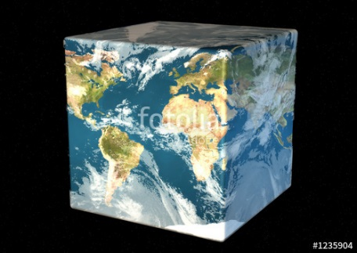
Hadron Spectroscopy
Hybrids
Tetraquark
Meson
Baryon
Glueball
$$π$$
$$π$$
$$J/ψ$$
$$π$$
Hadroquarkonium
Molecule
Experiment
Data
Amplitude analysis
Properties,
Model building
Lattice QCD
Interpretations on the spectrum leads to understanding fundamental laws of nature

Slide 3
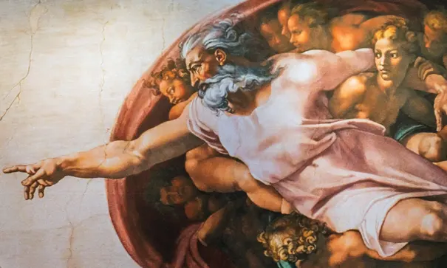
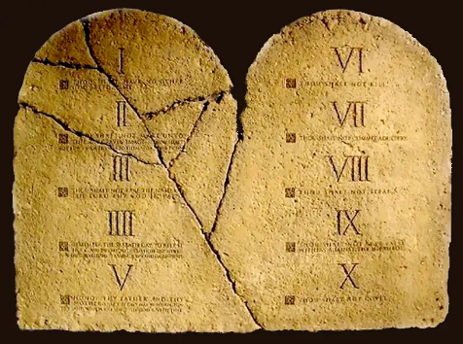
The flowchart(s)
You are given a model/theory
$$f(s)$$
You calculate the amplitude
You compare with data. Or you don’t.
Predictive power ✓
Physical interpretation ✓ (within the model! ✗) Biased by the input ✗
A. Pilloni – Studies of exotic hadrons at JPAC

Slide 4
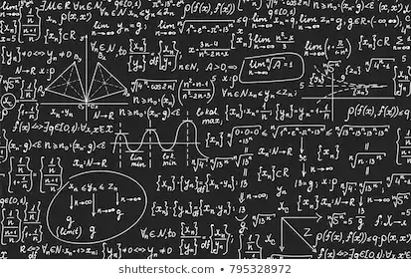
The flowchart(s)
Less predictive power ✗
Some physical interpretation ✗ Minimally biased ✓
You extract physics
You choose a set of generic amplitudes
You start with data
A. Pilloni – Studies of exotic hadrons at JPAC

Slide 5
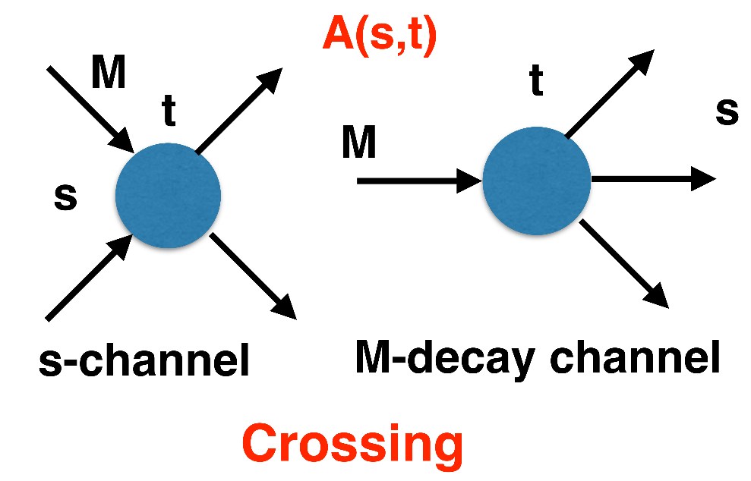
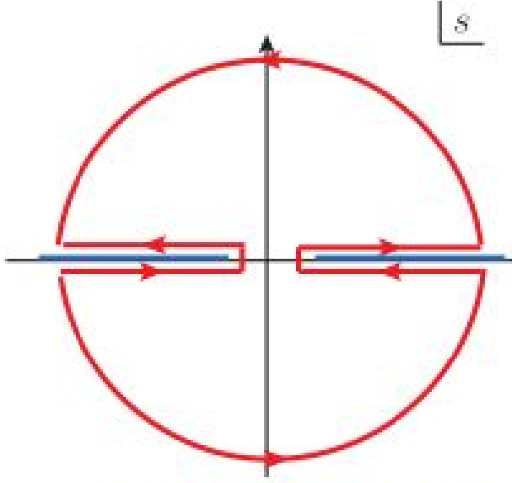
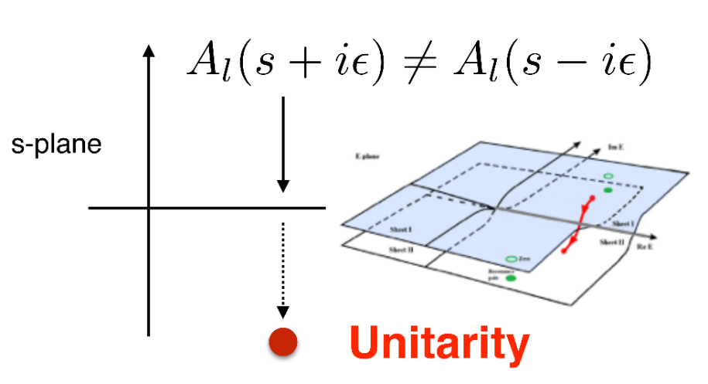
$S$-Matrix principles
$$t_{l}\left(s\right)=\lim_{ε→0}t_{l}(s+iε)⁡$$
Analyticity
$$\text{Im} t_{l}=ρ_{l}{\left|t_{l}\right|}^{2} ⁡$$
These are constraints the amplitudes have to satisfy, but do not fix the dynamics
They can be imposed with an increasing amount of rigor, to extract robust physics information
The «background» phenomena can be effectively parameterized in a controlled way
+ Lorentz, discrete & global symmetries
A. Pilloni – Studies of exotic hadrons at JPAC
Notes:
Controlla la parte su Regge

Slide 6
Joint Physics Analysis Center
Joint effort between theorists and experimentalists to work together to make the best use of the next generation of very precise data taken at JLab and in the world
Created in 2013 by JLab & IU agreement
It is engaged in education of further generations of hadron physics practitioners
Insight on QCD dynamics
Effective Field Theories Analyticity+Unitarity
Dispersion Relations Regge Theory
Fundamental parameters Resonances, exotic states
Experiments CLAS, GlueX, BESIII, COMPASS, LHCb, BaBar, Belle II, KLOE, MAMI Lattice
See also talk by A. Szczepaniak, tomorrow 8.30
A. Pilloni – Amplitude analysis for exotic states

Slide 7
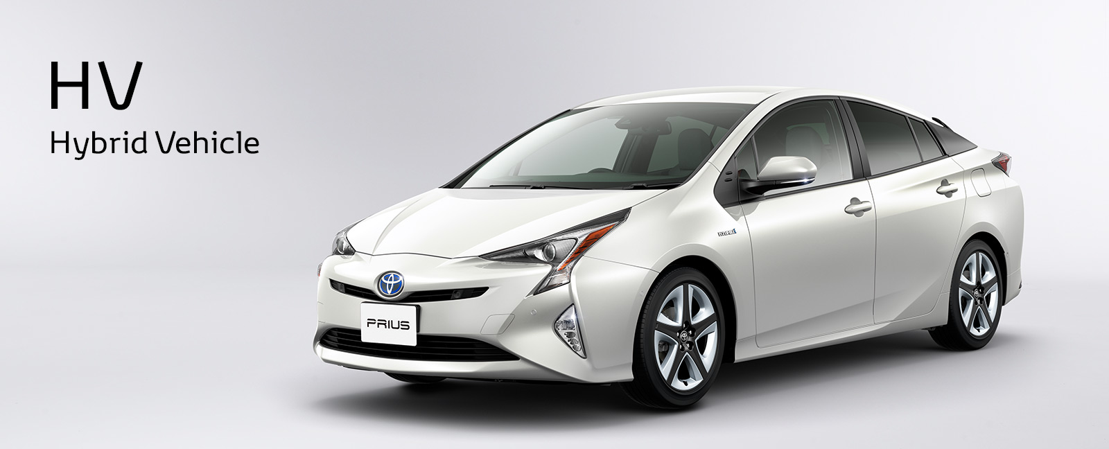
The hybrid $π_{1}$
A. Rodas, AP et al. (JPAC) PRL122, 042002
A. Pilloni – The quest for Exotic states
Notes:
2 slides su Zc, a Bes e a Belle
2 slide su tetraquark model: dall’hamiltoniana di Jaffe al calcolo delle masse
1 slide su molecular models, dove sono i carichi? (non in Tornqvist, si in Hanhart, vedere Braaten, citare Nefediev)
2 slides su decay channels, dove si dovrebbe vedere, e a seconda del modello, vedere qualche plot
1 slide su Y(4260), tetraquark? C’è lo strano (si vede la f0)
1 slide su Zc a cleo (anche il neutro)

Slide 8
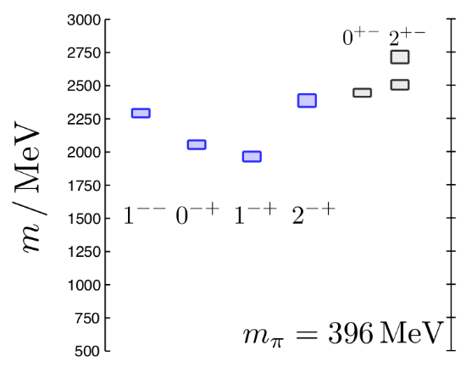
Hybrid hunting
Gluonic quasiparticle $$J^{PC}=1^{+−}$$ mass $∼1.0\text{−}1.5 \text{GeV}$
degenerate multiplet, $$J^{PC}={\left(0,1,2\right)}^{−+},1^{−−}$$
$$\overline{r}$$
$$\overline{g}$$
$$r$$
$$g$$
J. Dudek
Look for a $π_{1}$ state with $J^{PC}=1^{−+}$
decaying into $\left\{\begin{matrix}η π \text{and} η^{′}π \\ ρ π→3π \\ b_{1}π→5π\end{matrix}\right.$
A. Pilloni – The quest for Exotic states
Notes:
2 slides su Zc, a Bes e a Belle
2 slide su tetraquark model: dall’hamiltoniana di Jaffe al calcolo delle masse
1 slide su molecular models, dove sono i carichi? (non in Tornqvist, si in Hanhart, vedere Braaten, citare Nefediev)
2 slides su decay channels, dove si dovrebbe vedere, e a seconda del modello, vedere qualche plot
1 slide su Y(4260), tetraquark? C’è lo strano (si vede la f0)
1 slide su Zc a cleo (anche il neutro)

Slide 9
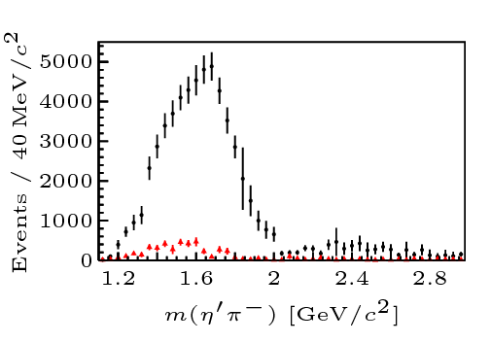
Two hybrid states???
Neither lattice nor models predict two $1^{−+}$ states in this region!
A. Pilloni – The quest for Exotic states
Notes:
2 slides su Zc, a Bes e a Belle
2 slide su tetraquark model: dall’hamiltoniana di Jaffe al calcolo delle masse
1 slide su molecular models, dove sono i carichi? (non in Tornqvist, si in Hanhart, vedere Braaten, citare Nefediev)
2 slides su decay channels, dove si dovrebbe vedere, e a seconda del modello, vedere qualche plot
1 slide su Y(4260), tetraquark? C’è lo strano (si vede la f0)
1 slide su Zc a cleo (anche il neutro)

Slide 10
Amplitudes for $η^{(′)}π$
We build the partial wave amplitudes according to the $N/D$ method
Jackura, Mikhasenko, AP et al. (JPAC & COMPASS), PLB
Rodas, AP et al. (JPAC), PRL
$$a\left(s\right)=\frac{n\left(s\right)}{D\left(s\right)}$$
$$D(s)$$
$$n(s)$$
The $n\left(s\right)$ → background physics, process-dependent, smooth
The $D(s)$ contains all the Final State Interactions constrained by unitarity → universal
A. Pilloni – Prospects for Hadron Spectroscopy at JLab
Notes:
Controlla la parte su Regge

Slide 11
Coupled channel: the model
Two channels, $i,k=ηπ, η^{′}π$ Two waves, $J=P,D$ 37 fit parameters
1 K-matrix pole for the P-wave
2 K-matrix poles for the D-wave
Left-hand scale (Blatt-Weisskopf radius) $s_{R}=s_{0}=1 {\text{GeV}}^{2}$
$α=2$, 3rd order polynomial for $n_{k}^{J}(s)$
A. Pilloni – The quest for Exotic states
Notes:
Controlla la parte su Regge

Slide 12
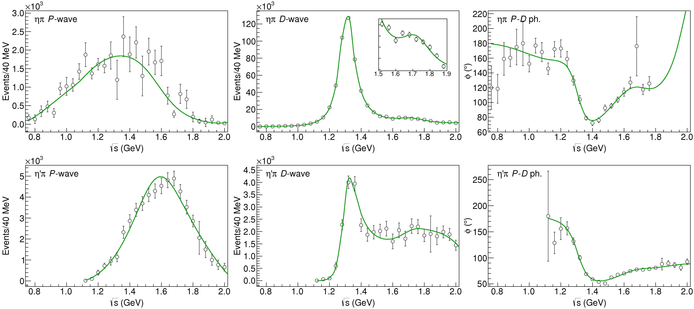
Fit to $η^{(′)}π$
$$π_{1}\left(1400\right)?$$
$$a_{2}\left(1320\right)$$
$$a_{2}^{′}\left(1700\right)$$
$$π_{1}\left(1600\right)?$$
$$a_{2}\left(1320\right)$$
$$a_{2}^{′}\left(1700\right)$$
$$J^{PC}=1^{−+}$$
$$J^{PC}=2^{++}$$
A. Pilloni – Challenges in Hadron Spectroscopy
Notes:
Controlla la parte su Regge

Slide 13
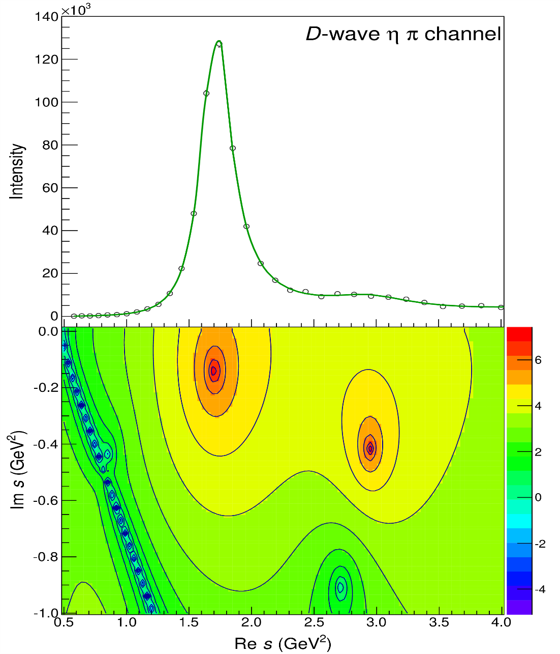
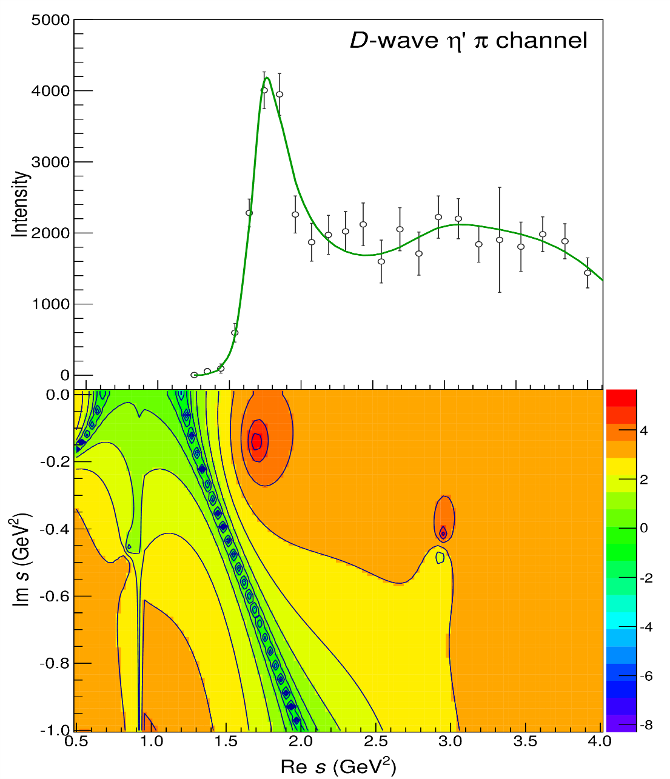
Pole hunting
$$a_{2}^{′}\left(1700\right)$$
$$a_{2}^{′}\left(1700\right)$$
$$a_{2}\left(1320\right)$$
$$a_{2}\left(1320\right)$$
A. Pilloni – Challenges in Hadron Spectroscopy
Notes:
Controlla la parte su Regge

Slide 14
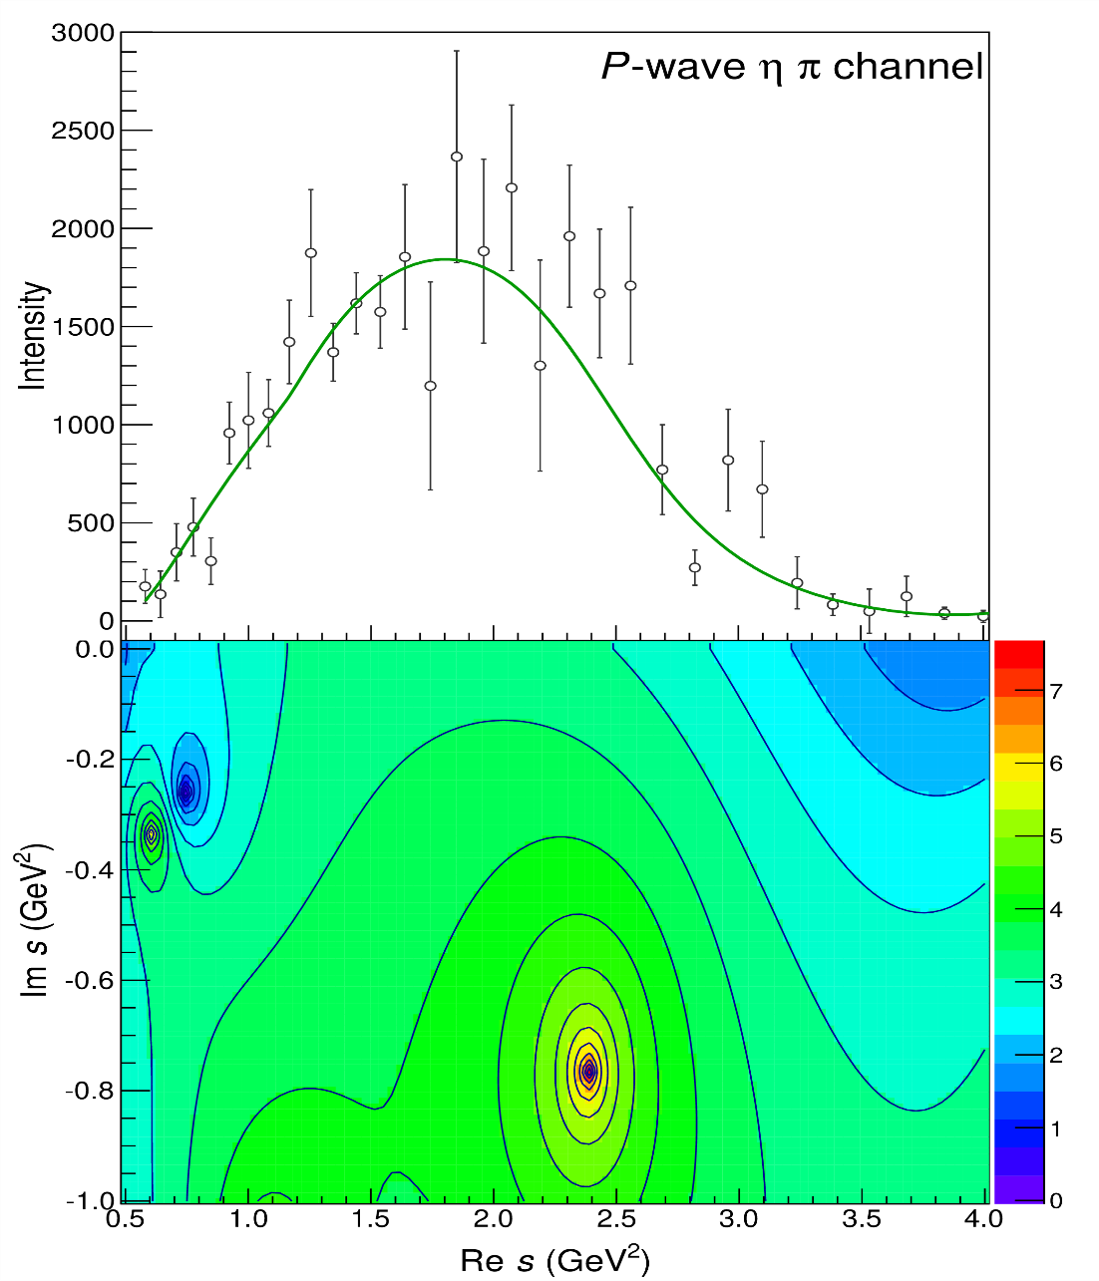
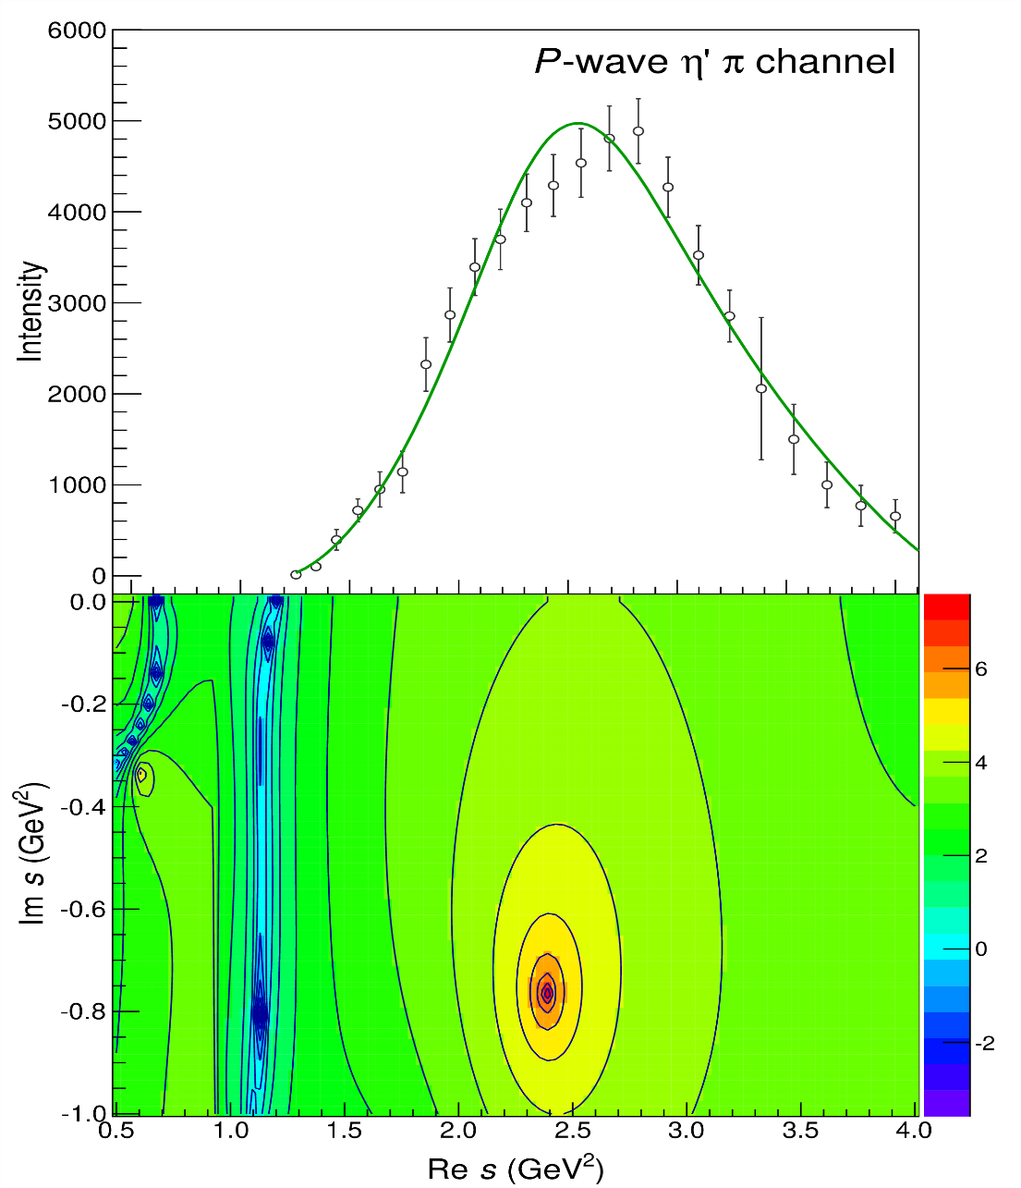
Pole hunting
$$π_{1}$$
$$π_{1}$$
A. Pilloni – Challenges in Hadron Spectroscopy
Notes:
Controlla la parte su Regge

Slide 15
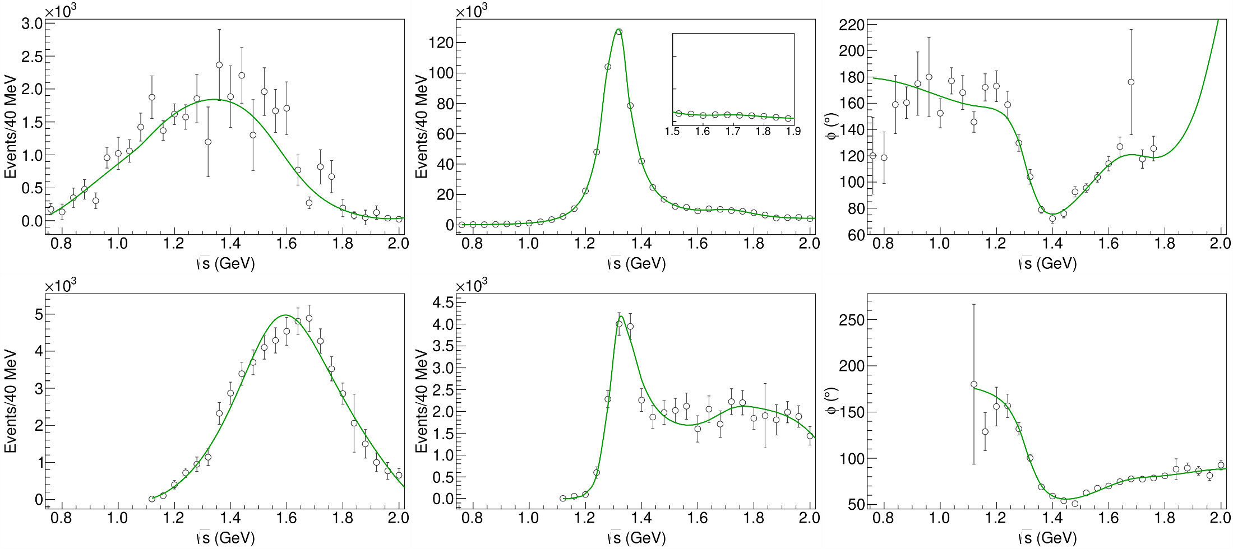
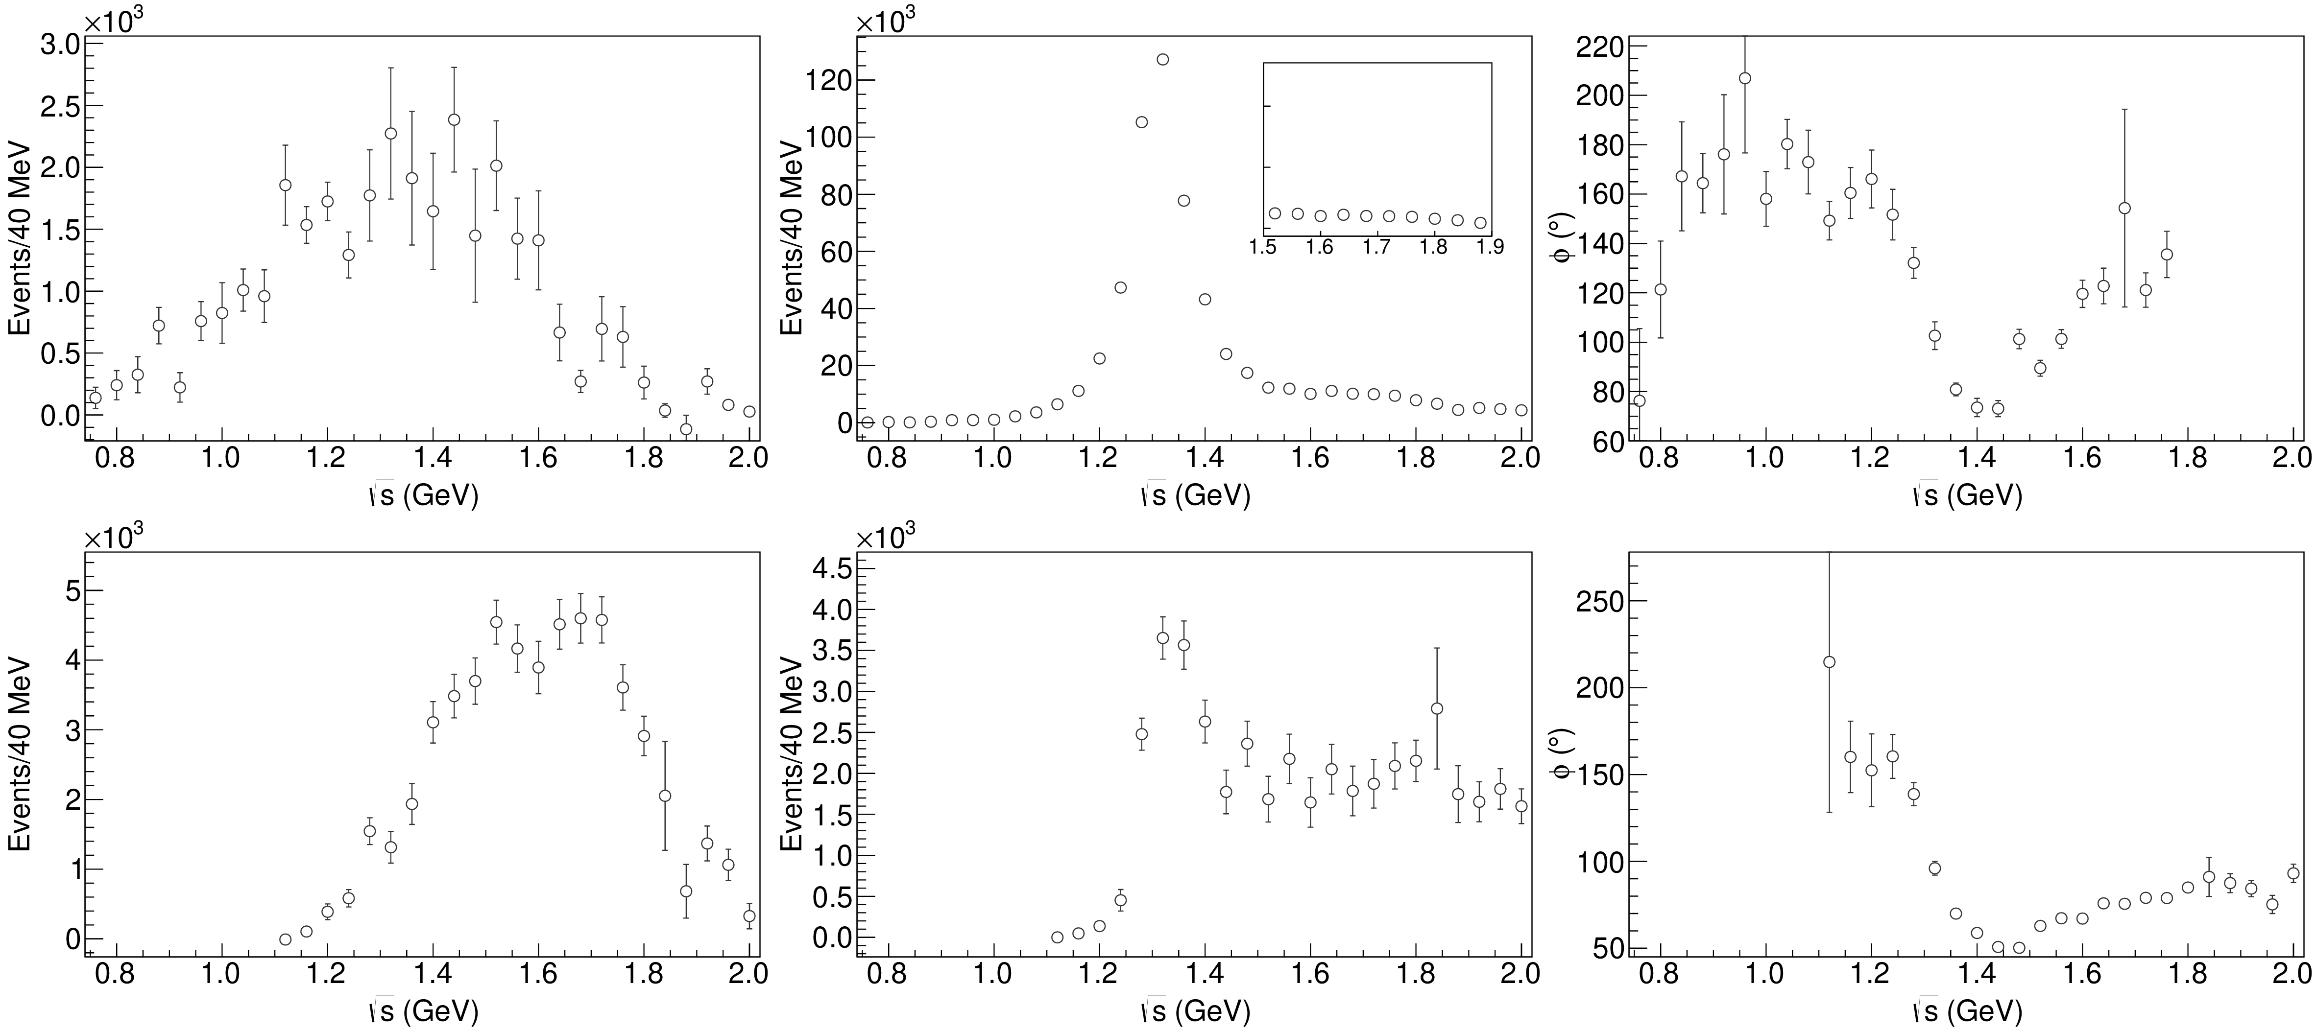
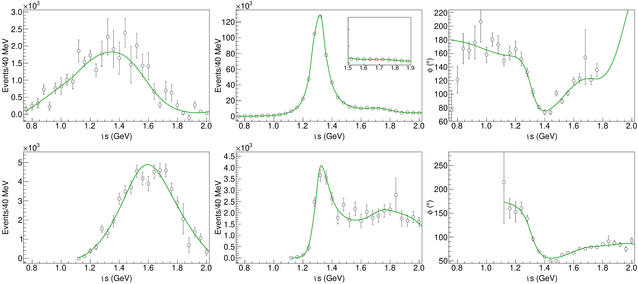
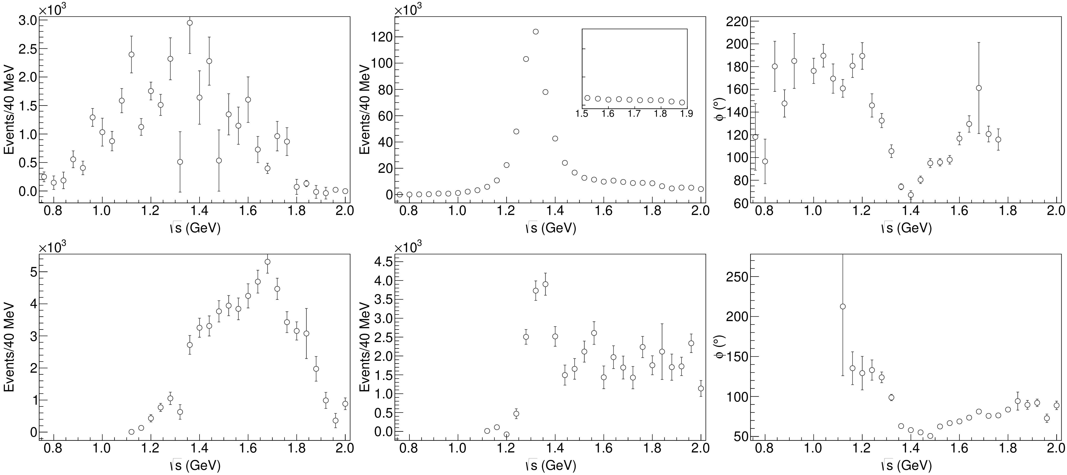
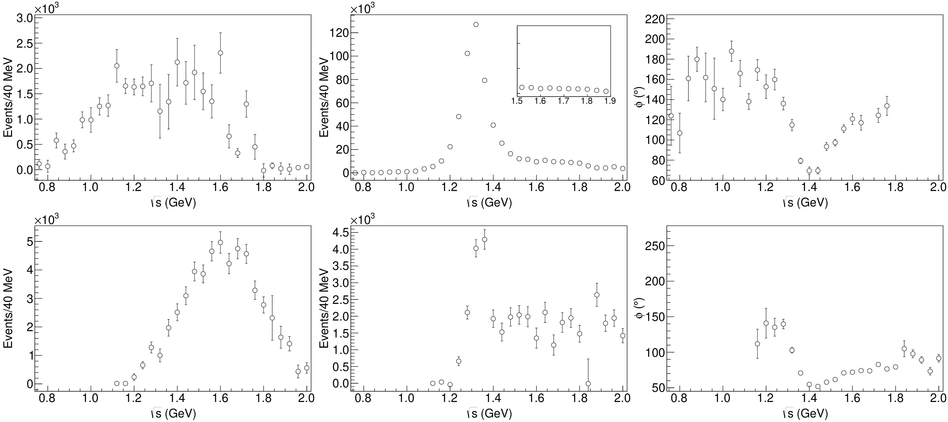
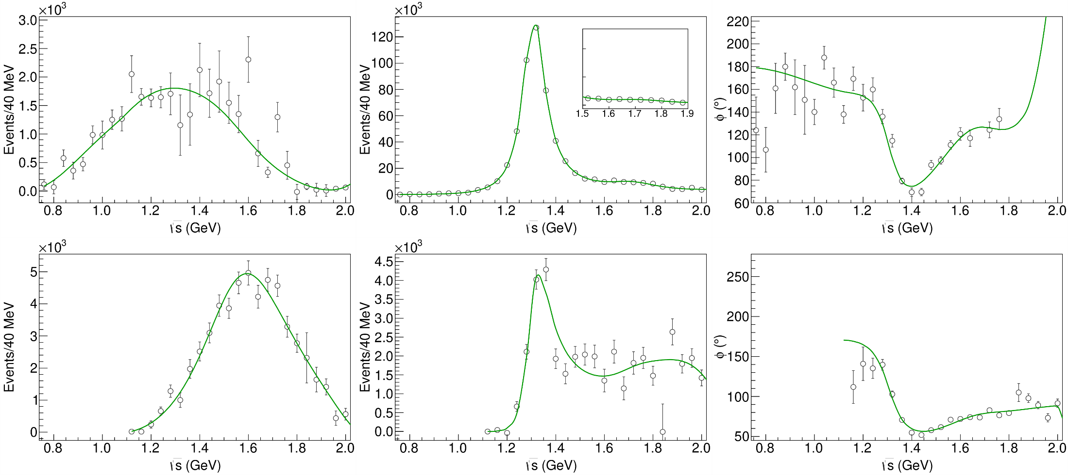
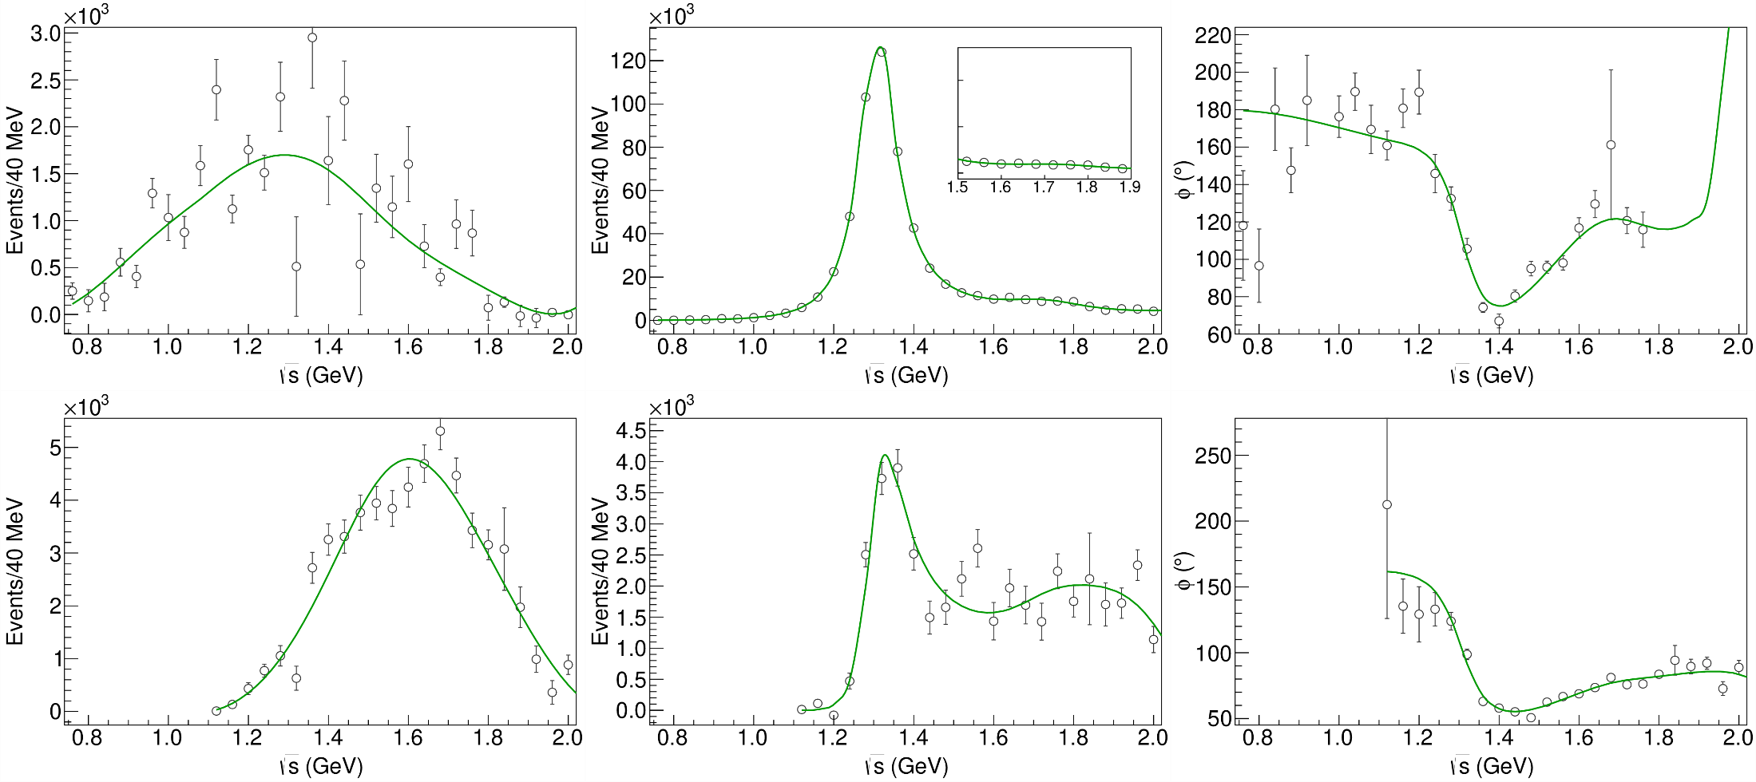
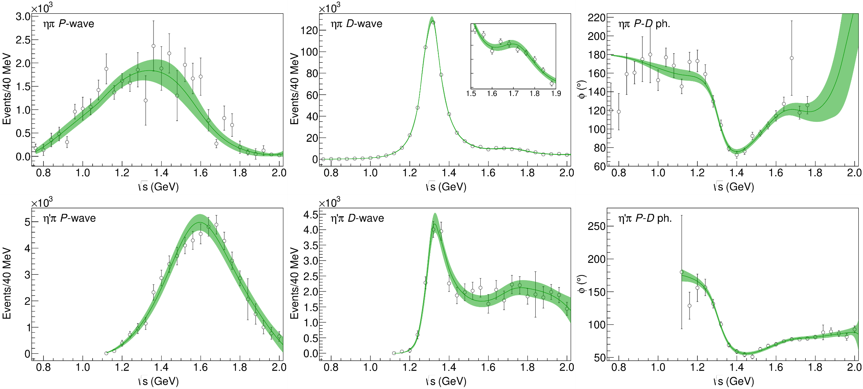
Statistical Bootstrap
A. Pilloni – Challenges in Hadron Spectroscopy
Notes:
Controlla la parte su Regge

Slide 16
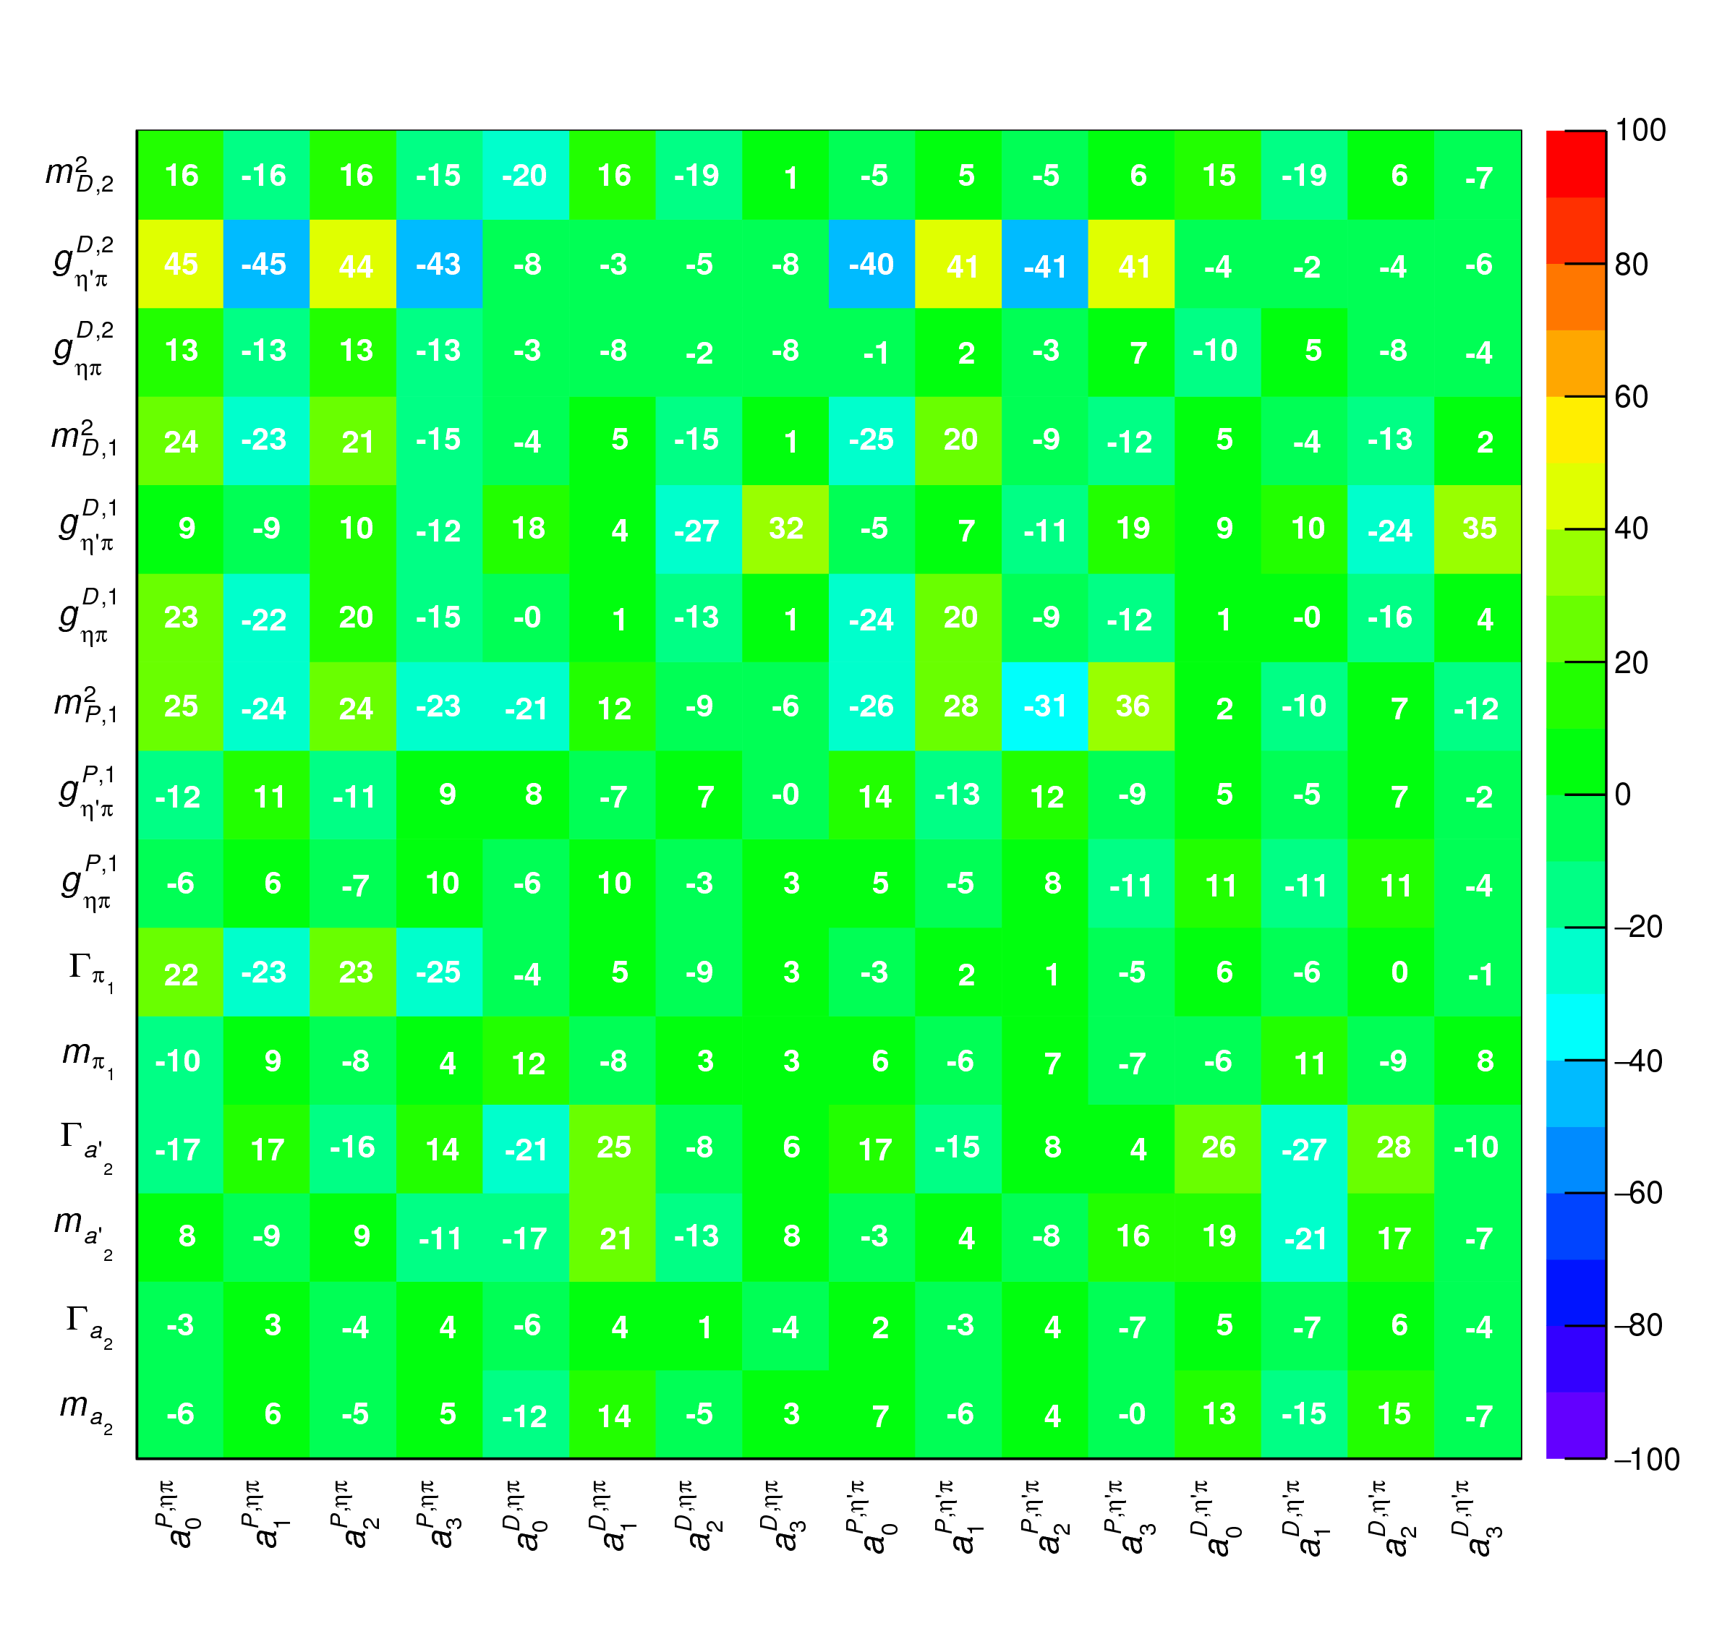
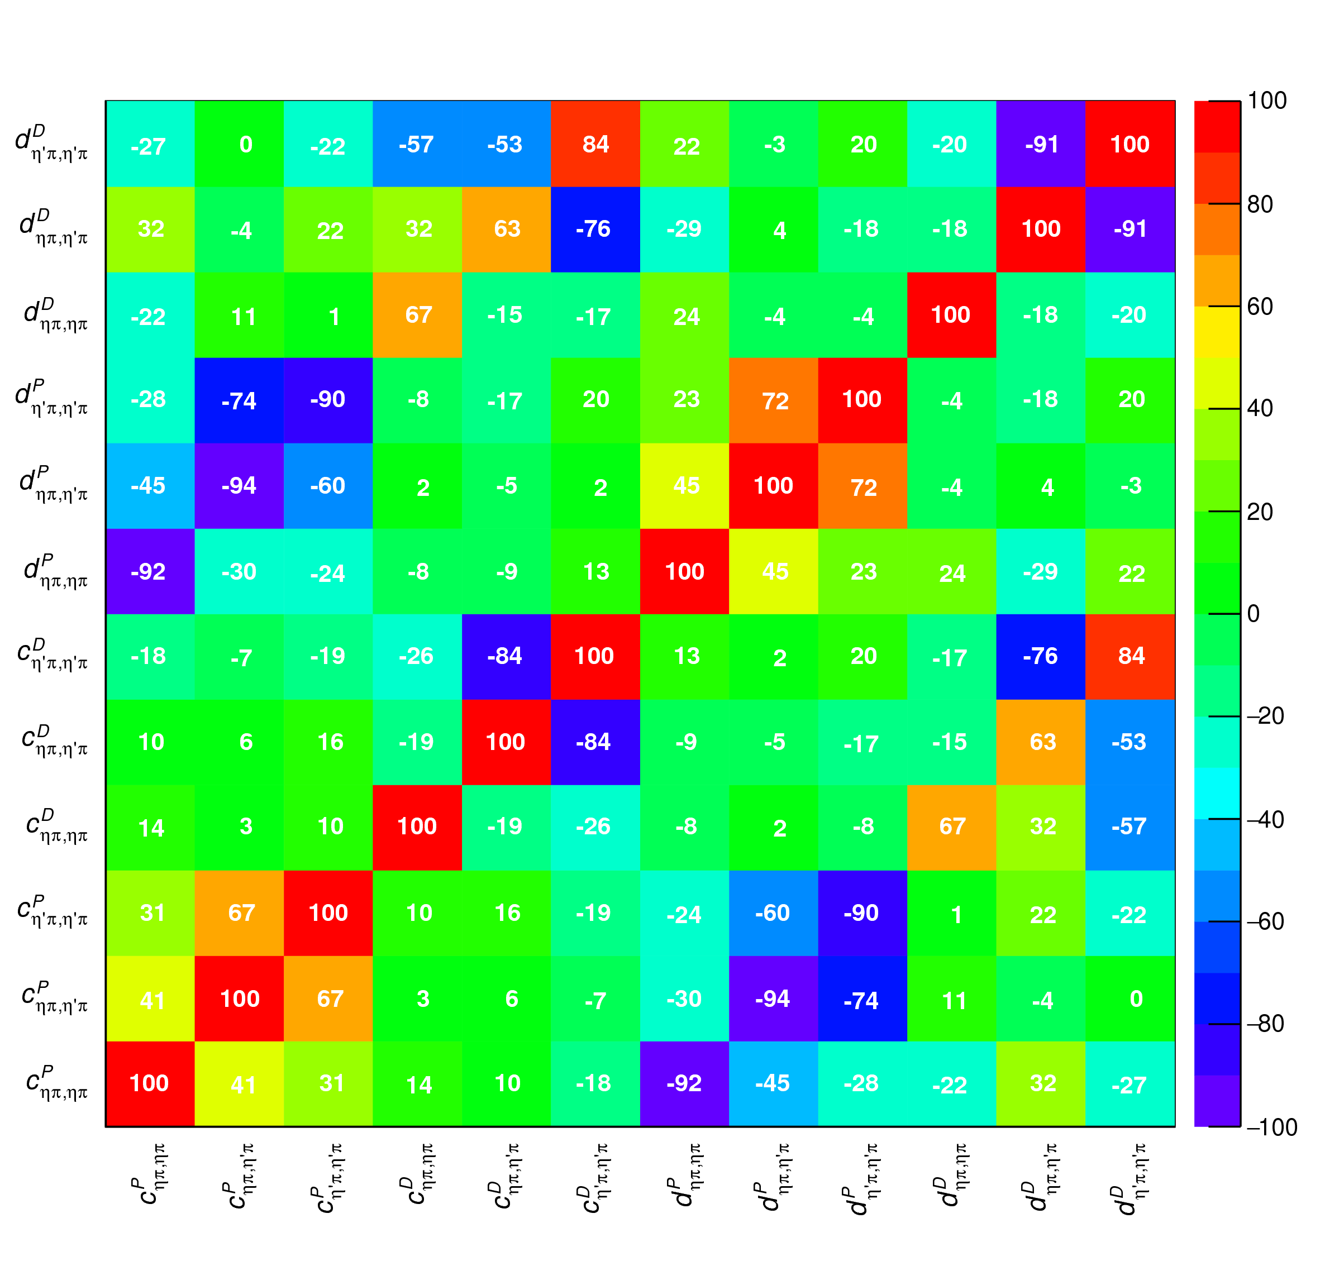
Correlations
Denominator parameters uncorrelated with the numerator ones ✓
Denominator parameters uncorrelated between P- and D-wave ✓
Production (numerator) parameters
K-matrix «bkg» parameters
K-matrix «pole» parameters
K-matrix «bkg» parameters
A. Pilloni – The quest for Exotic states
Notes:
Controlla la parte su Regge

Slide 17
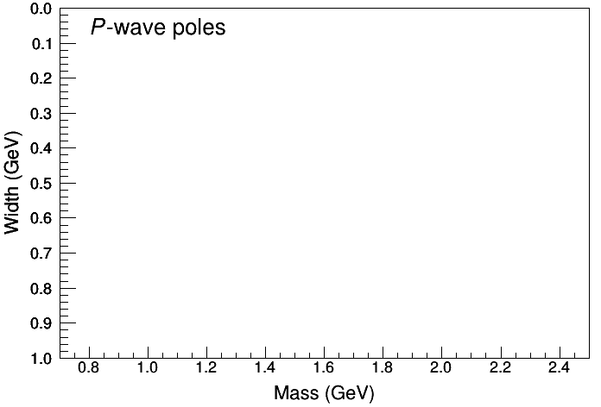
Statistical Bootstrap
We can identify the poles in the region $m∈\left[1.2, 2\right] \text{GeV},Γ∈\left[0, 1\right] \text{GeV}$
Two clusters in D-wave: $a_{2}\left(1320\right)$ and $a_{2}^{′}\left(1700\right)$
Only one stable cluster in $P$-wave: a single $π_{1}$
A. Pilloni – The quest for Exotic states
Notes:
Controlla la parte su Regge

Slide 18
Final results
Agreement with theory is restored
That’s the most rigorous extraction of an exotic meson available so far!
A. Pilloni – The quest for Exotic states
Notes:
Controlla la parte su Regge

Slide 19
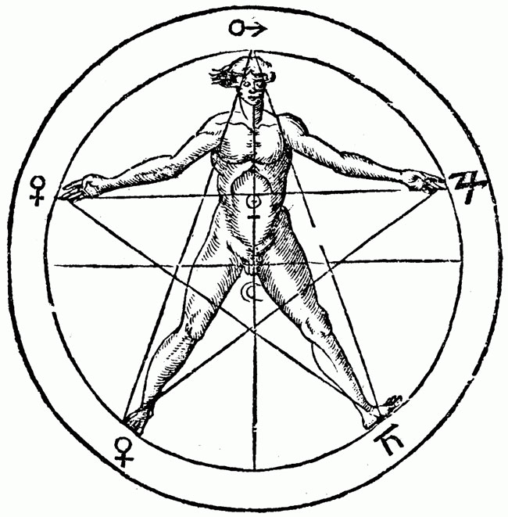
The $P_{c}(4312)$ pentaquark
$$u$$
C. Fernandez-Ramirez, AP, et al. (JPAC) 1904.10021 (PRL)
$$c$$
$$\overline{c}$$
$$u$$
$$d$$
A. Pilloni – The quest for Exotic states
Notes:
2 slides su Zc, a Bes e a Belle
2 slide su tetraquark model: dall’hamiltoniana di Jaffe al calcolo delle masse
1 slide su molecular models, dove sono i carichi? (non in Tornqvist, si in Hanhart, vedere Braaten, citare Nefediev)
2 slides su decay channels, dove si dovrebbe vedere, e a seconda del modello, vedere qualche plot
1 slide su Y(4260), tetraquark? C’è lo strano (si vede la f0)
1 slide su Zc a cleo (anche il neutro)

Slide 20
New pentaquarks discovered
The lowest $P_{c}(4312)$ appears as an isolated peak at the $Σ_{c}^{+}{\overline{D}}^{0}$ threshold
A detailed study of the lineshape provides insight on its nature
A. Pilloni – The quest for Exotic states
Notes:
Controlla la parte su Regge

Slide 21
Bound and virtual states
Decreasing the potential strength, the pole reaches threshold
The pole jumps on the 2nd sheet (dineutron), it becomes a virtual state
Example from $pn$ scattering Bound state on the real axis 1st sheet (deuteron)
$$V(r)$$
$$\text{Im} E$$
$$r$$
$$V$$
Deuteron
$$\text{Re} E$$
$${}_{}^{1}S$$
Deuteron pole
Dineutron pole
$${}_{}^{3}S$$
A. Pilloni – Studies of exotic hadrons at JPAC
Notes:
Controlla la parte su Regge

Slide 22
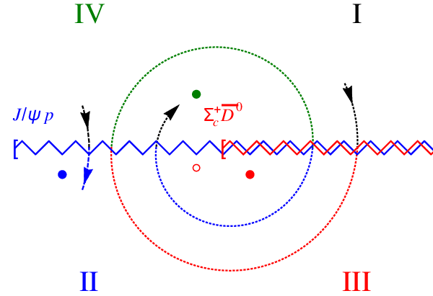
Bound and virtual states
The situation is more complicated when more channels are open
Virtual state
Bound state
Resonance
A. Pilloni – Studies of exotic hadrons at JPAC
Notes:
Controlla la parte su Regge

Slide 23
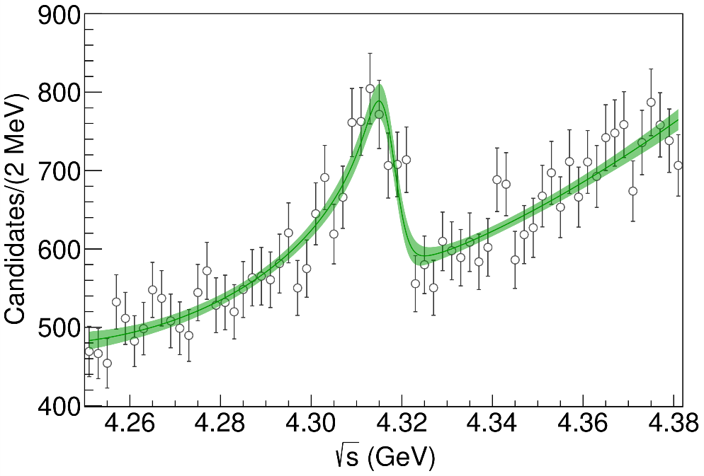
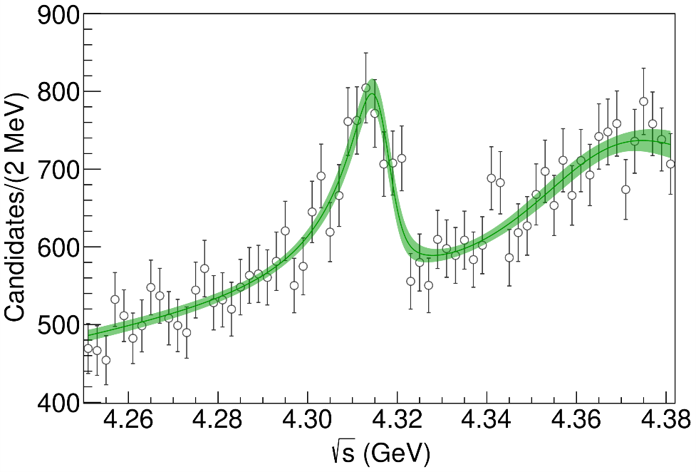
Minimal(istic) model
Effective range expansion We can set $c_{ii}=0$ to reduce to the scattering length approximation
$$c_{ii}=0$$
Finite $c_{ii}$
A. Pilloni – Studies of exotic hadrons at JPAC
Notes:
2 slides su Zc, a Bes e a Belle
2 slide su tetraquark model: dall’hamiltoniana di Jaffe al calcolo delle masse
1 slide su molecular models, dove sono i carichi? (non in Tornqvist, si in Hanhart, vedere Braaten, citare Nefediev)
2 slides su decay channels, dove si dovrebbe vedere, e a seconda del modello, vedere qualche plot
1 slide su Y(4260), tetraquark? C’è lo strano (si vede la f0)
1 slide su Zc a cleo (anche il neutro)

Slide 24
Minimal(istic) model
Effective range expansion We can set $c_{ii}=0$ to reduce to the scattering length approximation
$$c_{ii}=0$$
Finite $c_{ii}$
A. Pilloni – Studies of exotic hadrons at JPAC
Notes:
2 slides su Zc, a Bes e a Belle
2 slide su tetraquark model: dall’hamiltoniana di Jaffe al calcolo delle masse
1 slide su molecular models, dove sono i carichi? (non in Tornqvist, si in Hanhart, vedere Braaten, citare Nefediev)
2 slides su decay channels, dove si dovrebbe vedere, e a seconda del modello, vedere qualche plot
1 slide su Y(4260), tetraquark? C’è lo strano (si vede la f0)
1 slide su Zc a cleo (anche il neutro)

Slide 25
Minimal(istic) model
Effective range expansion We can set $c_{ii}=0$ to reduce to the scattering length approximation
Points to a virtual state
$$c_{ii}=0$$
Finite $c_{ii}$
A. Pilloni – Studies of exotic hadrons at JPAC
Notes:
2 slides su Zc, a Bes e a Belle
2 slide su tetraquark model: dall’hamiltoniana di Jaffe al calcolo delle masse
1 slide su molecular models, dove sono i carichi? (non in Tornqvist, si in Hanhart, vedere Braaten, citare Nefediev)
2 slides su decay channels, dove si dovrebbe vedere, e a seconda del modello, vedere qualche plot
1 slide su Y(4260), tetraquark? C’è lo strano (si vede la f0)
1 slide su Zc a cleo (anche il neutro)

Slide 26
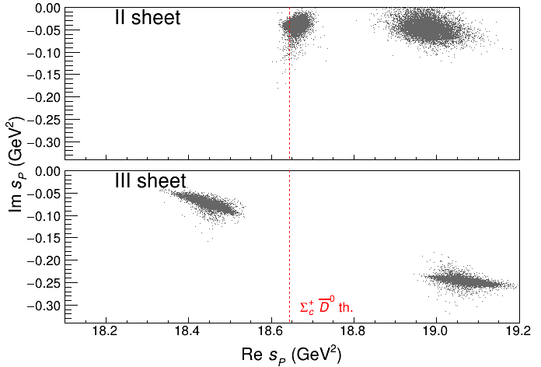
Minimal(istic) model
Effective range expansion We can set $c_{ii}=0$ to reduce to the scattering length approximation
Points to a virtual state
Doesn’t point to a resonance
$$c_{ii}=0$$
Finite $c_{ii}$
A. Pilloni – Studies of exotic hadrons at JPAC
Notes:
2 slides su Zc, a Bes e a Belle
2 slide su tetraquark model: dall’hamiltoniana di Jaffe al calcolo delle masse
1 slide su molecular models, dove sono i carichi? (non in Tornqvist, si in Hanhart, vedere Braaten, citare Nefediev)
2 slides su decay channels, dove si dovrebbe vedere, e a seconda del modello, vedere qualche plot
1 slide su Y(4260), tetraquark? C’è lo strano (si vede la f0)
1 slide su Zc a cleo (anche il neutro)

Slide 27
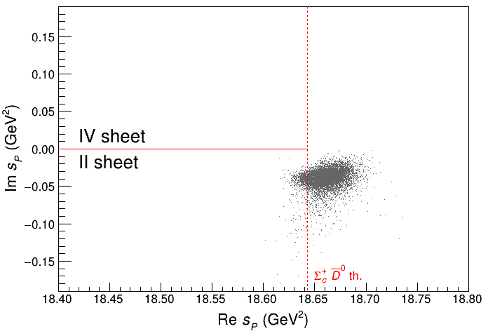
Minimal(istic) model
Effective range expansion We can set $c_{ii}=0$ to reduce to the scattering length approximation
Points to a virtual state
Doesn’t point to a resonance
$$c_{ii}=0$$
Finite $c_{ii}$
A. Pilloni – Studies of exotic hadrons at JPAC
Notes:
2 slides su Zc, a Bes e a Belle
2 slide su tetraquark model: dall’hamiltoniana di Jaffe al calcolo delle masse
1 slide su molecular models, dove sono i carichi? (non in Tornqvist, si in Hanhart, vedere Braaten, citare Nefediev)
2 slides su decay channels, dove si dovrebbe vedere, e a seconda del modello, vedere qualche plot
1 slide su Y(4260), tetraquark? C’è lo strano (si vede la f0)
1 slide su Zc a cleo (anche il neutro)

Slide 28
Epilogue
Studying exotic hadrons is challenging
They are related to dynamics of QCD building blocks
They often appear as small fraction of cross sections, hard (but mandatory!) to find consistency between different channels
Dispersive methods can improve the consistency, and offer insights into their nature
Thank you!
A. Pilloni – The quest for Exotic states
Notes:
2 slides su Zc, a Bes e a Belle
2 slide su tetraquark model: dall’hamiltoniana di Jaffe al calcolo delle masse
1 slide su molecular models, dove sono i carichi? (non in Tornqvist, si in Hanhart, vedere Braaten, citare Nefediev)
2 slides su decay channels, dove si dovrebbe vedere, e a seconda del modello, vedere qualche plot
1 slide su Y(4260), tetraquark? C’è lo strano (si vede la f0)
1 slide su Zc a cleo (anche il neutro)

Slide 29
Joint Physics Analysis Center
A. Pilloni – The quest for Exotic states

Slide 30
Backup

Slide 31
The scalar glueball
A. Rodas, AP et al. (JPAC) in progress
$$0^{++}$$
A. Pilloni – The quest for Exotic states
Notes:
2 slides su Zc, a Bes e a Belle
2 slide su tetraquark model: dall’hamiltoniana di Jaffe al calcolo delle masse
1 slide su molecular models, dove sono i carichi? (non in Tornqvist, si in Hanhart, vedere Braaten, citare Nefediev)
2 slides su decay channels, dove si dovrebbe vedere, e a seconda del modello, vedere qualche plot
1 slide su Y(4260), tetraquark? C’è lo strano (si vede la f0)
1 slide su Zc a cleo (anche il neutro)

Slide 32
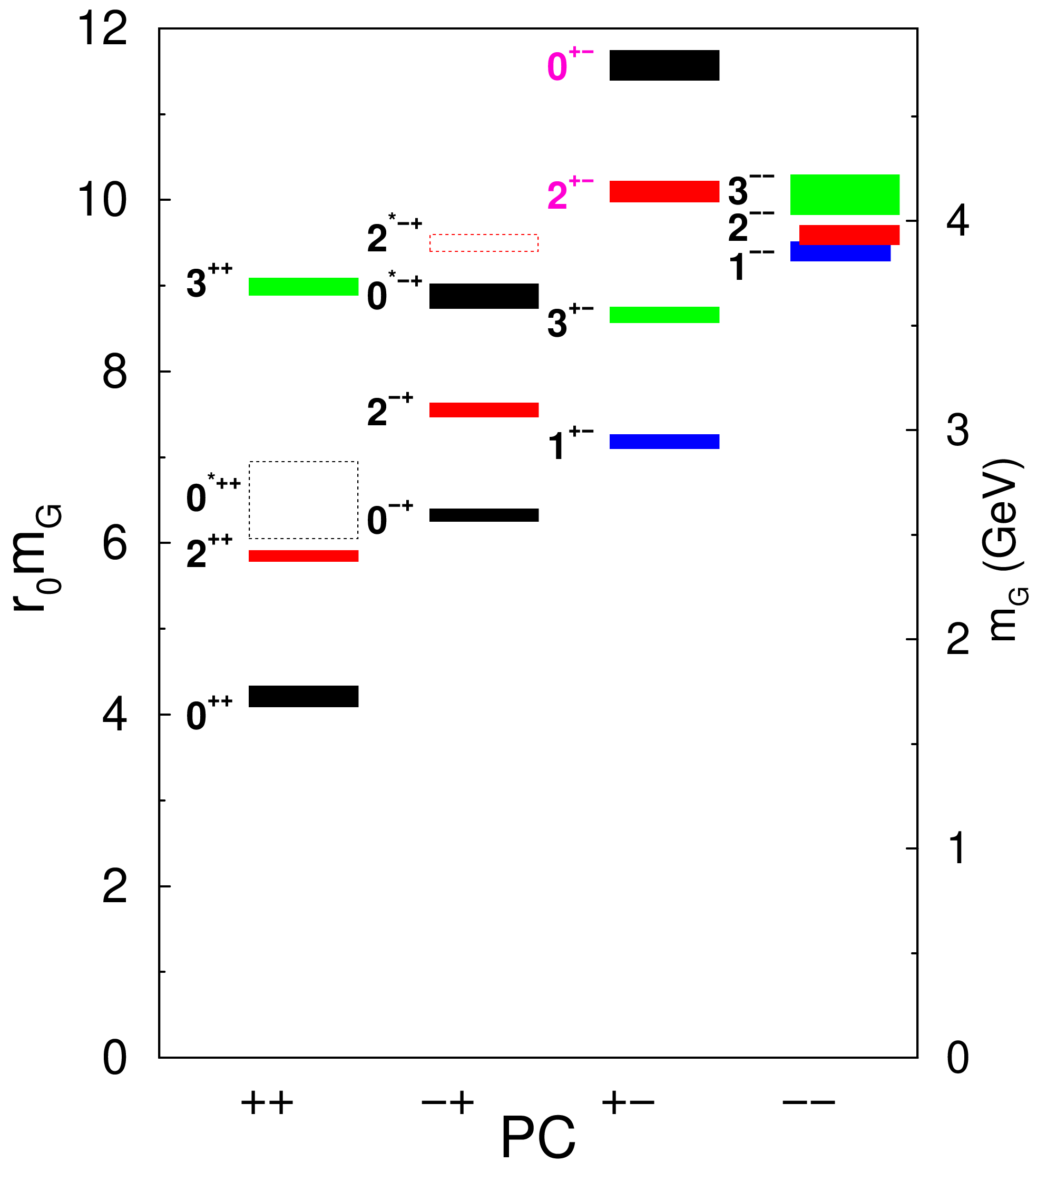
Glueballs
The clearest sign of confinement in pure Yang-Mills The worst state to search in real life
Morningstar and Peardon PRD60, 034509
Gregory et al. JHEP1210, 170
A. Pilloni – The quest for Exotic states

Slide 33
$J/ψ→γ π^{0}π^{0} and→γ K_{S}^{0}K_{S}^{0}$
$$c$$
This is a gluon-rich process, expected to be one of the golden channels for the search of the scalar glueball
J/ψ
$$\overline{c}$$
G
A. Pilloni – Amplitude analysis of $J/ψ→γ π^{0}π^{0}$

Slide 34
Same model as before
Two channels, $i,k=ππ, KK$ Two waves, $J=S,D$ 52 parameters
3 K-matrix pole for the S-wave
3 K-matrix poles for the D-wave
A. Pilloni – The quest for Exotic states
Notes:
Controlla la parte su Regge

Slide 35
Fit results (preliminary)
A. Pilloni – The quest for Exotic states
Notes:
Controlla la parte su Regge

Slide 36
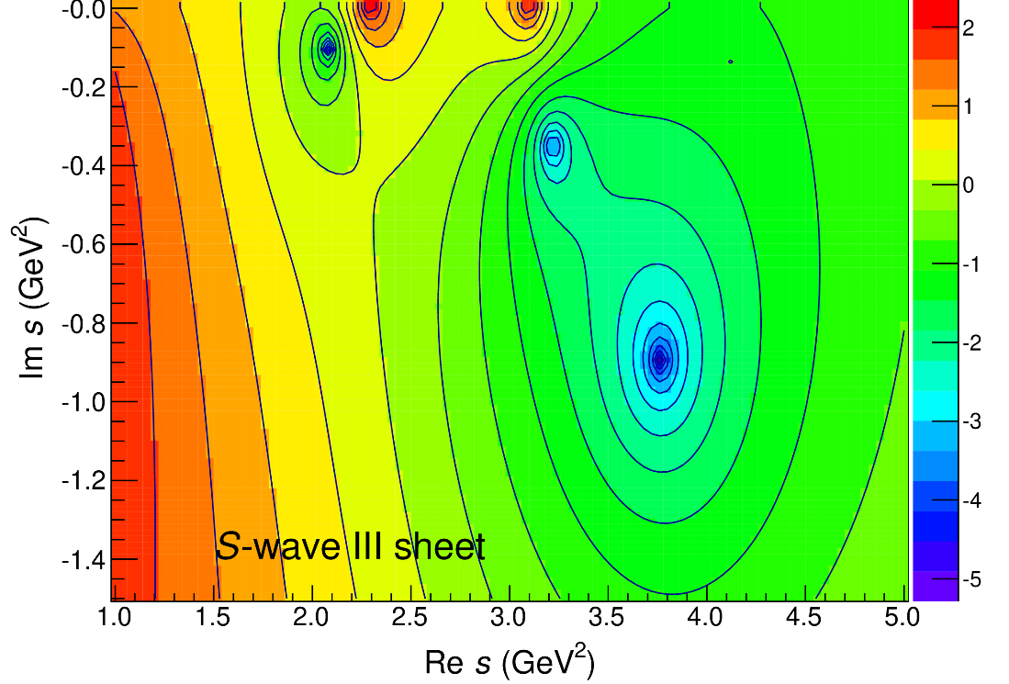
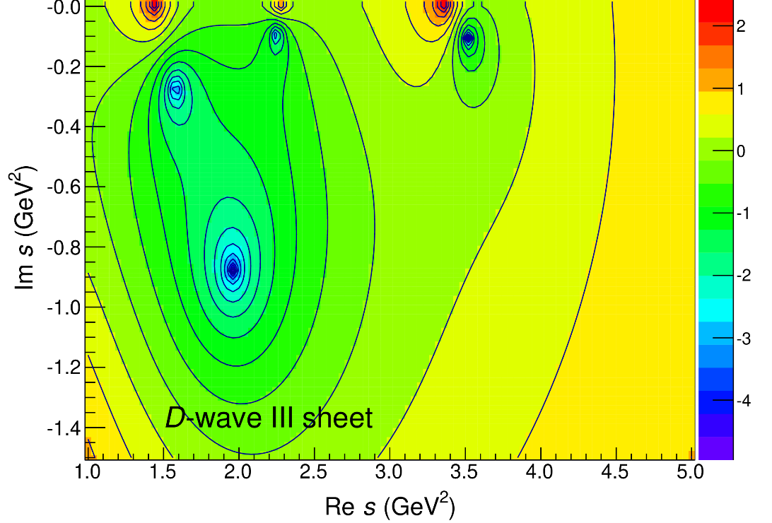
Pole position (preliminary)
$$M\left(f_{0}(1500)\right)=1460 \text{MeV}$$
$$M\left(f_{0}(1710)\right)=1800 \text{MeV}$$
$$M\left(f_{0}(2020)\right)=1970 \text{MeV}$$
$$Γ\left(f_{0}(1500)\right)=85 \text{MeV}$$
$$Γ\left(f_{0}(1710)\right)=190 \text{MeV}$$
$$Γ\left(f_{0}(2020)\right)=490 \text{MeV}$$
A. Pilloni – The quest for Exotic states
Notes:
Controlla la parte su Regge

Slide 37
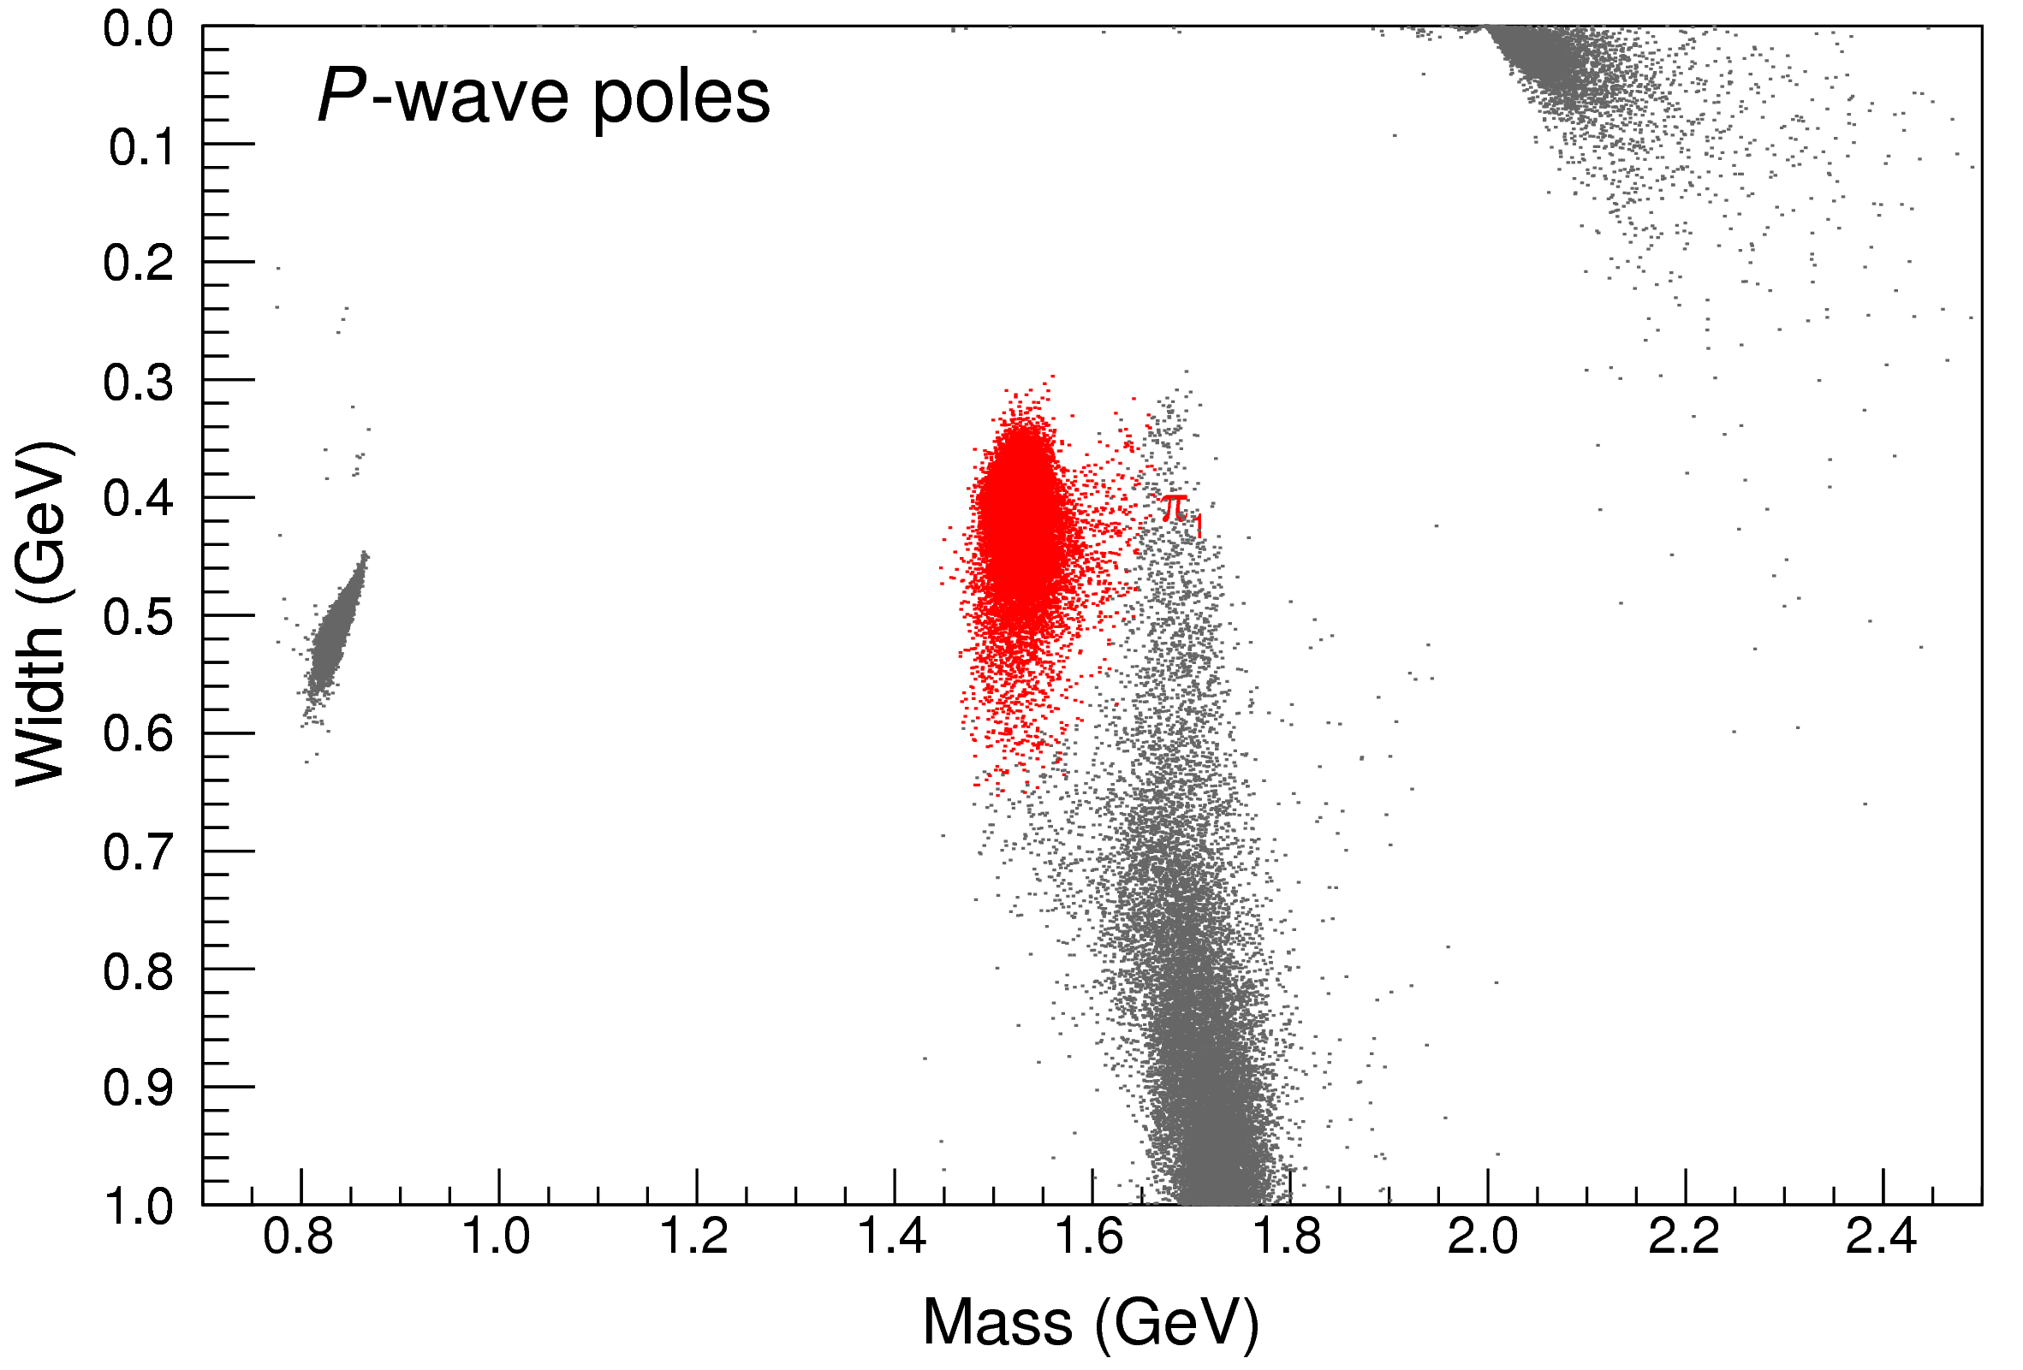
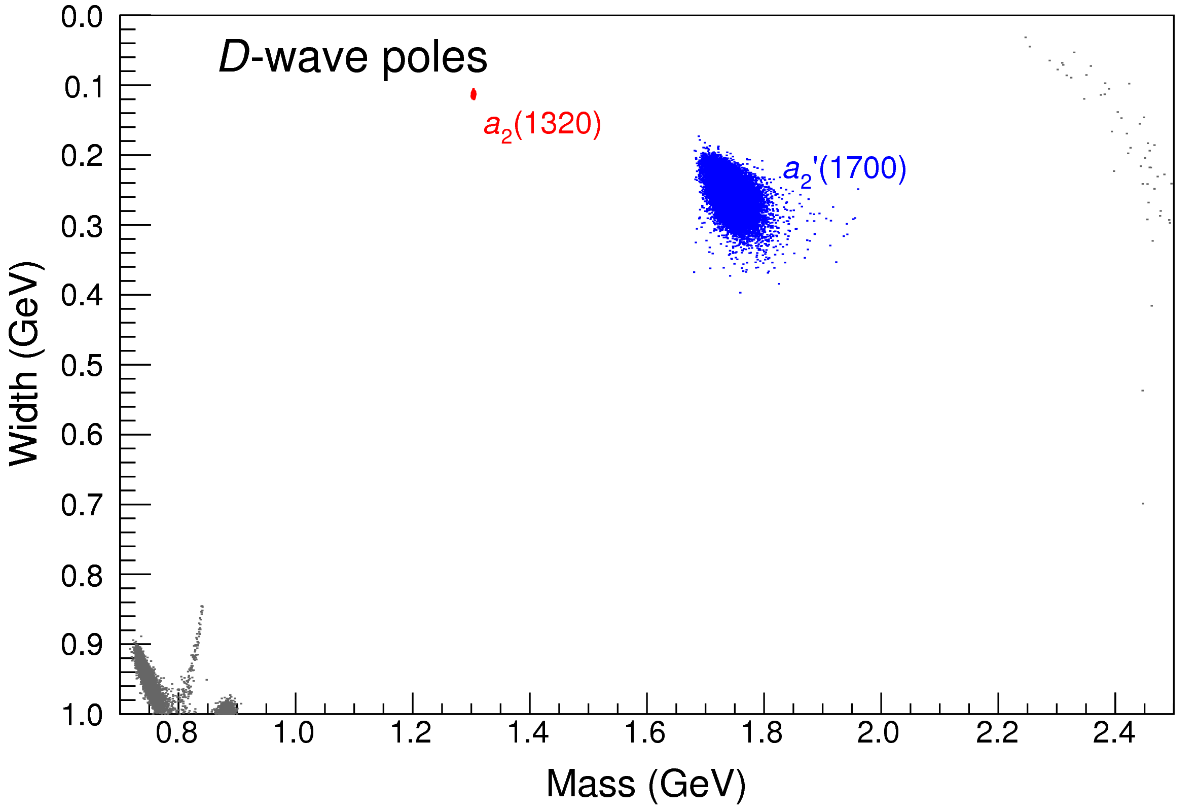
Bootstrap for $s_{R}=1.8 {\text{GeV}}^{2}$
Our skepticism about a second pole in the relevant region is confirmed:
It is unstable and not trustable
A. Pilloni – The quest for Exotic states
Notes:
Controlla la parte su Regge

Slide 38
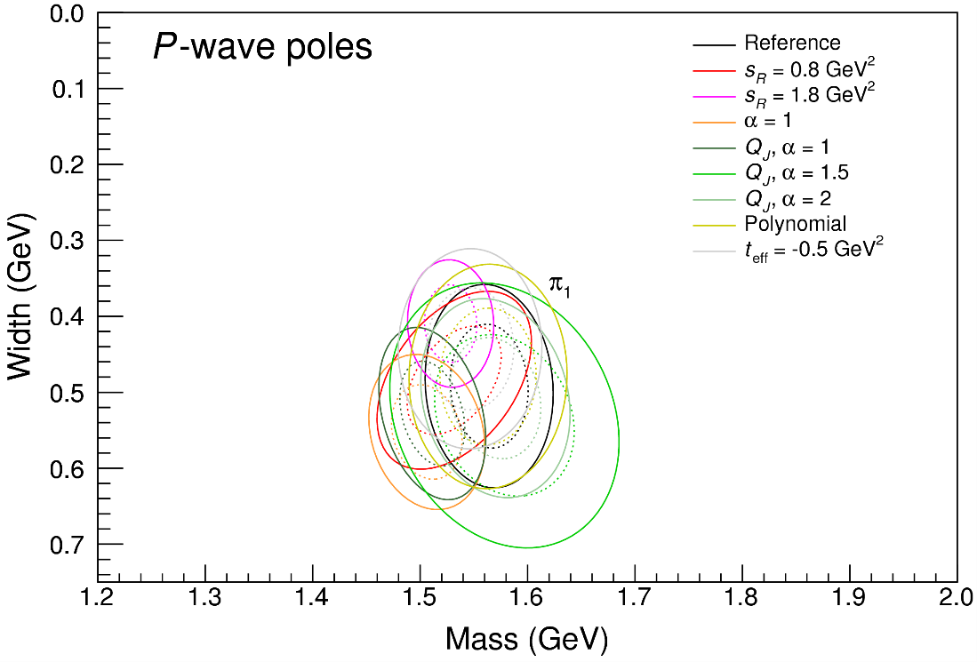
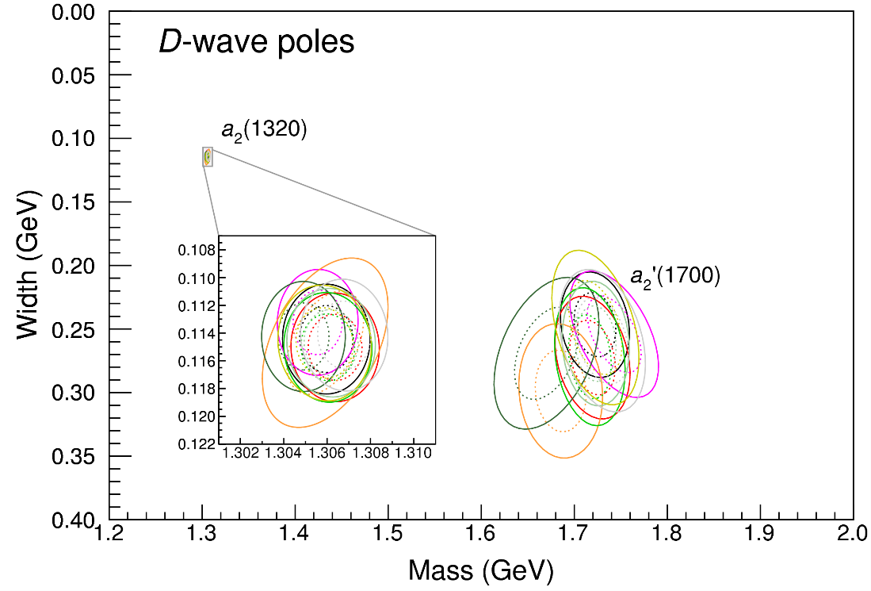
Systematic studies
For each class, the maximum deviation of mass and width is taken as a systematic error Deviation smaller than the statistical error are neglected Systematic of different classes are summed in quadrature
A. Pilloni – The quest for Exotic states
Notes:
Controlla la parte su Regge

Slide 39
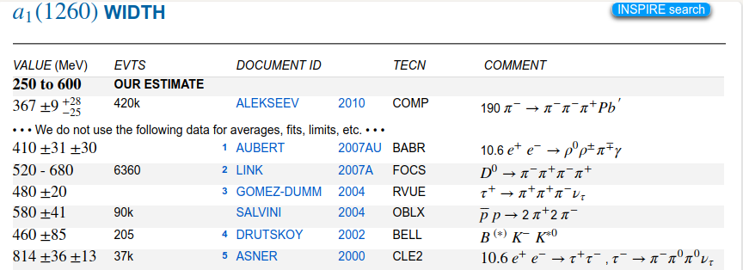
Life is not easy...
A. Pilloni – The quest for Exotic states
Notes:
2 slides su Zc, a Bes e a Belle
2 slide su tetraquark model: dall’hamiltoniana di Jaffe al calcolo delle masse
1 slide su molecular models, dove sono i carichi? (non in Tornqvist, si in Hanhart, vedere Braaten, citare Nefediev)
2 slides su decay channels, dove si dovrebbe vedere, e a seconda del modello, vedere qualche plot
1 slide su Y(4260), tetraquark? C’è lo strano (si vede la f0)
1 slide su Zc a cleo (anche il neutro)

Slide 40
$S$-Matrix principles
$$t_{l}\left(s\right)=\lim_{ε→0}t_{l}(s+iε)⁡$$
Analyticity
$$\text{Im} t_{l}=ρ_{l}{\left|t_{l}\right|}^{2} ⁡$$
These are constraints the amplitudes have to satisfy, but do not fix the dynamics
Impose the constraints, parameterize the ignorance, extract the physics
+ Lorentz, discrete & global symmetries
A. Pilloni – The quest for Exotic states
Notes:
Controlla la parte su Regge

Slide 41
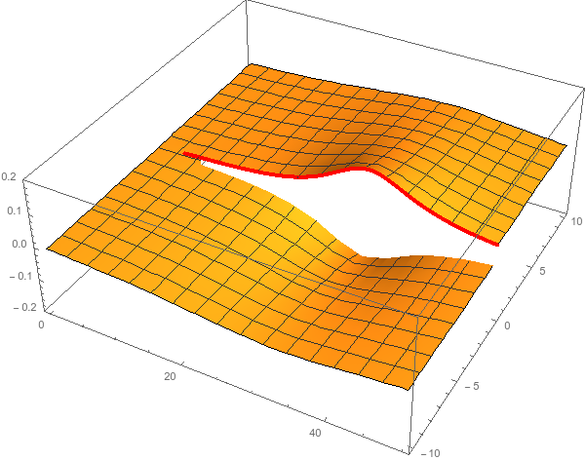
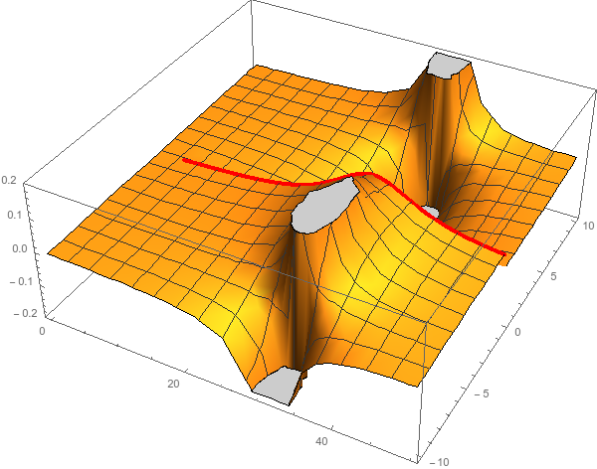
Unitarity & Pole hunting
Unitarity creates a branch cut on the real axis, two sheets continuosly connected
I sheet
II sheet
Finding resonances means writing analytic amplitude, and hunting for poles in the complex plane
A. Pilloni – The quest for Exotic states
Notes:
Controlla la parte su Regge

Slide 42
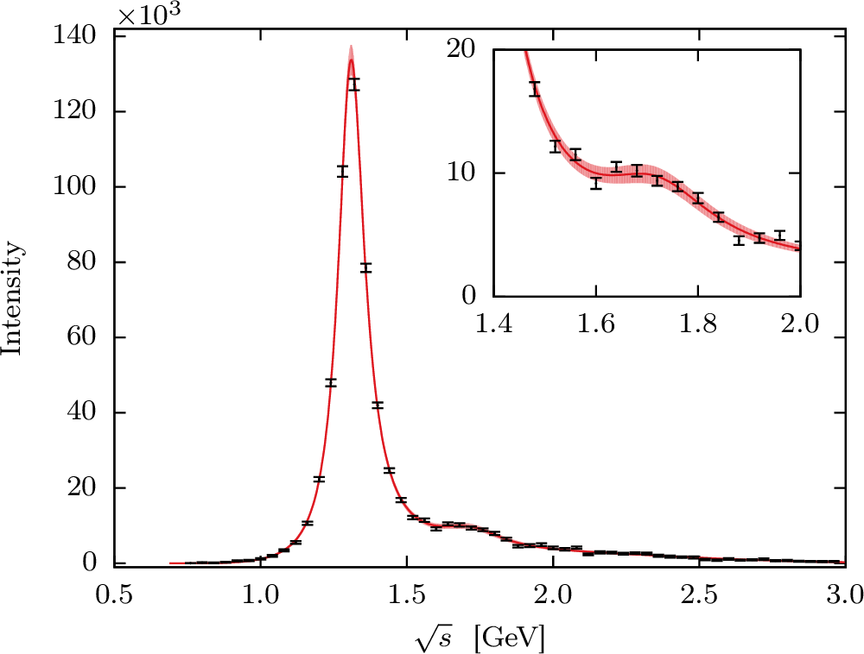
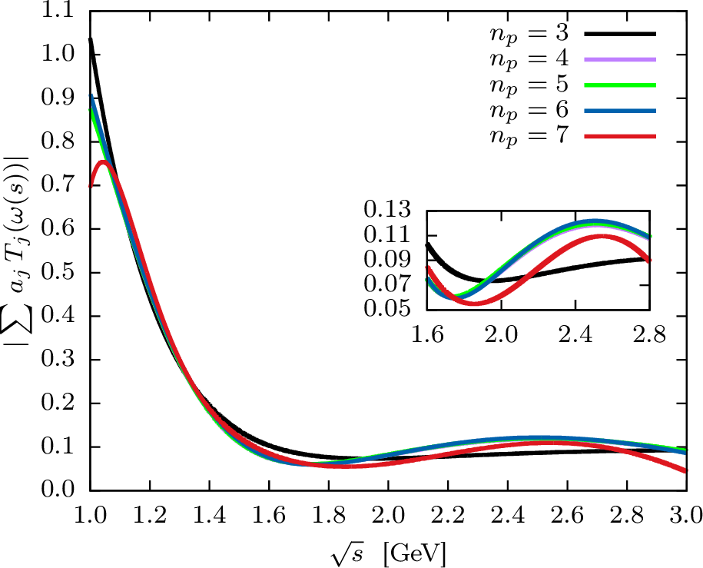
Recap: single channel $ηπ$
Test against the $D$-wave $ηπ$data, where the $a_{2}$ and the $a_{2}^{′}$ show up
A. Jackura, M. Mikhasenko, AP et al. (JPAC & COMPASS), PLB779, 464-472
Smooth «background»
Precise determination of pole position
Notes:
Controlla la parte su Regge

Slide 43
What about the $σ$?
Even if an Adler zero is added, hard to obtain a reasonable behavior of the phase in the $σ$region
We are exploring new parametrization
A. Pilloni – The quest for Exotic states
Notes:
Controlla la parte su Regge

Slide 44
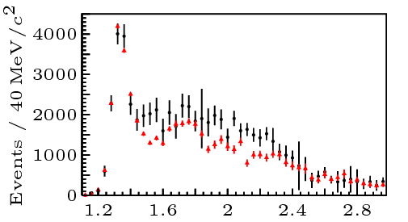
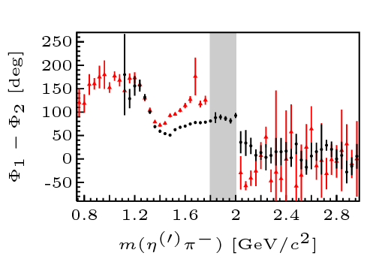
Data
COMPASS, PLB740, 303-311
P-wave $ηπ$ (resc.) $η^{′}π$
D-wave
A sharp drop appears at 2 GeV in P-wave intensity and phase No convincing physical motivation for it
It affects the position of the $a_{2}^{′}(1700)$
We decided to fit up to 2 GeV only
A. Pilloni – The quest for Exotic states
Notes:
Controlla la parte su Regge

Slide 45
Systematic studies
Change of functional form and parameters in the denominator
Default: $s_{R}=1 {\text{GeV}}^{2}$. We try $s_{R}=0.8, 1.8 {\text{GeV}}^{2}$
Default: $α=2$. We try $α=1$
We also try a different function: with $α=2, 1.5, 1$
Change of parameters in the numerator
Default: $t_{\text{eff}}=−0.1 {\text{GeV}}^{2}$. We try$t_{\text{eff}}=−0.5 {\text{GeV}}^{2}$
Default: 3rd order polynomial. We try 4th
A. Pilloni – The quest for Exotic states
Notes:
Controlla la parte su Regge

Slide 46
$ρπ$ channel and Deck amplitude
$$R_{ππ}$$
IP
The production allows for a nonresonant component (Deck effect) The singularity is close to the physical region, peaking background
We do not include this channel
(Deck)
(Deck)
A. Pilloni – The quest for Exotic states
Notes:
2 slides su Zc, a Bes e a Belle
2 slide su tetraquark model: dall’hamiltoniana di Jaffe al calcolo delle masse
1 slide su molecular models, dove sono i carichi? (non in Tornqvist, si in Hanhart, vedere Braaten, citare Nefediev)
2 slides su decay channels, dove si dovrebbe vedere, e a seconda del modello, vedere qualche plot
1 slide su Y(4260), tetraquark? C’è lo strano (si vede la f0)
1 slide su Zc a cleo (anche il neutro)

Slide 47
Searching for resonances in $ηπ$
Smooth «background»
Precise determination of pole position
Notes:
Controlla la parte su Regge

Slide 48
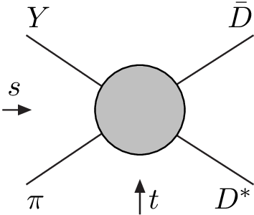
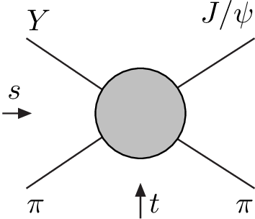
Amplitude analysis for $Z_{c}(3900)$
One can test different parametrizations of the amplitude, which correspond to different singularities → different natures
AP et al. (JPAC), PLB772, 200
$$Z_{c}\left(3900\right)?$$
$${u: D}_{0}(2400)$$
$${u:Z}_{c}\left(3900\right)?$$
$$"σ, f_{0}(980)"$$
$$D_{1}(2420)$$
Triangle rescattering, logarithmic branching point
(anti)bound state, II/IV sheet pole
(«molecule»)
Resonance, III sheet pole
(«compact state»)
$$π$$
$$D_{1}$$
$$Y$$
$$D^{∗}$$
$$π$$
$$\overline{D}$$
$$J/ψ$$
Tornqvist, Z.Phys. C61, 525
Swanson, Phys.Rept. 429
Hanhart et al. PRL111, 132003
Maiani et al., PRD71, 014028
Faccini et al., PRD87, 111102
Esposito et al., Phys.Rept. 668
Szczepaniak, PLB747, 410
A. Pilloni – The quest for Exotic states
Notes:
Controlla la parte su Regge

Slide 49
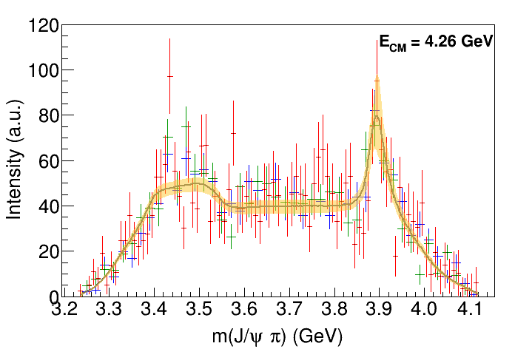
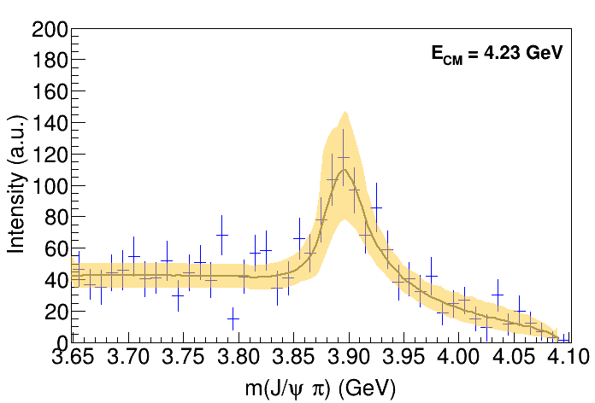
Fit: III
A. Pilloni – The quest for Exotic states
Notes:
Controlla la parte su Regge

Slide 50
Fit: III+tr.
A. Pilloni – The quest for Exotic states
Notes:
Controlla la parte su Regge

Slide 51
Fit: IV+tr.
A. Pilloni – The quest for Exotic states
Notes:
Controlla la parte su Regge

Slide 52
Fit: tr.
A. Pilloni – The quest for Exotic states
Notes:
Controlla la parte su Regge

Slide 53
Pole extraction
III
III+tr.
IV+tr.
A. Pilloni – The quest for Exotic states
Not conclusive at this stage
Notes:
Controlla la parte su Regge

Slide 54
Pole hunting
I sheet
Extracting physics information means to hunt for poles in the complex plane
Pole position → Mass and width
Residues → Couplings
Virtual state
II sheet
Bound state
Resonance
A. Pilloni – The quest for Exotic states
Notes:
Controlla la parte su Regge

Slide 55
Finite energy sum rules
PWA in the low energy region
Resonance extraction
Analytically connected
Regge exchanges at high energy
A. Pilloni – The quest for Exotic states
Notes:
Controlla la parte su Regge

Slide 56
$X(3872)$
Discovered in $B→K X→K J/ψ ππ$
Quantum numbers $1^{++}$
Very close to $DD^{∗}$ threshold
Too narrow for an above-treshold charmonium
Isospin violation too big $\frac{Γ\left(X→J/ψ ω\right)}{Γ\left(X→J/ψ ρ\right)}\sim 0.8±0.3$
Mass prediction not compatible with $χ_{c1}(2P)$
$M=3871.68±0.17$MeV
$$M_{X}−M_{DD^{∗}}=−3±192 \text{keV}$$
$Γ<1.2 \text{MeV}\text{ @90\%}$
A. Pilloni – The quest for Exotic states

Slide 57
$X(3872)$
Large prompt production at hadron colliders
$$σ_{B}/σ_{TOT}=\left(26.3±2.3±1.6\right)\%$$
$$σ_{PR}×B(X→J/ψππ)=\left(1.06±0.11±0.15\right) \text{nb}$$
CMS, JHEP 1304, 154
A. Pilloni – The quest for Exotic states

Slide 58
Vector $Y$ states
Lots of unexpected ${J^{PC}=1}^{−−}$ states found in ISR/direct production (and nowhere else!)
Seen in few final states, mostly $J/ψ ππ$ and $ψ\left(2S\right) ππ$
Not seen decaying into open charm pairs
Large HQSS violation
Belle $J/ψππ$
BES $h_{c}ππ$
A. Pilloni – The quest for Exotic states
Notes:
Y(4260), M=4263 +- 5, Gamma = 95+-14
D_1(2420)^0, M=2421.3 ±0.6, Gamma =27.1 ±2.7
D_1(2420)^+-, M=2423.4 ±3.1, Gamma =25 ±6
I D_1 hanno J^P = 1^+
La molecola D_1 D sta 22 MeV sotto
Se la Y è D_1 D, il pione lega fortemente, come fa la Y a essere così larga?
Come funziona lo scambio del pione???

Slide 59
Vector $Y$ states in BESIII
BESIII, PRL118, 092002 (2017)
BESIII, PRL118, 092001 (2017)
$$e^{+}e^{−}→J/ψ ππ$$
$$e^{+}e^{−}→h_{c} ππ$$
New BESIII data show a peculiar lineshape for the $Y(4260)$
The state appear lighter and narrower, compatible with the ones in $h_{c}ππ$ and $χ_{c0}ω$
A broader old-fashioned $Y(4260)$ is appearing in $\overline{D}D^{∗}π$, maybe indicating a ${\overline{D}D}_{1}$
dominance
$$e^{+}e^{−}→π^{+}D^{0}D^{∗−}$$
A. Pilloni – The quest for Exotic states
Notes:
Y(4260), M=4263 +- 5, Gamma = 95+-14
D_1(2420)^0, M=2421.3 ±0.6, Gamma =27.1 ±2.7
D_1(2420)^+-, M=2423.4 ±3.1, Gamma =25 ±6
I D_1 hanno J^P = 1^+
La molecola D_1 D sta 22 MeV sotto
Se la Y è D_1 D, il pione lega fortemente, come fa la Y a essere così larga?
Come funziona lo scambio del pione???
Close propone che la Y è D_1 D^* col pione scambiato in onda S,
La Y però non va in Ds come se fosse tetraquark

Slide 60
Charged $Z$ states: $Z_{c}\left(3900\right), Z_{c}^{′}(4020)$
Charged quarkonium-like resonances have been found, 4q needed
Two states $J^{PC}=1^{+−}$ appear slightly above $D^{(∗)}D^{∗}$ thresholds
$e^{+}e^{−}→Z_{c}{\left(3900\right)}^{+}π^{−}→J/ψ{ π}^{+}π^{−}$ and $→{\left(DD^{∗}\right)}^{+}π^{−}$ $M=3888.7±3.4$MeV, $Γ=35±7$ MeV
$e^{+}e^{−}→Z_{c}^{′}{\left(4020\right)}^{+}π^{−}→h_{c}{ π}^{+}π^{−}$ and $→{\overline{D}}^{∗0}D^{∗+}π^{−}$
$M=4023.9±2.4$MeV, $Γ=10±6$ MeV
A. Pilloni – The quest for Exotic states
Notes:
Y(4260), M=4263 +- 5, Gamma = 95+-14
D_1(2420)^0, M=2421.3 ±0.6, Gamma =27.1 ±2.7
D_1(2420)^+-, M=2423.4 ±3.1, Gamma =25 ±6
I D_1 hanno J^P = 1^+
La molecola D_1 D sta 22 MeV sotto
Se la Y è D_1 D, il pione lega fortemente, come fa la Y a essere così larga?
Come funziona lo scambio del pione???

Slide 61
Charged $Z$ states: $Z_{b}\left(10610\right), Z_{b}^{′}(10650)$
Anomalous dipion width in $Υ\left(5S\right)$,
2 orders of magnitude larger than $Υ\left(nS\right)$
Moreover, observed $Υ\left(5S\right)→h_{b}\left(nP\right)ππ$ which violates HQSS
$Υ\left(5S\right)→Z_{b}{\left(10610\right)}^{+}π^{−}→Υ\left(nS\right){ π}^{+}π^{−},h_{b}\left(nP\right){ π}^{+}π^{−}$ and $→{\left(BB^{∗}\right)}^{+}π^{−}$ $M=10607.2±2.0$MeV, $Γ=18.4±2.4$ MeV
$Υ\left(5S\right)→Z_{b}^{′}{\left(10650\right)}^{+}π^{−}→Υ\left(nS\right){ π}^{+}π^{−},h_{b}\left(nP\right){ π}^{+}π^{−}$ and $→{\overline{B}}^{∗0}B^{∗+}π^{−}$
$M=10652.2±1.5$MeV, $Γ=11.5±2.2$ MeV
2 twin resonances!
A. Pilloni – The quest for Exotic states
Notes:
Y(4260), M=4263 +- 5, Gamma = 95+-14
D_1(2420)^0, M=2421.3 ±0.6, Gamma =27.1 ±2.7
D_1(2420)^+-, M=2423.4 ±3.1, Gamma =25 ±6
I D_1 hanno J^P = 1^+
La molecola D_1 D sta 22 MeV sotto
Se la Y è D_1 D, il pione lega fortemente, come fa la Y a essere così larga?
Come funziona lo scambio del pione???

Slide 62
Pentaquarks!
LHCb, PRL 115, 072001
LHCb, PRL 117, 082003
Two states seen in $Λ_{b}→\left(J/ψ p\right) K^{−}$,
evidence in $Λ_{b}→\left(J/ψ p\right) π^{−}$
$$M_{1}=4380±8±29 \text{MeV} \\ Γ_{1}=205±18±86 \text{MeV}$$
$$M_{2}=4449.8±1.7±2.5 \text{MeV} \\ Γ_{2}=39±5±19 \text{MeV}$$
Quantum numbers $$J^{P}=\left({\frac{3}{2}}^{−},{\frac{5}{2}}^{+}\right) \text{or}\left({\frac{3}{2}}^{+},{\frac{5}{2}}^{−}\right)\text{or}\left({\frac{5}{2}}^{+},{\frac{3}{2}}^{−}\right)$$
Opposite parities needed for the interference to correctly describe angular distributions, low mass region contaminated by $Λ^{∗}$ (model dependence?)
No obvious threshold nearby
A. Pilloni – The quest for Exotic states
Notes:
Y(4260), M=4263 +- 5, Gamma = 95+-14
D_1(2420)^0, M=2421.3 ±0.6, Gamma =27.1 ±2.7
D_1(2420)^+-, M=2423.4 ±3.1, Gamma =25 ±6
I D_1 hanno J^P = 1^+
La molecola D_1 D sta 22 MeV sotto
Se la Y è D_1 D, il pione lega fortemente, come fa la Y a essere così larga?
Come funziona lo scambio del pione???

Slide 63
Pentaquarks!
LHCb, PRL 115, 072001
LHCb, PRL 117, 082003
Two states seen in $Λ_{b}→\left(J/ψ p\right) K^{−}$,
evidence in $Λ_{b}→\left(J/ψ p\right) π^{−}$
$$M_{1}=4380±8±29 \text{MeV} \\ Γ_{1}=205±18±86 \text{MeV}$$
$$M_{2}=4449.8±1.7±2.5 \text{MeV} \\ Γ_{2}=39±5±19 \text{MeV}$$
Quantum numbers $$J^{P}=\left({\frac{3}{2}}^{−},{\frac{5}{2}}^{+}\right) \text{or}\left({\frac{3}{2}}^{+},{\frac{5}{2}}^{−}\right)\text{or}\left({\frac{5}{2}}^{+},{\frac{3}{2}}^{−}\right)$$
Opposite parities needed for the interference to correctly describe angular distributions, low mass region contaminated by $Λ^{∗}$ (model dependence?)
No obvious threshold nearby
MC simul.
A. Pilloni – The quest for Exotic states
Notes:
Y(4260), M=4263 +- 5, Gamma = 95+-14
D_1(2420)^0, M=2421.3 ±0.6, Gamma =27.1 ±2.7
D_1(2420)^+-, M=2423.4 ±3.1, Gamma =25 ±6
I D_1 hanno J^P = 1^+
La molecola D_1 D sta 22 MeV sotto
Se la Y è D_1 D, il pione lega fortemente, come fa la Y a essere così larga?
Come funziona lo scambio del pione???

