Slide 1



Hadron Spectroscopy at the frontier of theory and experiment
Alessandro Pilloni
Multi-Particle 25 workshop, July 28th, 2025

Slide 2
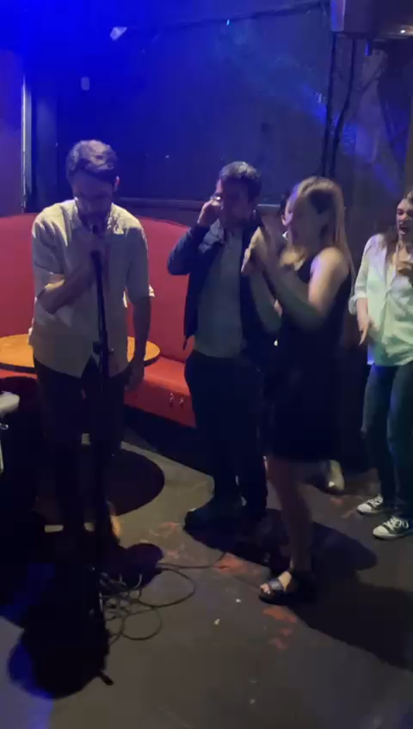
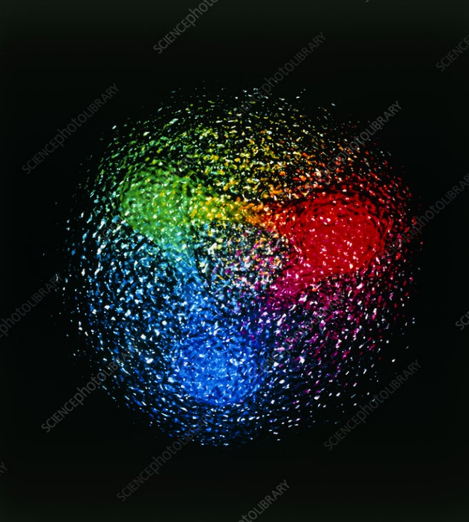
Why are we all here?
Goals:
Nuclear and nucleon structure
Excited spectrum
Hadron interactions and BSM searches
Hot and Dense QCD
Goals:
Nuclear and nucleon structure
Excited spectrum
Hadron interactions and BSM searches
Hot and Dense QCD
Goals:
Nuclear and nucleon structure
Excited spectrum
Hadron interactions and BSM searches
Hot and Dense QCD
QCD
Theory tools:
Lattice QCD
Functional methods
Effective field theories
QCD-like models
Scattering theory
Theory tools:
Lattice QCD
Functional methods
Effective field theories
QCD-like models
Scattering theory
Theory tools:
Lattice QCD
Functional methods
Effective field theories
QCD-like models
Scattering theory
Computational tools:
AI techniques
Bayesian inference
Uncertainty quant.
Computational tools:
AI techniques
Bayesian inference
Uncertainty quant.
Computational tools:
AI techniques
Bayesian inference
Uncertainty quant.
A. Pilloni – Hadron Spectroscopy at the frontier of theory and experiment
Notes:
Controlla la parte su Regge

Slide 3
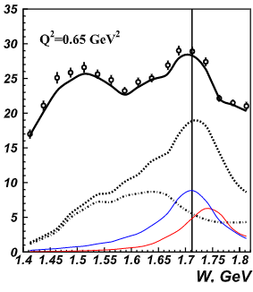

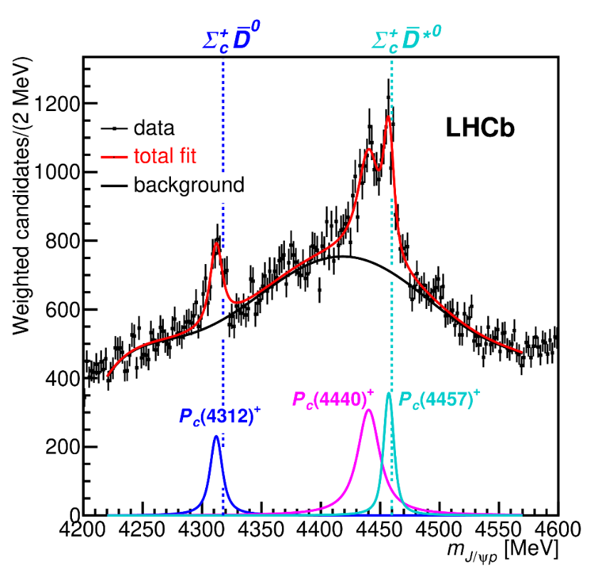
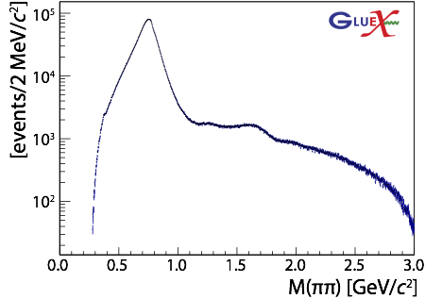

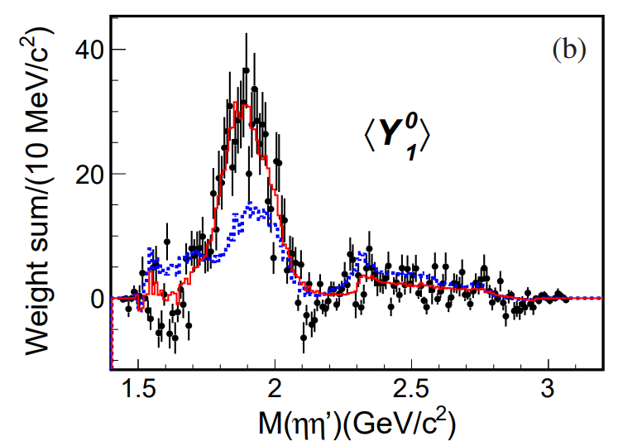
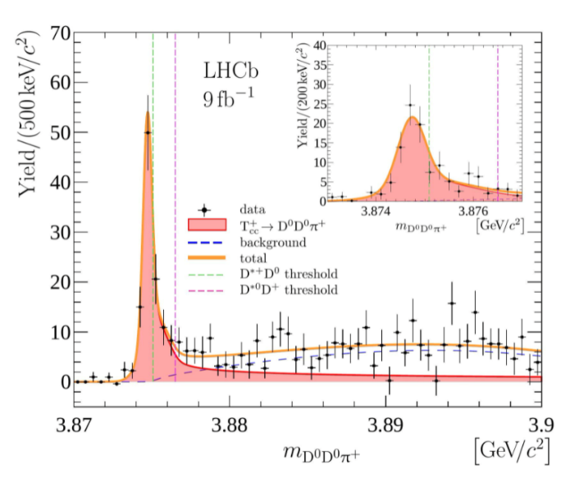

The richness of hadron spectrum
The structures populating hadron reactions
are extremely rich
Ultimate goal is to understand them
in term of QCD degrees of freedom
To do so, the spectrum of resonances
must be correctly reconstructed
A. Pilloni – Hadron Spectroscopy at the frontier of theory and experiment
Notes:
2 slides su Zc, a Bes e a Belle
2 slide su tetraquark model: dall’hamiltoniana di Jaffe al calcolo delle masse
1 slide su molecular models, dove sono i carichi? (non in Tornqvist, si in Hanhart, vedere Braaten, citare Nefediev)
2 slides su decay channels, dove si dovrebbe vedere, e a seconda del modello, vedere qualche plot
1 slide su Y(4260), tetraquark? C’è lo strano (si vede la f0)
1 slide su Zc a cleo (anche il neutro)

Slide 4
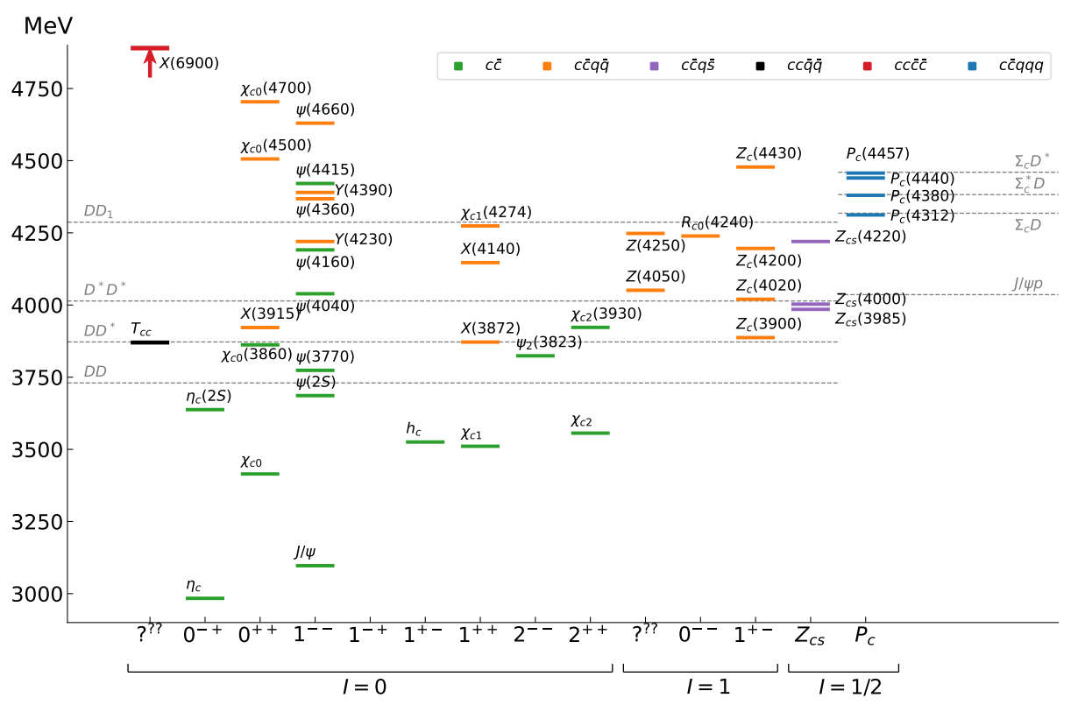
Exotics
The quark model is still the simplest tool to organize the spectrum
JPAC, PPNP 127 (2022), 103981
«Exotic hadrons» are Beyond the Standard (quark) Model
Organizing them teaches us some more about quark-gluon interactions
A. Pilloni – Hadron Spectroscopy at the frontier of theory and experiment
Notes:
2 slides su Zc, a Bes e a Belle
2 slide su tetraquark model: dall’hamiltoniana di Jaffe al calcolo delle masse
1 slide su molecular models, dove sono i carichi? (non in Tornqvist, si in Hanhart, vedere Braaten, citare Nefediev)
2 slides su decay channels, dove si dovrebbe vedere, e a seconda del modello, vedere qualche plot
1 slide su Y(4260), tetraquark? C’è lo strano (si vede la f0)
1 slide su Zc a cleo (anche il neutro)

Slide 5
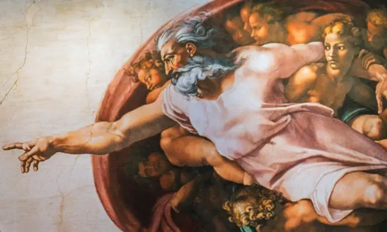
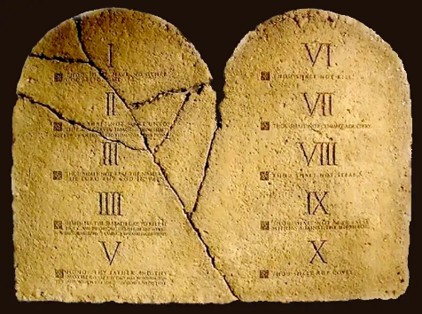
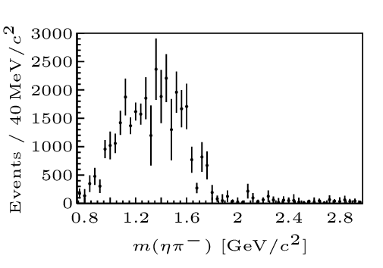
Top-down approach
You are given a model/theory
$$f(s)$$
You calculate the amplitude
You compare with data.
Or you don’t.
Predictive power ✓
Physical interpretation ✓
(within the model! ✗)
Biased by the input ✗
A. Pilloni – Hadron Spectroscopy at the frontier of theory and experiment

Slide 6
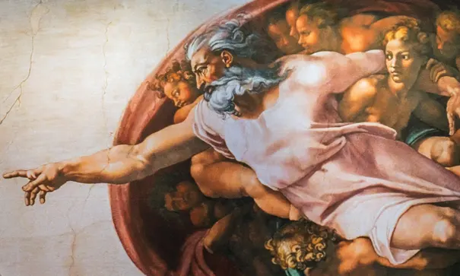
Options on the market
Quark-level calculations:
Quark models, DSE, pNRQCD, Hybrids, ...
Spectrum generally calculated as bound states of some potential
Decay rates as «overlap integrals» between two static configurations
Comprehensive picture ✓ Little scattering dynamics ✗
Hadron level calculations:
Microscopic models inspired to EFT + Unitarization
Compact states vs. molecules, triangles...
States as poles of scattering amplitudes
Couplings as residues at the poles
Scattering dynamics ✓ More case-by-case ✓✗
A. Pilloni – Hadron Spectroscopy at the frontier of theory and experiment

Slide 7
Potential problems
We can’t afford being misguided by simplistic resonance extraction!
(life is already hard enough without red herrings)
Amplitude analysis requires collaboration
of theorists and experimentalists
However, we don’t have a universal recipe to do things right
We have to proceed:
Case-by-case
Keep in mind the limitations of each approach
Overstudy (the more approaches the better)
No overstatement (do-no-harm)
A. Pilloni – Hadron Spectroscopy at the frontier of theory and experiment

Slide 8
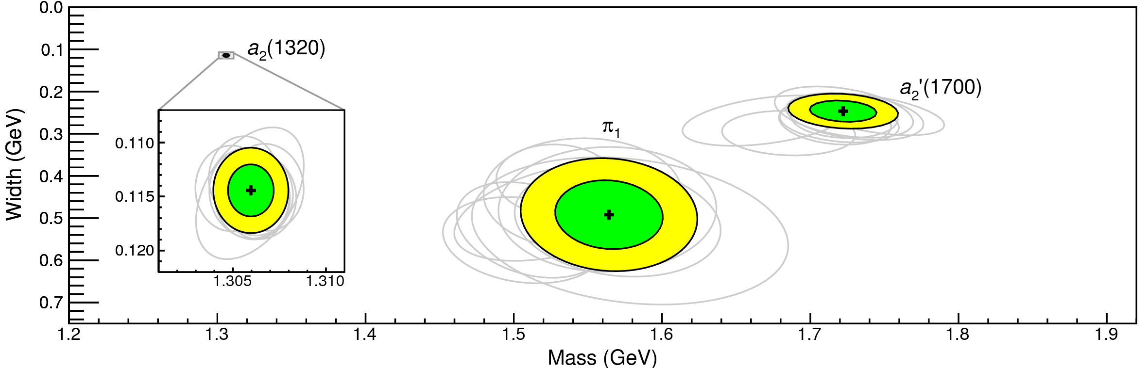
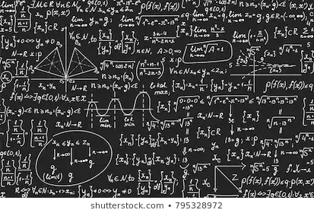
Bottom-up approach
Less predictive power ✗
Some physical interpretation ✗
Minimally biased ✓
You extract physics
You choose a set of generic amplitudes
You start with data
A. Pilloni – Hadron Spectroscopy at the frontier of theory and experiment

Slide 9
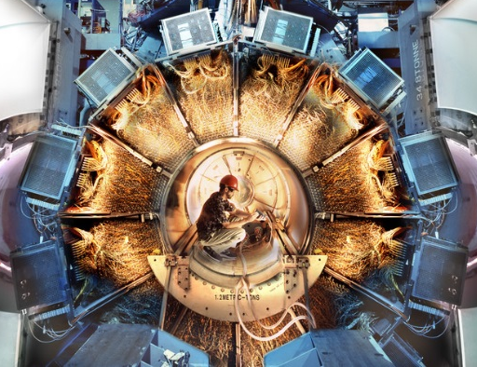
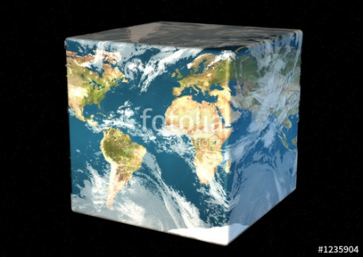




Hadron Spectroscopy
Hybrids
Tetraquark
Meson
Baryon
Glueball
$$π$$
$$π$$
$$J/ψ$$
$$π$$
Hadroquarkonium
Molecule
Experiment
Data
Amplitude analysis
QCD
Lattice QCD
Interpretations on the spectrum leads to
understanding fundamental laws of nature

Slide 10
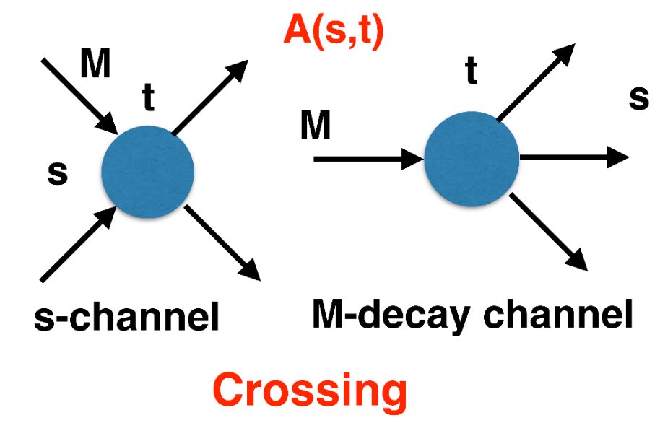
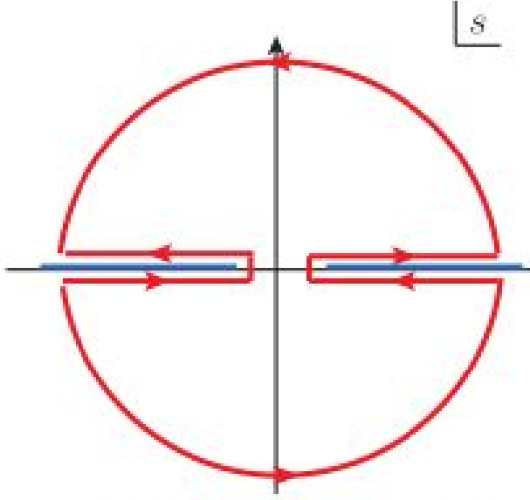
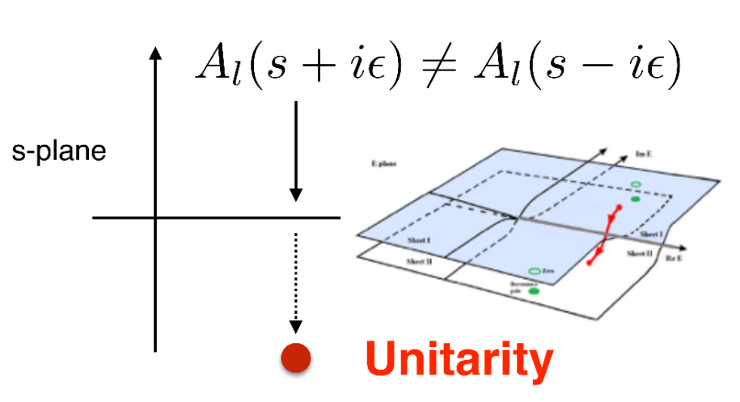

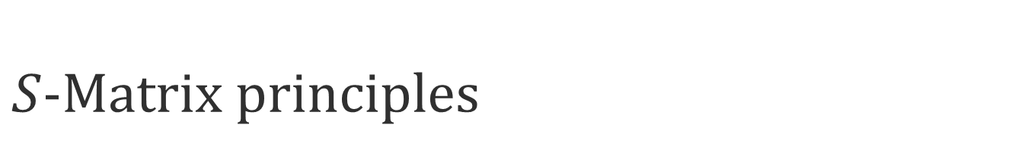

$S$-Matrix principles
$$t_{l}\left(s\right)=\lim_{ε→0}t_{l}(s+iε)⁡$$
Analyticity
$$\text{Im} t_{l}=ρ_{l}{\left|t_{l}\right|}^{2} ⁡$$
These are constraints the amplitudes have to satisfy, but do not fix the dynamics
They can be imposed with an increasing amount of rigor, to extract robust physics information
The «background» phenomena can be effectively parameterized in a controlled way
+ Lorentz, discrete & global symmetries
A. Pilloni – Hadron Spectroscopy at the frontier of theory and experiment
Notes:
Controlla la parte su Regge

Slide 11



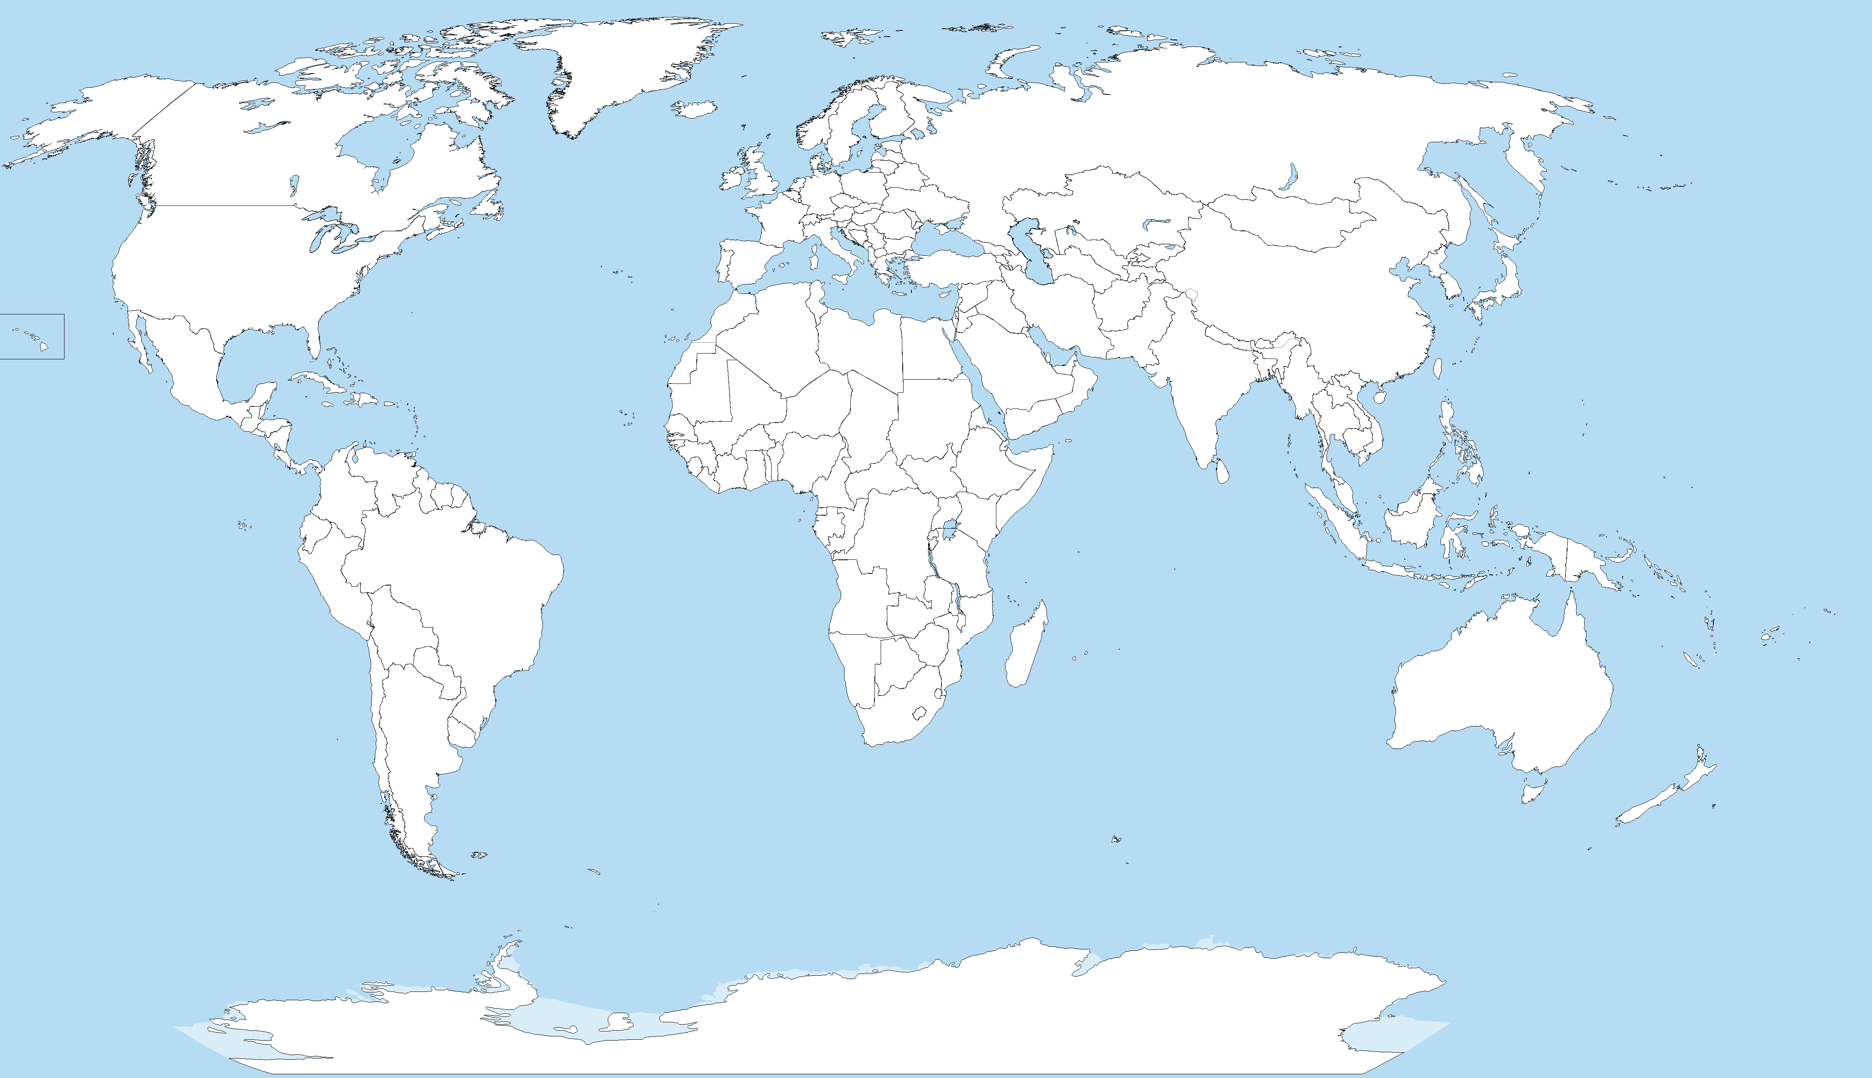










Joint Physics Analysis Center
Funded in 2013 as theory support
originally for JLab exps, but grew up much larger
40+ researchers affiliated during a decade
Flat hierarchy, decisions by consensus
Creates bridges between
theorists and experimentalists
Production mechanisms
Resonance studies
Multibody interactions
Running
Planned
A. Pilloni – Hadron Spectroscopy at the frontier of theory and experiment
Notes:
Controlla la parte su Regge

Slide 12
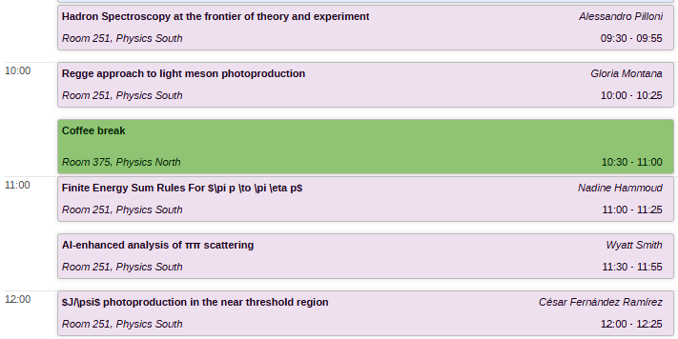
Joint Physics Analysis Center
Production mechanisms
Resonance studies
Multibody interactions
A. Pilloni – Hadron Spectroscopy at the frontier of theory and experiment
Notes:
Controlla la parte su Regge

Slide 13

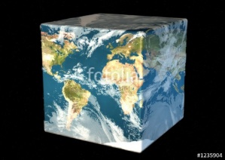


Exo(tic) Had(ron) TC
Funded in 2023 by DoE as a Topical Collaboration in Nuclear Physics
Hybrids from Scattering
Form factors
Lattice QCD
Aims at exploring all aspects of exotics
(= hybrids at GlueX)
Quark level calculations
Lessons from EFTs
QCD
Studying details of production mechanisms of exotics at GlueX
Finite energy sum rules
Amplitude Analysis
Phenomenology
A. Pilloni – Hadron Spectroscopy at the frontier of theory and experiment
Notes:
Controlla la parte su Regge

Slide 14
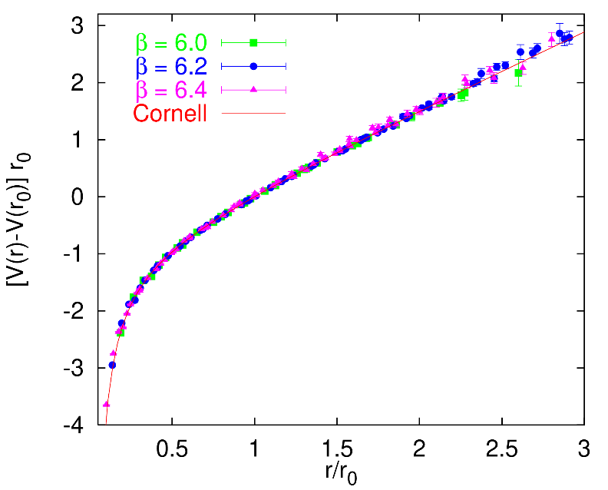
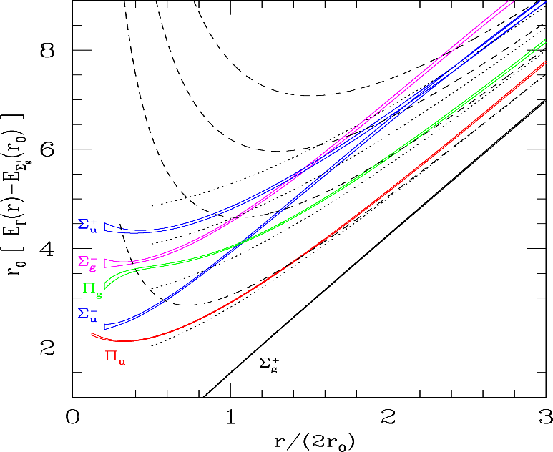
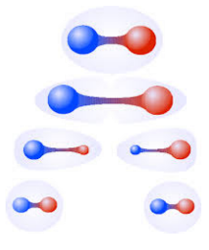
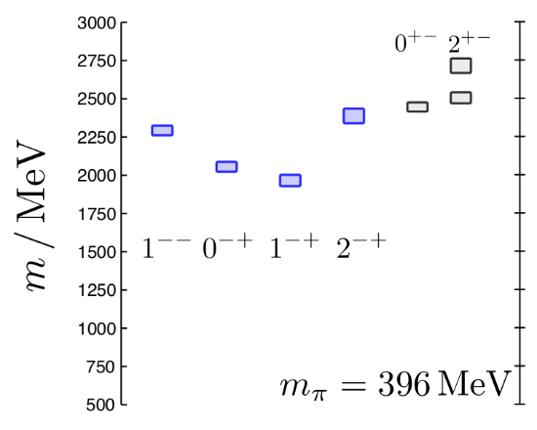
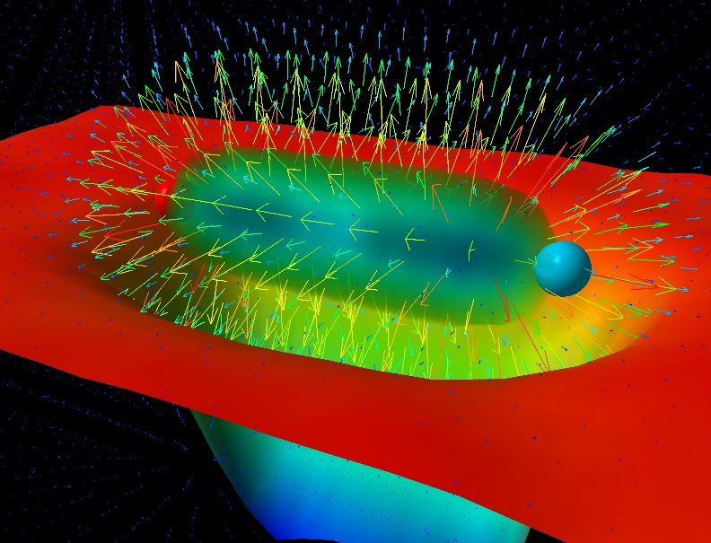

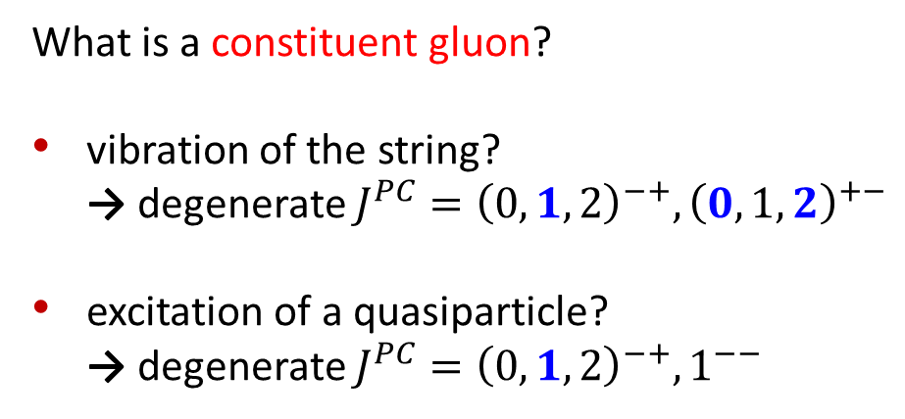
Learning about confinement
If quarks were infinitely heavy,
gluonic field is confined in a string
Linear rising potential
What is a constituent gluon?
vibration of the string?
→ degenerate $J^{PC}={\left(0,1,2\right)}^{−+},{\left(0,1,2\right)}^{+−}$
excitation of a quasiparticle?
→ degenerate $J^{PC}={\left(0,1,2\right)}^{−+},1^{−−}$
G. Bali
C. Morningstar
J. Dudek
excitation of a quasiparticle!
→ degenerate $J^{PC}={\left(0,1,2\right)}^{−+},1^{−−}$
says Lattice QCD...
What about real data?
D. Leinweber
A. Pilloni – Hadron Spectroscopy at the frontier of theory and experiment
Notes:
Controlla la parte su Regge

Slide 15
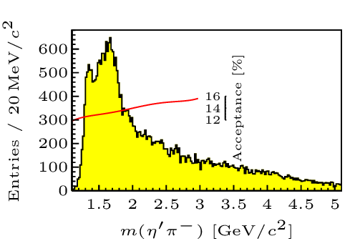



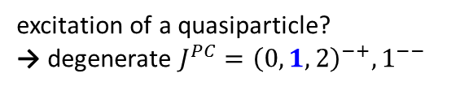


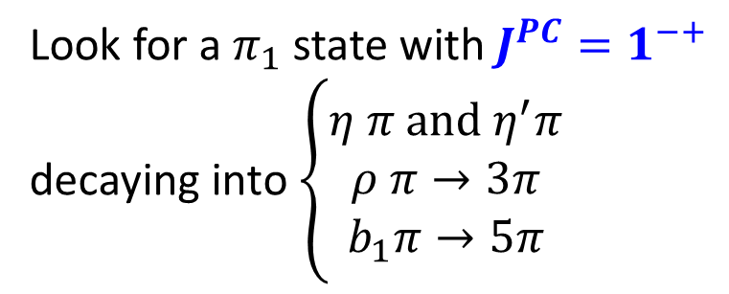
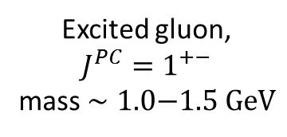
Hybrid hunting
J. Dudek
Excited gluon,
$$J^{PC}=1^{+−}$$
mass $∼1.0\text{−}1.5 \text{GeV}$
$$\overline{r}$$
$$\overline{g}$$
$$r$$
excitation of a quasiparticle?
→ degenerate $J^{PC}={\left(0,1,2\right)}^{−+},1^{−−}$
$$g$$
Look for a $π_{1}$ state with $J^{PC}=1^{−+}$
decaying into $\left\{\begin{matrix}η π \text{and} η^{′}π \\ ρ π→3π \\ b_{1}π→5π\end{matrix}\right.$
Small signal in data
A. Pilloni – Hadron Spectroscopy at the frontier of theory and experiment
Notes:
2 slides su Zc, a Bes e a Belle
2 slide su tetraquark model: dall’hamiltoniana di Jaffe al calcolo delle masse
1 slide su molecular models, dove sono i carichi? (non in Tornqvist, si in Hanhart, vedere Braaten, citare Nefediev)
2 slides su decay channels, dove si dovrebbe vedere, e a seconda del modello, vedere qualche plot
1 slide su Y(4260), tetraquark? C’è lo strano (si vede la f0)
1 slide su Zc a cleo (anche il neutro)

Slide 16
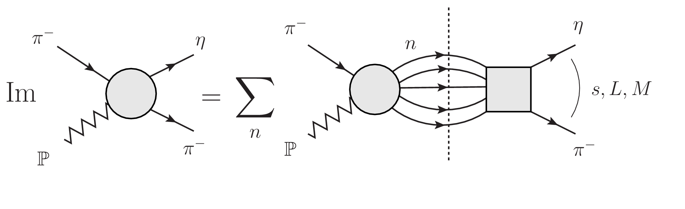

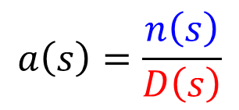



Amplitudes for $η^{(′)}π$
We build the partial wave amplitudes according to the $N/D$ method
Jackura, Mikhasenko, AP et al. (JPAC & COMPASS), PLB
Rodas, AP et al. (JPAC), PRL
$$a\left(s\right)=\frac{n\left(s\right)}{D\left(s\right)}$$
$$D(s)$$
$$n(s)$$
The $n\left(s\right)$ → background physics, process-dependent, smooth
The $D(s)$ contains all the Final State Interactions constrained by unitarity → universal
A. Pilloni – Hadron Spectroscopy at the frontier of theory and experiment
Notes:
Controlla la parte su Regge

Slide 17
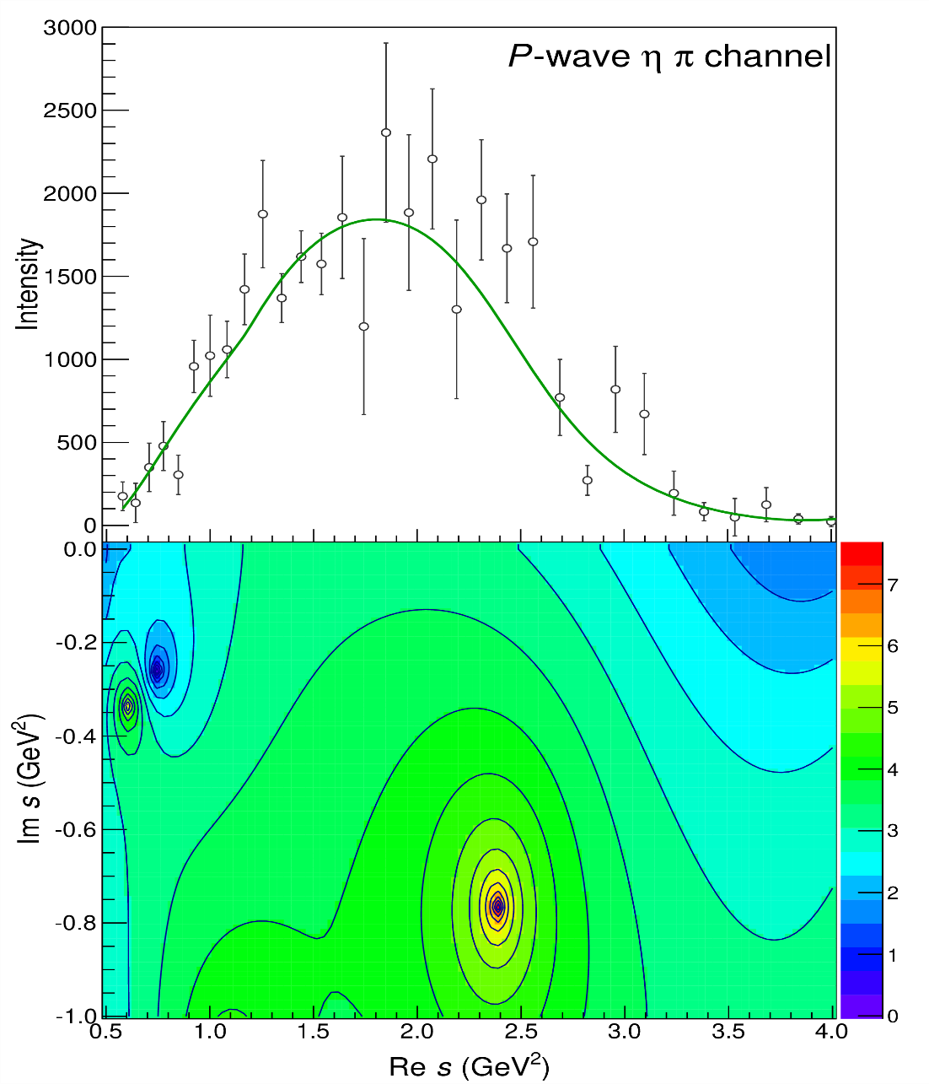
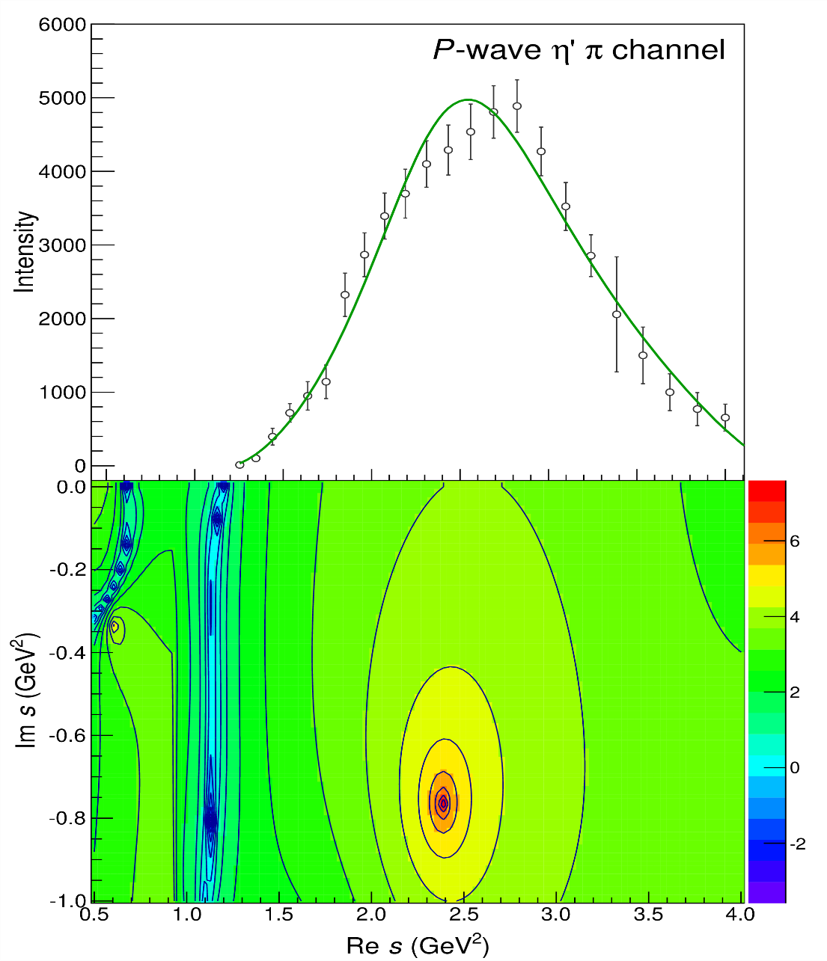


Pole hunting
$$π_{1}$$
$$π_{1}$$
A. Pilloni – Hadron Spectroscopy at the frontier of theory and experiment
Notes:
Controlla la parte su Regge

Slide 18
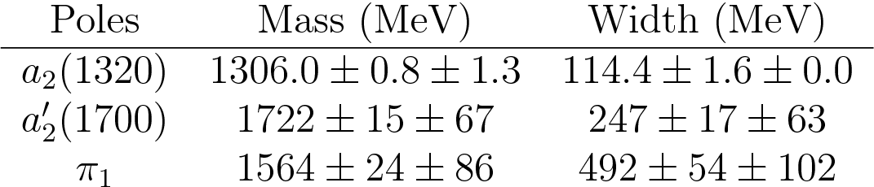
Final results
Agreement with Lattice is restored
That’s the most rigorous extraction
of an exotic meson available so far!
A. Pilloni – Hadron Spectroscopy at the frontier of theory and experiment
Notes:
Controlla la parte su Regge

Slide 19
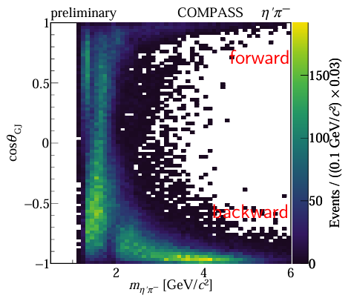
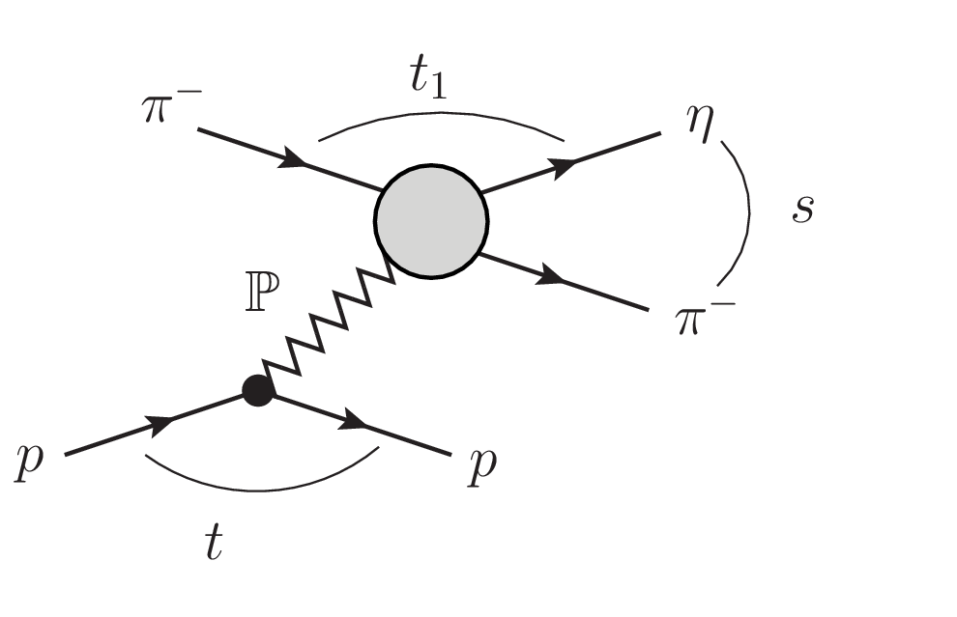
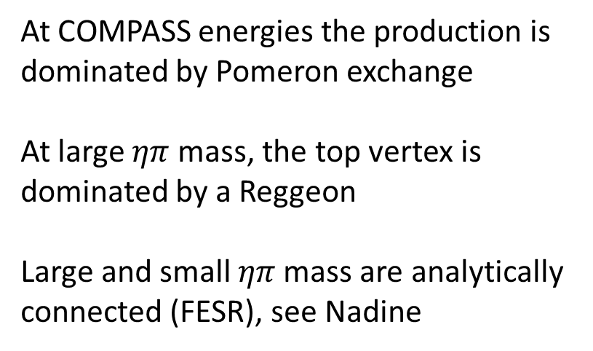
From COMPASS…
At COMPASS energies the production is dominated by Pomeron exchange
At large $ηπ$ mass, the top vertex is dominated by a Reggeon
Large and small $ηπ$ mass are analytically connected (FESR), see Nadine
Bibrzycki et al. (JPAC), EPJC
A. Pilloni – Hadron Spectroscopy at the frontier of theory and experiment
Notes:
Controlla la parte su Regge

Slide 20
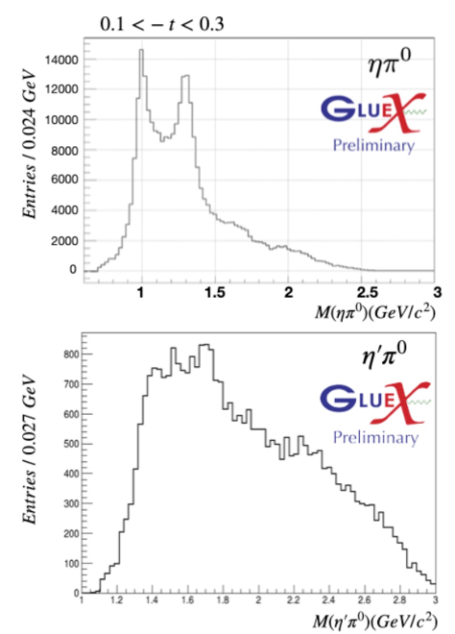


…to GlueX
$$γ$$
$$ρ,ω,π,$$
Richer structure of the exchanges,
polarization observables
Production mechanisms need to be understood starting from the simplest channels, see Gloria
A. Pilloni – Hadron Spectroscopy at the frontier of theory and experiment
Notes:
Controlla la parte su Regge

Slide 21
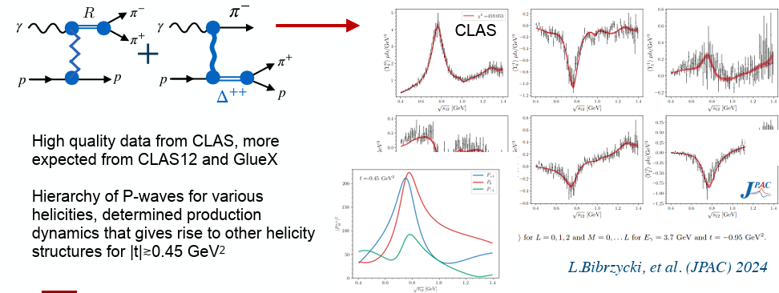
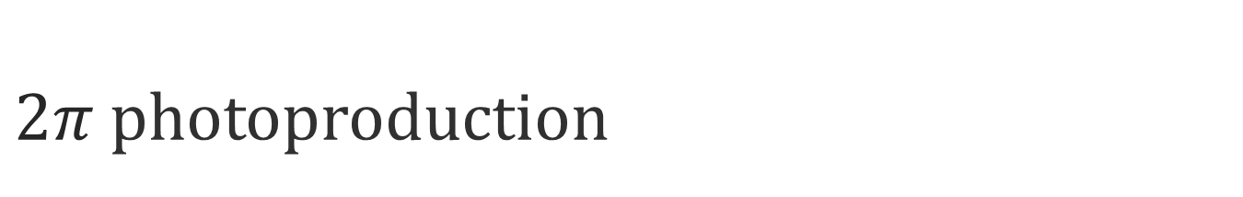
$2π$ photoproduction
A. Pilloni – Hadron Spectroscopy at the frontier of theory and experiment
Notes:
Controlla la parte su Regge

Slide 22
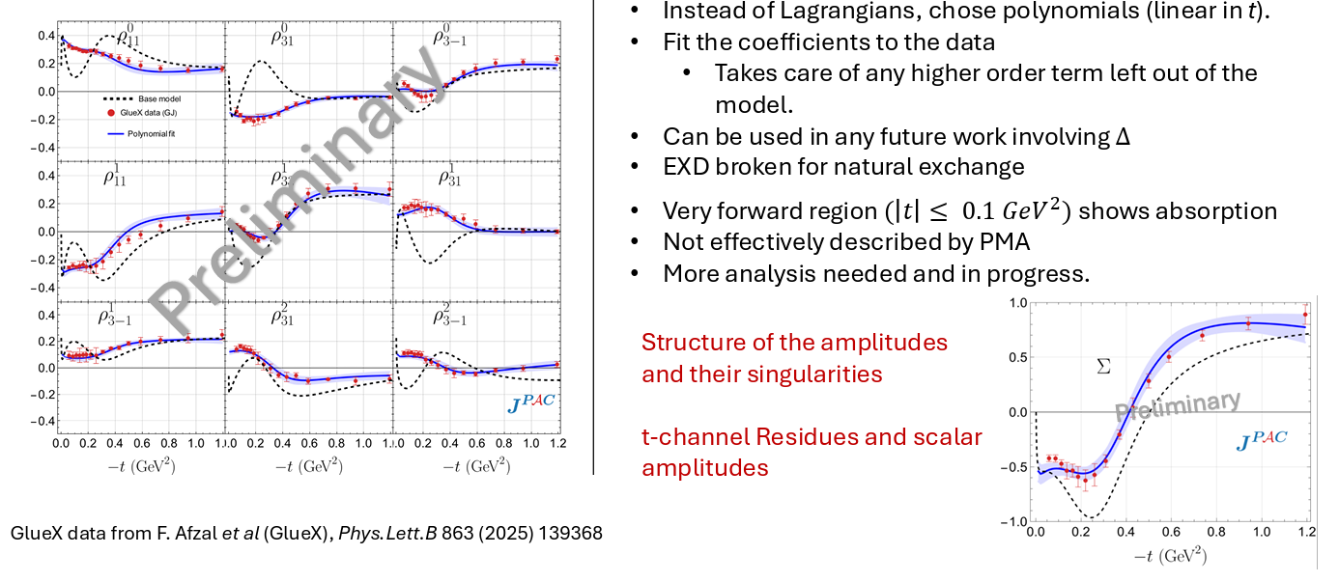
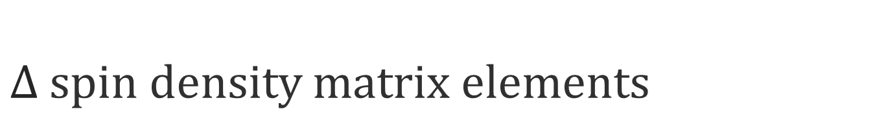
$Δ$ spin density matrix elements
Shastry et al. (JPAC), in progress
A. Pilloni – Hadron Spectroscopy at the frontier of theory and experiment
Notes:
Controlla la parte su Regge

Slide 23
Conclusions
Bottom-up approaches are important!
They allow us to get the most out of high statistics data!
JPAC and ExoHad will continue providing tools and results
to understand the exciting spectrum of QCD
Thank you!
A. Pilloni – Hadron Spectroscopy at the frontier of theory and experiment
Notes:
2 slides su Zc, a Bes e a Belle
2 slide su tetraquark model: dall’hamiltoniana di Jaffe al calcolo delle masse
1 slide su molecular models, dove sono i carichi? (non in Tornqvist, si in Hanhart, vedere Braaten, citare Nefediev)
2 slides su decay channels, dove si dovrebbe vedere, e a seconda del modello, vedere qualche plot
1 slide su Y(4260), tetraquark? C’è lo strano (si vede la f0)
1 slide su Zc a cleo (anche il neutro)

Slide 24
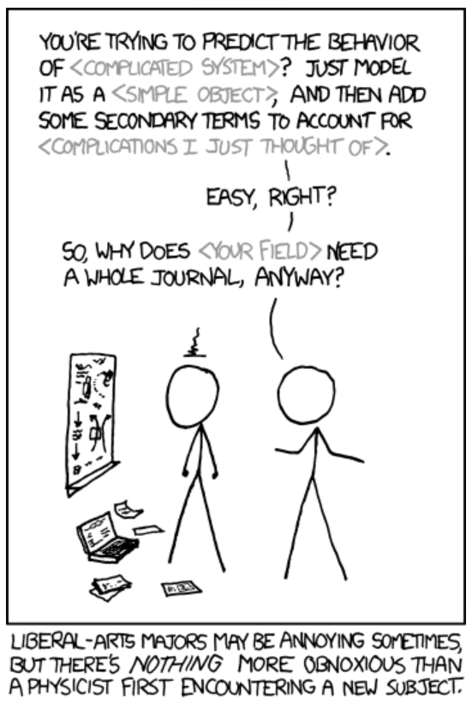
Real(istic) conversations
between theorists and experimentalists
T: How could you not find the XXX quantum numbers?
E: Well, you know, 5D fit, O(100) parameters, local minima, systematics…
T: You are not that good, are you?
T: You shouldn’t use Breit Wigners!
E: Gimme some better
T: I have an analytic unitary parametrization, but it works in a given mass window and only knows about energy dependence, you can’t add background terms to it…
E: Breit Wigners.
T: Stop using complex couplings!
E: HAHAHAHHAHAHAHAHAHHHAHAHAHA
A. Pilloni – Hadron Spectroscopy at the frontier of theory and experiment
Notes:
2 slides su Zc, a Bes e a Belle
2 slide su tetraquark model: dall’hamiltoniana di Jaffe al calcolo delle masse
1 slide su molecular models, dove sono i carichi? (non in Tornqvist, si in Hanhart, vedere Braaten, citare Nefediev)
2 slides su decay channels, dove si dovrebbe vedere, e a seconda del modello, vedere qualche plot
1 slide su Y(4260), tetraquark? C’è lo strano (si vede la f0)
1 slide su Zc a cleo (anche il neutro)

Slide 25
Backup

Slide 26
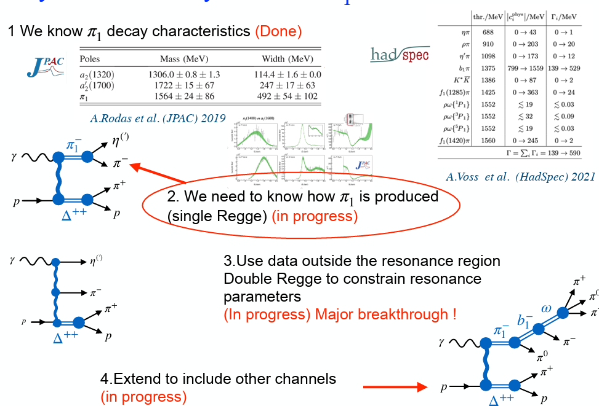
…to GlueX
A. Pilloni – Hadron Spectroscopy at the frontier of theory and experiment
Notes:
Controlla la parte su Regge

Slide 27
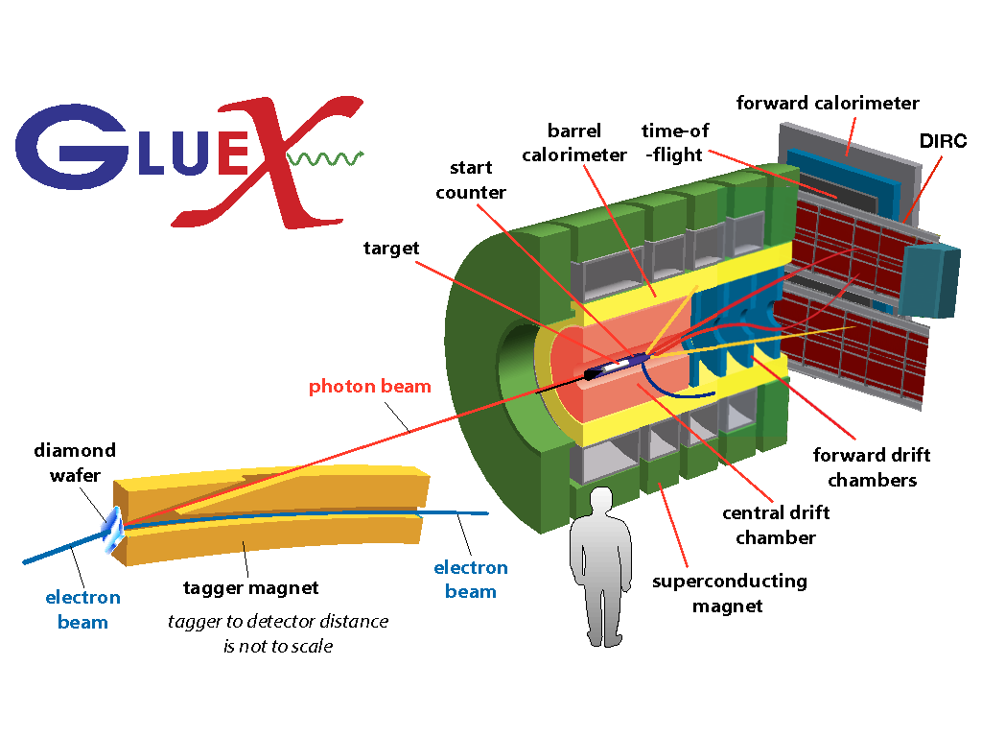



How theorists think of experiments
All the information about hadrons is collected
by the Particle Data Group
$$G$$
Changing beam and target,
you can change the font
P
D
What theorists see…
What experimentalists present…
A. Pilloni – Hadron Spectroscopy at the frontier of theory and experiment

Slide 28





Two hybrid states???
Neither lattice nor models predict two $1^{−+}$ states in this region!
A hybrid meson ($8$) cannot decay into $ηπ$
in the SU(3) limit
Tetraquark ($10⊕\overline{10}$)? Requires doubly charged
A. Pilloni – Hadron Spectroscopy at the frontier of theory and experiment
Notes:
2 slides su Zc, a Bes e a Belle
2 slide su tetraquark model: dall’hamiltoniana di Jaffe al calcolo delle masse
1 slide su molecular models, dove sono i carichi? (non in Tornqvist, si in Hanhart, vedere Braaten, citare Nefediev)
2 slides su decay channels, dove si dovrebbe vedere, e a seconda del modello, vedere qualche plot
1 slide su Y(4260), tetraquark? C’è lo strano (si vede la f0)
1 slide su Zc a cleo (anche il neutro)

Slide 29






Pole hunting
$$a_{2}^{′}\left(1700\right)$$
$$a_{2}^{′}\left(1700\right)$$
$$a_{2}\left(1320\right)$$
$$a_{2}\left(1320\right)$$
A. Pilloni – Hadron Spectroscopy at the frontier of theory and experiment
Notes:
Controlla la parte su Regge

Slide 30




In defense of VMD
The weak point of the whole approach is the use of VMD
While in the light sector it works reasonably, for heavy states is not justified
The X(3872) observed in purely hadronic and photonic modes gives us unique clue to efficacy of VMD
Belle extracted the coupling $X\left(3872\right)→γγ^{∗}$,
that can be compared with the VMD predictions
from $X\left(3872\right)→J/ψ ρ,ω$
Other estimate lead to differences of a factor $∼3$
A. Pilloni – Hadron Spectroscopy at the frontier of theory and experiment

Slide 31


New pentaquarks discovered
The lowest $P_{c}(4312)$ appears
as an isolated peak
at the $Σ_{c}^{+}{\overline{D}}^{0}$ threshold
A detailed study of the lineshape provides insight on its nature
Bottom-up:
DON’T YOU DARE describing everything!!!
Focus on the peak region
A. Pilloni – Hadron Spectroscopy at the frontier of theory and experiment
Notes:
Controlla la parte su Regge

Slide 32







Minimal(istic) model for $P_{c}(4312)$
Fernandez-Ramirez et al. (JPAC), PRL 123, 092001
Effective range expansion
We can set $c_{ii}=0$ to reduce
to the scattering length approximation
Points to a virtual state
$$c_{ii}=0$$
Finite $c_{ii}$
A. Pilloni – Hadron Spectroscopy at the frontier of theory and experiment
Notes:
2 slides su Zc, a Bes e a Belle
2 slide su tetraquark model: dall’hamiltoniana di Jaffe al calcolo delle masse
1 slide su molecular models, dove sono i carichi? (non in Tornqvist, si in Hanhart, vedere Braaten, citare Nefediev)
2 slides su decay channels, dove si dovrebbe vedere, e a seconda del modello, vedere qualche plot
1 slide su Y(4260), tetraquark? C’è lo strano (si vede la f0)
1 slide su Zc a cleo (anche il neutro)

Slide 33




Minimal(istic) model with ANN
Ng, et al. (JPAC), PRD 105, L091501
Same conclusion reached if the analysis is performed with a Deep Neural Network
The peak region has the largest impact for the decision
Highest probability for a virtual state in the IV sheet
A. Pilloni – Hadron Spectroscopy at the frontier of theory and experiment
Notes:
2 slides su Zc, a Bes e a Belle
2 slide su tetraquark model: dall’hamiltoniana di Jaffe al calcolo delle masse
1 slide su molecular models, dove sono i carichi? (non in Tornqvist, si in Hanhart, vedere Braaten, citare Nefediev)
2 slides su decay channels, dove si dovrebbe vedere, e a seconda del modello, vedere qualche plot
1 slide su Y(4260), tetraquark? C’è lo strano (si vede la f0)
1 slide su Zc a cleo (anche il neutro)

Slide 34
Hadron Spectroscopy
Hybrids
Tetraquark
Meson
Baryon
Glueball
$$π$$
$$π$$
$$J/ψ$$
$$π$$
Hadroquarkonium
Molecule
Experiment
Data
Amplitude analysis
QCD
Lattice QCD
Interpretations on the spectrum leads to
understanding fundamental laws of nature

Slide 35







How to identify a glueball
You don’t. Since it mixes with light isoscalars, there is no model-independent way of saying which state is (mostly) the glueball. Only suggestions:
There is one too many wrt QM. Indeed, $f_{0}\left(1370\right),f_{0}\left(1500\right),$ $f_{0}\left(1710\right)$
A glueball couples to photons only throughout mixing, so radiative widths should be small
Their production is enhanced in gluon-rich processes, as $J/ψ$ radiative decays
It couples equally to mesons of all flavors (?)
$$c$$
However, an argument based on chiral symmetry
claims the coupling proportional to quark mass
$$J/ψ$$
$$\overline{c}$$
G
A. Pilloni – Hadron Spectroscopy at the frontier of theory and experiment

Slide 36


Differential cross section
This is realized with the interference of various waves,
- constructive in the forward direction
- distructive in the backward direction
because of the Legendre polynomials
Good hierarchy between waves
A. Pilloni – Hadron Spectroscopy at the frontier of theory and experiment

Slide 37



Spectroscopy from peripheral production
Need to establish Regge factorization
Single Regge pole dominate
A. Pilloni – Hadron Spectroscopy at the frontier of theory and experiment
Notes:
2 slides su Zc, a Bes e a Belle
2 slide su tetraquark model: dall’hamiltoniana di Jaffe al calcolo delle masse
1 slide su molecular models, dove sono i carichi? (non in Tornqvist, si in Hanhart, vedere Braaten, citare Nefediev)
2 slides su decay channels, dove si dovrebbe vedere, e a seconda del modello, vedere qualche plot
1 slide su Y(4260), tetraquark? C’è lo strano (si vede la f0)
1 slide su Zc a cleo (anche il neutro)

Slide 38


Total cross section
With optical theorem one gets the total cross section $J/ψ p→\text{X}$.
This has been estimated from
the A-dependence of nuclear targets,
$4\text{mb}$ at $\sqrt{s}=6.2 \text{GeV}$.
VMD estimates provide values at least 1order of magnitude smaller
A. Pilloni – Hadron Spectroscopy at the frontier of theory and experiment

Slide 39
Options on the market
Quark-level calculations:
Quark models, pNRQCD, Hybrids, ...
Spectrum generally calculated as bound states of some potential
Decay rates as «overlap integrals» between two static configurations
Comprehensive picture ✓ Little scattering dynamics ✗
Hadron level calculations:
Microscopic models inspired to EFT + Unitarization
Compact states vs. molecules, triangles...
States as poles of scattering amplitudes
Couplings as residues at the poles
Scattering dynamics ✓ More case-by-case ✓✗
A. Pilloni – Hadron Spectroscopy at the frontier of theory and experiment

Slide 40







Quarkonium orthodoxy
$$Q$$
$$\overline{Q}$$
Potential models
(meaningful when $M_{Q}→∞$)
$$V\left(r\right)=−\frac{C_{F}α_{s}}{r}+σr$$
(Cornell potential)
$$α_{s}\left(M_{Q}\right)∼0.3$$
(perturbative regime)
OZI-rule, QCD multipole
Solve NR Schrödinger eq. → spectrum
Effective theories
(HQET, NRQCD, pNRQCD...)
Heavy quark spin flip suppressed by quark mass,
approximate heavy quark spin symmetry (HQSS)
Integrate out heavy DOF
↓
(spectrum), decay & production rates
A. Pilloni – Hadron Spectroscopy at the frontier of theory and experiment
Notes:
2 slides su Zc, a Bes e a Belle
2 slide su tetraquark model: dall’hamiltoniana di Jaffe al calcolo delle masse
1 slide su molecular models, dove sono i carichi? (non in Tornqvist, si in Hanhart, vedere Braaten, citare Nefediev)
2 slides su decay channels, dove si dovrebbe vedere, e a seconda del modello, vedere qualche plot
1 slide su Y(4260), tetraquark? C’è lo strano (si vede la f0)
1 slide su Zc a cleo (anche il neutro)

Slide 41




Amplitudes for $J/ψ→γ PP$
Rodas et al., EPJC 82, 1, 80
We build the partial wave amplitudes according to the $N/D$ method
$$n(s)$$
$$a\left(s\right)=\frac{n\left(s\right)}{D\left(s\right)}$$
$$D(s)$$
The $n\left(s\right)$ → background physics, process-dependent, smooth
The $D(s)$ contains all the Final State Interactions constrained by unitarity → universal
A. Pilloni – Hadron Spectroscopy at the frontier of theory and experiment
Notes:
Controlla la parte su Regge

Slide 42




$J/ψ→γ π^{0}π^{0} and→γ K_{S}^{0}K_{S}^{0}$
The fit is decent, but it’s struggling in getting the $f_{2}′$ right
Being quasi-elastic, it’s too constrained
Fit quality and local description improve when a third $ρρ$ channel is added
( data)
A. Pilloni – Hadron Spectroscopy at the frontier of theory and experiment

Slide 43


Pole extraction
For data-driven pole extractions, see also D. Binosi, A. Pilloni, R.-A. Tripolt PLB 839, 137809
A. Pilloni – Hadron Spectroscopy at the frontier of theory and experiment

Slide 44



Looking at the residues
Despite the large systematics,
the $f_{0}\left(1710\right)$ couples to kaons
more than the $f_{0}\left(1500\right)$
Also, the $f_{0}\left(1710\right)$ couples to
the initial gluon-rich state
more than the $f_{0}\left(1500\right)$
Both these fact suggest a sizeable glueball component for the $f_{0}\left(1710\right)$
Caveats:
some of the relevant channels are neglected, hopefully ratios not affected
Left-hand cuts of scattering processes contribute to scattering.
Poorly known and neglected here.
A. Pilloni – Hadron Spectroscopy at the frontier of theory and experiment

Slide 45


Exotic landscape in $c\overline{c}$
Esposito, AP, Polosa, Phys.Rept. 668
JPAC, PPNP
A host of unexpected resonances have appeared
decaying mostly into charmonium + light
Hardly reconciled with usual $q\overline{q}$ pheno
A. Pilloni – Hadron Spectroscopy at the frontier of theory and experiment
Notes:
2 slides su Zc, a Bes e a Belle
2 slide su tetraquark model: dall’hamiltoniana di Jaffe al calcolo delle masse
1 slide su molecular models, dove sono i carichi? (non in Tornqvist, si in Hanhart, vedere Braaten, citare Nefediev)
2 slides su decay channels, dove si dovrebbe vedere, e a seconda del modello, vedere qualche plot
1 slide su Y(4260), tetraquark? C’è lo strano (si vede la f0)
1 slide su Zc a cleo (anche il neutro)

Slide 46



Exotic landscape
Broad mesons seen in $b$ decay:
$X(4140)$, $Z(4430)$, $Z_{cs}(4000)$...
Narrow structures seen in $b$ decay:
$X\left(3872\right), P_{c}$, $(P_{cs})$
Scarce consistency between various
production mechanisms
Narrow structures seen in $e^{+}e^{−}$:
$X(3872)$, $Y(4260)$, $Z_{c,b}^{(′)}$
A. Pilloni – Hadron Spectroscopy at the frontier of theory and experiment

Slide 47

Why photoproduction?
It’s new: no XYZ state has been uncontroversially seen so far
Rescattering mechanisms that could mimic resonances in multibody decays can be controlled better (one can change the energy beam but not the $B$ mass…)
The framework is (relatively) clean from a theory point of view
Radiative decays offer another way of discerning
the nature of the states
A. Pilloni – Hadron Spectroscopy at the frontier of theory and experiment

Slide 48


Exclusive (quasi-real) photoproduction
XYZ have so far not been seen in photoproduction: independent confirmation
Not affected by 3-body dynamics: determination of resonant nature
Experiments with high luminosity in the appropriate energy range are promising
We study near-threshold (LE) and high energies (HE)
Couplings extracted from data as much as possible, not relying on the nature of XYZ
M. Albaladejo et al. [JPAC], PRD
$$<λ_{𝒬}λ_{N}^{′}|T|λ_{γ}λ_{N}>=\underset{V,ℰ}{∑}\frac{ef_{V}}{m_{V}}𝒯_{λ_{V}=λ_{γ},λ_{𝒬}}^{α_{1}⋯α_{j}}𝒫_{α_{1}⋯α_{j};β_{1}⋯β_{j}}ℬ_{λ_{N}λ_{N}^{′}}^{β_{1}⋯β_{j}}$$
VMD is used to couple the incoming photon
to a vector quarkonium V
….we’ll come back to that!
A. Pilloni – Hadron Spectroscopy at the frontier of theory and experiment

Slide 49

Exclusive (quasi-real) photoproduction
XYZ have so far not been seen in photoproduction: independent confirmation
Not affected by 3-body dynamics: determination of resonant nature
Experiments with high luminosity in the appropriate energy range are promising
We study near-threshold (LE) and high energies (HE)
Couplings extracted from data as much as possible, not relying on the nature of XYZ
M. Albaladejo et al. [JPAC], PRD
$$<λ_{𝒬}λ_{N}^{′}|T|λ_{γ}λ_{N}>=\underset{V,ℰ}{∑}\frac{ef_{V}}{m_{V}}𝒯_{λ_{V}=λ_{γ},λ_{𝒬}}^{α_{1}⋯α_{j}}𝒫_{α_{1}⋯α_{j};β_{1}⋯β_{j}}ℬ_{λ_{N}λ_{N}^{′}}^{β_{1}⋯β_{j}}$$
Top vertex from measured $𝒬→Vℰ$ decay width
A. Pilloni – Hadron Spectroscopy at the frontier of theory and experiment

Slide 50
Exclusive (quasi-real) photoproduction
XYZ have so far not been seen in photoproduction: independent confirmation
Not affected by 3-body dynamics: determination of resonant nature
Experiments with high luminosity in the appropriate energy range are promising
We study near-threshold (LE) and high energies (HE)
Couplings extracted from data as much as possible, not relying on the nature of XYZ
M. Albaladejo et al. [JPAC], PRD
$$<λ_{𝒬}λ_{N}^{′}|T|λ_{γ}λ_{N}>=\underset{V,ℰ}{∑}\frac{ef_{V}}{m_{V}}𝒯_{λ_{V}=λ_{γ},λ_{𝒬}}^{α_{1}⋯α_{j}}𝒫_{α_{1}⋯α_{j};β_{1}⋯β_{j}}ℬ_{λ_{N}λ_{N}^{′}}^{β_{1}⋯β_{j}}$$
Bottom vertex from standard photoproduction pheno,
exponential form factors to further suppress large t
A. Pilloni – Hadron Spectroscopy at the frontier of theory and experiment

Slide 51




Threshold vs. high energy
Fixed-spin exchanges expected to hold in the low energy region
$t$ channel grows as $s j$, exceeding unitarity bound, Regge physics kicks in:
Reggeized tower of particles with arbitrary spin at HE
$$s^{j}⟶s^{α_{0}+α^{′}t }$$
Holds at low energy,
fixed spin
Holds at high energy,
resummation
of leading $s$ power
If $ε≠$IP, $α_{0}<1$, $dσ/dt$ decreases with energy
Exchange of heavy particles further suppressed
A. Pilloni – Hadron Spectroscopy at the frontier of theory and experiment

Slide 52




$Z$ photoproduction
The $Zs$ are charged charmoniumlike $1^{+−}$ states close to open flavor thresholds
Focus on $Z_{c}{\left(3900\right)}^{+}→J/ψ π^{+}$, $Z_{b}{\left(10610\right)}^{+},Z_{b}^{′}{\left(10650\right)}^{+}→Υ(nS) π^{+}$
The pion is exchanged in the $t$-channel
A. Pilloni – Hadron Spectroscopy at the frontier of theory and experiment

Slide 53




$X$ photoproduction
Focus on the famous $1^{++} X\left(3872\right)→J/ψ ρ,ω$
𝛚 and 𝛒 exchanges give main contributions:
Large theory uncertainty
in the intermediate region
A. Pilloni – Hadron Spectroscopy at the frontier of theory and experiment

Slide 54



Semi-inclusive photoproduction
Semi-inclusive cross sections are typically larger
For small $t$ and large $x$, one can assume the process to be dominated by pion exchange
The bottom vertex depends on the (known) pion-proton total cross section
The pion is exchanged in the $t$-channel
Model benchmarked on $b_{1}$ production
Model underestimates lower bins, conservative estimates
The model is expected to hold in the highest bin
A. Pilloni – Hadron Spectroscopy at the frontier of theory and experiment

Slide 55




Semi-inclusive photoproduction
For the $Z_{c}^{+}$, the inclusive cross section is sizably larger than the exclusive process
$$Z_{c}^{−}Δ^{++}$$
$$Z_{c}^{+}n$$
A. Pilloni – Hadron Spectroscopy at the frontier of theory and experiment

Slide 56


Semi-inclusive photoproduction
At higher energies the triple Regge regime is reached, cross sections saturate
A. Pilloni – Hadron Spectroscopy at the frontier of theory and experiment

Slide 57


XYZ photoproduction
VMD-based predictions for reactions of interest at EIC and JLab22
Exclusive reactions: Albaladejo et al., PRD 102, 114010
Inclusive reactions with pion exchange: Winney et al., PRD 109, 094009
Inclusive reactions with pion exchange: Winney et al., arXiv:2404.05326
Code available on https://github.com/JointPhysicsAnalysisCenter/jpacPhoto
$$Z_{c}^{−}Δ^{++}$$
$$Z_{c}^{+}n$$
A. Pilloni – Hadron Spectroscopy at the frontier of theory and experiment

Slide 58



Semi-inclusive photoproduction
Semi-inclusive cross sections are typically larger
For small $t$ and large $x$, one can assume the process to be dominated by pion/vector exchange
The bottom vertex depends on the (known) total pion-nucleon cross section,
or encoded in the PDFs at large $x$
$$π, ρ, ω$$
A. Pilloni – Hadron Spectroscopy at the frontier of theory and experiment

Slide 59











Data in $η^{(′)}π$
( data)
$$π_{1}\left(1400\right)?$$
$$a_{2}\left(1320\right)$$
$$a_{2}^{′}\left(1700\right)$$
$$π_{1}\left(1600\right)?$$
$$a_{2}\left(1320\right)$$
$$a_{2}^{′}\left(1700\right)$$
$$J^{PC}=1^{−+}$$
$$J^{PC}=2^{++}$$
A. Pilloni – Hadron Spectroscopy at the frontier of theory and experiment
Notes:
Controlla la parte su Regge

Slide 60



Coupled channel: the model
A. Rodas, AP et al. (JPAC) PRL122, 042002
Two channels, $i,k=ηπ, η^{′}π$ Two waves, $J=P,D$ 37 fit parameters
1 K-matrix pole for the P-wave
2 K-matrix poles for the D-wave
Left-hand scale (Blatt-Weisskopf radius) $s_{R}=s_{0}=1 {\text{GeV}}^{2}$
$α=2$, 3rd order polynomial for $n_{k}^{J}(s)$
A. Pilloni – Hadron Spectroscopy at the frontier of theory and experiment
Notes:
Controlla la parte su Regge

Slide 61


Fit to $η^{(′)}π$
( data)
$$π_{1}\left(1400\right)?$$
$$a_{2}\left(1320\right)$$
$$a_{2}^{′}\left(1700\right)$$
$$π_{1}\left(1600\right)?$$
$$a_{2}\left(1320\right)$$
$$a_{2}^{′}\left(1700\right)$$
$$J^{PC}=1^{−+}$$
$$J^{PC}=2^{++}$$
A. Pilloni – Hadron Spectroscopy at the frontier of theory and experiment
Notes:
Controlla la parte su Regge

Slide 62








Statistical Bootstrap
A. Pilloni – Hadron Spectroscopy at the frontier of theory and experiment
Notes:
Controlla la parte su Regge

Slide 63


Correlations
Denominator parameters uncorrelated with the numerator ones ✓
Denominator parameters uncorrelated between P- and D-wave ✓
Production (numerator) parameters
K-matrix «bkg» parameters
K-matrix «pole» parameters
K-matrix «bkg» parameters
A. Pilloni – Hadron Spectroscopy at the frontier of theory and experiment
Notes:
Controlla la parte su Regge

Slide 64

Statistical Bootstrap
For each fit, we search poles: two clusters in D-wave: $a_{2}\left(1320\right)$ and $a_{2}^{′}\left(1700\right)$
A. Pilloni – Challenges in Hadron Spectroscopy
Notes:
Controlla la parte su Regge

Slide 65


Statistical Bootstrap
Only one stable cluster in $P$-wave: a single $π_{1}$
A. Pilloni – Challenges in Hadron Spectroscopy
Notes:
Controlla la parte su Regge

Slide 66


Systematic studies
For each class, the maximum deviation of mass and width is taken as a systematic error
Deviation smaller than the statistical error are neglected
Systematic of different classes are summed in quadrature
A. Pilloni – Hadron Spectroscopy at the frontier of theory and experiment
Notes:
Controlla la parte su Regge

Slide 67



Bootstrap for $s_{R}=1.8 {\text{GeV}}^{2}$
Our skepticism about a second pole in the relevant region is confirmed:
It is unstable and not trustable
A. Pilloni – Hadron Spectroscopy at the frontier of theory and experiment
Notes:
Controlla la parte su Regge

Slide 68



Primakoff X photoproduction
Using measurement of $Γ(X→γγ^{∗})$ from Belle, one can get predictions for Primakoff
Makes use of ion targets,
enhancement of cross sections as $Z^{2}$
A. Pilloni – Hadron Spectroscopy at the frontier of theory and experiment

Slide 69





$Y$ (vector) photoproduction
Diffractive production, dominated by Pomeron (2-gluon) exchange
Existing data allow to put a 95% upper limit
on the ratio of $ψ′/Y(4260)$ yields
Assuming previous formula, one gets:
$Γ_{ee}^{Y}=930 eV$
(cfr. hep-ex/0603024, 2002.05641)
$BR\left(Y→J/ψππ\right)=0.96\%$
$R_{Y}=0.84$
$$R_{Y}=\frac{ef_{ψ}}{m_{ψ}}\sqrt{\frac{g^{2}(Y→ψππ)}{g^{2}(ψ→γgg)}\frac{g^{2}(ψ^{′}→ψgg)}{g^{2}(ψ^{′}→ψππ)}}$$
A. Pilloni – Hadron Spectroscopy at the frontier of theory and experiment

Slide 70




$Y$ (vector) photoproduction
Focus on the $1^{−−} Y\left(4260\right)→J/ψ π^{+}π^{−}$, check with $ψ′→J/ψ π^{+}π^{−}$
Diffractive production, dominated by Pomeron (2-gluon) exchange
Good candidates for EIC: diffractive production increases with energy!
We have $γψ$-pomeron coupling from our analyses 1606.08912, 1907.09393
How to rescale from $J/ψ$ to $ψ′$ ?
$$R_{ψ^{′}}=\sqrt{\frac{g^{2}(ψ^{′}→γgg)}{g^{2}(ψ→γgg)}}∼0.55$$
$$g^{2}(ψ→γgg)=\frac{6m_{ψ}ℬ(ψ→γgg)Γ_{ψ}}{PS(ψ→γgg)}$$
A. Pilloni – Hadron Spectroscopy at the frontier of theory and experiment

Slide 71


$Y$ (vector) photoproduction
Focus on the $1^{−−} Y\left(4260\right)→J/ψ π^{+}π^{−}$, check with $ψ′→J/ψ π^{+}π^{−}$
Diffractive production, dominated by Pomeron (2-gluon) exchange
Good candidates for EIC: diffractive production increases with energy!
We have $γψ$-pomeron coupling from our analyses 1606.08912, 1907.09393
How to rescale from $J/ψ$ to $Y(4260)$ ?
We assume VMD and $g^{2}\left(Y→ψππ\right)=g^{2}\left(Y→ψgg\right)×g^{2}(gg→ππ)$ (Novikov & Shifman)
$$R_{Y}=\frac{ef_{ψ}}{m_{ψ}}\sqrt{\frac{g^{2}(Y→ψππ)}{g^{2}(ψ→γgg)}\frac{g^{2}(ψ^{′}→ψgg)}{g^{2}(ψ^{′}→ψππ)}}$$
Caveat : $BR(Y→ψππ)$ only known times the leptonic width $Γ_{ee}^{Y}$
A. Pilloni – Hadron Spectroscopy at the frontier of theory and experiment

Slide 72

$Y$ (vector) photoproduction
Data from H1
hep-ex/971112
Existing data allow to put a 95% upper limit
on the ratio of $ψ′/Y(4260)$ yields
Assuming previous formula, one gets:
$Γ_{ee}^{Y}=930 eV$
(cfr. hep-ex/0603024, 2002.05641)
$BR\left(Y→J/ψππ\right)=0.96\%$
$R_{Y}=0.84$
A. Pilloni – Hadron Spectroscopy at the frontier of theory and experiment

Slide 73




Minimal(istic) model for $P_{c}(4312)$
( data)
Fernandez-Ramirez, AP et al. (JPAC), PRL 123, 092001
Effective range expansion
We can set $c_{ii}=0$ to reduce
to the scattering length approximation
$$c_{ii}=0$$
Finite $c_{ii}$
A. Pilloni – Hadron Spectroscopy at the frontier of theory and experiment
Notes:
2 slides su Zc, a Bes e a Belle
2 slide su tetraquark model: dall’hamiltoniana di Jaffe al calcolo delle masse
1 slide su molecular models, dove sono i carichi? (non in Tornqvist, si in Hanhart, vedere Braaten, citare Nefediev)
2 slides su decay channels, dove si dovrebbe vedere, e a seconda del modello, vedere qualche plot
1 slide su Y(4260), tetraquark? C’è lo strano (si vede la f0)
1 slide su Zc a cleo (anche il neutro)

Slide 74


Minimal(istic) model for $P_{c}(4312)$
Effective range expansion
We can set $c_{ii}=0$ to reduce
to the scattering length approximation
$$c_{ii}=0$$
Finite $c_{ii}$
A. Pilloni – Hadron Spectroscopy at the frontier of theory and experiment
Notes:
2 slides su Zc, a Bes e a Belle
2 slide su tetraquark model: dall’hamiltoniana di Jaffe al calcolo delle masse
1 slide su molecular models, dove sono i carichi? (non in Tornqvist, si in Hanhart, vedere Braaten, citare Nefediev)
2 slides su decay channels, dove si dovrebbe vedere, e a seconda del modello, vedere qualche plot
1 slide su Y(4260), tetraquark? C’è lo strano (si vede la f0)
1 slide su Zc a cleo (anche il neutro)

Slide 75

Minimal(istic) model for $P_{c}(4312)$
Effective range expansion
We can set $c_{ii}=0$ to reduce
to the scattering length approximation
Points to a virtual state
Doesn’t point to a resonance
$$c_{ii}=0$$
Finite $c_{ii}$
A. Pilloni – Hadron Spectroscopy at the frontier of theory and experiment
Notes:
2 slides su Zc, a Bes e a Belle
2 slide su tetraquark model: dall’hamiltoniana di Jaffe al calcolo delle masse
1 slide su molecular models, dove sono i carichi? (non in Tornqvist, si in Hanhart, vedere Braaten, citare Nefediev)
2 slides su decay channels, dove si dovrebbe vedere, e a seconda del modello, vedere qualche plot
1 slide su Y(4260), tetraquark? C’è lo strano (si vede la f0)
1 slide su Zc a cleo (anche il neutro)

Slide 76


Glueballs
The clearest sign of confinement in pure Yang-Mills
The worst state to search in real life
Morningstar and Peardon
PRD60, 034509
Gregory et al.
JHEP1210, 170
A. Pilloni – Hadron Spectroscopy at the frontier of theory and experiment

Slide 77







$J/ψ→γ π^{0}π^{0} and→γ K_{S}^{0}K_{S}^{0}$
We consider the $S$ and $D$ wave by BESIII to use the information about their relative phase.
The D-wave is populated by two almost elastic resonances: the $f_{2}(1270)$ and $f_{2}′(1525)$
$f_{2}(1270)$
$f_{2}′(1525)$
A. Pilloni – Amplitude analysis of $J/ψ→γ π^{0}π^{0}$

