Slide 1
Theoretical overview of new hadronic states
Alessandro Pilloni
APS April meeting, April 4th, 2024

Slide 2
Definition of exotics
«Exotic hadrons» are Beyond the Standard (quark) Model
Despite it’s wrong, the vaste majority of hadrons obeys QM
Whatever is beyond $q\overline{q}$ for mesons and $qqq$ for baryons is exotic
Flavor exotics: e.g. doubly charged meson, baryon with positive strangeness Ex.: $T_{cc}^{+}$ with $cc\overline{u}\overline{d}$; if OZI rule enforced, $Z_{c,b}$ with $c\overline{c}u\overline{d}$, $P_{c}$…
Spin exotics: $J^{PC}$ not allowed in QM Ex.: $π_{1}(1600)$ has $J^{PC}=1^{−+}$
Criptoexotics: $J^{PC}$ allowed, but properties not compatible with QM expectations Ex.: $Y(4260)$, $Λ(1405)$, hybrid baryons, $X(3872)$
A. Pilloni – Theoretical overview of new hadronic states
Notes:
2 slides su Zc, a Bes e a Belle
2 slide su tetraquark model: dall’hamiltoniana di Jaffe al calcolo delle masse
1 slide su molecular models, dove sono i carichi? (non in Tornqvist, si in Hanhart, vedere Braaten, citare Nefediev)
2 slides su decay channels, dove si dovrebbe vedere, e a seconda del modello, vedere qualche plot
1 slide su Y(4260), tetraquark? C’è lo strano (si vede la f0)
1 slide su Zc a cleo (anche il neutro)

Slide 3
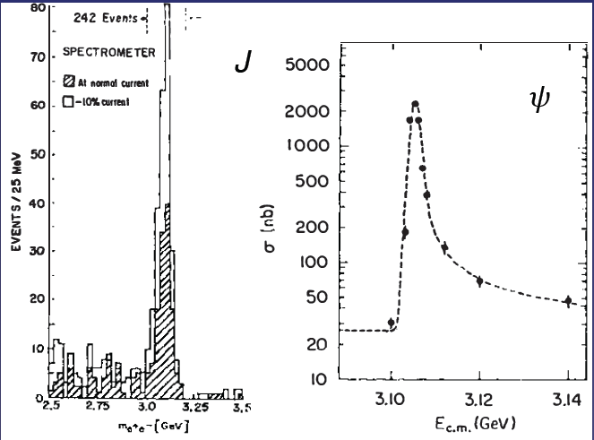
Quarkonium orthodoxy
$$Q$$
$$\overline{Q}$$
Potential models
(meaningful when $M_{Q}→∞$)
$$V\left(r\right)=−\frac{C_{F}α_{s}}{r}+σr$$
(Cornell potential)
$$α_{s}\left(M_{Q}\right)∼0.3$$
(perturbative regime)
OZI-rule, QCD multipole
Solve NR Schrödinger eq. → spectrum
Effective theories
(HQET, NRQCD, pNRQCD...)
Heavy quark spin flip suppressed by quark mass, approximate heavy quark spin symmetry (HQSS)
Integrate out heavy DOF
↓
(spectrum), decay & production rates
A. Pilloni – Theoretical overview of new hadronic states
Notes:
2 slides su Zc, a Bes e a Belle
2 slide su tetraquark model: dall’hamiltoniana di Jaffe al calcolo delle masse
1 slide su molecular models, dove sono i carichi? (non in Tornqvist, si in Hanhart, vedere Braaten, citare Nefediev)
2 slides su decay channels, dove si dovrebbe vedere, e a seconda del modello, vedere qualche plot
1 slide su Y(4260), tetraquark? C’è lo strano (si vede la f0)
1 slide su Zc a cleo (anche il neutro)

Slide 4
Multiscale system
Systematically integrate out the heavy scale,
$$m_{Q}≫Λ_{QCD}$$
$$m_{Q}≫m_{Q}v≫m_{Q}v^{2}$$
$$m_{b}∼5 \text{GeV}, m_{c}∼1.5 \text{GeV}$$
$$v_{b}^{2}∼0.1, v_{c}^{2}∼0.3$$
Full QCD
NRQCD
pNRQCD
Factorization (to be proved) of universal LDMEs
Good description of many production channels, some known puzzles (polarizations)
A. Pilloni – Theoretical overview of new hadronic states
Notes:
2 slides su Zc, a Bes e a Belle
2 slide su tetraquark model: dall’hamiltoniana di Jaffe al calcolo delle masse
1 slide su molecular models, dove sono i carichi? (non in Tornqvist, si in Hanhart, vedere Braaten, citare Nefediev)
2 slides su decay channels, dove si dovrebbe vedere, e a seconda del modello, vedere qualche plot
1 slide su Y(4260), tetraquark? C’è lo strano (si vede la f0)
1 slide su Zc a cleo (anche il neutro)

Slide 5
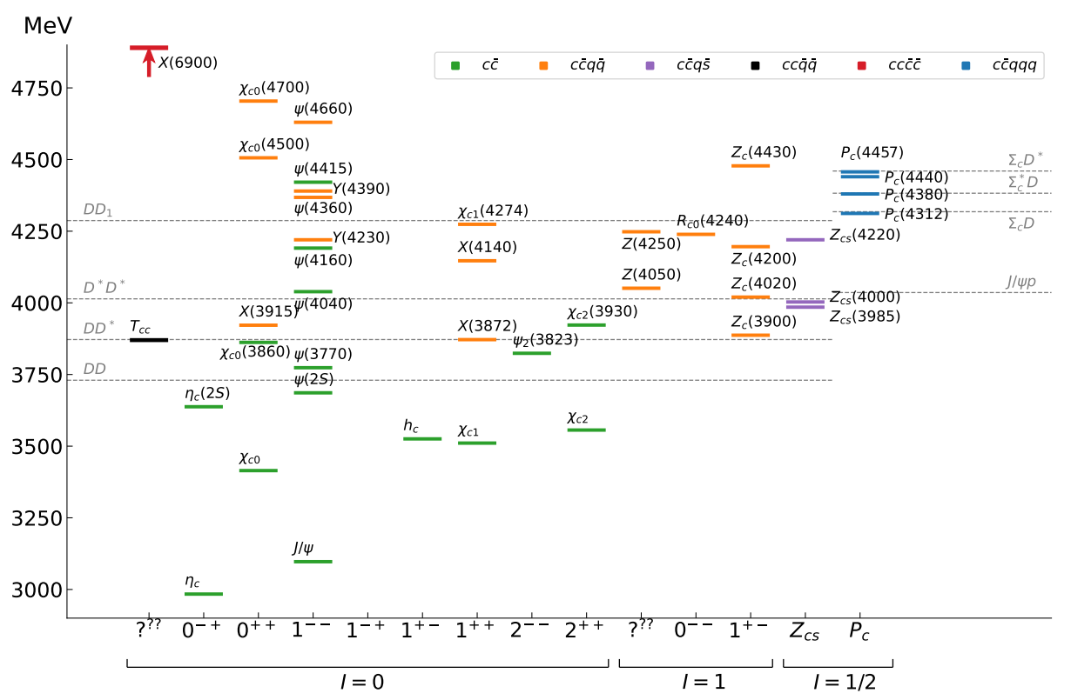
Exotic landscape in $c\overline{c}$
Esposito, AP, Polosa, Phys.Rept. 668
JPAC, PPNP127, 103981
A host of unexpected resonances have appeared
decaying mostly into charmonium + light Hardly reconciled with usual $q\overline{q}$ pheno
A. Pilloni – Theoretical overview of new hadronic states
Notes:
2 slides su Zc, a Bes e a Belle
2 slide su tetraquark model: dall’hamiltoniana di Jaffe al calcolo delle masse
1 slide su molecular models, dove sono i carichi? (non in Tornqvist, si in Hanhart, vedere Braaten, citare Nefediev)
2 slides su decay channels, dove si dovrebbe vedere, e a seconda del modello, vedere qualche plot
1 slide su Y(4260), tetraquark? C’è lo strano (si vede la f0)
1 slide su Zc a cleo (anche il neutro)

Slide 6
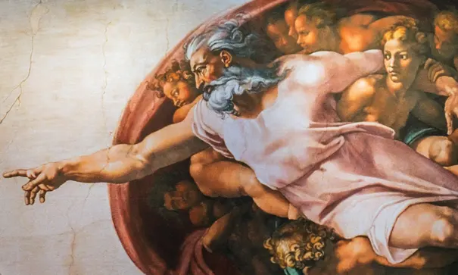
Options on the market
Quark-level calculations:
Quark models, pNRQCD, Functional methods, Coulomb gauge, Holography, large-N QCD, Sum Rules…
Spectrum generally calculated as bound states of some potential
Decay rates as «overlap integrals» between two static configurations
Comprehensive picture ✓ Little scattering dynamics ✗
Hadron level calculations:
Microscopic models inspired to EFT + Unitarization
Compact states vs. molecules, triangles...
States as poles of scattering amplitudes
Couplings as residues at the poles
Scattering dynamics ✓ More case-by-case ✓✗
A. Pilloni – A review of Theoretical overview of new hadronic states

Slide 7
Models for every taste
Compact
Hybrids
Containing gluonic degrees of freedom
Multiquark
Several (cluster) of valence quarks
Hadroquarkonium
Heavy core interacting with a light cloud via Van der Waals forces
$$π$$
$$π$$
$$J/ψ$$
$$π$$
Rescattering effects
Structures generated by cross-channel rescattering, very process-dependent
Molecule
Bound or virtual state generated by long-range exchange forces
Extended
A. Pilloni – Theoretical overview of new hadronic states

Slide 8
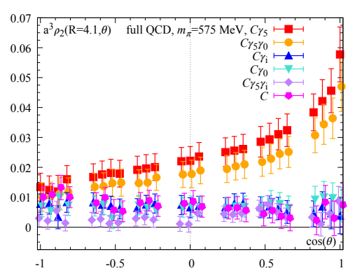
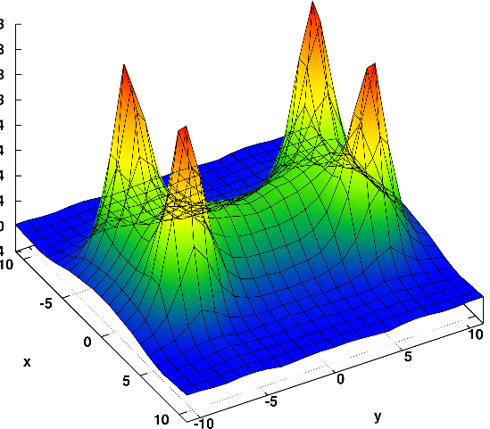
Diquarks
Attraction and repulsion in 1-gluon exchange approximation is given by
$$R=\frac{1}{2}\left(C_{2}\left(R_{12}\right)−C_{2}\left(R_{1}\right)−C_{2}\left(R_{2}\right)\right)$$
$$R_{1}=−\frac{4}{3}, R_{8}=+\frac{1}{6}$$
$$R_{3}=−\frac{2}{3}, R_{6}=+\frac{1}{3}$$
$$j$$
$$l$$
$$3_{c}×3_{c}∈{\overline{3}}_{c}$$
$$T_{ij}^{a}$$
$$T_{kl}^{a}$$
$$i$$
$$k$$
Francis et al. 2106.09080
H-shape with a 4 quark system
Cardoso, Cardoso, Bicudo, PRD84, 054508
A. Pilloni – Theoretical overview of new hadronic states

Slide 9
Molecules
Tornqvist, Z.Phys. C61, 525
Braaten and Kusunoki, PRD69 074005
Swanson, Phys.Rept. 429 243-305
$$D^{0}$$
$$X\left(3872\right)∼{\overline{D}}^{0}D^{∗0}$$
$$Z_{c}\left(3900\right)∼{\overline{D}}^{0}D^{∗+}$$
$$Z_{c}^{′}\left(4020\right)∼{\overline{D}}^{∗0}D^{∗+}$$
$$Y\left(4260\right)∼\overline{D}D_{1}$$
$$π^{0}$$
$$\overline{D^{0∗}}$$
A deuteron-like meson pair, the interaction is mediated by the exchange of light mesons
Good description of decay patterns (mostly to constituents) and $X\left(3872\right)$ isospin violation ✓
States appear close to thresholds ✓ Binding energy varies from $−70$to $−0.1 \text{MeV}$ ✗
Unclear spectrum (a state for each threshold?) – depends on potential models ✗
Some non-predictive model-independent relations (Weinberg’s theorem) ✓
$$V_{π}\left(r\right)=\frac{g_{πN}^{2}}{3}\left(\vec{τ_{1}}⋅\vec{τ_{2}}\right)\left\{\left[3\left(\vec{σ_{1}}⋅\hat{r}\right)\left(\vec{σ_{2}}⋅\hat{r}\right)−\left(\vec{σ_{1}}⋅\vec{σ_{2}}\right)\right]\left(1+\frac{3}{{\left(m_{π}r\right)}^{2}}+\frac{3}{m_{π}r}\right)+\left(\vec{σ_{1}}⋅\vec{σ_{2}}\right)\right\}\frac{e^{−m_{π}r}}{r}$$
Needs regularization, cutoff dependence
A. Pilloni – Theoretical overview of new hadronic states

Slide 10
Weinberg’s criterion and lineshapes
Let us imagine to have a theory with a bound state with a binding momentum much smaller than the inverse of the range of the potential
The potential is just a delta function, we calculate the $2→2$ scattering amplitude
+
+
+ …
$$A(E)=\frac{1}{1/a−i\sqrt{2μE}}$$
This has a pole at $E=−E_{B}=−\frac{1}{2μa^{2}}$ and residue $g^{2}=\sqrt{\frac{2E_{B}}{μ}}$
A. Pilloni – Theoretical overview of new hadronic states
Notes:
Controlla la parte su Regge

Slide 11
Weinberg’s criterion and lineshapes
Now let us consider the propagation of a bare intermediate state
+
+
+ …
$$A\left(E\right)=\frac{g_{0}^{2}}{E_{0}−E−ig_{0}^{2}\sqrt{2μE}}=\frac{g_{0}^{2}}{{−E}_{B}−E−ig_{0}^{2}\sqrt{2μE}−g_{0}^{2}\sqrt{2μE_{B}}}$$
This has a pole at $E_{B}$ and residue $g^{2}=\sqrt{\frac{2E_{B}}{μ}}\left(1−Z\right)$ where $Z$ is the w.f. renormalization, $Z={\left(1+g_{0}^{2}\sqrt{\frac{μ}{2E_{B}}}\right)}^{−1}$= overlap between the bare state and the continuum
A. Pilloni – Theoretical overview of new hadronic states
Notes:
Controlla la parte su Regge

Slide 12
Weinberg’s criterion and lineshapes
The amplitude can be rewritten as
$$A\left(E\right)=\frac{1}{\frac{1}{a}+\frac{1}{2}r_{0}k^{2}−ik}$$
Thus identifying $a=−2 \frac{1−Z}{2−Z}\frac{1}{\sqrt{2μE_{B}}}$, $r_{0}=−\frac{Z}{1−Z}\frac{1}{\sqrt{2μE_{B}}}$
So a negative $r_{0}$ points to a short range component in the wave function
This is true up to corrections of the order of the range of the potential, which btw are positive under general assumptions
Esposito, Maiani, Pilloni, Polosa, Riquer, 105 (2022) 3, L031503
A. Pilloni – Theoretical overview of new hadronic states
Notes:
Controlla la parte su Regge

Slide 13
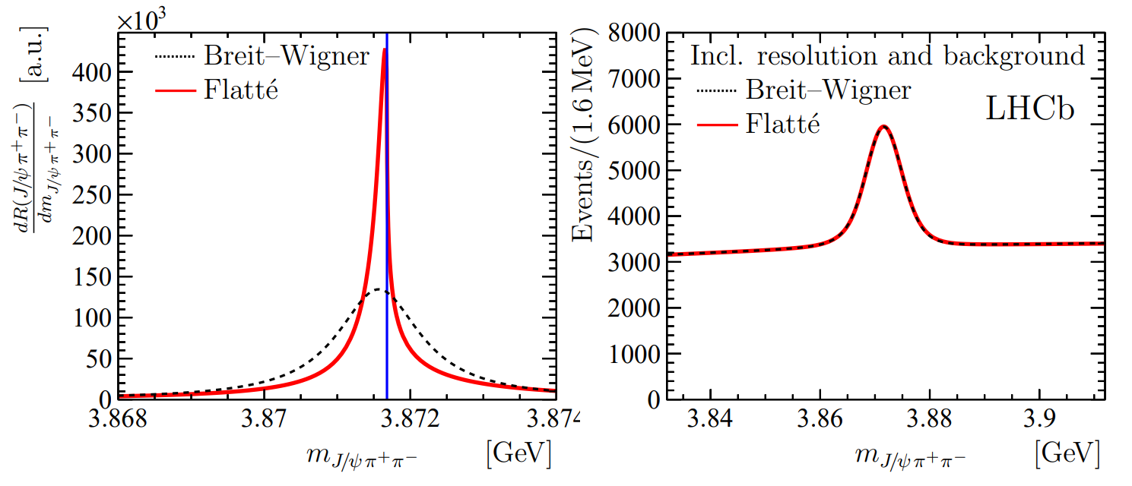
The lineshape of the $X(3872)$
Blue line is $D^{0}\overline{D^{∗0}}$,
$D^{+}D^{∗−}$ is $δ=8.2 \text{MeV}$
heavier
Because of experimental resolution, different lineshapes are indistinguishable
Unitary parametrizations tend to be narrower, $Γ_{BW}=1.39±0.24±0.10 \text{MeV}$, $Γ_{fl}={0.22}_{−0.06−0.13}^{+0.07+0.11} \text{MeV}$
A. Pilloni – Theoretical overview of new hadronic states
Notes:
Controlla la parte su Regge

Slide 14
The lineshape of the $X(3872)$
Esposito, Maiani, AP, Polosa, Riquer, PRD 105 (2022) 3, L031503
LHCb data is fitted with the Flatte’ parametrization
The $D^{0}\overline{D^{∗0}}$ threshold
Two options: a) I set $δ=0$ b) I expand at threshold
The $D^{+}D^{∗−}$ threshold
The $J/ψ ρ,ω,$ and other unknown channels
This considers coupled channel, but Weinberg’s criterion applies to single channel bound states only
A. Pilloni – Theoretical overview of new hadronic states
Notes:
Controlla la parte su Regge

Slide 15
The lineshape of the $X(3872)$
Esposito, Maiani, AP, Polosa, Riquer, PRD 105 (2022) 3, L031503
Option b)
Option a)
According to Weinberg’s, the first result points to a sizeable short-range structure of the X(3872)
Still disagreement on how to perform the extraction though
A. Pilloni – Theoretical overview of new hadronic states
Notes:
Controlla la parte su Regge

Slide 16
Bound and virtual states
Decreasing the potential strength, the pole reaches threshold
The pole jumps on the 2nd sheet (dineutron), it becomes a virtual state
Example from $pn$ scattering Bound state on the real axis 1st sheet (deuteron)
$$V(r)$$
$$\text{Im} E$$
$$r$$
$$V$$
Deuteron
$$\text{Re} E$$
$${}_{}^{1}S$$
Deuteron pole
Dineutron pole
$${}_{}^{3}S$$
A. Pilloni – Theoretical overview of new hadronic states
Notes:
Controlla la parte su Regge

Slide 17
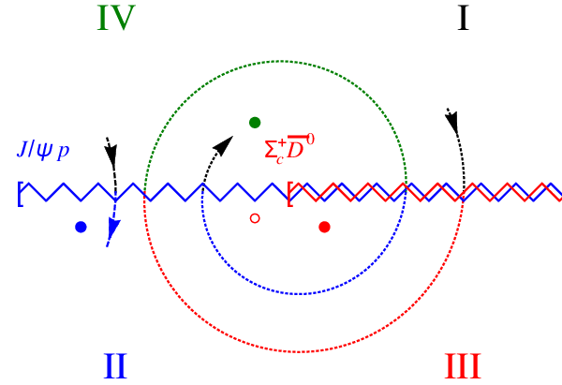
The $P_{c}\left(4312\right):$ Bound and virtual states
We focus on now the $P_{c}(4312)$, which is seen as an isolated peak over a smooth background. In this simple setup, model dependence can be reduced
Virtual state
Bound state
Resonance
A. Pilloni – Theoretical overview of new hadronic states
Notes:
Controlla la parte su Regge

Slide 18
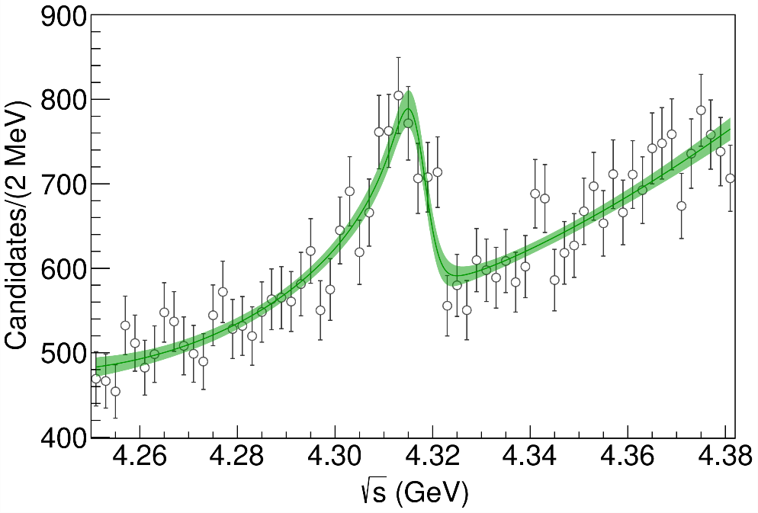
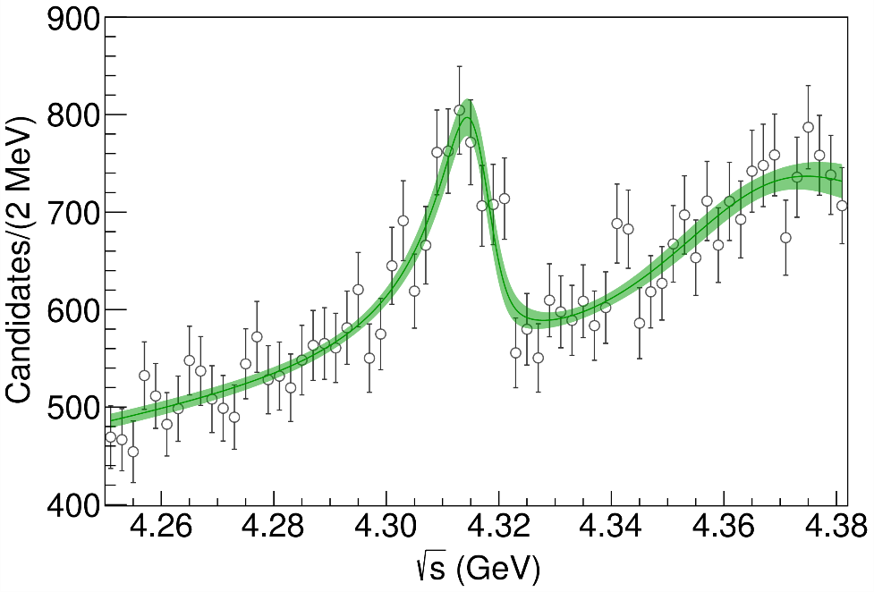
Minimal(istic) model
Fernandez-Ramirez, AP et al. (JPAC), PRL 123, 092001
Model-independent expansion at the $Σ_{c}\overline{D^{0}}$ threshold
$$c_{ii}=0$$
Finite $c_{ii}$
A. Pilloni – Theoretical overview of new hadronic states
Notes:
2 slides su Zc, a Bes e a Belle
2 slide su tetraquark model: dall’hamiltoniana di Jaffe al calcolo delle masse
1 slide su molecular models, dove sono i carichi? (non in Tornqvist, si in Hanhart, vedere Braaten, citare Nefediev)
2 slides su decay channels, dove si dovrebbe vedere, e a seconda del modello, vedere qualche plot
1 slide su Y(4260), tetraquark? C’è lo strano (si vede la f0)
1 slide su Zc a cleo (anche il neutro)

Slide 19
Minimal(istic) model
Model-independent expansion at the $Σ_{c}\overline{D^{0}}$ threshold
$$c_{ii}=0$$
Finite $c_{ii}$
A. Pilloni – Theoretical overview of new hadronic states
Notes:
2 slides su Zc, a Bes e a Belle
2 slide su tetraquark model: dall’hamiltoniana di Jaffe al calcolo delle masse
1 slide su molecular models, dove sono i carichi? (non in Tornqvist, si in Hanhart, vedere Braaten, citare Nefediev)
2 slides su decay channels, dove si dovrebbe vedere, e a seconda del modello, vedere qualche plot
1 slide su Y(4260), tetraquark? C’è lo strano (si vede la f0)
1 slide su Zc a cleo (anche il neutro)

Slide 20
Minimal(istic) model
Model-independent expansion at the $Σ_{c}\overline{D^{0}}$ threshold
Points to a virtual state
$$c_{ii}=0$$
Finite $c_{ii}$
A. Pilloni – Theoretical overview of new hadronic states
Notes:
2 slides su Zc, a Bes e a Belle
2 slide su tetraquark model: dall’hamiltoniana di Jaffe al calcolo delle masse
1 slide su molecular models, dove sono i carichi? (non in Tornqvist, si in Hanhart, vedere Braaten, citare Nefediev)
2 slides su decay channels, dove si dovrebbe vedere, e a seconda del modello, vedere qualche plot
1 slide su Y(4260), tetraquark? C’è lo strano (si vede la f0)
1 slide su Zc a cleo (anche il neutro)

Slide 21
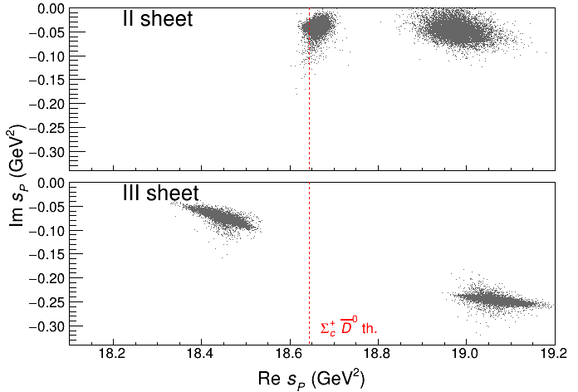
Minimal(istic) model
Model-independent expansion at the $Σ_{c}\overline{D^{0}}$ threshold
Points to a virtual state
Doesn’t point to a resonance
$$c_{ii}=0$$
Finite $c_{ii}$
A. Pilloni – Theoretical overview of new hadronic states
Notes:
2 slides su Zc, a Bes e a Belle
2 slide su tetraquark model: dall’hamiltoniana di Jaffe al calcolo delle masse
1 slide su molecular models, dove sono i carichi? (non in Tornqvist, si in Hanhart, vedere Braaten, citare Nefediev)
2 slides su decay channels, dove si dovrebbe vedere, e a seconda del modello, vedere qualche plot
1 slide su Y(4260), tetraquark? C’è lo strano (si vede la f0)
1 slide su Zc a cleo (anche il neutro)

Slide 22
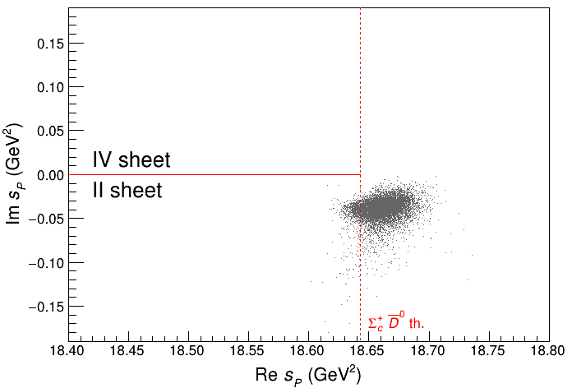
Minimal(istic) model
Model-independent expansion at the $Σ_{c}\overline{D^{0}}$ threshold
Points to a virtual state
Doesn’t point to a resonance
$$c_{ii}=0$$
Finite $c_{ii}$
A. Pilloni – Theoretical overview of new hadronic states
Notes:
2 slides su Zc, a Bes e a Belle
2 slide su tetraquark model: dall’hamiltoniana di Jaffe al calcolo delle masse
1 slide su molecular models, dove sono i carichi? (non in Tornqvist, si in Hanhart, vedere Braaten, citare Nefediev)
2 slides su decay channels, dove si dovrebbe vedere, e a seconda del modello, vedere qualche plot
1 slide su Y(4260), tetraquark? C’è lo strano (si vede la f0)
1 slide su Zc a cleo (anche il neutro)

Slide 23
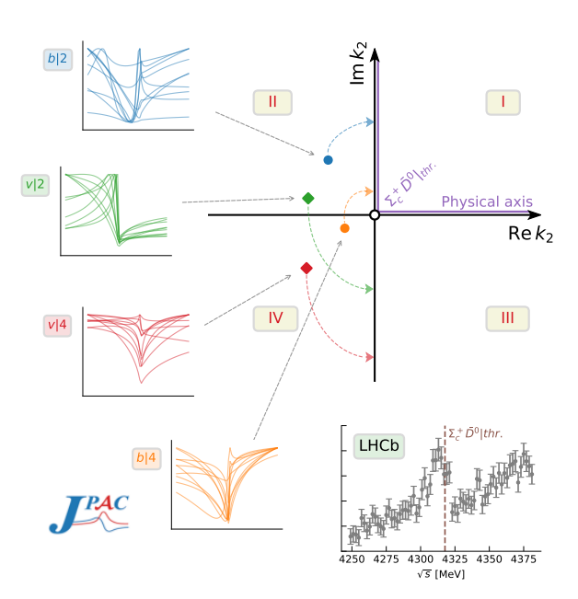
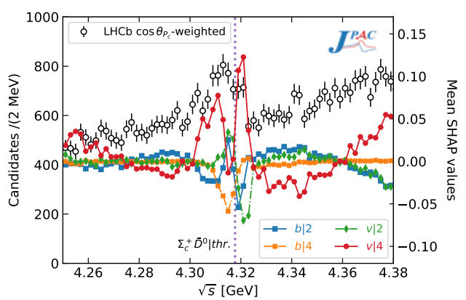
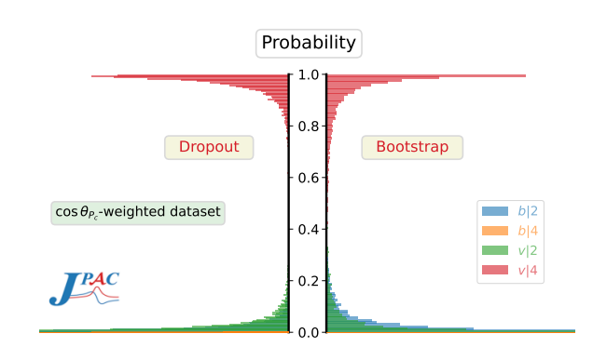
Minimal(istic) model with ANN
Ng, et al. (JPAC), PRD 105, L091501
Same conclusion reached if the analysis is performed with a Deep Neural Network
The peak region has the largest impact for the decision
Highest probability for a virtual state in the IV sheet
A. Pilloni – Theoretical review of exotic states
Notes:
2 slides su Zc, a Bes e a Belle
2 slide su tetraquark model: dall’hamiltoniana di Jaffe al calcolo delle masse
1 slide su molecular models, dove sono i carichi? (non in Tornqvist, si in Hanhart, vedere Braaten, citare Nefediev)
2 slides su decay channels, dove si dovrebbe vedere, e a seconda del modello, vedere qualche plot
1 slide su Y(4260), tetraquark? C’è lo strano (si vede la f0)
1 slide su Zc a cleo (anche il neutro)

Slide 24
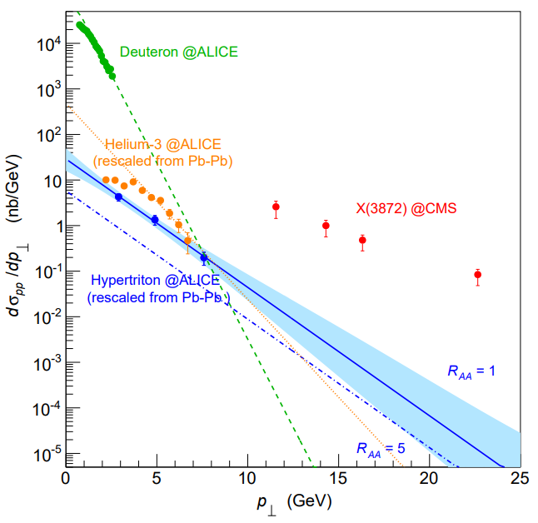
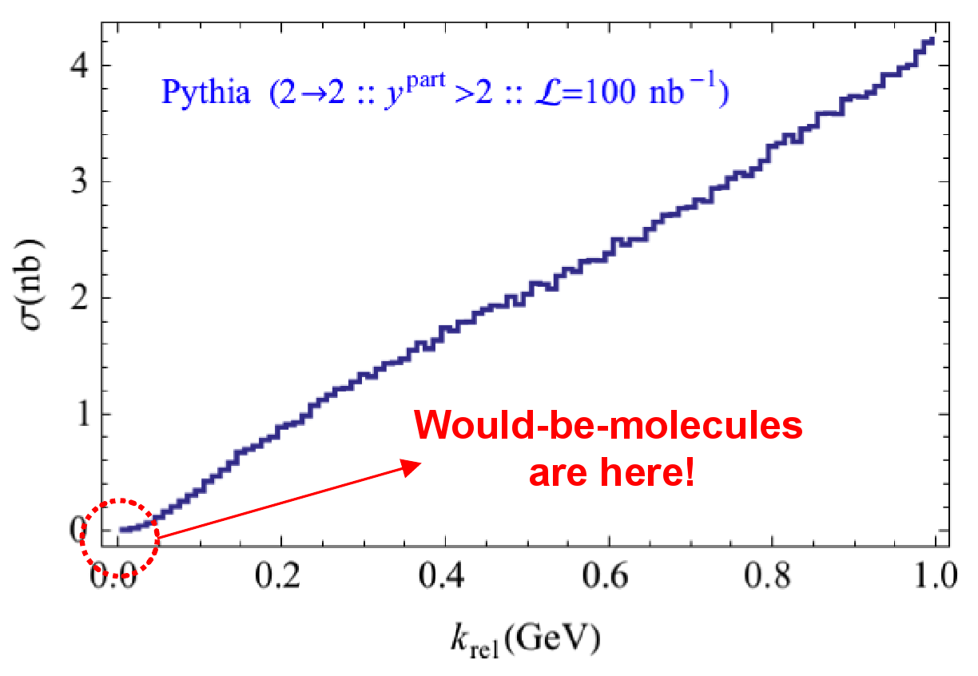
Prompt production of $X(3872)$
However, the applicability of Watson theorem is challenged by the presence of pions that interfere with $DD^{∗}$ propagation
$$D^{∗}$$
$$π$$
$$π$$
(CDF acceptance)
$$π$$
$$π$$
$$π$$
$$\overline{D^{0}}$$
A solution can be FSI (rescattering of $DD^{∗}$), which allow $k_{max}$ to be as large as $5m_{π}$, $σ\left(p\overline{p}→DD^{∗}|k<k_{max}\right)≈230 \text{nb}$
Artoisenet and Braaten, PRD81, 114018
However, this is controversial because of the presence of comover that interfere with $DD^{∗}$ propagation
Bignamini et al. PLB684, 228-230
Esposito, Piccinini, AP, Polosa, JMP 4, 1569
Guerrieri, Piccinini, AP, Polosa, PRD90, 034003
$$σ_{MC}\left(p\overline{p}→DD^{∗}|k<k_{max}\right)≈0.1 \text{nb}$$
$σ_{exp}\left(p\overline{p}→X(3872)\right)≈30−70 \text{nb}$!!!
The comparison of production of other light nuclei suggests a different behavior
Esposito, Guerrieri, Maiani, Piccinini, AP, Polosa, Riquer, PRD92 (2015) 3, 034028
Bignamini et al. PRL103 (2009) 162001
A. Pilloni – Theoretical overview of new hadronic states
Notes:
2 slides su Zc, a Bes e a Belle
2 slide su tetraquark model: dall’hamiltoniana di Jaffe al calcolo delle masse
1 slide su molecular models, dove sono i carichi? (non in Tornqvist, si in Hanhart, vedere Braaten, citare Nefediev)
2 slides su decay channels, dove si dovrebbe vedere, e a seconda del modello, vedere qualche plot
1 slide su Y(4260), tetraquark? C’è lo strano (si vede la f0)
1 slide su Zc a cleo (anche il neutro)

Slide 25
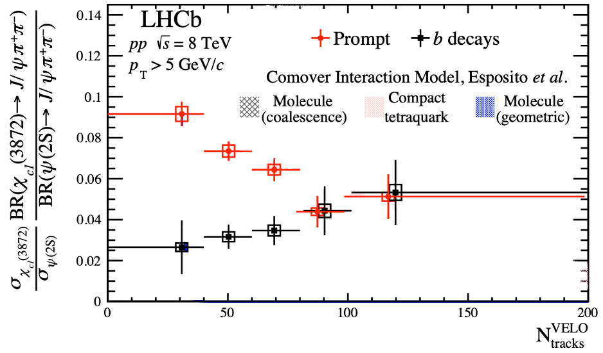
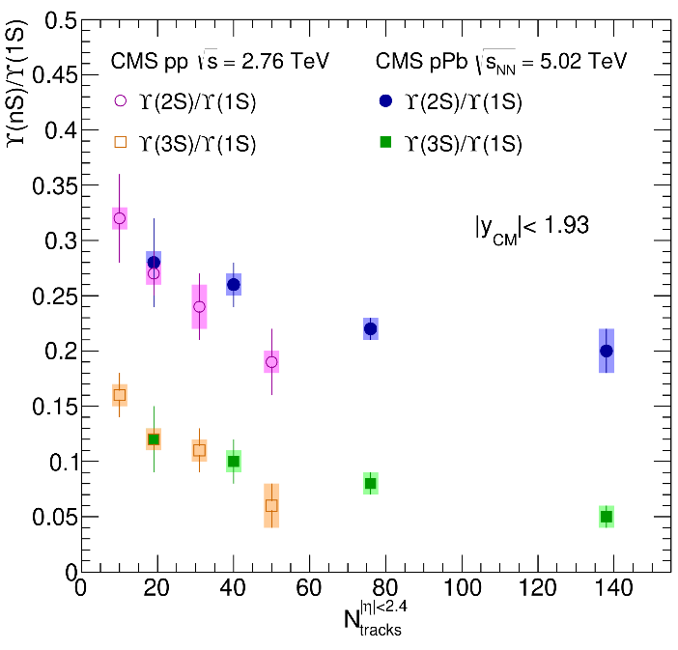
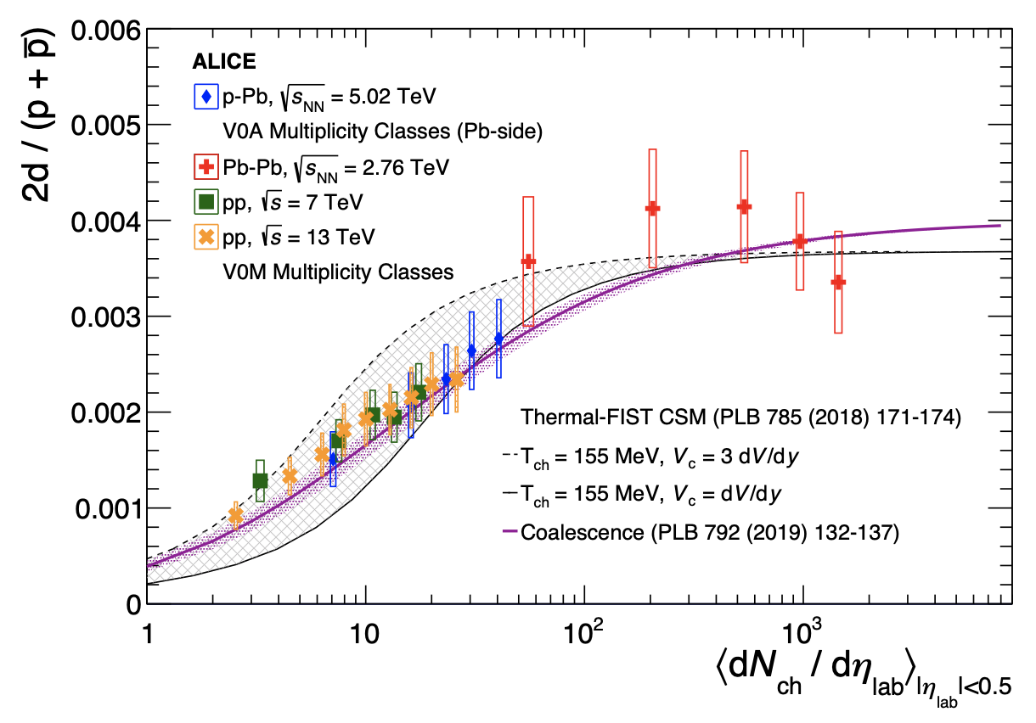
Multiplicity dependence
The $X(3872)$is more and more suppressed wrt $ψ(2S)$when more comovers are present Does it make the $X(3872)$a fragile molecule?
The $X(3872)$is more and more suppressed wrt $ψ(2S)$when more comovers are present Does it make the $X(3872)$a fragile molecule? No.
LHCb 2009.06619
Deuteron is a molecule, but it increases
CMS JHEP04(2014), 103
ALICE EPJC80, 9, 889
$Υ(2S)$ and $Υ\left(3S\right)$ are not molecules, but they decrease
$Υ(2S)$ and $Υ\left(3S\right)$ are not molecules, but they decrease
A. Pilloni – Theoretical overview of new hadronic states
Notes:
2 slides su Zc, a Bes e a Belle
2 slide su tetraquark model: dall’hamiltoniana di Jaffe al calcolo delle masse
1 slide su molecular models, dove sono i carichi? (non in Tornqvist, si in Hanhart, vedere Braaten, citare Nefediev)
2 slides su decay channels, dove si dovrebbe vedere, e a seconda del modello, vedere qualche plot
1 slide su Y(4260), tetraquark? C’è lo strano (si vede la f0)
1 slide su Zc a cleo (anche il neutro)

Slide 26
The comover model
The interaction with final state comoving particles can help create/destroy a hadron
Baym PLB138, 18
For a compact state in 𝑝𝑝 collisions the number evolves following
hadron yield
destruction cross section
$$τ\frac{dN_{𝒬}}{dτ}=−⟨vσ⟩_{𝒬}ρ_{c}N_{𝒬}$$
comover density at initial time (Glauber model) $∝N_{ch}$
In the Comover Interaction Model one takes $⟨vσ⟩_{𝒬}∼πr_{𝒬}^{2}$
This has proved to be successful at describing 𝑝Pb and PbPb data
Ferreiro PLB749, 98
Ferreiro, Lansberg JHEP10(2018), 94
A. Pilloni – Theoretical overview of new hadronic states
Notes:
2 slides su Zc, a Bes e a Belle
2 slide su tetraquark model: dall’hamiltoniana di Jaffe al calcolo delle masse
1 slide su molecular models, dove sono i carichi? (non in Tornqvist, si in Hanhart, vedere Braaten, citare Nefediev)
2 slides su decay channels, dove si dovrebbe vedere, e a seconda del modello, vedere qualche plot
1 slide su Y(4260), tetraquark? C’è lo strano (si vede la f0)
1 slide su Zc a cleo (anche il neutro)

Slide 27
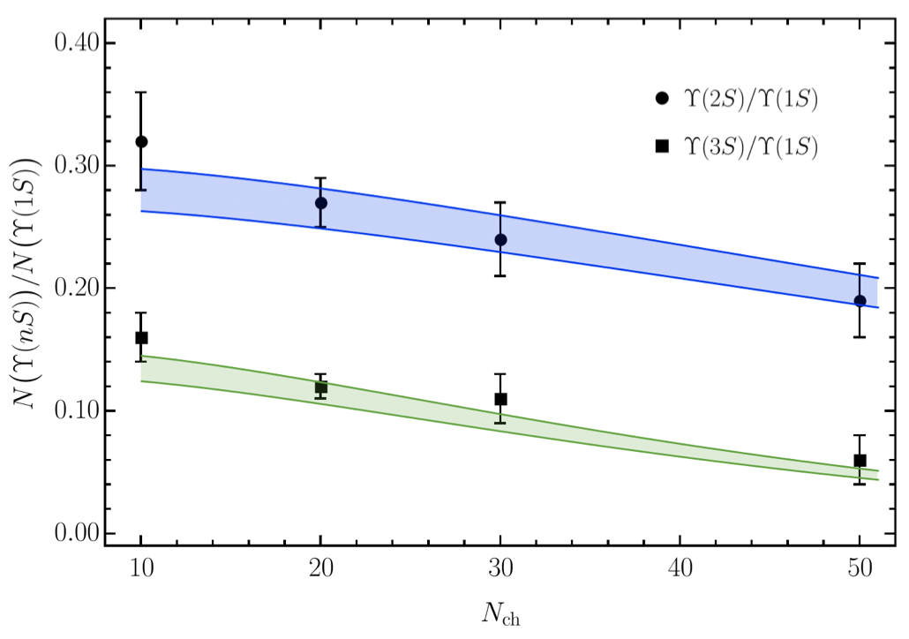
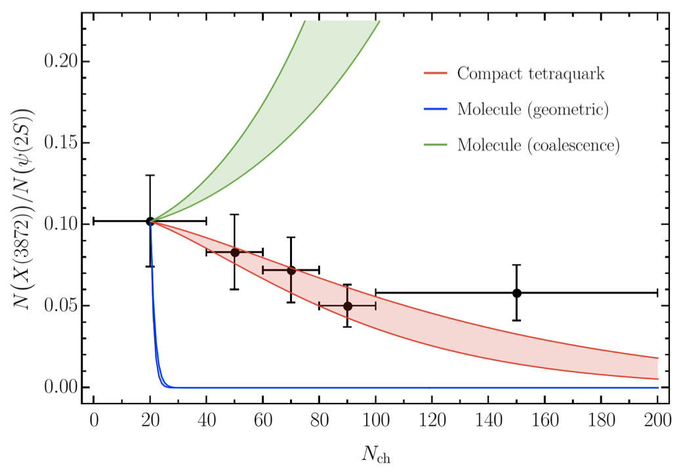
Bottomonia & $X(3872)$
Further validate the model using CMS $pp$ data Using same cross sections as in 𝑝Pb and PbPb
Same model for a compact $X(3872)$
Esposito, Ferreiro, AP, Polosa, Salgado EPJC 81 (2021) 7, 669
A. Pilloni – Theoretical overview of new hadronic states
Notes:
2 slides su Zc, a Bes e a Belle
2 slide su tetraquark model: dall’hamiltoniana di Jaffe al calcolo delle masse
1 slide su molecular models, dove sono i carichi? (non in Tornqvist, si in Hanhart, vedere Braaten, citare Nefediev)
2 slides su decay channels, dove si dovrebbe vedere, e a seconda del modello, vedere qualche plot
1 slide su Y(4260), tetraquark? C’è lo strano (si vede la f0)
1 slide su Zc a cleo (anche il neutro)

Slide 28
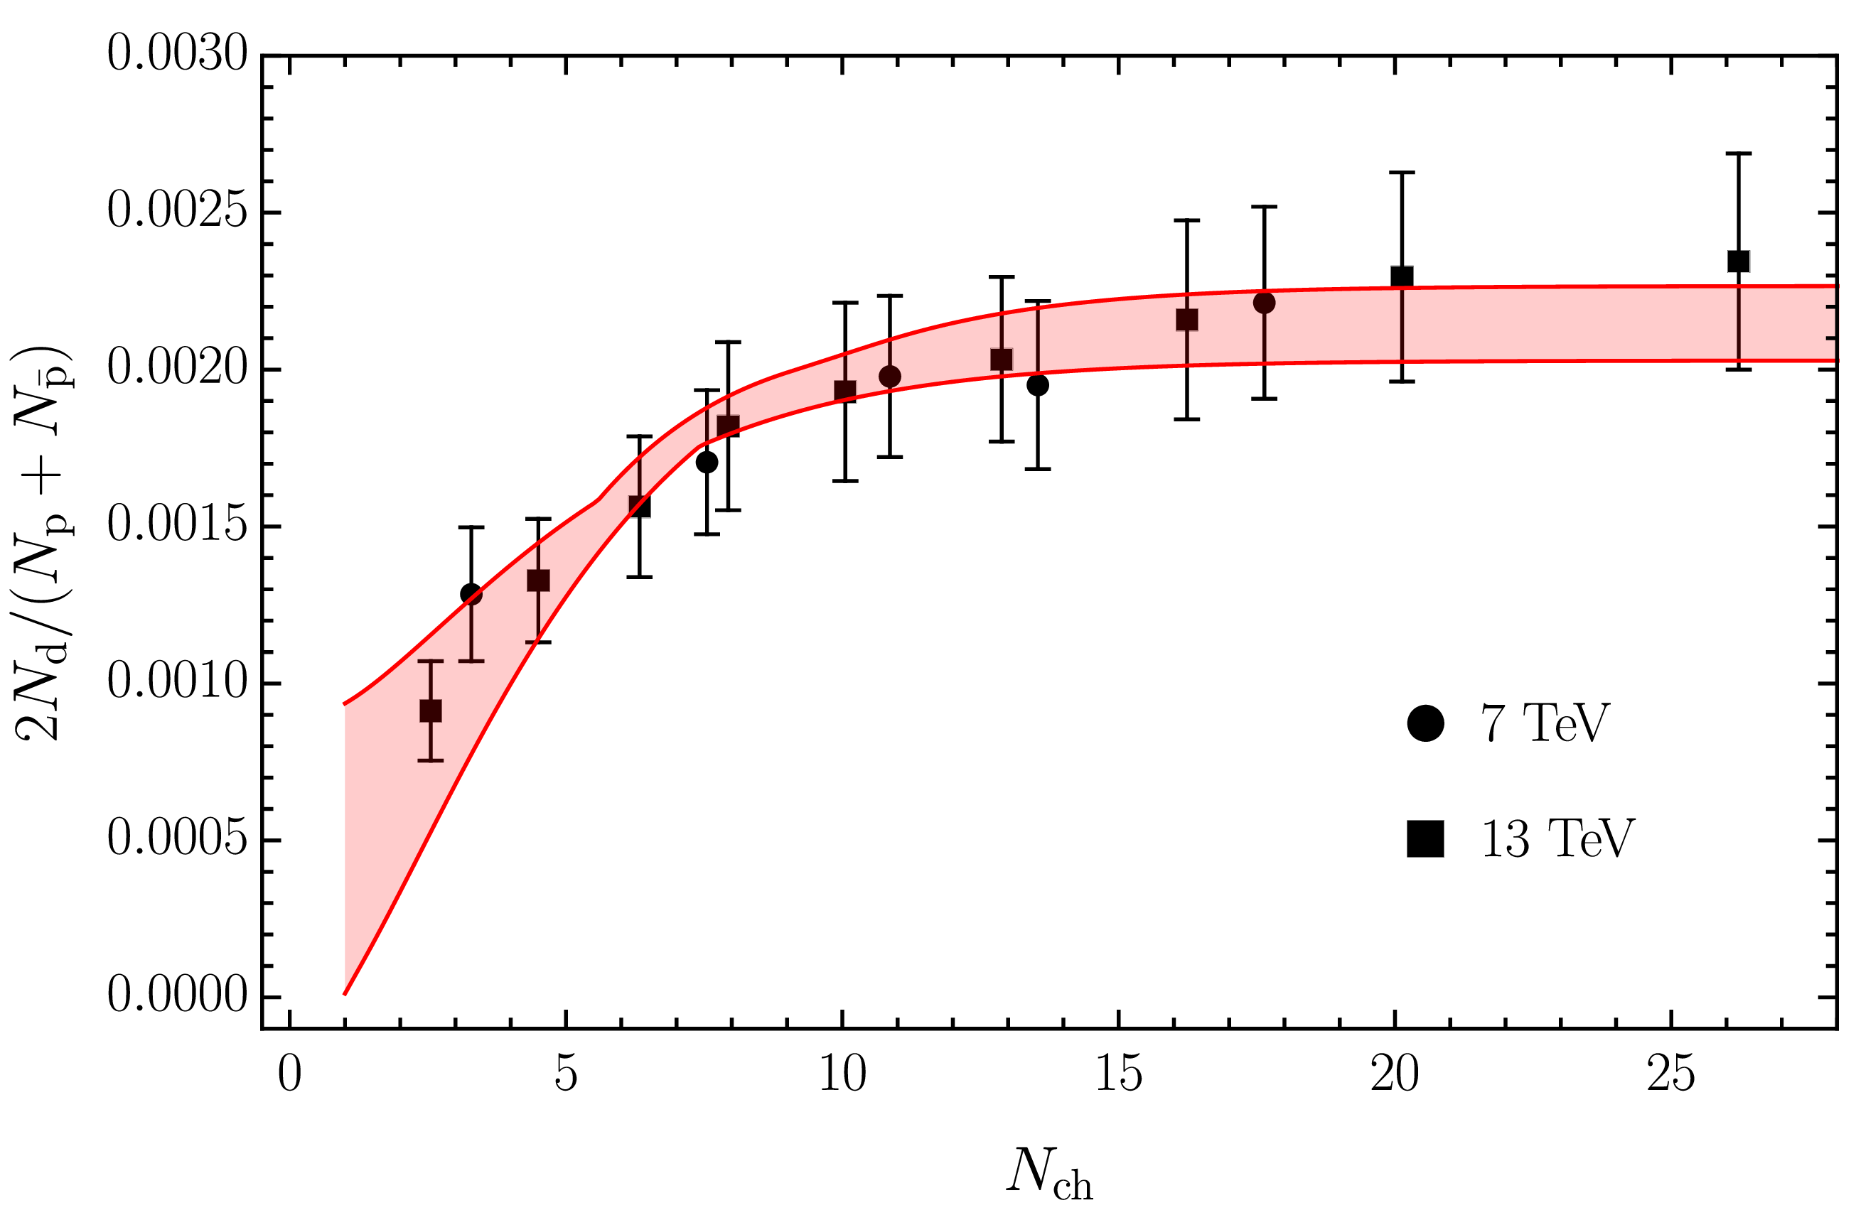
Deuteron in coalescence model
Solution of the evolution equation with recombination
$$\frac{N_{m}}{N_{h}}=\frac{{\left\langle vσ\right\rangle }_{m}}{{\left\langle vσ\right\rangle }_{m}+{\left\langle vσ\right\rangle }_{hh}}+\left(\frac{N_{m}^{0}}{N_{h}^{0}}−\frac{{\left\langle vσ\right\rangle }_{m}}{{\left\langle vσ\right\rangle }_{m}+{\left\langle vσ\right\rangle }_{hh}}\right)e^{−\left({\left\langle vσ\right\rangle }_{m}+{\left\langle vσ\right\rangle }_{hh}\right)ρ_{c}\ln\left(ρ_{c}/ρ_{c}^{pp}\right)}$$
Numbers of molecule at $t=0$,
$≈0$ in Pythia
The coalescence momentum for deuteron is known to be $Λ=50 ÷200 \text{MeV}$
Cross sections calculated from scattering of constituents
A. Pilloni – Theoretical overview of new hadronic states
Notes:
2 slides su Zc, a Bes e a Belle
2 slide su tetraquark model: dall’hamiltoniana di Jaffe al calcolo delle masse
1 slide su molecular models, dove sono i carichi? (non in Tornqvist, si in Hanhart, vedere Braaten, citare Nefediev)
2 slides su decay channels, dove si dovrebbe vedere, e a seconda del modello, vedere qualche plot
1 slide su Y(4260), tetraquark? C’è lo strano (si vede la f0)
1 slide su Zc a cleo (anche il neutro)

Slide 29
$X(3872)$ again
The coalescence momentum for the $X(3872)$ is $Λ=30 ÷300 \text{MeV}$
Controversies for $N_{m}/N_{h}$: How is the 𝑋 produced?
Through ${\overline{D}}^{0}D^{∗0}$: $N_{m}/N_{h}≈0$
Through $χ_{c1}(2P)$: $N_{m}/N_{h}≈1$
The difference shown with a green band
A. Pilloni – Theoretical overview of new hadronic states
Notes:
2 slides su Zc, a Bes e a Belle
2 slide su tetraquark model: dall’hamiltoniana di Jaffe al calcolo delle masse
1 slide su molecular models, dove sono i carichi? (non in Tornqvist, si in Hanhart, vedere Braaten, citare Nefediev)
2 slides su decay channels, dove si dovrebbe vedere, e a seconda del modello, vedere qualche plot
1 slide su Y(4260), tetraquark? C’è lo strano (si vede la f0)
1 slide su Zc a cleo (anche il neutro)

Slide 30
Epilogue
Why all this is interesting?
Because it’s hard! Nature challenges us constantly
Bottom-up: analytic methods can improve the rigour and robustness in the extraction of the spectrum
Top-down: models have been reviled in favor of rigorous calculations, but they make us understand the dynamics: this makes the path less regular and systematic, more fantasy is needed
Lattice QCD, experiments, etc. are needed to provide further observables to disentangle the various pictures
Thank you!
A. Pilloni – Theoretical overview of new hadronic states
Notes:
2 slides su Zc, a Bes e a Belle
2 slide su tetraquark model: dall’hamiltoniana di Jaffe al calcolo delle masse
1 slide su molecular models, dove sono i carichi? (non in Tornqvist, si in Hanhart, vedere Braaten, citare Nefediev)
2 slides su decay channels, dove si dovrebbe vedere, e a seconda del modello, vedere qualche plot
1 slide su Y(4260), tetraquark? C’è lo strano (si vede la f0)
1 slide su Zc a cleo (anche il neutro)

Slide 31
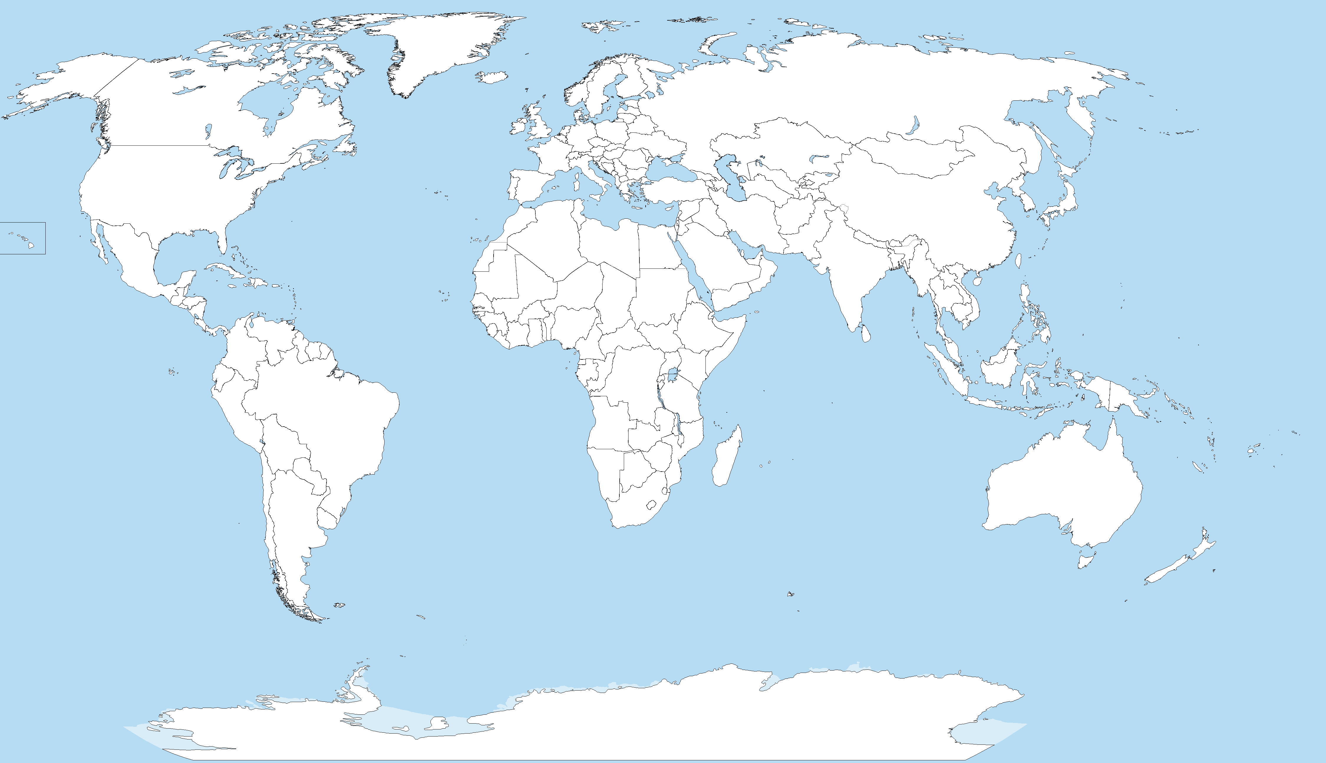
Joint Physics Analysis Center
Funded in 2013 as theory support originally for JLab exps, but grew up much larger Creates bridges between theorists and experimentalists
Running
Planned
A. Pilloni – Theoretical overview of new hadronic states
Notes:
Controlla la parte su Regge

Slide 32
ExoHad topical collaboration
Funded in 2023 by DoE as a Topical Collaboration in Nuclear Physics
Aims at exploring all aspects of exotics (= hybrids at GlueX)
from predictions within lattice QCD
through reliable extraction of their existence and properties from experimental data,
to descriptions of their structure within phenomenological models.
A. Pilloni – Theoretical overview of new hadronic states
Notes:
Controlla la parte su Regge

Slide 33
Backup

Slide 34
Exotic landscape
Broad mesons seen in $b$ decay:
$X(4140)$, $Z(4430)$, $Z_{cs}(4000)$...
Narrow structures seen in $b$ decay:
$X\left(3872\right), P_{c}$, $(P_{cs})$
Scarce consistency between various production mechanisms
Narrow structures seen in $e^{+}e^{−}$:
$X(3872)$, $Y(4260)$, $Z_{c,b}^{(′)}$
Pretty much all narrow states appear in the vicinity of some open flavor threshold
A. Pilloni – Theoretical overview of new hadronic states

Slide 35
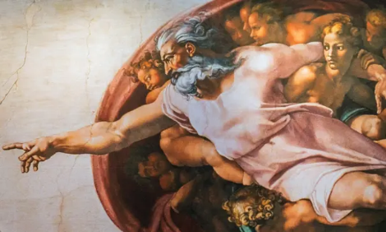
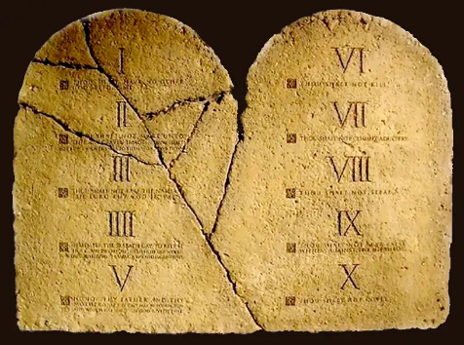
The flowchart(s)
You are given a model/theory
$$f(s)$$
You calculate the amplitude
You compare with data. Or you don’t.
Predictive power ✓
Physical interpretation ✓ (within the model! ✗) Biased by the input ✗
A. Pilloni – Analysis tools in searching for resonances

Slide 36
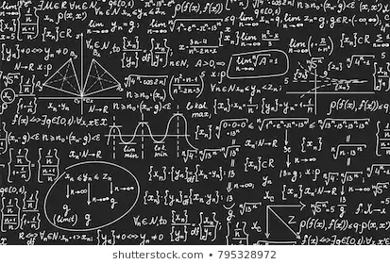
The flowchart(s)
Less predictive power ✗
Some physical interpretation ✗ Minimally biased ✓
You extract physics
You choose a set of generic amplitudes
You start with data
A. Pilloni – Analysis tools in searching for resonances

Slide 37
Photoproduction of XYZ
It’s new: no XYZ state has been uncontroversially seen so far
Rescattering mechanisms that could mimic resonances in multibody decays can be controlled better (one can change the energy beam but not the $B$ mass…)
The framework is (relatively) clean from a theory point of view
Radiative decays offer another way of discerning the nature of the states
A. Pilloni – Theoretical overview of new hadronic states

Slide 38
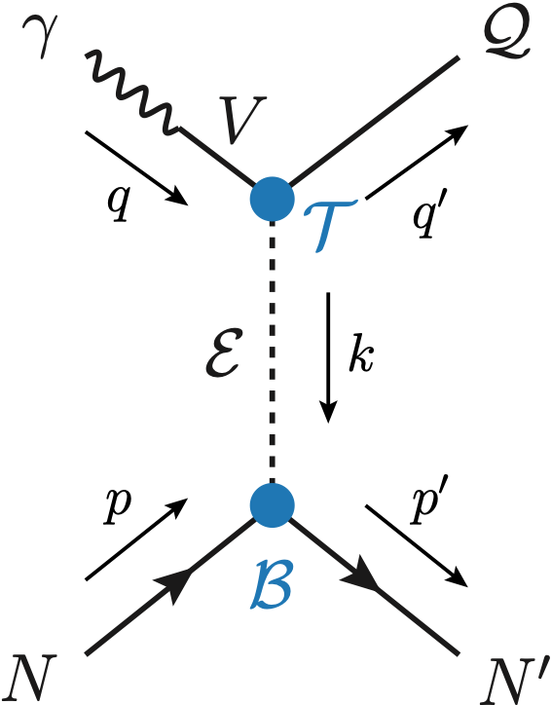
Exclusive (quasi-real) photoproduction
XYZ have so far not been seen in photoproduction: independent confirmation
Not affected by 3-body dynamics: determination of resonant nature
Experiments with high luminosity in the appropriate energy range are promising
We study near-threshold (LE) and high energies (HE)
Couplings extracted from data as much as possible, not relying on the nature of XYZ
M. Albaladejo et al. [JPAC], PRD
$$<λ_{𝒬}λ_{N}^{′}|T|λ_{γ}λ_{N}>=\underset{V,ℰ}{∑}\frac{ef_{V}}{m_{V}}𝒯_{λ_{V}=λ_{γ},λ_{𝒬}}^{α_{1}⋯α_{j}}𝒫_{α_{1}⋯α_{j};β_{1}⋯β_{j}}ℬ_{λ_{N}λ_{N}^{′}}^{β_{1}⋯β_{j}}$$
Bottom vertex from standard photoproduction pheno, exponential form factors to further suppress large t
VMD is used to couple the incoming photon to a vector quarkonium V
Top vertex from measured $𝒬→Vℰ$ decay width
A. Pilloni – Theoretical overview of new hadronic states

Slide 39
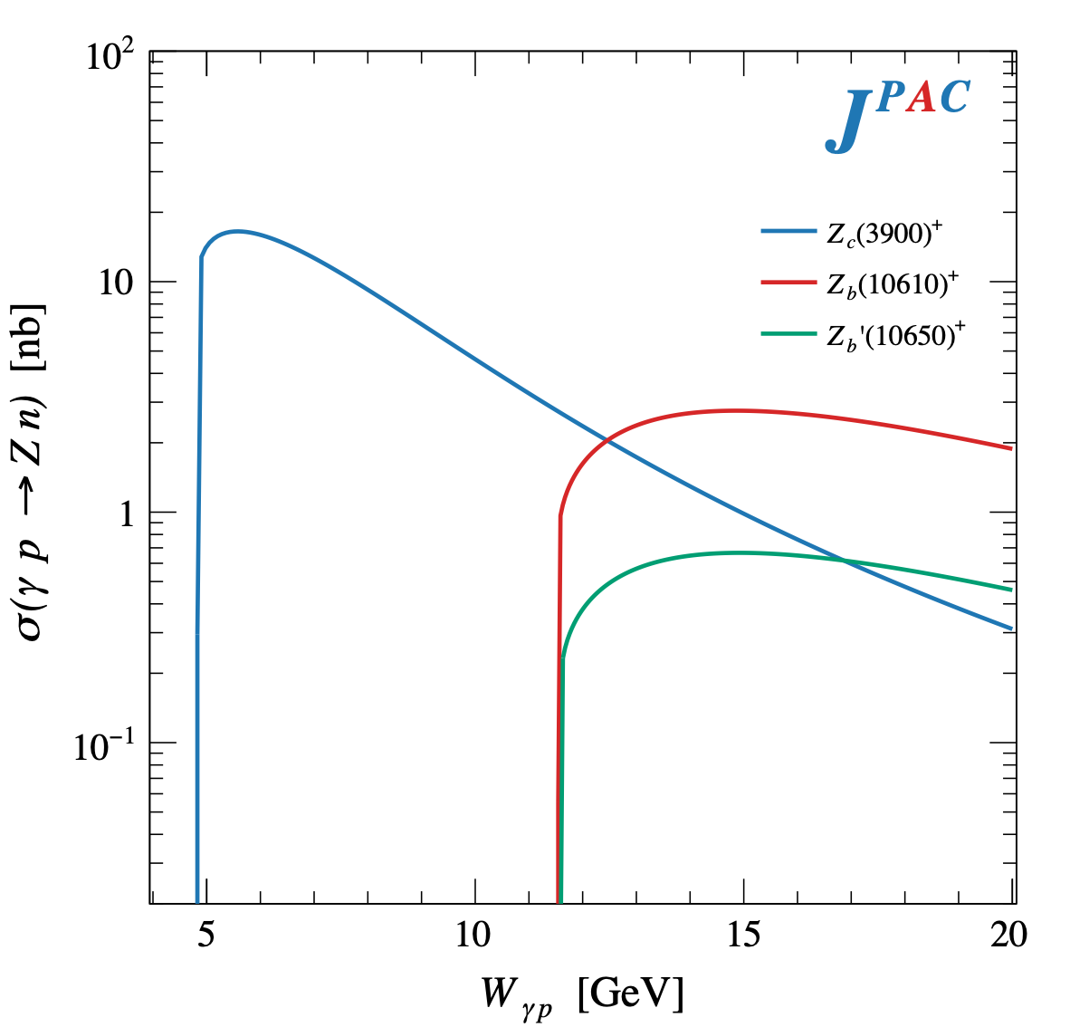
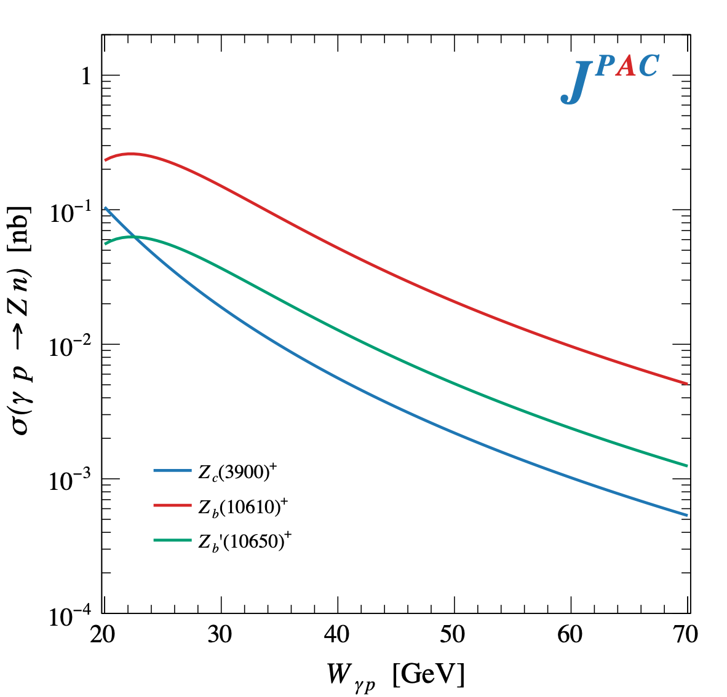
$Z$ photoproduction
The $Zs$ are charged charmoniumlike $1^{+−}$ states close to open flavor thresholds
Focus on $Z_{c}{\left(3900\right)}^{+}→J/ψ π^{+}$, $Z_{b}{\left(10610\right)}^{+},Z_{b}^{′}{\left(10650\right)}^{+}→Υ(nS) π^{+}$
The pion is exchanged in the $t$-channel
A. Pilloni – Theoretical overview of new hadronic states

Slide 40
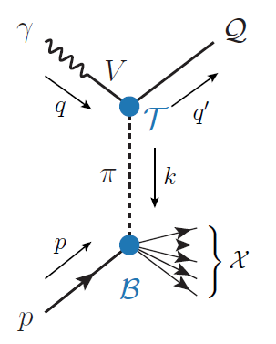
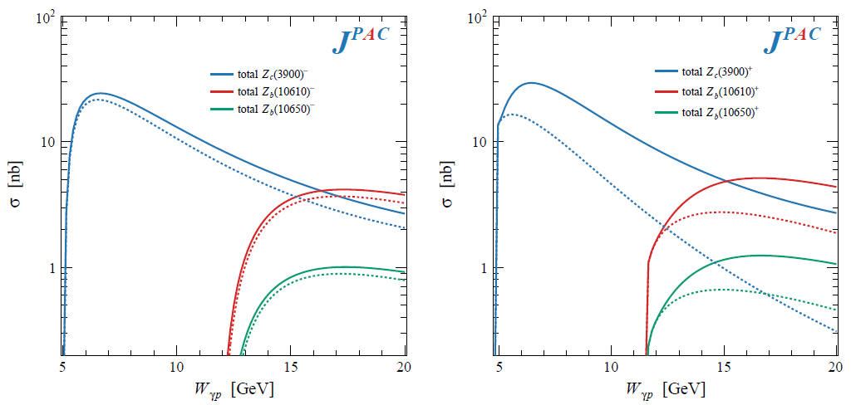
Semi-inclusive photoproduction (pion ex)
For the $Z_{c}^{+}$, the inclusive cross section is sizably larger than the exclusive process
$$Z_{c}^{−}Δ^{++}$$
$$Z_{c}^{+}n$$
A. Pilloni – Theoretical overview of new hadronic states

Slide 41
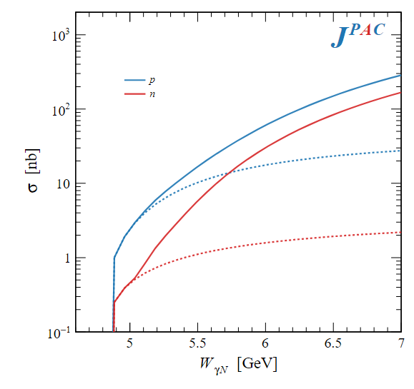
Semi-inclusive photoproduction (vector ex)
PDFs encode the information about $γ p$ inclusive scattering for different photon polarizations
Using VMD, one can infer the $ρ p$ and $ω p$ inclusive cross sections
We use the pheno parametrization by Christy and Bosted in the resonance region
D. Winney, AP et al., to appear
$$ρ, ω$$
Exclusive alone
A. Pilloni – Theoretical overview of new hadronic states

Slide 42
How to interpret this?
Top-down: you study models, and verify predictions
Bottom-up: you study data (lineshapes), and try and infer the physics
$$f(s)$$
A. Pilloni – Theoretical overview of new hadronic states
Notes:
Y(4260), M=4263 +- 5, Gamma = 95+-14
D_1(2420)^0, M=2421.3 ±0.6, Gamma =27.1 ±2.7
D_1(2420)^+-, M=2423.4 ±3.1, Gamma =25 ±6
I D_1 hanno J^P = 1^+
La molecola D_1 D sta 22 MeV sotto
Se la Y è D_1 D, il pione lega fortemente, come fa la Y a essere così larga?
Come funziona lo scambio del pione???

Slide 43
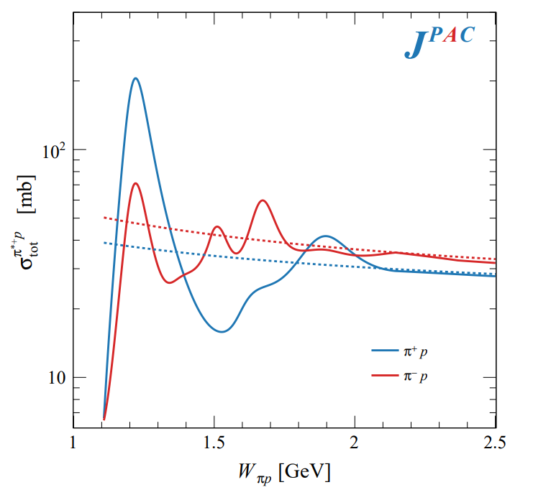
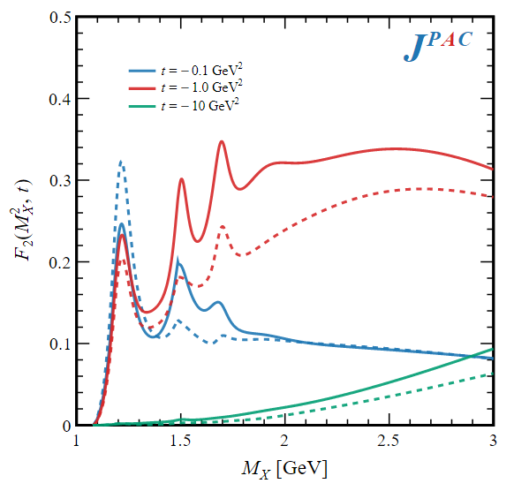
Semi-inclusive photoproduction
Semi-inclusive cross sections are typically larger
For small $t$ and large $x$, one can assume the process to be dominated by pion/vector exchange
The bottom vertex depends on the (known) total pion-nucleon cross section, or encoded in the PDFs at large $x$
$$π, ρ, ω$$
A. Pilloni – Theoretical overview of new hadronic states

Slide 44
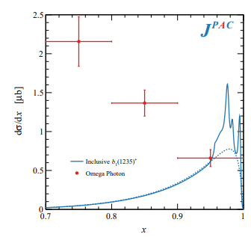
Semi-inclusive photoproduction (pion ex)
The bottom vertex depends on the (known) pion-proton total cross section
The pion is exchanged in the $t$-channel
Model benchmarked on $b_{1}$ production
Model underestimates lower bins, conservative estimates
The model is expected to hold in the highest bin
A. Pilloni – Theoretical overview of new hadronic states

Slide 45
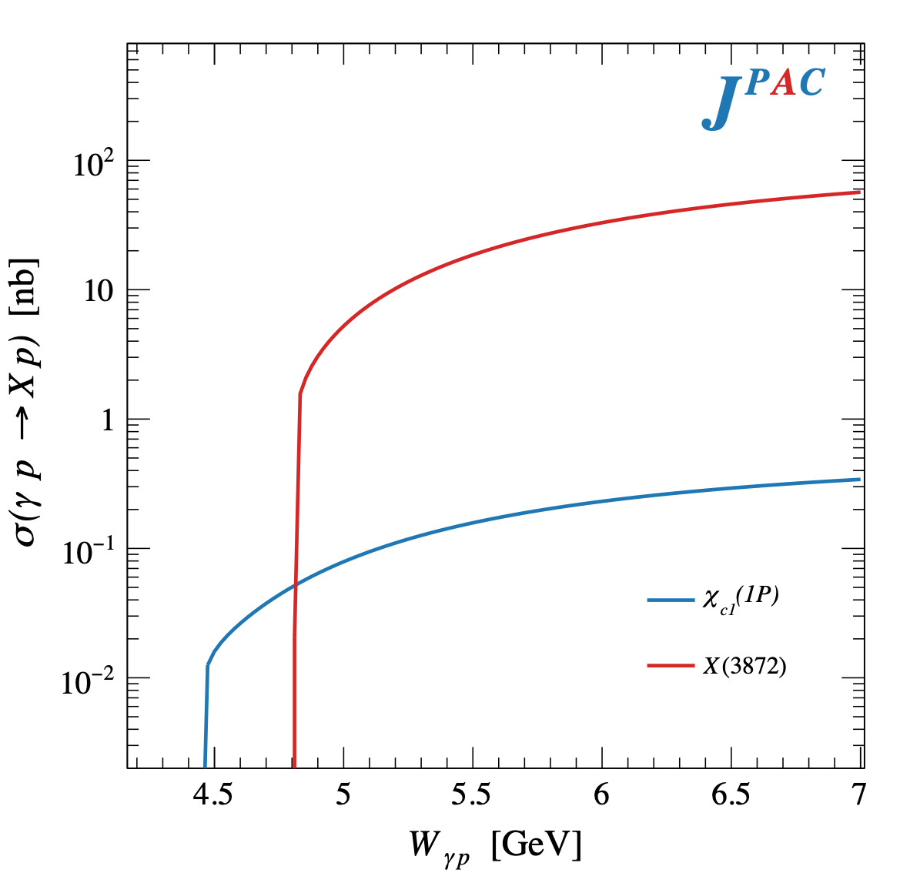
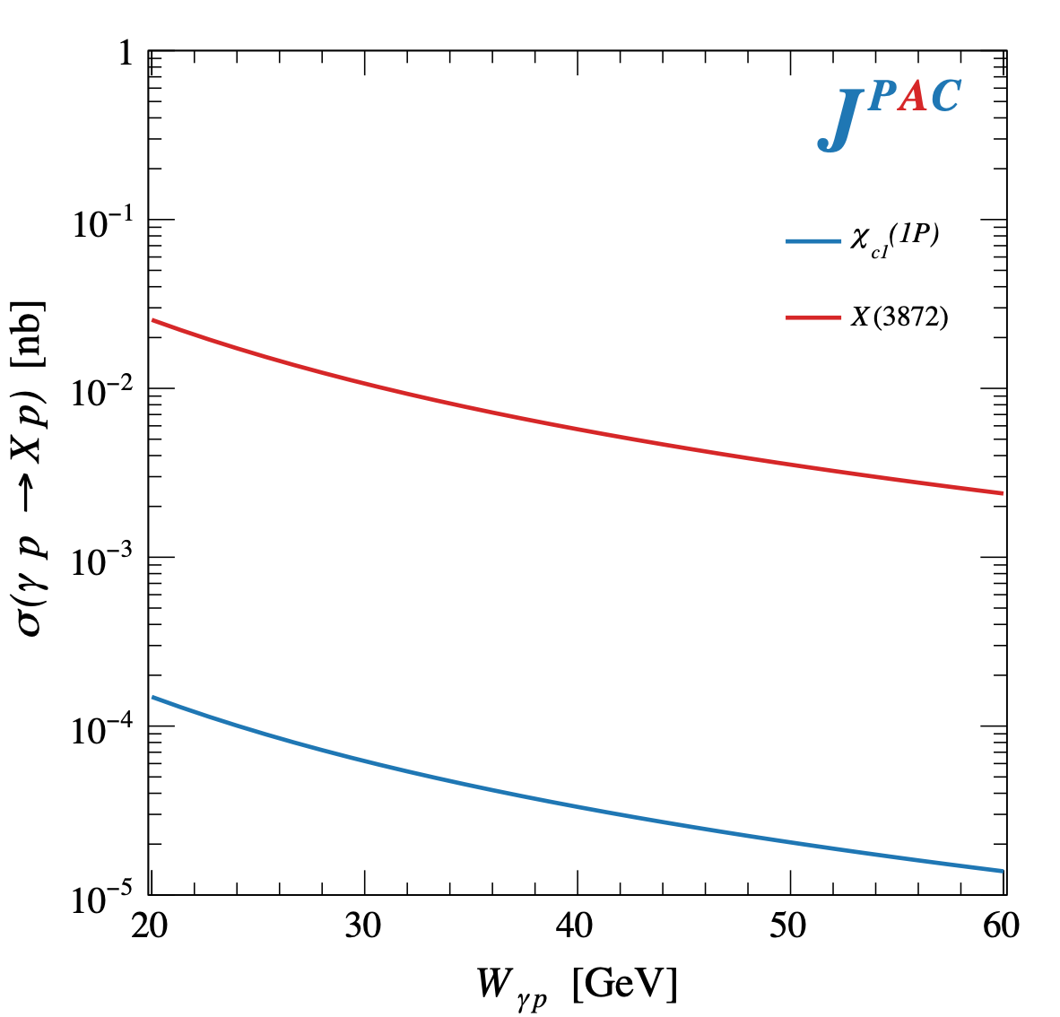
$X$ photoproduction
Focus on the famous $1^{++} X\left(3872\right)→J/ψ ρ,ω$
𝛚 and 𝛒 exchanges give main contributions:
Large theory uncertainty in the intermediate region
A. Pilloni – Theoretical overview of new hadronic states

Slide 46
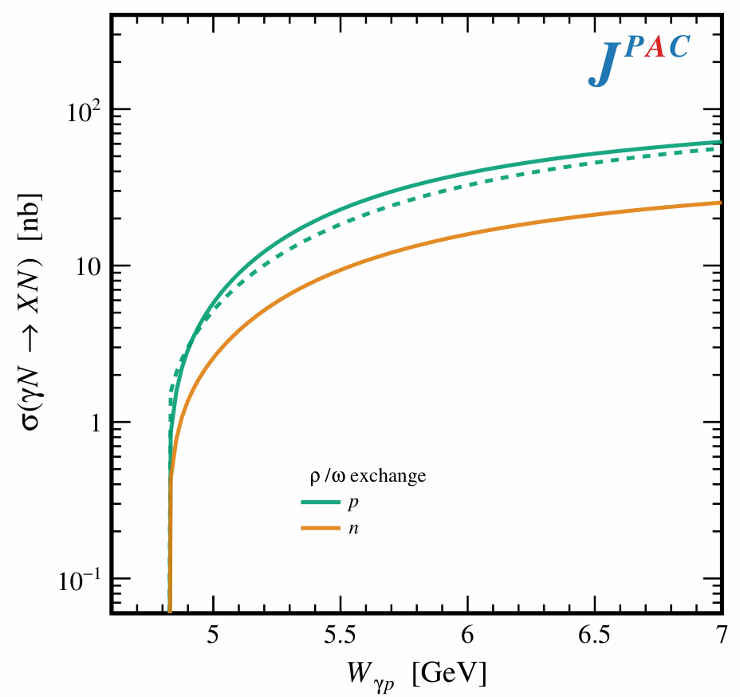
In defense of VMD
The weak point of the whole approach is the use of VMD While in the light sector it works reasonably, for heavy states is not justified There are hints that it fails badly for $J/ψ$ photoproduction The X(3872) observed in purely hadronic and photonic modes gives us unique clue to efficacy of VMD
Belle extracted the coupling $X\left(3872\right)→γγ^{∗}$, that can be compared with the VMD predictions from $X\left(3872\right)→J/ψ ρ,ω$
Hadronic Dashed
VMD Solid
A. Pilloni – Theoretical overview of new hadronic states

Slide 47
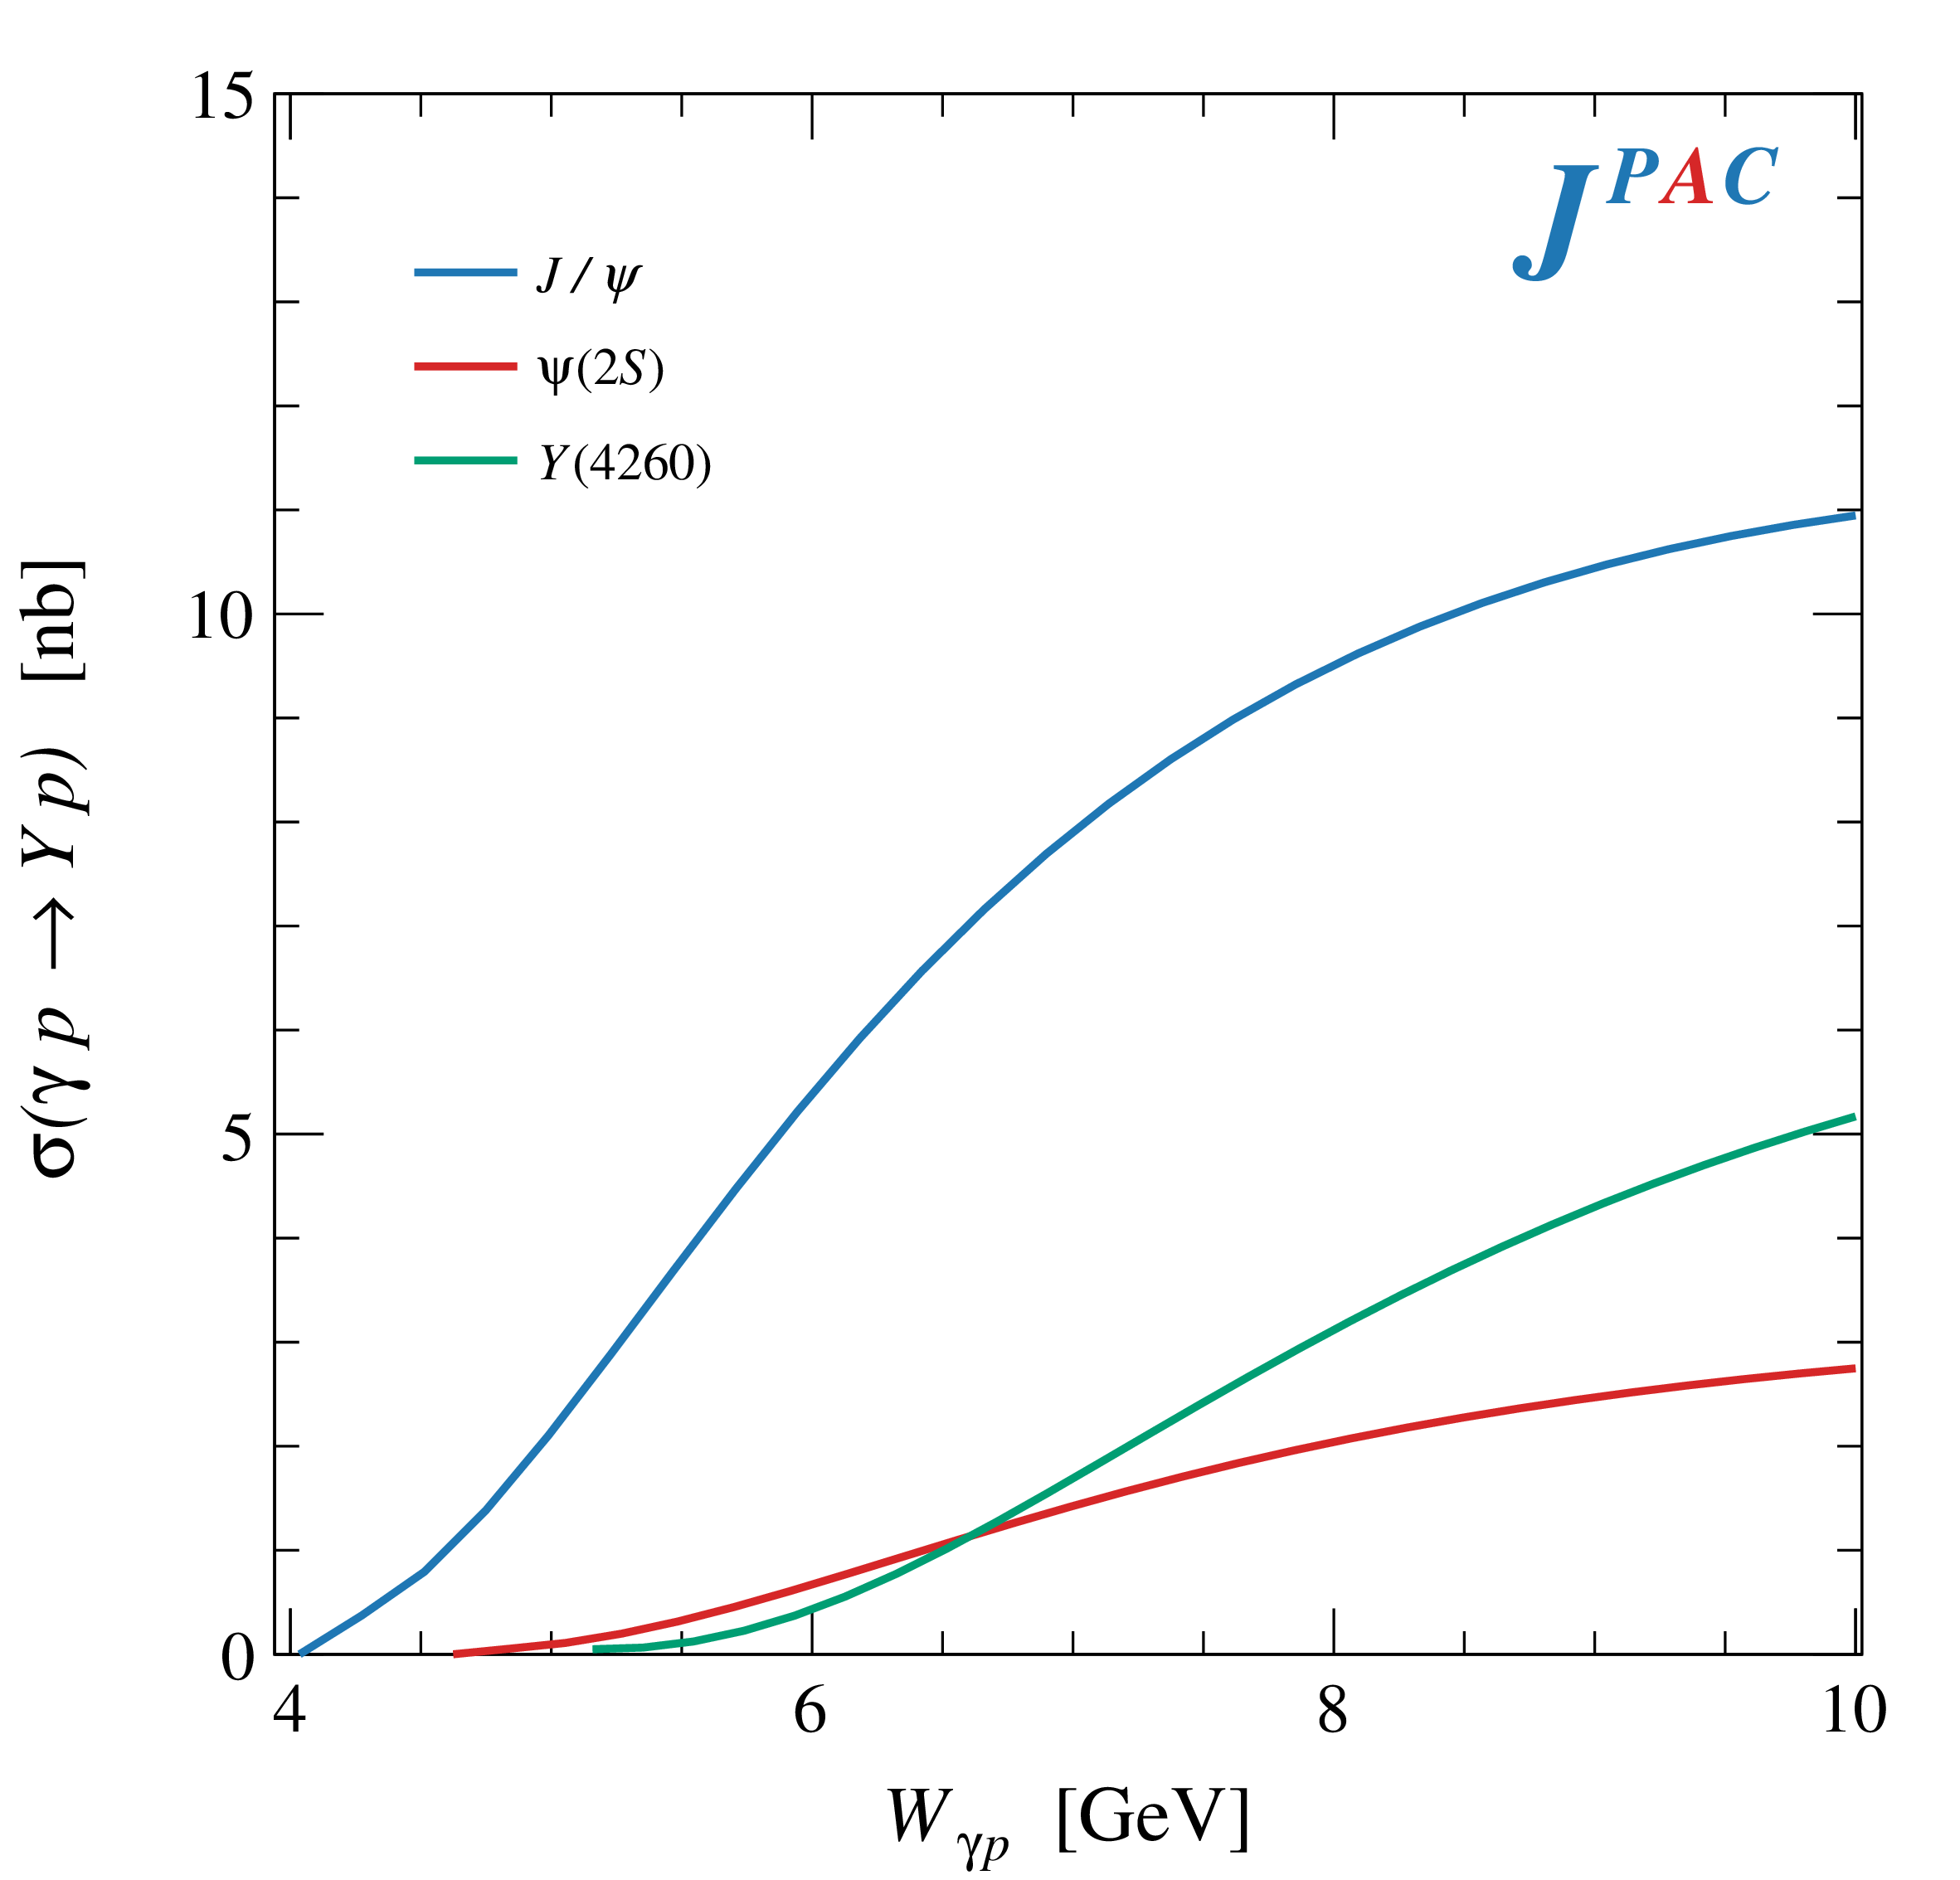
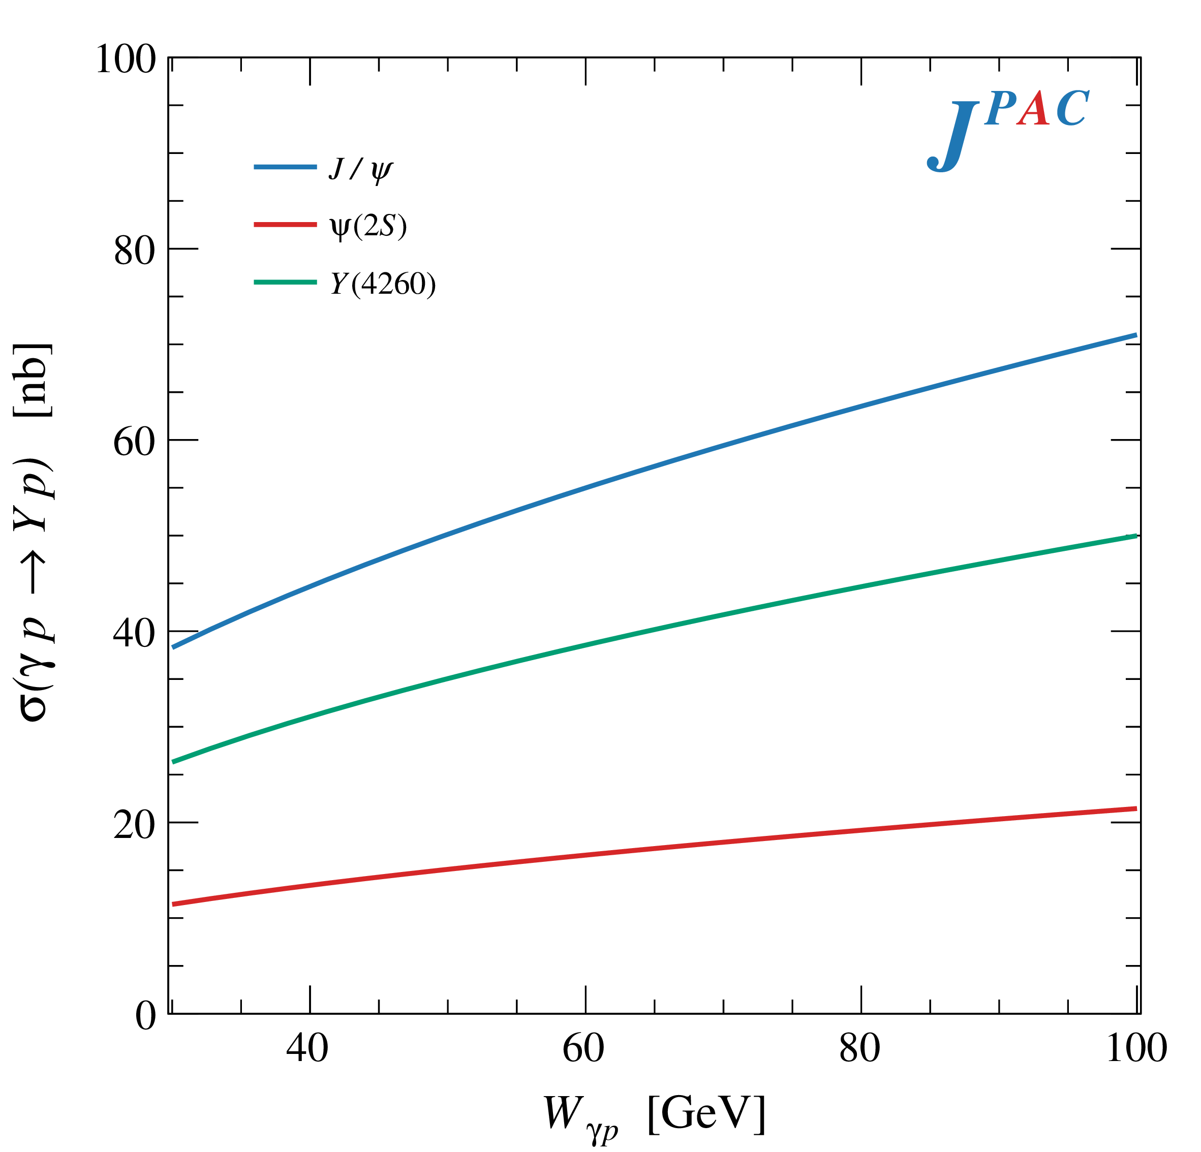
$Y$ (vector) photoproduction
Diffractive production, dominated by Pomeron (2-gluon) exchange
Existing data allow to put a 95% upper limit on the ratio of $ψ′/Y(4260)$ yields
Assuming previous formula, one gets: $Γ_{ee}^{Y}=930 eV$
(cfr. hep-ex/0603024, 2002.05641)
$BR\left(Y→J/ψππ\right)=0.96\%$
$R_{Y}=0.84$
$$R_{Y}=\frac{ef_{ψ}}{m_{ψ}}\sqrt{\frac{g^{2}(Y→ψππ)}{g^{2}(ψ→γgg)}\frac{g^{2}(ψ^{′}→ψgg)}{g^{2}(ψ^{′}→ψππ)}}$$
A. Pilloni – Theoretical overview of new hadronic states

Slide 48
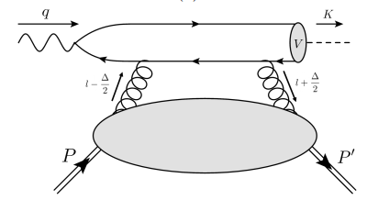
$J/ψ$ photoproduction at threshold
The common lore is that the study of vector quarkonium photoproduction at threshold is directly related to nucleon matrix elements
GPD
Assumptions:
Factorization proof for timelike DVCS can be extended at threshold as the heavy quark mass plays the role of a hard scale
The top vertex contains the trivial $γ$-$ψ$ coupling ${\left|ψ\left(0\right)\right|}^{2}$
The exchange of anything but gluons is (OZI-, mass-) suppressed
The exchange is dynamically dominated by gluons carrying $J=2$
Then one extracts matrix element of the energy momentum tensor $\left\langle p′ | T_{μν}(0) | p\right\rangle$
A. Pilloni – XYZ and 𝐽/𝜓 photoproduction

Slide 49
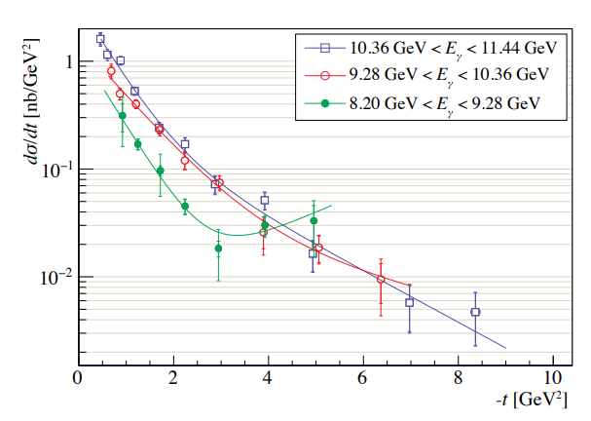
$J/ψ$ photoproduction at threshold
Winney et al. PRD108, 054018
The common lore is that the study of vector quarkonium photoproduction at threshold is directly related to nucleon matrix elements
GPD
A unitary reanalysis of recent GlueX and Hall-C data suggests that:
factorization-breaking open charm intermediate states are sizeable
predictions of VMD might be off by orders of magnitude
A. Pilloni – XYZ and 𝐽/𝜓 photoproduction

Slide 50
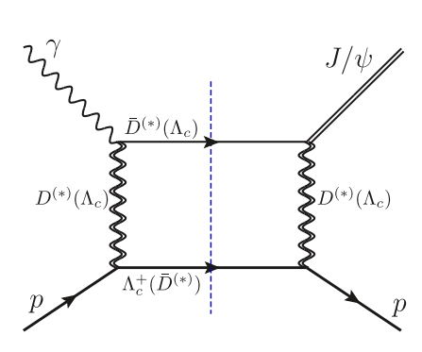
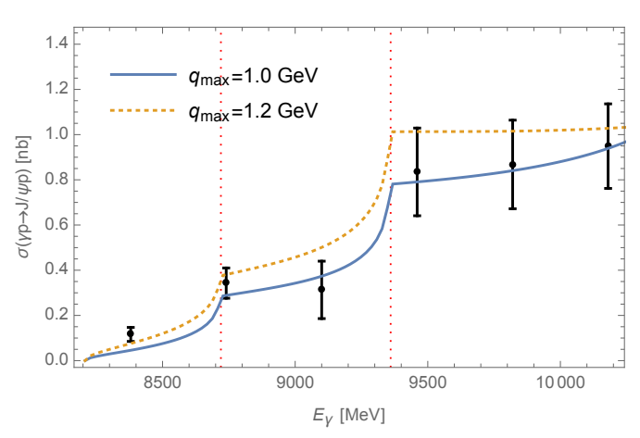
Role of open charm
Highly off-shell t-channel propagators
Du et al. Eur.Phys.J.C 80, 11, 1053
The role of intermediate open charm thresholds has been pointed out,
Maybe «all that glitters is not glue» ….
Calculation based on EFT and known couplings, S-wave saturates the cross section
A. Pilloni – XYZ and 𝐽/𝜓 photoproduction
Notes:
2 slides su Zc, a Bes e a Belle
2 slide su tetraquark model: dall’hamiltoniana di Jaffe al calcolo delle masse
1 slide su molecular models, dove sono i carichi? (non in Tornqvist, si in Hanhart, vedere Braaten, citare Nefediev)
2 slides su decay channels, dove si dovrebbe vedere, e a seconda del modello, vedere qualche plot
1 slide su Y(4260), tetraquark? C’è lo strano (si vede la f0)
1 slide su Zc a cleo (anche il neutro)

Slide 51
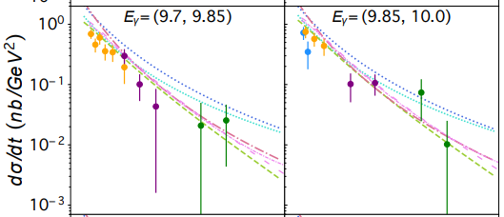
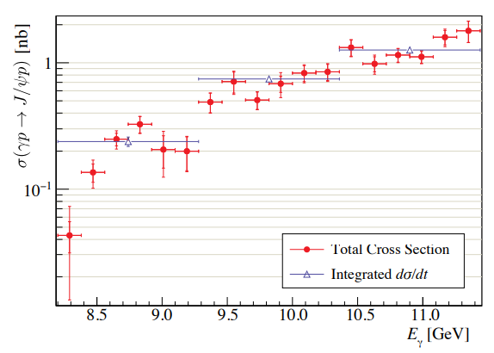
$J/ψ$ photoproduction at threshold
Nature 615, 813
Cusp at the $Λ_{c}\overline{D^{∗}}$ treshold
arXiv:2304.03845
A. Pilloni – XYZ and 𝐽/𝜓 photoproduction

Slide 52
Unitary reanalysis
Winney et al. arXiv:2305.01449
Differential and total cross sections are fitted with a unitary model
In lack of polarization observables and SDME, only orbital angular momentum is considered (spinless approx.)
Truncated sum of PWs, $ℓ≤3$
The dominant S-wave can include coupled channels, for higher waves cusps are suppressed and there is no point
A. Pilloni – XYZ and 𝐽/𝜓 photoproduction

Slide 53
Unitary reanalysis
Winney et al. arXiv:2305.01449
Differential and total cross sections are fitted with a unitary model
In lack of polarization observables and SDME, only orbital angular momentum is considered (spinless approx.)
Truncated sum of PWs, $ℓ≤3$
The dominant S-wave can include coupled channels, for higher waves cusps are suppressed and there is no point
A. Pilloni – XYZ and 𝐽/𝜓 photoproduction

Slide 54
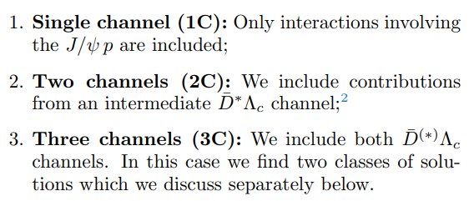
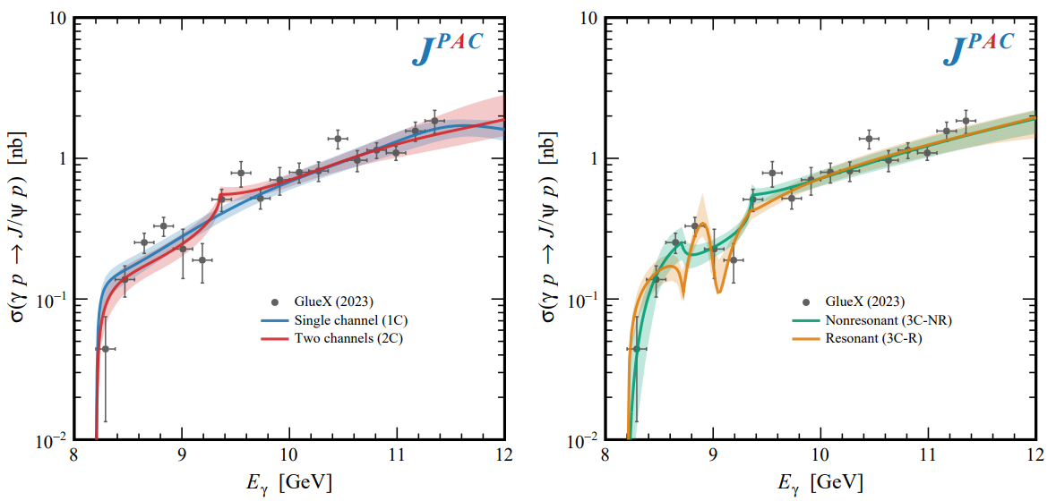
Total cross section
A. Pilloni – XYZ and 𝐽/𝜓 photoproduction

Slide 55
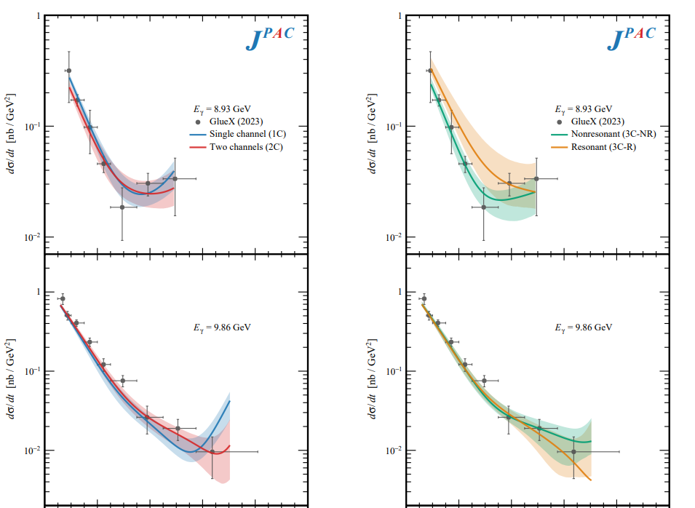
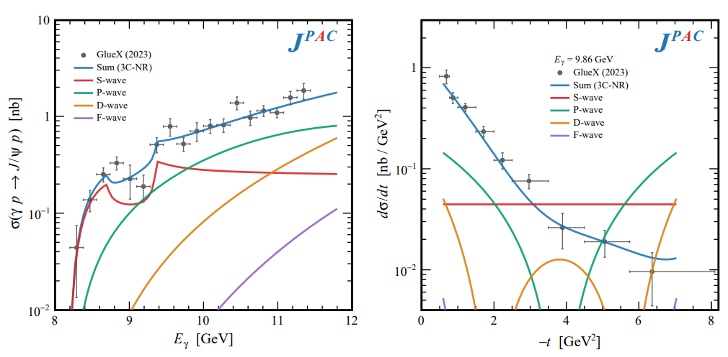
Differential cross section
This is realized with the interference of various waves, - constructive in the forward direction - distructive in the backward direction because of the Legendre polynomials
Good hierarchy between waves
A. Pilloni – XYZ and 𝐽/𝜓 photoproduction

Slide 56
Contribution of open charm
Naively Wilk’s theorem says the single channel is unfavored at $3.7σ$
(no look elsewhere etc.),
indication but not the end of the story
Contribution of open charm $>25\%$ at 90% CL
A. Pilloni – XYZ and 𝐽/𝜓 photoproduction

Slide 57
Vector Meson Dominance
Since unitary model parametrize separately the production and scattering amplitude, one can compare with the predictions of VMD
$$γ$$
$$ψ$$
$$ψ$$
$$ψ$$
$$F\left(s,t\right)=$$
$=g_{γψ}×$
But $G\left(s_{\text{th}}\right)=0$
$$p$$
$$p$$
$$p$$
$$p$$
The value of the scattering amplitude at threshold is called scattering length
According to VMD, a small photoproduction cross sections implies a small scattering length O(1am)
With the unitary model, the value of the amplitude at threshold is an unrelated parameter, the scattering length enters with the energy dependence
A. Pilloni – XYZ and 𝐽/𝜓 photoproduction

Slide 58
Vector Meson Dominance
VMD badly excluded, except for the poorly constrained 3C-R model
Scattering lengths generally of O(1fm), but smaller ones are not excluded
Crucial to constrain better these fits by measuring open charm final states
A. Pilloni – XYZ and 𝐽/𝜓 photoproduction

Slide 59
Total cross section
With optical theorem one gets the total cross section $J/ψ p→\text{X}$.
This has been estimated from the A-dependence of nuclear targets, $4\text{mb}$ at $\sqrt{s}=6.2 \text{GeV}$. VMD estimates provide values at least 1order of magnitude smaller
A. Pilloni – XYZ and 𝐽/𝜓 photoproduction

Slide 60
Bound and virtual states
The amplitude close to threshold can be expanded as
$$A\left(E\right)=\frac{1}{\frac{1}{a}+\frac{1}{2}r_{0}k^{2}−ik+O\left(k^{4}\right)}$$
$a$ is the scattering length
$r_{0}$is the effective range
The sign of $a$ controls whether we have a bound or virtual state
Matuschek et al. EPJA57 (2021) 3, 101
A. Pilloni – Theoretical review of exotic states
Notes:
Controlla la parte su Regge

Slide 61
Vector $Y$ states in BESIII
BESIII, PRL118, 092002 (2017)
BESIII, PRL118, 092001 (2017)
$$e^{+}e^{−}→J/ψ ππ$$
New BESIII data show a peculiar lineshape for the $Y(4260)$
The state appear lighter and narrower, compatible with the ones in $h_{c}ππ$ and $χ_{c0}ω$
A broader old-fashioned $Y(4260)$ is appearing in $\overline{D}D^{∗}π$, maybe indicating a ${\overline{D}D}_{1}$
dominance
$$e^{+}e^{−}→π^{+}D^{0}D^{∗−}$$
A. Pilloni – Theoretical overview of new hadronic states
Notes:
Y(4260), M=4263 +- 5, Gamma = 95+-14
D_1(2420)^0, M=2421.3 ±0.6, Gamma =27.1 ±2.7
D_1(2420)^+-, M=2423.4 ±3.1, Gamma =25 ±6
I D_1 hanno J^P = 1^+
La molecola D_1 D sta 22 MeV sotto
Se la Y è D_1 D, il pione lega fortemente, come fa la Y a essere così larga?
Come funziona lo scambio del pione???
Close propone che la Y è D_1 D^* col pione scambiato in onda S,
La Y però non va in Ds come se fosse tetraquark

Slide 62
Learning about confinement
If quarks were infinitely heavy, gluonic field is confined in a string
Linear rising potential
What is a constituent gluon?
vibration of the string? → degenerate $J^{PC}={\left(0,1,2\right)}^{−+},{\left(0,1,2\right)}^{+−}$
excitation of a quasiparticle? → degenerate $J^{PC}={\left(0,1,2\right)}^{−+},1^{−−}$
G. Bali
C. Morningstar
J. Dudek
excitation of a quasiparticle! → degenerate $J^{PC}={\left(0,1,2\right)}^{−+},1^{−−}$ says Lattice QCD...
What about real data?
D. Leinweber
A. Pilloni – Theoretical overview of new hadronic states
Notes:
Controlla la parte su Regge

Slide 63
Hybrid hunting
Excited gluon, $$J^{PC}=1^{+−}$$ mass $∼1.0\text{−}1.5 \text{GeV}$
$$\overline{r}$$
$$\overline{g}$$
$$r$$
$$g$$
Look for a $π_{1}$ state with $J^{PC}=1^{−+}$
decaying into $\left\{\begin{matrix}η π \text{and} η^{′}π \\ ρ π→3π \\ b_{1}π→5π\end{matrix}\right.$
Small signal in data
A. Pilloni – Theoretical overview of new hadronic states
Notes:
2 slides su Zc, a Bes e a Belle
2 slide su tetraquark model: dall’hamiltoniana di Jaffe al calcolo delle masse
1 slide su molecular models, dove sono i carichi? (non in Tornqvist, si in Hanhart, vedere Braaten, citare Nefediev)
2 slides su decay channels, dove si dovrebbe vedere, e a seconda del modello, vedere qualche plot
1 slide su Y(4260), tetraquark? C’è lo strano (si vede la f0)
1 slide su Zc a cleo (anche il neutro)

Slide 64
Two hybrid states???
Neither lattice nor models predict two $1^{−+}$ states in this region!
A. Pilloni – Theoretical overview of new hadronic states
Notes:
2 slides su Zc, a Bes e a Belle
2 slide su tetraquark model: dall’hamiltoniana di Jaffe al calcolo delle masse
1 slide su molecular models, dove sono i carichi? (non in Tornqvist, si in Hanhart, vedere Braaten, citare Nefediev)
2 slides su decay channels, dove si dovrebbe vedere, e a seconda del modello, vedere qualche plot
1 slide su Y(4260), tetraquark? C’è lo strano (si vede la f0)
1 slide su Zc a cleo (anche il neutro)

Slide 65
Data in $η^{(′)}π$
$$π_{1}\left(1400\right)?$$
$$a_{2}\left(1320\right)$$
$$a_{2}^{′}\left(1700\right)$$
$$π_{1}\left(1600\right)?$$
$$a_{2}\left(1320\right)$$
$$a_{2}^{′}\left(1700\right)$$
$$J^{PC}=1^{−+}$$
$$J^{PC}=2^{++}$$
A. Pilloni – Theoretical overview of new hadronic states
Notes:
Controlla la parte su Regge

Slide 66
Amplitudes for $η^{(′)}π$
We build the partial wave amplitudes according to the $N/D$ method
Jackura, Mikhasenko, AP et al. (JPAC & COMPASS), PLB
Rodas, AP et al. (JPAC), PRL
$$a\left(s\right)=\frac{n\left(s\right)}{D\left(s\right)}$$
$$D(s)$$
$$n(s)$$
The $n\left(s\right)$ → background physics, process-dependent, smooth
The $D(s)$ contains all the Final State Interactions constrained by unitarity → universal
A. Pilloni – Prospects for Hadron Spectroscopy at JLab
Notes:
Controlla la parte su Regge

Slide 67
Fit to $η^{(′)}π$
$$π_{1}\left(1400\right)?$$
$$a_{2}\left(1320\right)$$
$$a_{2}^{′}\left(1700\right)$$
$$π_{1}\left(1600\right)?$$
$$a_{2}\left(1320\right)$$
$$a_{2}^{′}\left(1700\right)$$
$$J^{PC}=1^{−+}$$
$$J^{PC}=2^{++}$$
A. Pilloni – Theoretical overview of new hadronic states
Notes:
Controlla la parte su Regge

Slide 68
Pole hunting
$$a_{2}^{′}\left(1700\right)$$
$$a_{2}^{′}\left(1700\right)$$
$$a_{2}\left(1320\right)$$
$$a_{2}\left(1320\right)$$
A. Pilloni – Theoretical overview of new hadronic states
Notes:
Controlla la parte su Regge

Slide 69
Pole hunting
$$π_{1}$$
$$π_{1}$$
A. Pilloni – Theoretical overview of new hadronic states
Notes:
Controlla la parte su Regge

Slide 70
Statistical Bootstrap
A. Pilloni – Theoretical overview of new hadronic states
Notes:
Controlla la parte su Regge

Slide 71
Statistical Bootstrap
For each fit, we search poles: two clusters in D-wave: $a_{2}\left(1320\right)$ and $a_{2}^{′}\left(1700\right)$
A. Pilloni – Theoretical overview of new hadronic states
Notes:
Controlla la parte su Regge

Slide 72
Statistical Bootstrap
Only one stable cluster in $P$-wave: a single $π_{1}$
A. Pilloni – Theoretical overview of new hadronic states
Notes:
Controlla la parte su Regge

Slide 73
Final results
Agreement with Lattice is restored
That’s the most rigorous extraction of an exotic meson available so far!
A. Pilloni – Theoretical overview of new hadronic states
Notes:
Controlla la parte su Regge

Slide 74
Searching for resonances in $ηπ$
Smooth «background»
Precise determination of pole position
Notes:
Controlla la parte su Regge

Slide 75
Systematic studies
For each class, the maximum deviation of mass and width is taken as a systematic error Deviation smaller than the statistical error are neglected Systematic of different classes are summed in quadrature
A. Pilloni – Determination of the lightest hybrid meson pole
Notes:
Controlla la parte su Regge

Slide 76
Quarkonium orthodoxy
$$Q$$
$$\overline{Q}$$
Potential models
(meaningful when $M_{Q}$ large)
$$α_{s}\left(M_{Q}\right)∼0.3$$
(perturbative regime)
Solve NR Schrödinger eq. → spectrum
A. Pilloni – Theoretical overview of new hadronic states
Notes:
2 slides su Zc, a Bes e a Belle
2 slide su tetraquark model: dall’hamiltoniana di Jaffe al calcolo delle masse
1 slide su molecular models, dove sono i carichi? (non in Tornqvist, si in Hanhart, vedere Braaten, citare Nefediev)
2 slides su decay channels, dove si dovrebbe vedere, e a seconda del modello, vedere qualche plot
1 slide su Y(4260), tetraquark? C’è lo strano (si vede la f0)
1 slide su Zc a cleo (anche il neutro)

Slide 77
Example: The charged $Z_{c}\left(3900\right)$
A charged charmonium-like resonance has been claimed by BESIII in 2013.
$e^{+}e^{−}→Z_{c}{\left(3900\right)}^{+}π^{−}→J/ψ{ π}^{+}π^{−}$ and $→{\left(DD^{∗}\right)}^{+}π^{−}$ $M=3888.7±3.4$MeV, $Γ=35±7$ MeV
Such a state would require a minimal 4q content and would be manifestly exotic
A. Pilloni – Theoretical overview of new hadronic states
Notes:
Y(4260), M=4263 +- 5, Gamma = 95+-14
D_1(2420)^0, M=2421.3 ±0.6, Gamma =27.1 ±2.7
D_1(2420)^+-, M=2423.4 ±3.1, Gamma =25 ±6
I D_1 hanno J^P = 1^+
La molecola D_1 D sta 22 MeV sotto
Se la Y è D_1 D, il pione lega fortemente, come fa la Y a essere così larga?
Come funziona lo scambio del pione???

Slide 78
Amplitude analysis for $Z_{c}(3900)$
One can test different parametrizations of the amplitude, which correspond to different singularities → different natures
AP et al. (JPAC), PLB772, 200
$$Z_{c}\left(3900\right)?$$
$${u: D}_{0}(2400)$$
$${u:Z}_{c}\left(3900\right)?$$
$$"σ, f_{0}(980)"$$
$$D_{1}(2420)$$
Triangle rescattering, logarithmic branching point
(anti)bound state, II/IV sheet pole
(«molecule»)
Resonance, III sheet pole
(«compact state»)
$$π$$
$$D_{1}$$
$$Y$$
$$D^{∗}$$
$$π$$
$$\overline{D}$$
$$J/ψ$$
Tornqvist, Z.Phys. C61, 525
Swanson, Phys.Rept. 429
Hanhart et al. PRL111, 132003
Maiani et al., PRD71, 014028
Faccini et al., PRD87, 111102
Esposito et al., Phys.Rept. 668
Szczepaniak, PLB747, 410
A. Pilloni – Theoretical overview of new hadronic states
Notes:
Controlla la parte su Regge

Slide 79
Fit: III
A. Pilloni – Theoretical overview of new hadronic states
Notes:
Controlla la parte su Regge

Slide 80
Fit: III+tr.
A. Pilloni – Theoretical overview of new hadronic states
Notes:
Controlla la parte su Regge

Slide 81
Fit: IV+tr.
A. Pilloni – Theoretical overview of new hadronic states
Notes:
Controlla la parte su Regge

Slide 82
Fit: tr.
A. Pilloni – Theoretical overview of new hadronic states
Notes:
Controlla la parte su Regge

Slide 83
Pole extraction
III
III+tr.
IV+tr.
A. Pilloni – Theoretical overview of new hadronic states
Not conclusive at this stage
Notes:
Controlla la parte su Regge

Slide 84
Finite energy sum rules
PWA in the low energy region
Resonance extraction
Analytically connected
Regge exchanges at high energy
A. Pilloni – Theoretical overview of new hadronic states
Notes:
Controlla la parte su Regge

Slide 85
Pole hunting
I sheet
Extracting physics information means to hunt for poles in the complex plane
Pole position → Mass and width
Residues → Couplings
Virtual state
II sheet
Bound state
Resonance
A. Pilloni – Theoretical overview of new hadronic states
Notes:
Controlla la parte su Regge

Slide 86
$X(3872)$
Discovered in $B→K X→K J/ψ ππ$
Quantum numbers $1^{++}$
Very close to $DD^{∗}$ threshold
Too narrow for an above-treshold charmonium
Isospin violation too big $\frac{Γ\left(X→J/ψ ω\right)}{Γ\left(X→J/ψ ρ\right)}\sim 0.8±0.3$
Mass prediction not compatible with $χ_{c1}(2P)$
$M=3871.68±0.17$MeV
$$M_{X}−M_{DD^{∗}}=−3±192 \text{keV}$$
$Γ<1.2 \text{MeV}\text{ @90\%}$
A. Pilloni – Theoretical overview of new hadronic states

Slide 87
$X(3872)$
Large prompt production at hadron colliders
$$σ_{B}/σ_{TOT}=\left(26.3±2.3±1.6\right)\%$$
$$σ_{PR}×B(X→J/ψππ)=\left(1.06±0.11±0.15\right) \text{nb}$$
CMS, JHEP 1304, 154
A. Pilloni – Theoretical overview of new hadronic states

Slide 88
Vector $Y$ states
Lots of unexpected ${J^{PC}=1}^{−−}$ states found in ISR/direct production (and nowhere else!)
Seen in few final states, mostly $J/ψ ππ$ and $ψ\left(2S\right) ππ$
Not seen decaying into open charm pairs
Large HQSS violation
Belle $J/ψππ$
BES $h_{c}ππ$
A. Pilloni – Theoretical overview of new hadronic states
Notes:
Y(4260), M=4263 +- 5, Gamma = 95+-14
D_1(2420)^0, M=2421.3 ±0.6, Gamma =27.1 ±2.7
D_1(2420)^+-, M=2423.4 ±3.1, Gamma =25 ±6
I D_1 hanno J^P = 1^+
La molecola D_1 D sta 22 MeV sotto
Se la Y è D_1 D, il pione lega fortemente, come fa la Y a essere così larga?
Come funziona lo scambio del pione???

Slide 89
Vector $Y$ states in BESIII
BESIII, PRL118, 092002 (2017)
BESIII, PRL118, 092001 (2017)
$$e^{+}e^{−}→J/ψ ππ$$
$$e^{+}e^{−}→h_{c} ππ$$
New BESIII data show a peculiar lineshape for the $Y(4260)$
The state appear lighter and narrower, compatible with the ones in $h_{c}ππ$ and $χ_{c0}ω$
A broader old-fashioned $Y(4260)$ is appearing in $\overline{D}D^{∗}π$, maybe indicating a ${\overline{D}D}_{1}$
dominance
$$e^{+}e^{−}→π^{+}D^{0}D^{∗−}$$
A. Pilloni – Theoretical overview of new hadronic states
Notes:
Y(4260), M=4263 +- 5, Gamma = 95+-14
D_1(2420)^0, M=2421.3 ±0.6, Gamma =27.1 ±2.7
D_1(2420)^+-, M=2423.4 ±3.1, Gamma =25 ±6
I D_1 hanno J^P = 1^+
La molecola D_1 D sta 22 MeV sotto
Se la Y è D_1 D, il pione lega fortemente, come fa la Y a essere così larga?
Come funziona lo scambio del pione???
Close propone che la Y è D_1 D^* col pione scambiato in onda S,
La Y però non va in Ds come se fosse tetraquark

Slide 90
Charged $Z$ states: $Z_{c}\left(3900\right), Z_{c}^{′}(4020)$
Charged quarkonium-like resonances have been found, 4q needed
Two states $J^{PC}=1^{+−}$ appear slightly above $D^{(∗)}D^{∗}$ thresholds
$e^{+}e^{−}→Z_{c}{\left(3900\right)}^{+}π^{−}→J/ψ{ π}^{+}π^{−}$ and $→{\left(DD^{∗}\right)}^{+}π^{−}$ $M=3888.7±3.4$MeV, $Γ=35±7$ MeV
$e^{+}e^{−}→Z_{c}^{′}{\left(4020\right)}^{+}π^{−}→h_{c}{ π}^{+}π^{−}$ and $→{\overline{D}}^{∗0}D^{∗+}π^{−}$
$M=4023.9±2.4$MeV, $Γ=10±6$ MeV
A. Pilloni – Theoretical overview of new hadronic states
Notes:
Y(4260), M=4263 +- 5, Gamma = 95+-14
D_1(2420)^0, M=2421.3 ±0.6, Gamma =27.1 ±2.7
D_1(2420)^+-, M=2423.4 ±3.1, Gamma =25 ±6
I D_1 hanno J^P = 1^+
La molecola D_1 D sta 22 MeV sotto
Se la Y è D_1 D, il pione lega fortemente, come fa la Y a essere così larga?
Come funziona lo scambio del pione???

Slide 91
Charged $Z$ states: $Z_{b}\left(10610\right), Z_{b}^{′}(10650)$
Anomalous dipion width in $Υ\left(5S\right)$,
2 orders of magnitude larger than $Υ\left(nS\right)$
Moreover, observed $Υ\left(5S\right)→h_{b}\left(nP\right)ππ$ which violates HQSS
$Υ\left(5S\right)→Z_{b}{\left(10610\right)}^{+}π^{−}→Υ\left(nS\right){ π}^{+}π^{−},h_{b}\left(nP\right){ π}^{+}π^{−}$ and $→{\left(BB^{∗}\right)}^{+}π^{−}$ $M=10607.2±2.0$MeV, $Γ=18.4±2.4$ MeV
$Υ\left(5S\right)→Z_{b}^{′}{\left(10650\right)}^{+}π^{−}→Υ\left(nS\right){ π}^{+}π^{−},h_{b}\left(nP\right){ π}^{+}π^{−}$ and $→{\overline{B}}^{∗0}B^{∗+}π^{−}$
$M=10652.2±1.5$MeV, $Γ=11.5±2.2$ MeV
2 twin resonances!
A. Pilloni – Theoretical overview of new hadronic states
Notes:
Y(4260), M=4263 +- 5, Gamma = 95+-14
D_1(2420)^0, M=2421.3 ±0.6, Gamma =27.1 ±2.7
D_1(2420)^+-, M=2423.4 ±3.1, Gamma =25 ±6
I D_1 hanno J^P = 1^+
La molecola D_1 D sta 22 MeV sotto
Se la Y è D_1 D, il pione lega fortemente, come fa la Y a essere così larga?
Come funziona lo scambio del pione???

Slide 92
Pentaquarks!
LHCb, PRL 115, 072001
LHCb, PRL 117, 082003
Two states seen in $Λ_{b}→\left(J/ψ p\right) K^{−}$,
evidence in $Λ_{b}→\left(J/ψ p\right) π^{−}$
$$M_{1}=4380±8±29 \text{MeV} \\ Γ_{1}=205±18±86 \text{MeV}$$
$$M_{2}=4449.8±1.7±2.5 \text{MeV} \\ Γ_{2}=39±5±19 \text{MeV}$$
Quantum numbers $$J^{P}=\left({\frac{3}{2}}^{−},{\frac{5}{2}}^{+}\right) \text{or}\left({\frac{3}{2}}^{+},{\frac{5}{2}}^{−}\right)\text{or}\left({\frac{5}{2}}^{+},{\frac{3}{2}}^{−}\right)$$
Opposite parities needed for the interference to correctly describe angular distributions, low mass region contaminated by $Λ^{∗}$ (model dependence?)
No obvious threshold nearby
A. Pilloni – Theoretical overview of new hadronic states
Notes:
Y(4260), M=4263 +- 5, Gamma = 95+-14
D_1(2420)^0, M=2421.3 ±0.6, Gamma =27.1 ±2.7
D_1(2420)^+-, M=2423.4 ±3.1, Gamma =25 ±6
I D_1 hanno J^P = 1^+
La molecola D_1 D sta 22 MeV sotto
Se la Y è D_1 D, il pione lega fortemente, come fa la Y a essere così larga?
Come funziona lo scambio del pione???

Slide 93
Pentaquarks!
LHCb, PRL 115, 072001
LHCb, PRL 117, 082003
Two states seen in $Λ_{b}→\left(J/ψ p\right) K^{−}$,
evidence in $Λ_{b}→\left(J/ψ p\right) π^{−}$
$$M_{1}=4380±8±29 \text{MeV} \\ Γ_{1}=205±18±86 \text{MeV}$$
$$M_{2}=4449.8±1.7±2.5 \text{MeV} \\ Γ_{2}=39±5±19 \text{MeV}$$
Quantum numbers $$J^{P}=\left({\frac{3}{2}}^{−},{\frac{5}{2}}^{+}\right) \text{or}\left({\frac{3}{2}}^{+},{\frac{5}{2}}^{−}\right)\text{or}\left({\frac{5}{2}}^{+},{\frac{3}{2}}^{−}\right)$$
Opposite parities needed for the interference to correctly describe angular distributions, low mass region contaminated by $Λ^{∗}$ (model dependence?)
No obvious threshold nearby
MC simul.
A. Pilloni – Theoretical overview of new hadronic states
Notes:
Y(4260), M=4263 +- 5, Gamma = 95+-14
D_1(2420)^0, M=2421.3 ±0.6, Gamma =27.1 ±2.7
D_1(2420)^+-, M=2423.4 ±3.1, Gamma =25 ±6
I D_1 hanno J^P = 1^+
La molecola D_1 D sta 22 MeV sotto
Se la Y è D_1 D, il pione lega fortemente, come fa la Y a essere così larga?
Come funziona lo scambio del pione???

Slide 94
$X(3872)$
Discovered in $B→K X→K J/ψ ππ$
Quantum numbers $1^{++}$
Very close to $DD^{∗}$ threshold
Too narrow for an above-treshold charmonium
Isospin violation too big $\frac{Γ\left(X→J/ψ ω\right)}{Γ\left(X→J/ψ ρ\right)}\sim 1.1±0.4$
Mass prediction not compatible with $χ_{c1}(2P)$
$M=3871.65±0.06$MeV
$$M_{X}−M_{DD^{∗}}=−3±192 \text{keV}$$
$Γ_{BW}=1.19±0.2\text{1 }\text{MeV}$
A. Pilloni – Theoretical overview of new hadronic states

Slide 95
$X(3872)$
Large prompt production at hadron colliders
$$σ_{B}/σ_{TOT}=\left(26.3±2.3±1.6\right)\%$$
$$σ_{PR}×B(X→J/ψππ)=\left(1.06±0.11±0.15\right) \text{nb}$$
CMS, JHEP 1304, 154
A. Pilloni – Theoretical overview of new hadronic states

Slide 96
Charged $Z$ states: $Z_{c}\left(3900\right), Z_{c}^{′}\left(4020\right), Z_{cs}(3985)$
Charged quarkonium-like resonances have been found, 4q needed
Two states $J^{PC}=1^{+−}$ appear slightly above $D^{(∗)}D^{∗}$ thresholds
$e^{+}e^{−}→Z_{c}{\left(3900\right)}^{+}π^{−}→J/ψ{ π}^{+}π^{−}$ and $→{\left(DD^{∗}\right)}^{+}π^{−}$ $M=3888.7±3.4$MeV, $Γ=35±7$ MeV
$e^{+}e^{−}→Z_{c}^{′}{\left(4020\right)}^{+}π^{−}→h_{c}{ π}^{+}π^{−}$ and $→{\overline{D}}^{∗0}D^{∗+}π^{−}$
$M=4023.9±2.4$MeV, $Γ=10±6$ MeV
Strange partner with smaller significance $$e^{+}e^{−}→Z_{cs}{\left(3985\right)}^{+}K^{−}→D_{s}^{+}\overline{D^{∗0}}{ K}^{−}$$ $M={3982.5}_{−2.6}^{+1.8}±2.1$MeV, $Γ={12.8}_{−4.4}^{+5.3}±3.0$ MeV
A. Pilloni – Theoretical overview of new hadronic states
Notes:
Y(4260), M=4263 +- 5, Gamma = 95+-14
D_1(2420)^0, M=2421.3 ±0.6, Gamma =27.1 ±2.7
D_1(2420)^+-, M=2423.4 ±3.1, Gamma =25 ±6
I D_1 hanno J^P = 1^+
La molecola D_1 D sta 22 MeV sotto
Se la Y è D_1 D, il pione lega fortemente, come fa la Y a essere così larga?
Come funziona lo scambio del pione???

Slide 97
Charged $Z$ states: $Z_{b}\left(10610\right), Z_{b}^{′}(10650)$
Anomalous dipion width in $Υ\left(5S\right)$,
2 orders of magnitude larger than $Υ\left(nS\right)$
Moreover, observed $Υ\left(5S\right)→h_{b}\left(nP\right)ππ$ which violates HQSS
$Υ\left(5S\right)→Z_{b}{\left(10610\right)}^{+}π^{−}→Υ\left(nS\right){ π}^{+}π^{−},h_{b}\left(nP\right){ π}^{+}π^{−}$ and $→{\left(BB^{∗}\right)}^{+}π^{−}$ $M=10607.2±2.0$MeV, $Γ=18.4±2.4$ MeV
$Υ\left(5S\right)→Z_{b}^{′}{\left(10650\right)}^{+}π^{−}→Υ\left(nS\right){ π}^{+}π^{−},h_{b}\left(nP\right){ π}^{+}π^{−}$ and $→{\overline{B}}^{∗0}B^{∗+}π^{−}$
$M=10652.2±1.5$MeV, $Γ=11.5±2.2$ MeV
2 twin resonances!
A. Pilloni – Theoretical overview of new hadronic states
Notes:
Y(4260), M=4263 +- 5, Gamma = 95+-14
D_1(2420)^0, M=2421.3 ±0.6, Gamma =27.1 ±2.7
D_1(2420)^+-, M=2423.4 ±3.1, Gamma =25 ±6
I D_1 hanno J^P = 1^+
La molecola D_1 D sta 22 MeV sotto
Se la Y è D_1 D, il pione lega fortemente, come fa la Y a essere così larga?
Come funziona lo scambio del pione???

Slide 98
Vector $Y$ states
Lots of unexpected ${J^{PC}=1}^{−−}$ states found in ISR/direct production (and nowhere else!)
Seen in few final states, mostly $J/ψ ππ$ and $ψ\left(2S\right) ππ$
Not seen decaying into open charm pairs
Large HQSS violation
Belle $J/ψππ$
BES $h_{c}ππ$
A. Pilloni – Theoretical overview of new hadronic states
Notes:
Y(4260), M=4263 +- 5, Gamma = 95+-14
D_1(2420)^0, M=2421.3 ±0.6, Gamma =27.1 ±2.7
D_1(2420)^+-, M=2423.4 ±3.1, Gamma =25 ±6
I D_1 hanno J^P = 1^+
La molecola D_1 D sta 22 MeV sotto
Se la Y è D_1 D, il pione lega fortemente, come fa la Y a essere così larga?
Come funziona lo scambio del pione???

Slide 99
Fully charm: the $X(6900)$
Two structures are seen in the $J/ψ J/ψ$ spectrum
The heavier one is narrower and well assessed
The nature of the lighter one is unclear
A. Pilloni – Theoretical overview of new hadronic states
Notes:
Y(4260), M=4263 +- 5, Gamma = 95+-14
D_1(2420)^0, M=2421.3 ±0.6, Gamma =27.1 ±2.7
D_1(2420)^+-, M=2423.4 ±3.1, Gamma =25 ±6
I D_1 hanno J^P = 1^+
La molecola D_1 D sta 22 MeV sotto
Se la Y è D_1 D, il pione lega fortemente, come fa la Y a essere così larga?
Come funziona lo scambio del pione???

Slide 100
Very open charm: the $T_{cc}^{+}$
A supernarrow state is seen at the $D^{∗+}D^{0}$ threshold
BW parameters give
$δm_{BW}=−273±61 \text{keV}$
$Γ_{BW}=410±65 \text{keV}$
Unitary analysis gives
$δm=−360±{40}_{−0}^{+4} \text{keV}$
$Γ={48±2}_{−14}^{+0} \text{keV}$
It cannot mix with ordinary charmonia It does not have lighter open channels
A. Pilloni – Theoretical overview of new hadronic states
Notes:
Y(4260), M=4263 +- 5, Gamma = 95+-14
D_1(2420)^0, M=2421.3 ±0.6, Gamma =27.1 ±2.7
D_1(2420)^+-, M=2423.4 ±3.1, Gamma =25 ±6
I D_1 hanno J^P = 1^+
La molecola D_1 D sta 22 MeV sotto
Se la Y è D_1 D, il pione lega fortemente, come fa la Y a essere così larga?
Come funziona lo scambio del pione???

Slide 101
Pentaquarks
LHCb, PRL 115, 072001
LHCb, PRL 117, 082003
States seen in $Λ_{b}→\left(J/ψ p\right) K^{−}$,
Original analysis found a narrow and a broad states
The subsequent 1D update find 3 narrow ones
The lightest $P_{c}(4312)$ appears as an isolated peak at the $Σ_{c}^{+}{\overline{D}}^{0}$ threshold
A. Pilloni – Theoretical overview of new hadronic states
Notes:
Controlla la parte su Regge

Slide 102
Strange pentaquarks
Can you search pentaquarks in meson decays? $B^{−}→J/ψ Λ^{0} \overline{p}$
Bingo! $P_{cs}$!
$$m=4338.2±0.7±0.4 \text{MeV}$$
$$Γ=7.0±1.2±1.3 \text{MeV}$$
It remains to be seen the connections with the nonstrange pentaquarks
No $K^{∗}$ expected in this $Λ^{0}\overline{p}$ mass region
None seen, mostly flat
A. Pilloni – Theoretical overview of new hadronic states
Notes:
Controlla la parte su Regge

Slide 103
Broad exotics in $B$ decays
Lots of new exotics have been seen by LHCb with multidimensional amplitude analyses of $B→$ 3+ body
Most of these are broad, and the precise determination can crucially depend on the amplitude model, so that the resonant nature cannot be assessed with the same strong statements as for the narrow guys
A. Pilloni – Theoretical overview of new hadronic states
Notes:
Y(4260), M=4263 +- 5, Gamma = 95+-14
D_1(2420)^0, M=2421.3 ±0.6, Gamma =27.1 ±2.7
D_1(2420)^+-, M=2423.4 ±3.1, Gamma =25 ±6
I D_1 hanno J^P = 1^+
La molecola D_1 D sta 22 MeV sotto
Se la Y è D_1 D, il pione lega fortemente, come fa la Y a essere così larga?
Come funziona lo scambio del pione???

Slide 104
Charged $Z$ states: $Z(4430)$
$$Z{\left(4430\right)}^{+}→ψ(2S){ π}^{+} \\ {I^{G}J}^{PC}=1^{+}1^{+−}$$
$M=4475±7_{−25}^{+15}$MeV
$Γ=172±{13}_{−34}^{+37}$MeV
Far from open charm thresholds
If the amplitude is a free complex number, in each bin of $m_{ψ^{′}π^{−}}^{2}$, the resonant behaviour appears as well
A. Pilloni – Theoretical overview of new hadronic states
Notes:
Y(4260), M=4263 +- 5, Gamma = 95+-14
D_1(2420)^0, M=2421.3 ±0.6, Gamma =27.1 ±2.7
D_1(2420)^+-, M=2423.4 ±3.1, Gamma =25 ±6
I D_1 hanno J^P = 1^+
La molecola D_1 D sta 22 MeV sotto
Se la Y è D_1 D, il pione lega fortemente, come fa la Y a essere così larga?
Come funziona lo scambio del pione???

Slide 105
Tetraquarks: the $B^{+}→J/ψ φ K^{+}$ decay
$$\text{In} J/ψ φ: \left\{\begin{aligned}\text{1}× 1^{−+} \\ \text{2}× 0^{++} \\ 3× 1^{++}\end{aligned}\right.$$
$$In J/ψ K^{+}:2×1^{+}$$
Widths from 50 to 230 MeV
A. Pilloni – Theoretical overview of new hadronic states
Notes:
Y(4260), M=4263 +- 5, Gamma = 95+-14
D_1(2420)^0, M=2421.3 ±0.6, Gamma =27.1 ±2.7
D_1(2420)^+-, M=2423.4 ±3.1, Gamma =25 ±6
I D_1 hanno J^P = 1^+
La molecola D_1 D sta 22 MeV sotto
Se la Y è D_1 D, il pione lega fortemente, come fa la Y a essere così larga?
Come funziona lo scambio del pione???
Close propone che la Y è D_1 D^* col pione scambiato in onda S,
La Y però non va in Ds come se fosse tetraquark

