Slide 1
Very-very-very high-energy spectroscopy: Studying strong interactions with a light beam
Alessandro Pilloni
Appunti di Fisica, February 19th, 2025

Slide 2
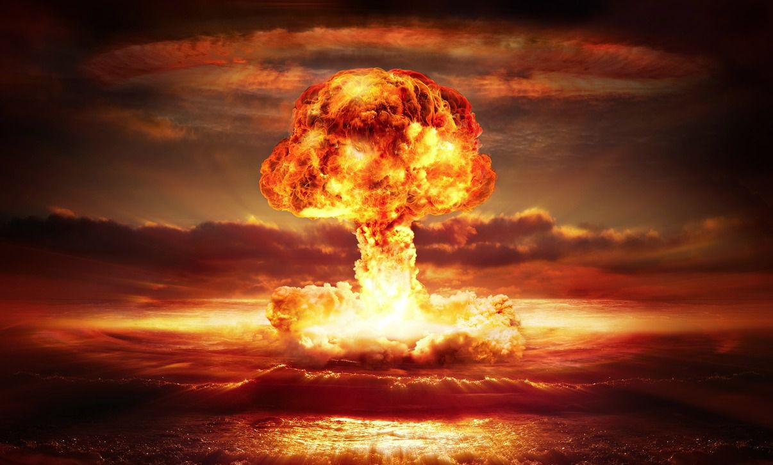
The strong force
It binds protons and neutrons inside nuclei
It is relevant at short distances only
Particles interacting via the strong force are called hadrons
Hadrons are composite objects, formed by quarks, and bound by gluons (the mediators of the strong force)
Quarks are confined inside hadrons
Strong means strong: the force between two quarks in a hadron is roughly the same as the weight of a truck
Natural units will be adopted, $ℏ=c=1$
A. Pilloni – Very-very-very high energy spectroscopy
Notes:
2 slides su Zc, a Bes e a Belle
2 slide su tetraquark model: dall’hamiltoniana di Jaffe al calcolo delle masse
1 slide su molecular models, dove sono i carichi? (non in Tornqvist, si in Hanhart, vedere Braaten, citare Nefediev)
2 slides su decay channels, dove si dovrebbe vedere, e a seconda del modello, vedere qualche plot
1 slide su Y(4260), tetraquark? C’è lo strano (si vede la f0)
1 slide su Zc a cleo (anche il neutro)

Slide 3
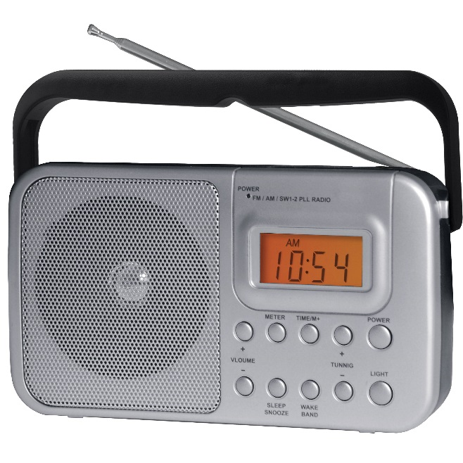
We have E&M theory: QED
Linear at the classical level → Maxwell equations
Any electromagnetic process is described by this equation (in principle)
A. Pilloni – Very-very-very high energy spectroscopy

Slide 4
We have E&M theory: QED
The electric charge is small, «Taylor» expansion
$$f∼\frac{e^{2}}{4π}f_{0}+{\left(\frac{e^{2}}{4π}\right)}^{2}f_{1}+{\left(\frac{e^{2}}{4π}\right)}^{3}f_{2}+{\left(\frac{e^{2}}{4π}\right)}^{4}f_{3}+…$$
$$\frac{e^{2}}{4π}∼\frac{1}{137}≪1$$
A. Pilloni – Very-very-very high energy spectroscopy

Slide 5
We have strong theory: QCD
Matrix equation
Gluons self-interact → Nonlinear even at classical level
A. Pilloni – Very-very-very high energy spectroscopy

Slide 6
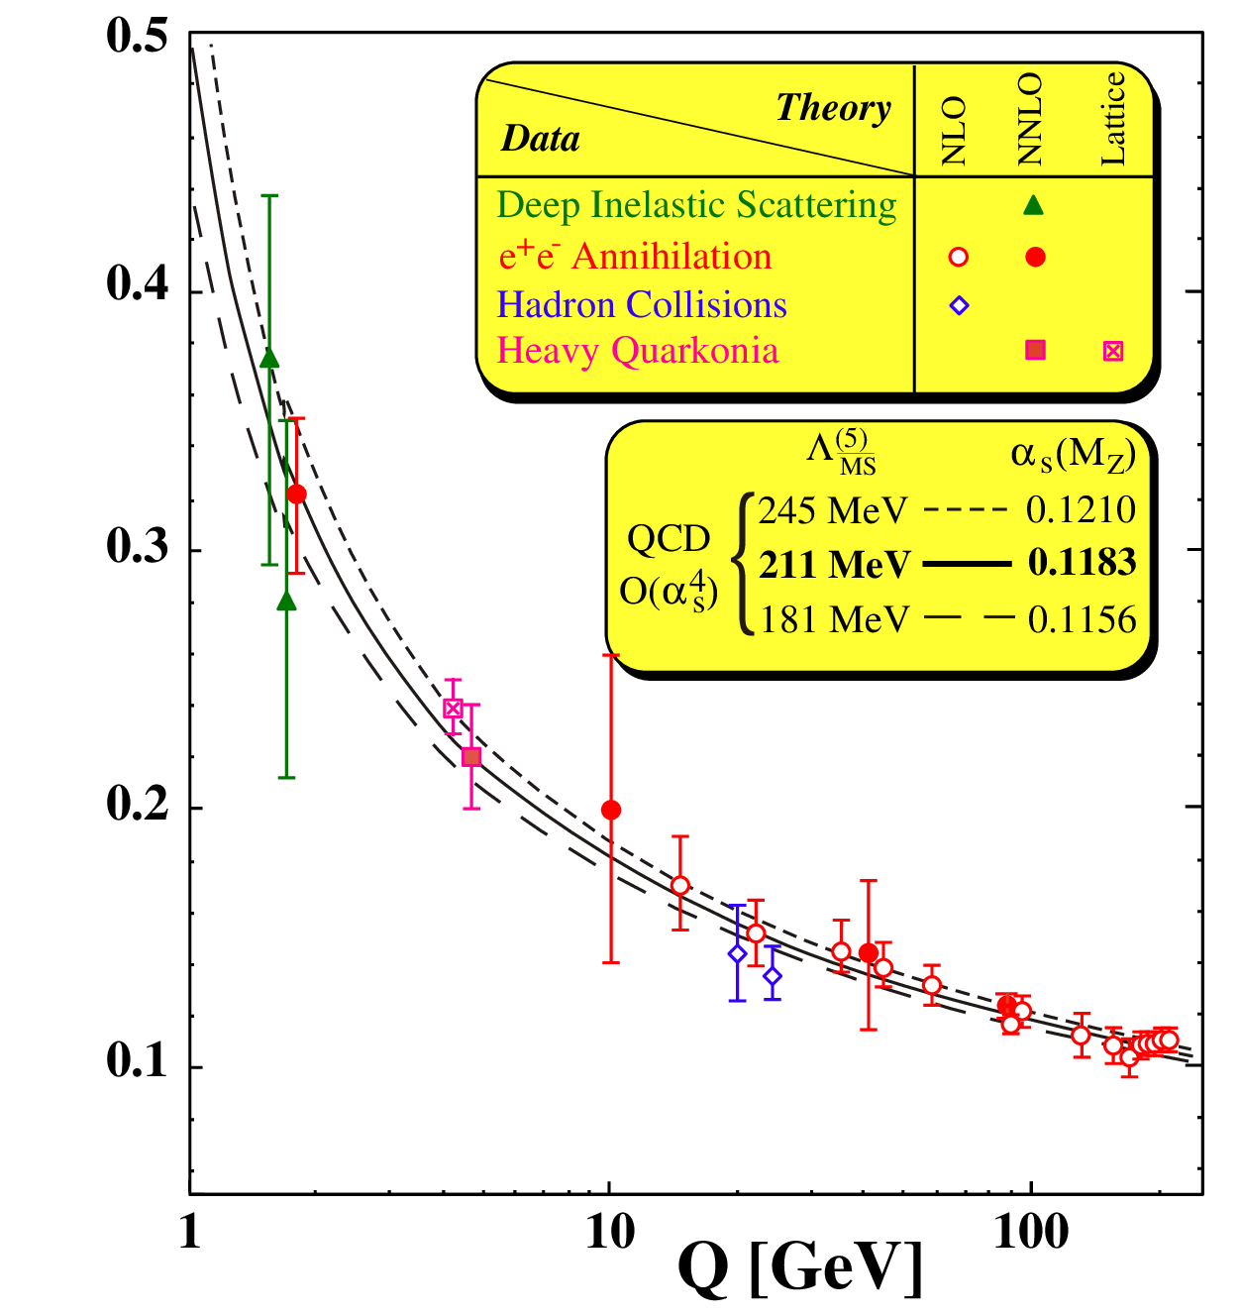
Asymptotic freedom
$\frac{g_{s}^{2}}{4π}(Q)$
At high energies $\frac{g_{s}^{2}}{4π}≪0.1$
A. Pilloni – Very-very-very high energy spectroscopy

Slide 7
At low energies?
At low energies $\frac{g_{s}^{2}}{4π}>1$, no hierarchy
Emerging properties: Confinement; Mass generation
No calculable solution yet
$\frac{g_{s}^{2}}{4π}(Q)$
A. Pilloni – Very-very-very high energy spectroscopy

Slide 8
Three quarks for Muster Mark
Quarks appear in 3 colors
Antiquarks appear in 3 anticolors
$$π^{0}$$
$$\overline{g}$$
$$g$$
$$\overline{r}$$
$$r$$
$$\overline{b}$$
$$b$$
Quarks appear in 6 flavors
$q\overline{q}$ pairs form a meson
Hadrons must be white:
A. Pilloni – Very-very-very high energy spectroscopy
Notes:
2 slides su Zc, a Bes e a Belle
2 slide su tetraquark model: dall’hamiltoniana di Jaffe al calcolo delle masse
1 slide su molecular models, dove sono i carichi? (non in Tornqvist, si in Hanhart, vedere Braaten, citare Nefediev)
2 slides su decay channels, dove si dovrebbe vedere, e a seconda del modello, vedere qualche plot
1 slide su Y(4260), tetraquark? C’è lo strano (si vede la f0)
1 slide su Zc a cleo (anche il neutro)

Slide 9
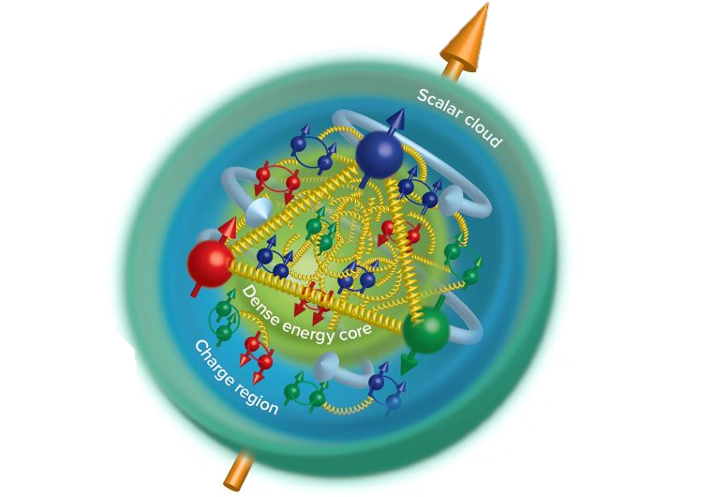
Three quarks for Muster Mark
Quarks appear in 3 colors
Antiquarks appear in 3 anticolors
$$\overline{g}$$
$$g$$
$$\overline{n}$$
$$\overline{r}$$
$$r$$
$$p$$
$$\overline{b}$$
$$b$$
$qqq$ triplets form a baryon
Hadrons must be white:
$\overline{q}\overline{q}\overline{q}$ triplets form an antibaryon
A. Pilloni – Very-very-very high energy spectroscopy
Notes:
2 slides su Zc, a Bes e a Belle
2 slide su tetraquark model: dall’hamiltoniana di Jaffe al calcolo delle masse
1 slide su molecular models, dove sono i carichi? (non in Tornqvist, si in Hanhart, vedere Braaten, citare Nefediev)
2 slides su decay channels, dove si dovrebbe vedere, e a seconda del modello, vedere qualche plot
1 slide su Y(4260), tetraquark? C’è lo strano (si vede la f0)
1 slide su Zc a cleo (anche il neutro)

Slide 10
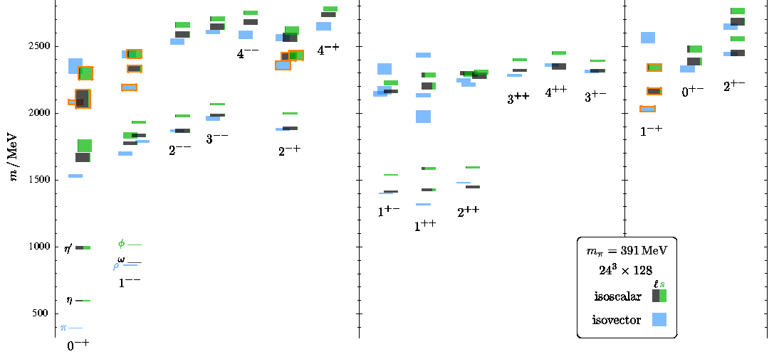
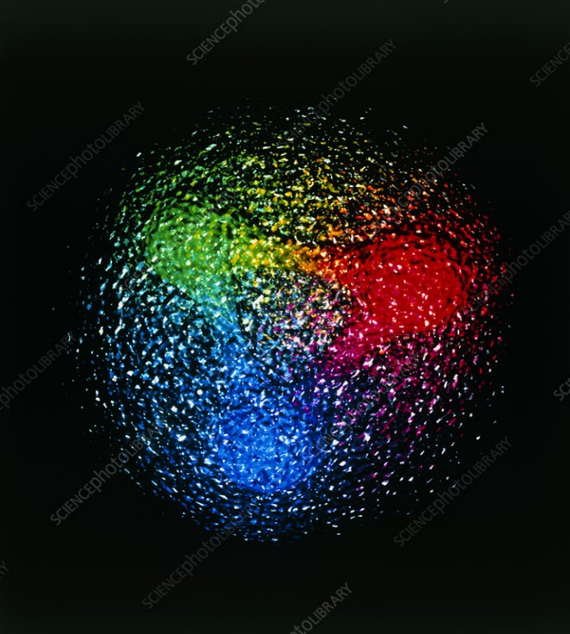
QCD has no solution. Don’t panic
Plan of attack
Collect data
Identify states
Compare with expectations
Answer big questions
We can build models to describe the spectrum. Grasp some aspects of QCD, get insights
Quark models
Lattice QCD (not a model but...)
The excited spectrum is populated by unstable states, is $∼{10}^{−24} s$
Feedback from experiments
A. Pilloni – Very-very-very high energy spectroscopy

Slide 11
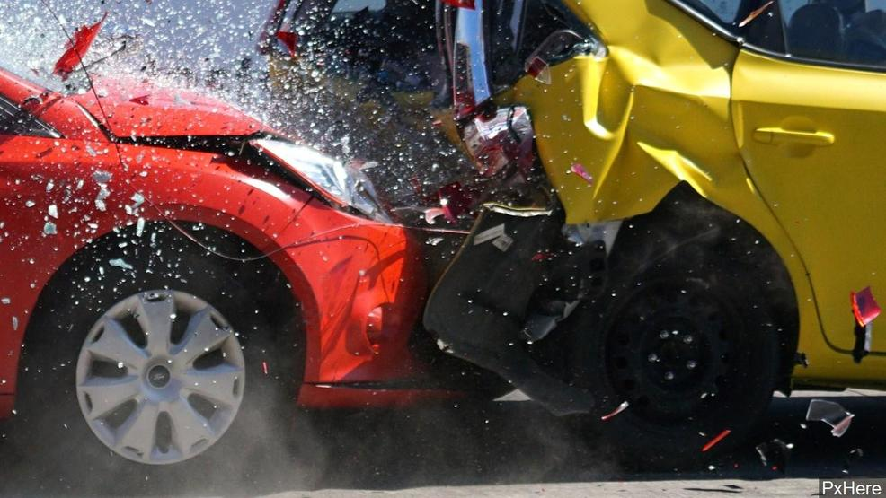
Unraveling QCD
Beam
Beam
Products
A. Pilloni – Very-very-very high energy spectroscopy

Slide 12
Unraveling QCD
Electromagnetic machines
$$e^{+}e^{−}→γ^{∗}→\text{hadrons}$$
Electrohadron machines
Cross sections
Cleanliness
$$e^{−}→e^{−}γ^{(∗)}$$
$$\text{and} γ^{(∗)}p,γ^{(∗)}A→\text{hadrons}$$
Hadron machines
$$pp,p\overline{p},π^{−}p,pA,AA→ \text{hadrons}$$
A. Pilloni – Very-very-very high energy spectroscopy

Slide 13
How to produce resonances: $e^{+}e^{−}$ and $γγ$
Ion
$$e^{+}$$
$$q$$
$$γ^{(∗)}$$
$$q$$
$$1^{−−}$$
$$0^{±+}$$
$$γ^{(∗)}$$
$$2^{±+}$$
$$\overline{q}$$
$$\overline{q}$$
Ion
$$3^{++}$$
$$e^{−}$$
Central exclusive production (CEP)
Electromagnetic probes are the cleanest Form factors give information about the meson wave function
also
A. Pilloni – Very-very-very high energy spectroscopy
Notes:
Controlla la parte su Regge

Slide 14
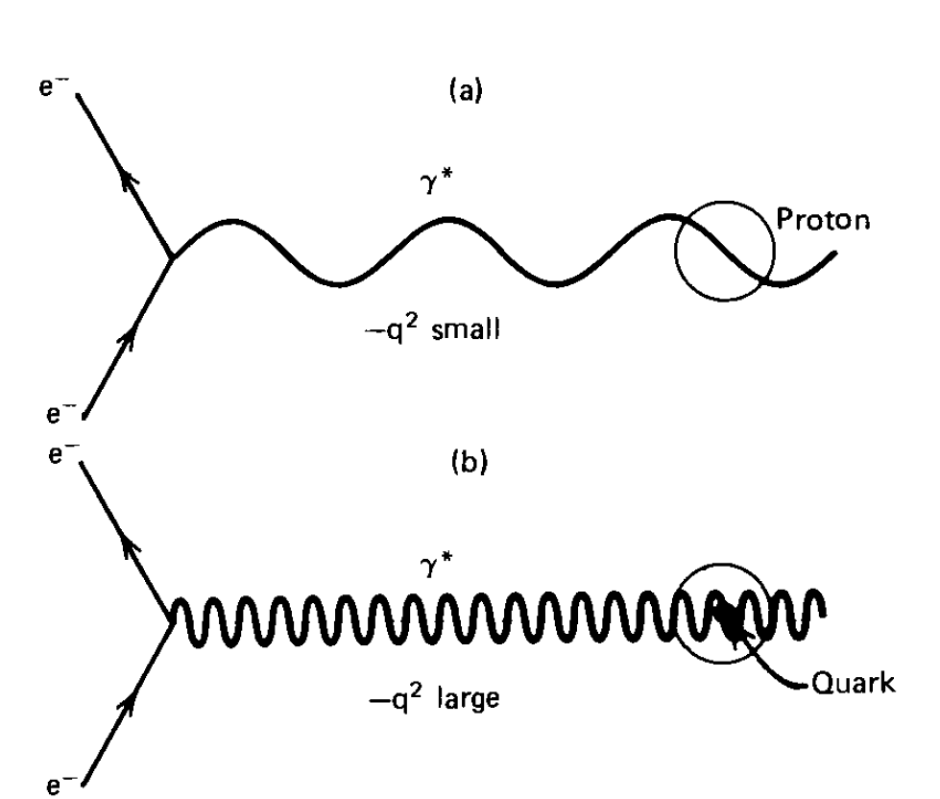
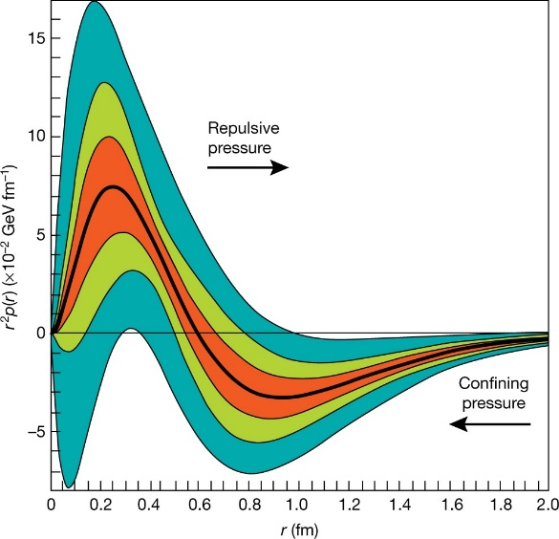
Photons shed light!
Since the EM scattering is calculable, one can use a photon beam to probe strong interacting particles
Real photons see the proton as a whole: nonperturbative
Burkert, Nature
Virtual photons see the proton constituents: perturbative
One can define the «proton radius» and other «mechanical properties»
A. Pilloni – Very-very-very high energy spectroscopy

Slide 15
How to produce resonances: photo- and electroproduction
$$e^{−}$$
$$γ^{(∗)}$$
$$Q^{2}=4E_{e}E_{e′}\sin^{2}{\frac{θ_{e}}{2}}$$
$$N$$
Photo- and electroproduction allows us to get information about the structure of nucleon excitations
The $Q^{2}$ dependence at the resonance pole can be compared with (quark model, DSE) calculations
If $Q^{2}$ is large, one enters the realm of pQCD and can put constraints to PDF behavior at large x
A. Pilloni – Very-very-very high energy spectroscopy
Notes:
Controlla la parte su Regge

Slide 16
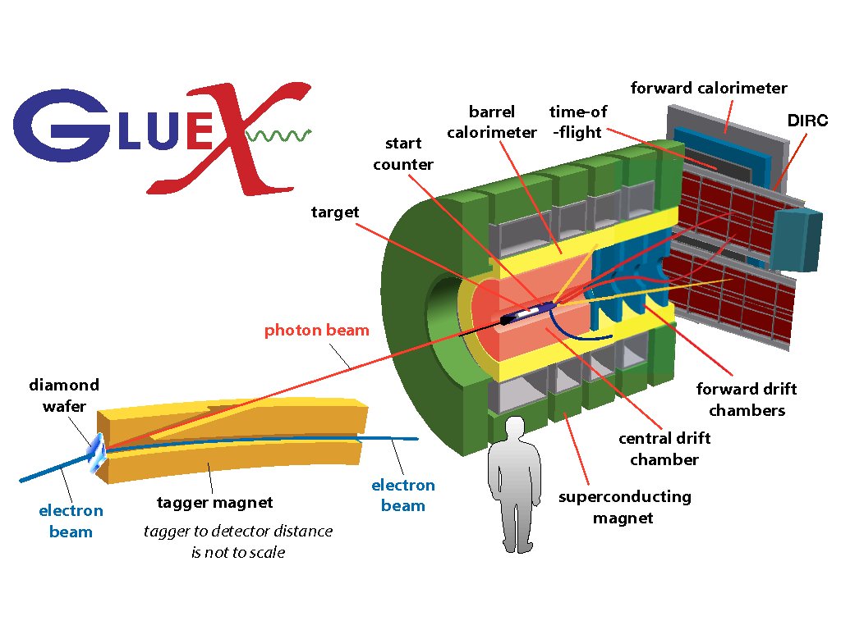
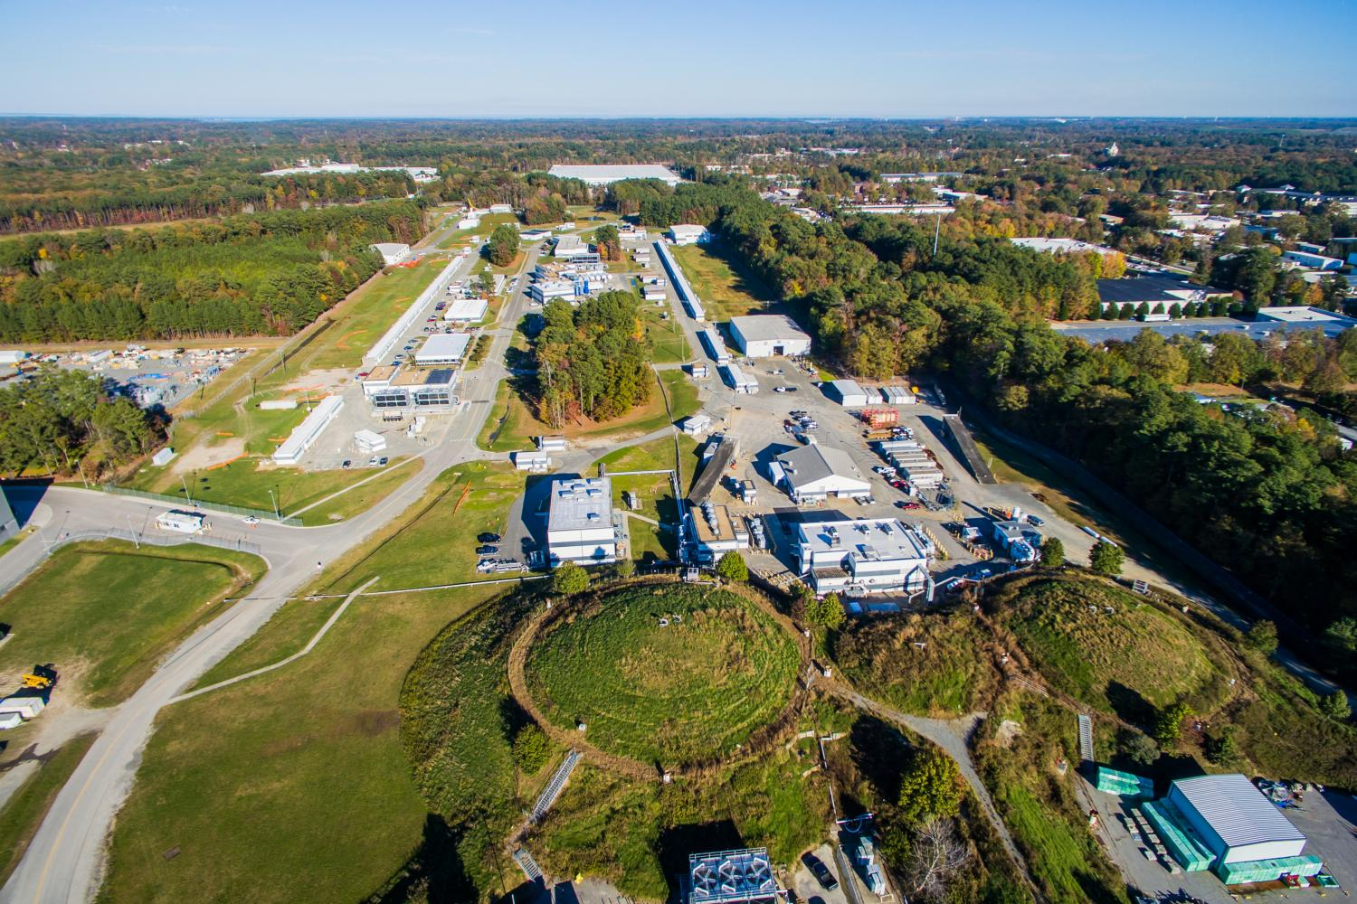
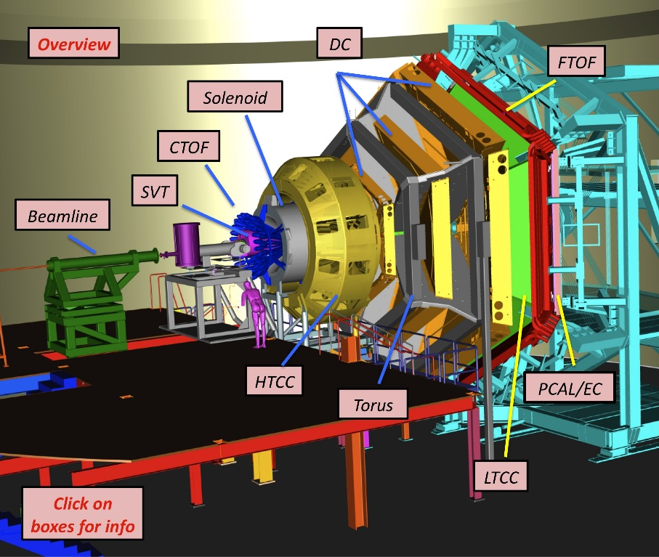
Unraveling QCD at JLab
Electrons at $12 \text{GeV}$
$v=99.9999999\% c$
Hydrogen target (mostly),
Clean (?) physics
A. Pilloni – Very-very-very high energy spectroscopy

Slide 17
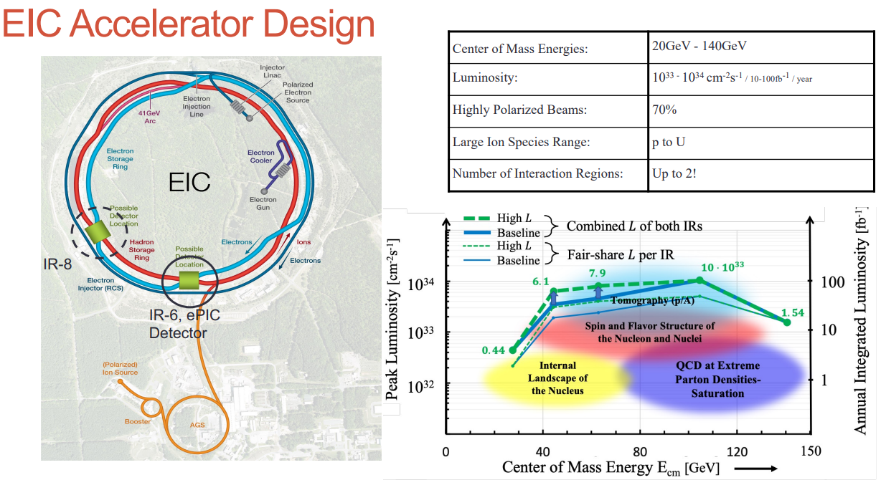
An Electron Ion Collider @BNL
A. Deshpande
arXiv:2103.05419
A. Pilloni – Very-very-very high energy spectroscopy

Slide 18
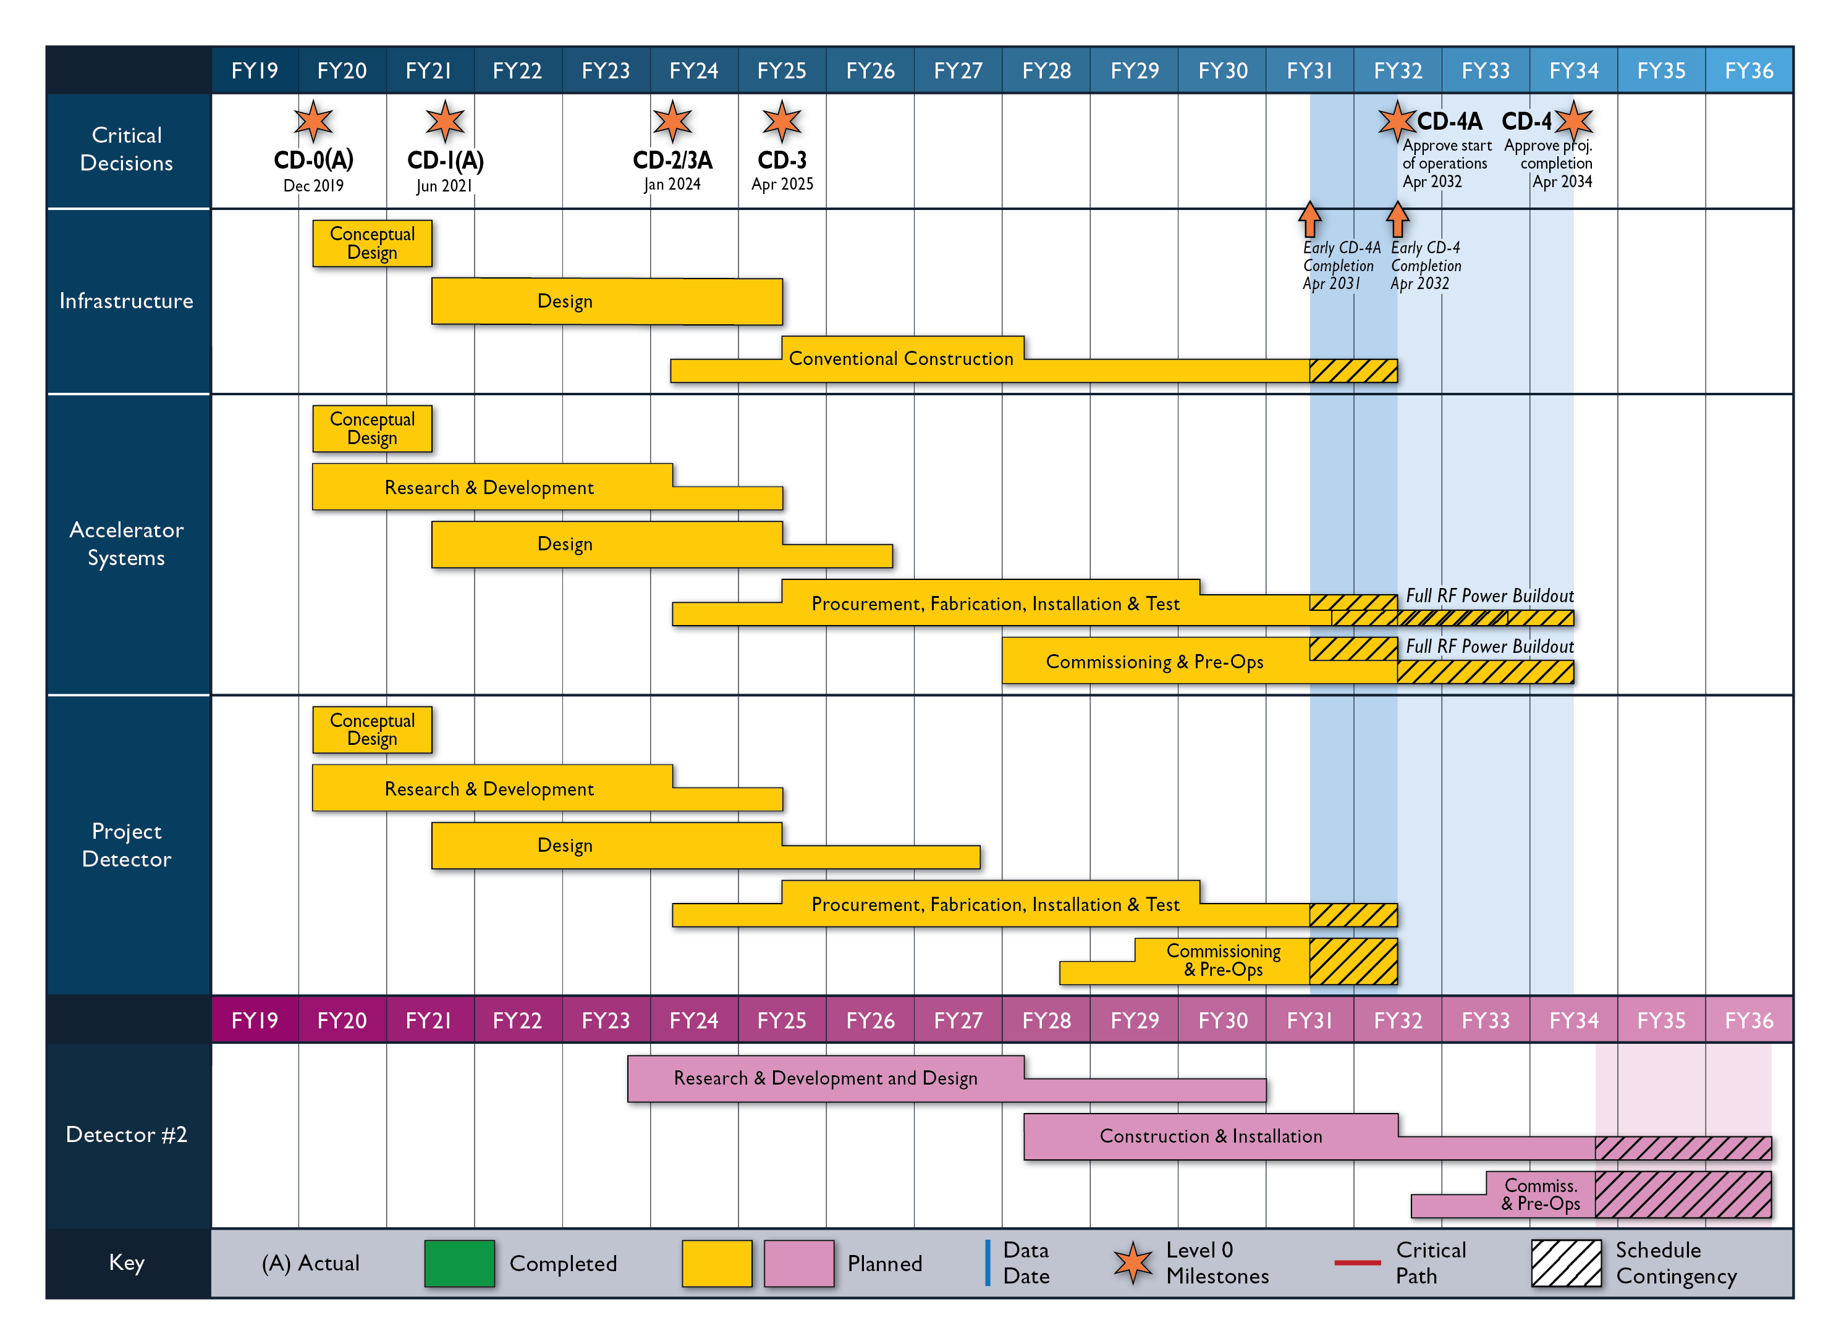
An Electron Ion Collider @BNL
A. Deshpande
2nd Detector and IR 5yrs behind IR-1
Today
A. Pilloni – Very-very-very high energy spectroscopy

Slide 19
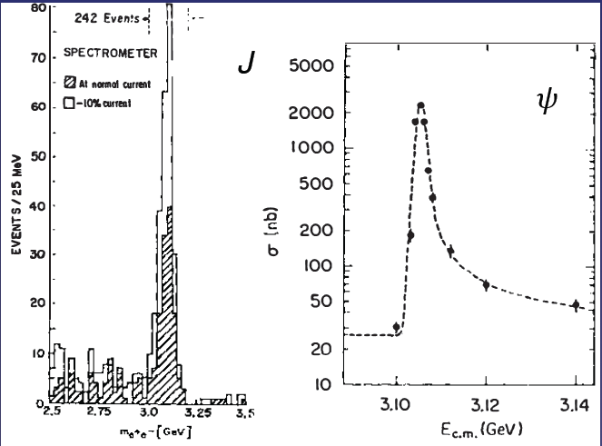
Quarkonium orthodoxy
$$Q$$
$$\overline{Q}$$
Potential models
(meaningful when $M_{Q}→∞$)
$$V\left(r\right)=−\frac{C_{F}α_{s}}{r}+σr$$
(Cornell potential)
$$α_{s}\left(M_{Q}\right)∼0.3$$
(perturbative regime)
OZI-rule, QCD multipole
Solve NR Schrödinger eq. → spectrum
Effective theories
(HQET, NRQCD, pNRQCD...)
Heavy quark spin flip suppressed by quark mass, approximate heavy quark spin symmetry (HQSS)
Integrate out heavy DOF
↓
(spectrum), decay & production rates
A. Pilloni – Very-very-very high energy spectroscopy
Notes:
2 slides su Zc, a Bes e a Belle
2 slide su tetraquark model: dall’hamiltoniana di Jaffe al calcolo delle masse
1 slide su molecular models, dove sono i carichi? (non in Tornqvist, si in Hanhart, vedere Braaten, citare Nefediev)
2 slides su decay channels, dove si dovrebbe vedere, e a seconda del modello, vedere qualche plot
1 slide su Y(4260), tetraquark? C’è lo strano (si vede la f0)
1 slide su Zc a cleo (anche il neutro)

Slide 20
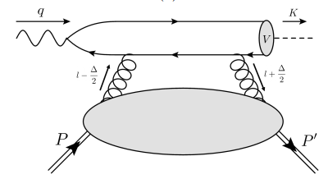
$J/ψ$ photoproduction at threshold
The common lore is that the study of vector quarkonium photoproduction at threshold is directly related to nucleon matrix elements
GPD
Assumptions:
Factorization proof for timelike DVCS can be extended at threshold as the heavy quark mass plays the role of a hard scale
The top vertex contains the trivial $γ$-$ψ$ coupling ${\left|ψ\left(0\right)\right|}^{2}$
The exchange of anything but gluons is (OZI-, mass-) suppressed
The exchange is dynamically dominated by gluons carrying $J=2$
Then one extracts matrix element of the energy momentum tensor $\left\langle p′ | T_{μν}(0) | p\right\rangle$
A. Pilloni – Very-very-very high energy spectroscopy

Slide 21
Potential problems
We can’t afford being misguided by simplistic analyses! (life is already hard enough without red herrings)
Amplitude analysis requires collaboration of theorists and experimentalists
However, we don’t have a universal recipe to do things right
We have to proceed:
Case-by-case
Keep in mind the limitations of each approach
Overstudy (the more approaches the better)
No overstatement (do-no-harm)
A. Pilloni – Heavy- and light-quark mesons: A theory perspective

Slide 22
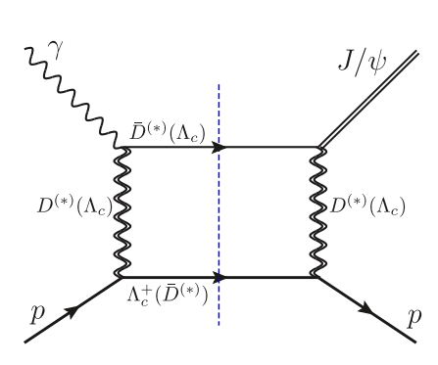
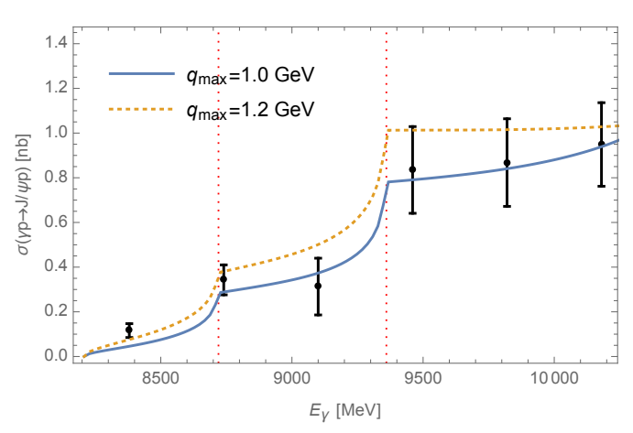
Role of open charm
Highly off-shell t-channel propagators
Du et al. Eur.Phys.J.C 80, 11, 1053
The role of intermediate open charm thresholds has been pointed out,
Maybe «all that glitters is not glue» ….
Calculation based on EFT and known couplings, S-wave saturates the cross section
A. Pilloni – Very-very-very high energy spectroscopy
Notes:
2 slides su Zc, a Bes e a Belle
2 slide su tetraquark model: dall’hamiltoniana di Jaffe al calcolo delle masse
1 slide su molecular models, dove sono i carichi? (non in Tornqvist, si in Hanhart, vedere Braaten, citare Nefediev)
2 slides su decay channels, dove si dovrebbe vedere, e a seconda del modello, vedere qualche plot
1 slide su Y(4260), tetraquark? C’è lo strano (si vede la f0)
1 slide su Zc a cleo (anche il neutro)

Slide 23
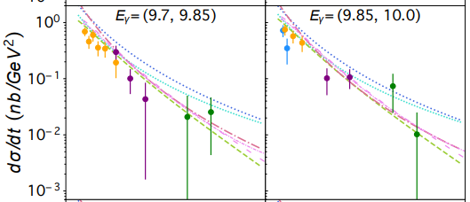
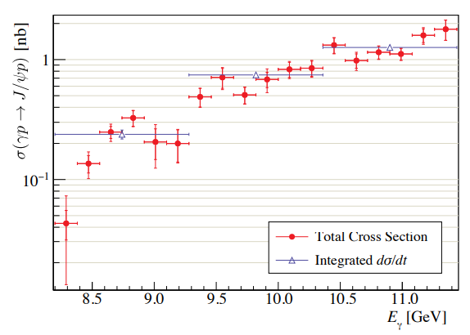
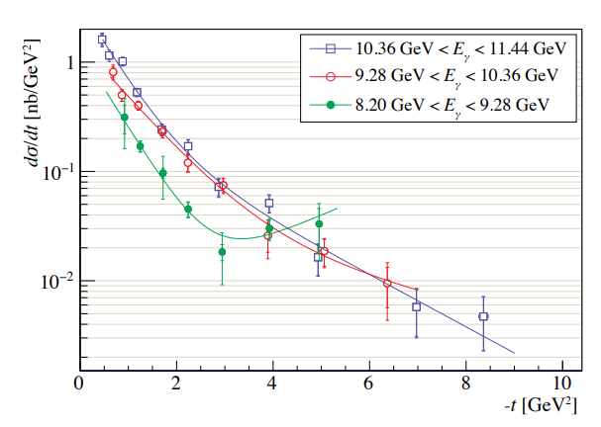
$J/ψ$ photoproduction at threshold
Nature 615, 813
Cusp at the $Λ_{c}\overline{D^{∗}}$ treshold
arXiv:2304.03845
A. Pilloni – Very-very-very high energy spectroscopy

Slide 24
Unitary reanalysis
Winney et al. PRD
Differential and total cross sections are fitted with a unitary model
In lack of polarization observables and SDME, only orbital angular momentum is considered (spinless approx.)
Truncated sum of PWs, $ℓ≤3$
The dominant S-wave can include coupled channels, for higher waves cusps are suppressed and there is no point
A. Pilloni – Very-very-very high energy spectroscopy

Slide 25
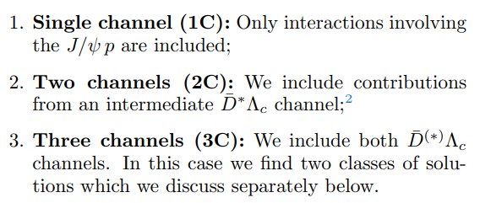
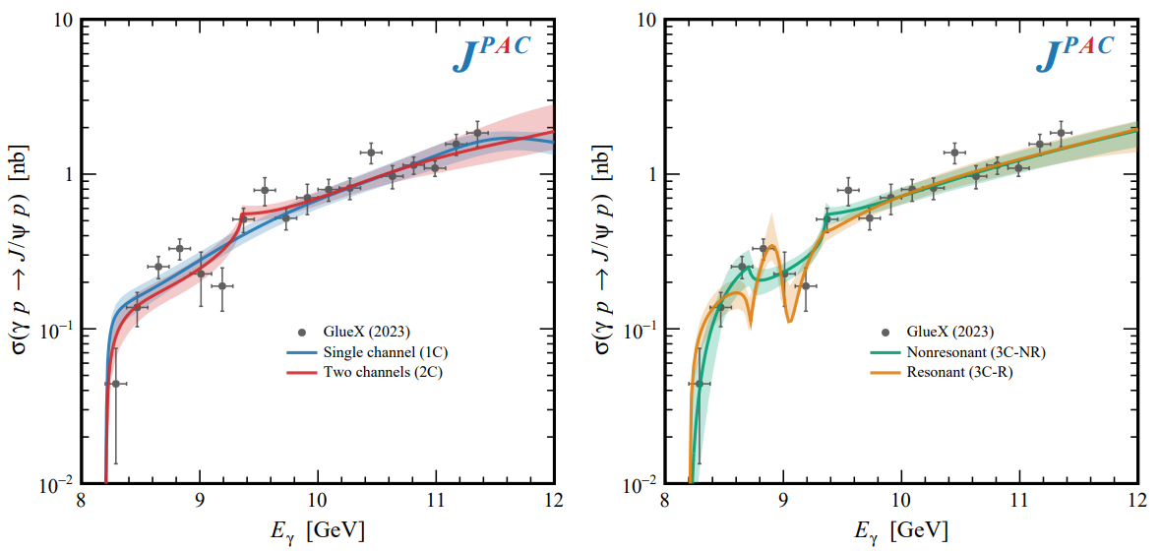
Total cross section
A. Pilloni – Very-very-very high energy spectroscopy

Slide 26
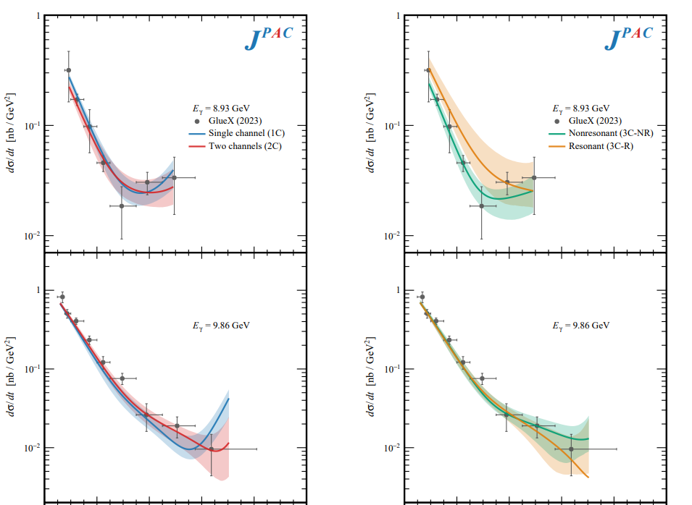
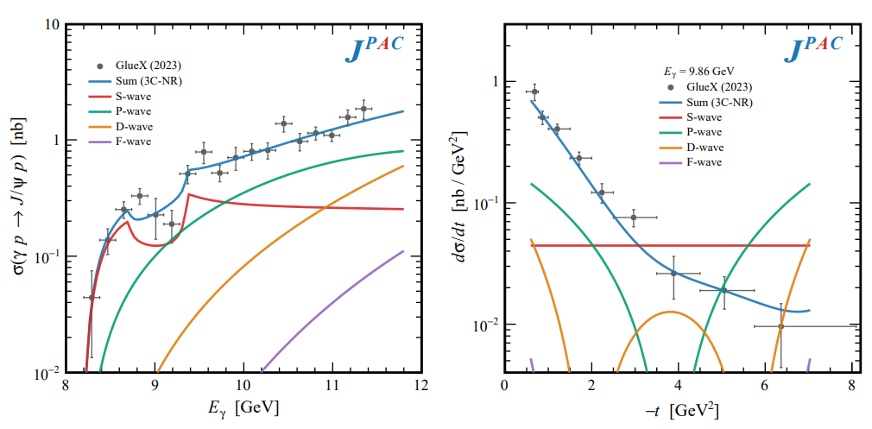
Differential cross section
This is realized with the interference of various waves, - constructive in the forward direction - distructive in the backward direction because of the Legendre polynomials
Good hierarchy between waves
A. Pilloni – Very-very-very high energy spectroscopy

Slide 27
Contribution of open charm
Naively Wilk’s theorem says the single channel is unfavored at $3.7σ$
(no look elsewhere etc.),
indication but not the end of the story
Contribution of open charm $>25\%$ at 90% CL
A. Pilloni – Very-very-very high energy spectroscopy

Slide 28
Vector Meson Dominance
Since unitary model parametrize separately the production and scattering amplitude, one can compare with the predictions of VMD
$$γ$$
$$ψ$$
$$ψ$$
$$ψ$$
$$F\left(s,t\right)=$$
$=g_{γψ}×$
But $G\left(s_{\text{th}}\right)=0$
$$p$$
$$p$$
$$p$$
$$p$$
The value of the scattering amplitude at threshold is called scattering length
According to VMD, a small photoproduction cross sections implies a small scattering length O(1am)
With the unitary model, the value of the amplitude at threshold is an unrelated parameter, the scattering length enters with the energy dependence
A. Pilloni – Very-very-very high energy spectroscopy

Slide 29
Vector Meson Dominance
VMD badly excluded, except for the poorly constrained 3C-R model
Scattering lengths generally of O(1fm), but smaller ones are not excluded
Crucial to constrain better these fits by measuring open charm final states
A. Pilloni – Very-very-very high energy spectroscopy

Slide 30
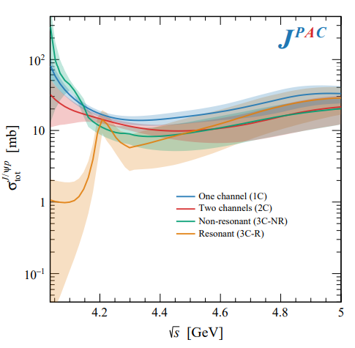
Total cross section
With optical theorem one gets the total cross section $J/ψ p→\text{X}$.
This has been estimated from the A-dependence of nuclear targets, $4\text{mb}$ at $\sqrt{s}=6.2 \text{GeV}$. VMD estimates provide values at least 1order of magnitude smaller
A. Pilloni – Very-very-very high energy spectroscopy

Slide 31
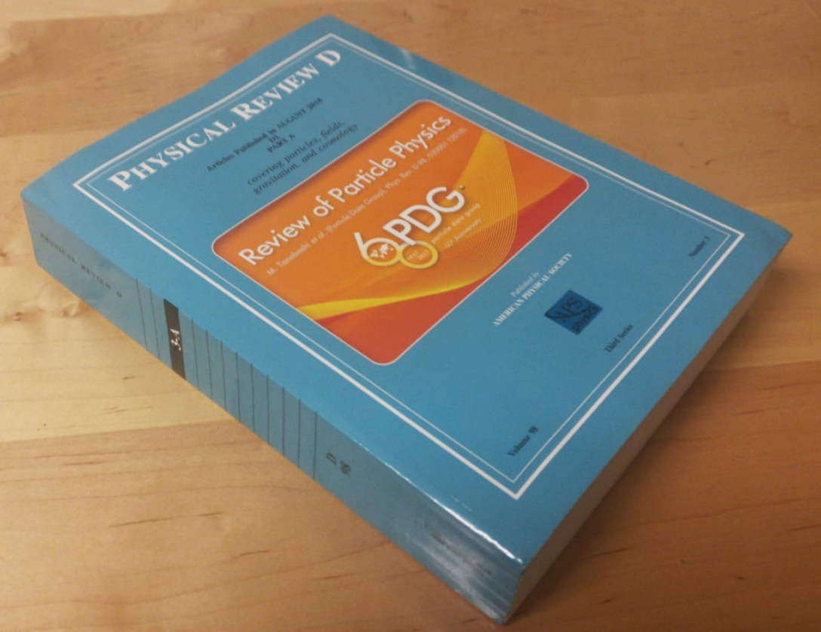
More quarks?
The Particle Data Group collects all the information from experiments about observed hadrons
Almost the totality of them can be understood as 2- or 3-quark states
A. Pilloni – Very-very-very high energy spectroscopy
Notes:
2 slides su Zc, a Bes e a Belle
2 slide su tetraquark model: dall’hamiltoniana di Jaffe al calcolo delle masse
1 slide su molecular models, dove sono i carichi? (non in Tornqvist, si in Hanhart, vedere Braaten, citare Nefediev)
2 slides su decay channels, dove si dovrebbe vedere, e a seconda del modello, vedere qualche plot
1 slide su Y(4260), tetraquark? C’è lo strano (si vede la f0)
1 slide su Zc a cleo (anche il neutro)

Slide 32
More quarks?
I can keep adding $q\overline{q}$ pairs, the hadron is still white
$$g$$
$$P_{c}$$
$$\overline{r}$$
$$r$$
$$b$$
$$r$$
Pentaquarks with half-integer spin
…or in white groups (molecular pentaquarks)
The question is whether quark cluster in colored groups (compact pentaquarks)…
Tetraquarks with integer spin
A. Pilloni – Very-very-very high energy spectroscopy
Notes:
2 slides su Zc, a Bes e a Belle
2 slide su tetraquark model: dall’hamiltoniana di Jaffe al calcolo delle masse
1 slide su molecular models, dove sono i carichi? (non in Tornqvist, si in Hanhart, vedere Braaten, citare Nefediev)
2 slides su decay channels, dove si dovrebbe vedere, e a seconda del modello, vedere qualche plot
1 slide su Y(4260), tetraquark? C’è lo strano (si vede la f0)
1 slide su Zc a cleo (anche il neutro)

Slide 33
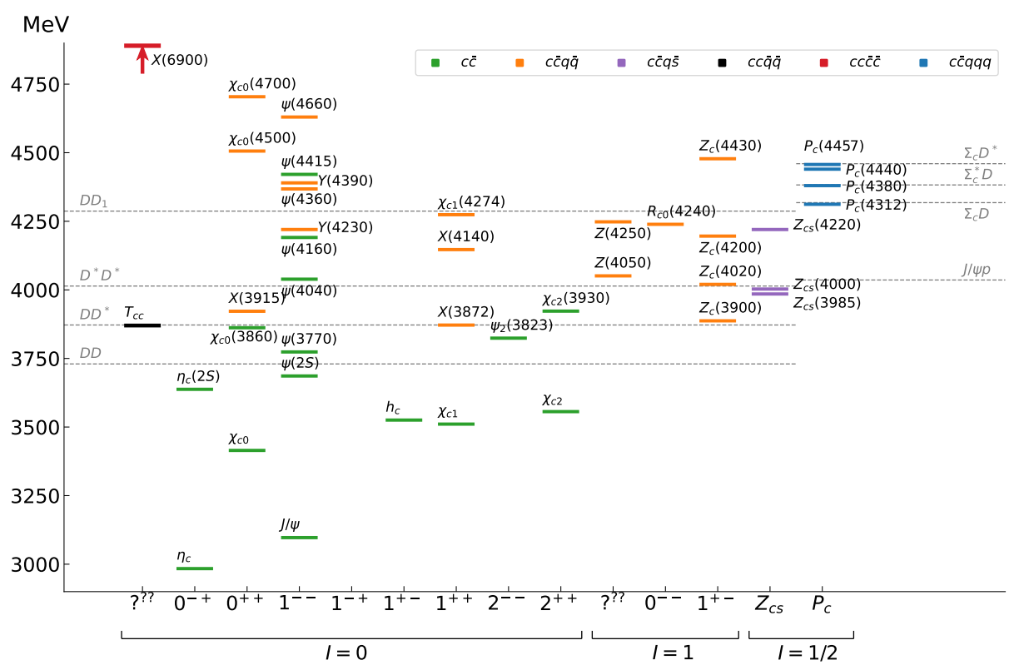
Exotic landscape in $c\overline{c}$
Esposito, AP, Polosa, Phys.Rept.
JPAC, PPNP
A host of unexpected resonances have appeared
decaying mostly into charmonium + light Hardly reconciled with usual $q\overline{q}$ pheno
A. Pilloni – Very-very-very high energy spectroscopy
Notes:
2 slides su Zc, a Bes e a Belle
2 slide su tetraquark model: dall’hamiltoniana di Jaffe al calcolo delle masse
1 slide su molecular models, dove sono i carichi? (non in Tornqvist, si in Hanhart, vedere Braaten, citare Nefediev)
2 slides su decay channels, dove si dovrebbe vedere, e a seconda del modello, vedere qualche plot
1 slide su Y(4260), tetraquark? C’è lo strano (si vede la f0)
1 slide su Zc a cleo (anche il neutro)

Slide 34
Why photoproduction for exotics?
It’s new: no XYZ state has been uncontroversially seen so far
Rescattering mechanisms that could mimic resonances in multibody decays can be controlled better (one can change the energy beam but not the $B$ mass…)
The framework is (relatively) clean from a theory point of view
Radiative decays offer another way of discerning the nature of the states
A. Pilloni – Very-very-very high energy spectroscopy

Slide 35
Exclusive (quasi-real) photoproduction
XYZ have so far not been seen in photoproduction: independent confirmation
Not affected by 3-body dynamics: determination of resonant nature
Experiments with high luminosity in the appropriate energy range are promising
We study near-threshold (LE) and high energies (HE)
Couplings extracted from data as much as possible, not relying on the nature of XYZ
M. Albaladejo et al. [JPAC], PRD
$$<λ_{𝒬}λ_{N}^{′}|T|λ_{γ}λ_{N}>=\underset{V,ℰ}{∑}\frac{ef_{V}}{m_{V}}𝒯_{λ_{V}=λ_{γ},λ_{𝒬}}^{α_{1}⋯α_{j}}𝒫_{α_{1}⋯α_{j};β_{1}⋯β_{j}}ℬ_{λ_{N}λ_{N}^{′}}^{β_{1}⋯β_{j}}$$
Bottom vertex from standard photoproduction pheno, exponential form factors to further suppress large t
VMD is used to couple the incoming photon to a vector quarkonium V
Top vertex from measured $𝒬→Vℰ$ decay width
A. Pilloni – Very-very-very high energy spectroscopy

Slide 36
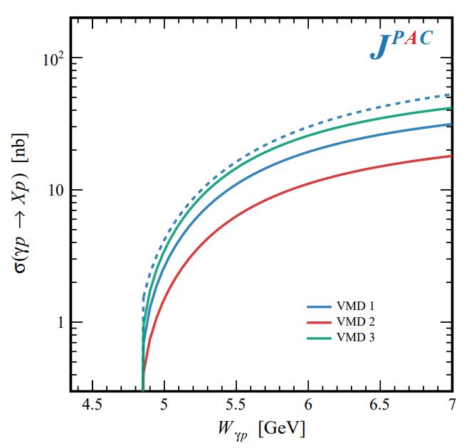
In defense of VMD
The weak point of the whole approach is the use of VMD While in the light sector it works reasonably, for heavy states is not justified
The X(3872) observed in purely hadronic and photonic modes gives us unique clue to efficacy of VMD
Belle extracted the coupling $X\left(3872\right)→γγ^{∗}$, that can be compared with the VMD predictions from $X\left(3872\right)→J/ψ ρ,ω$
Other estimate lead to differences of a factor $∼3$
A. Pilloni – Very-very-very high energy spectroscopy

Slide 37
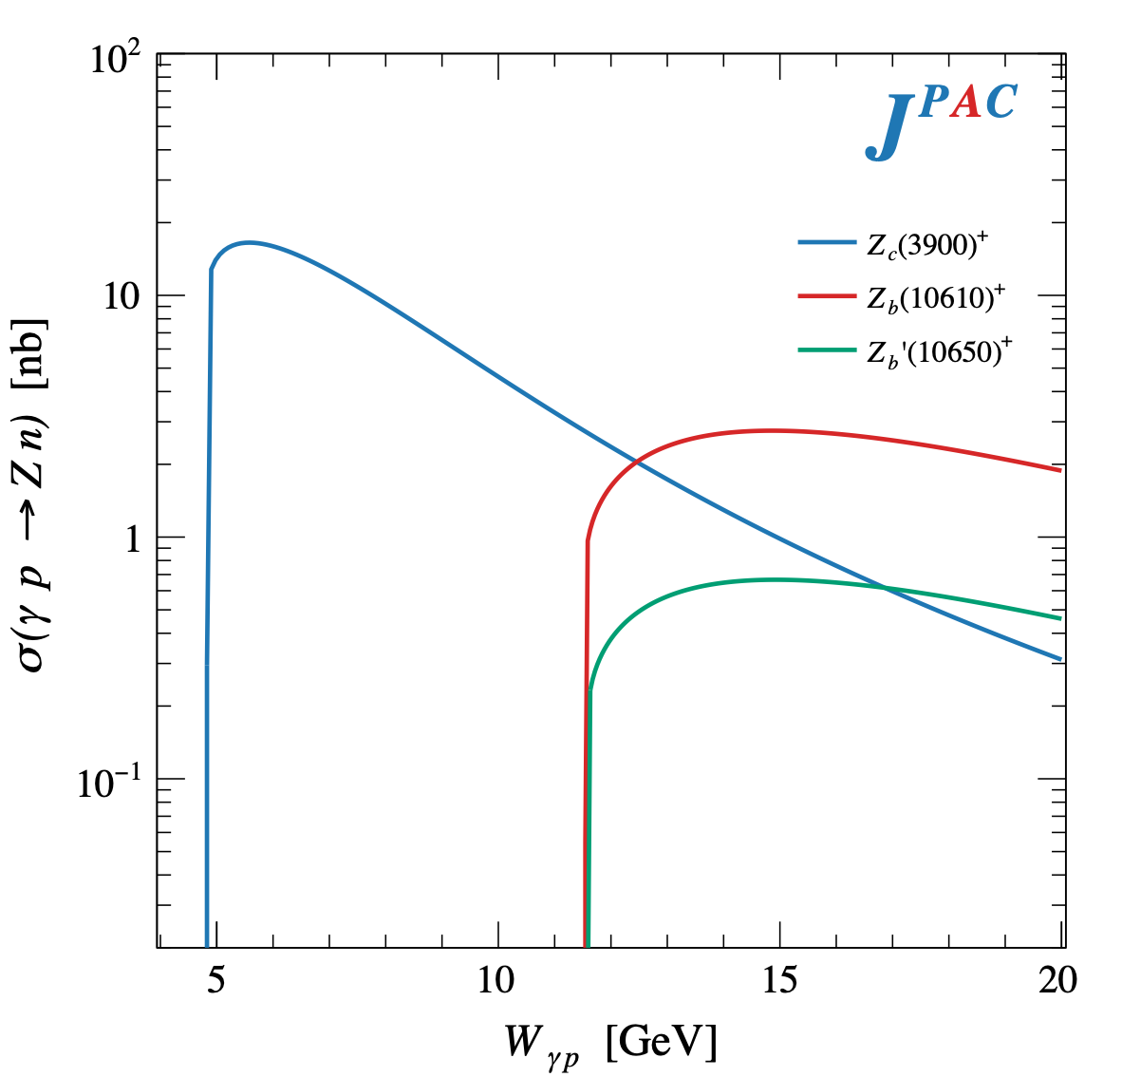
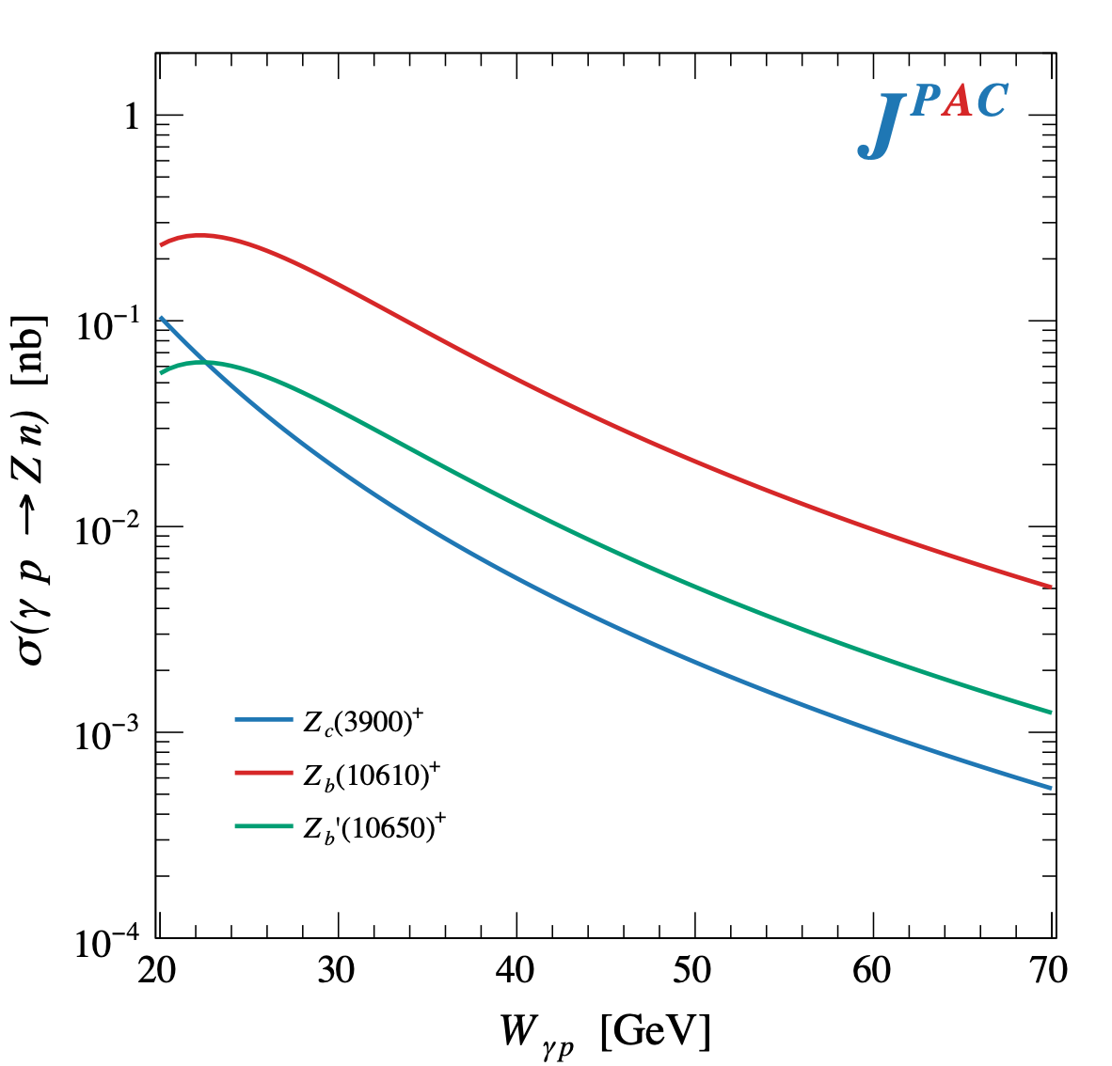
$Z$ photoproduction
The $Zs$ are charged charmoniumlike $1^{+−}$ states close to open flavor thresholds
Focus on $Z_{c}{\left(3900\right)}^{+}→J/ψ π^{+}$, $Z_{b}{\left(10610\right)}^{+},Z_{b}^{′}{\left(10650\right)}^{+}→Υ(nS) π^{+}$
The pion is exchanged in the $t$-channel
Sizeable cross sections especially at LE
A. Pilloni – Very-very-very high energy spectroscopy

Slide 38
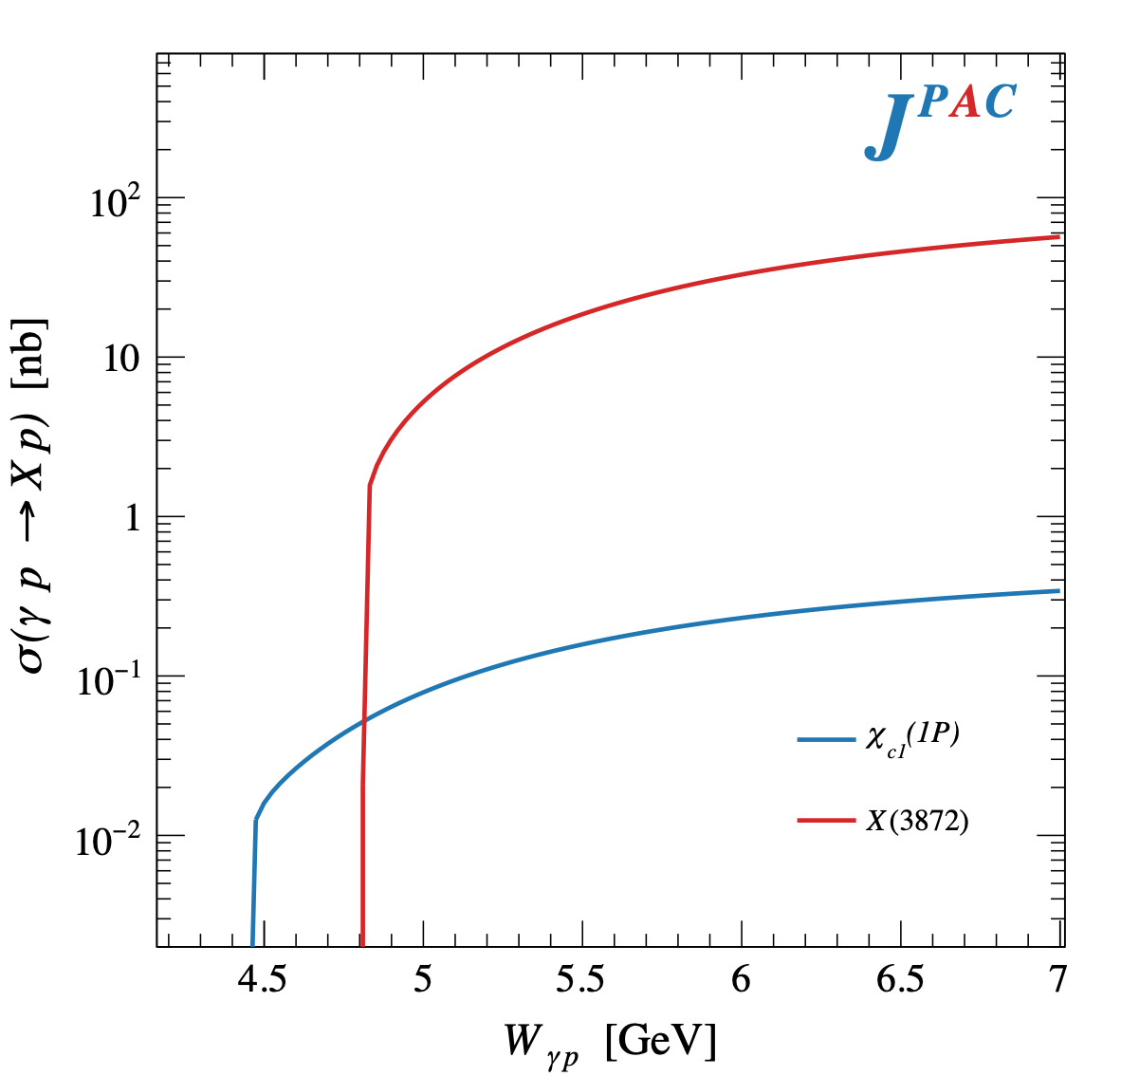
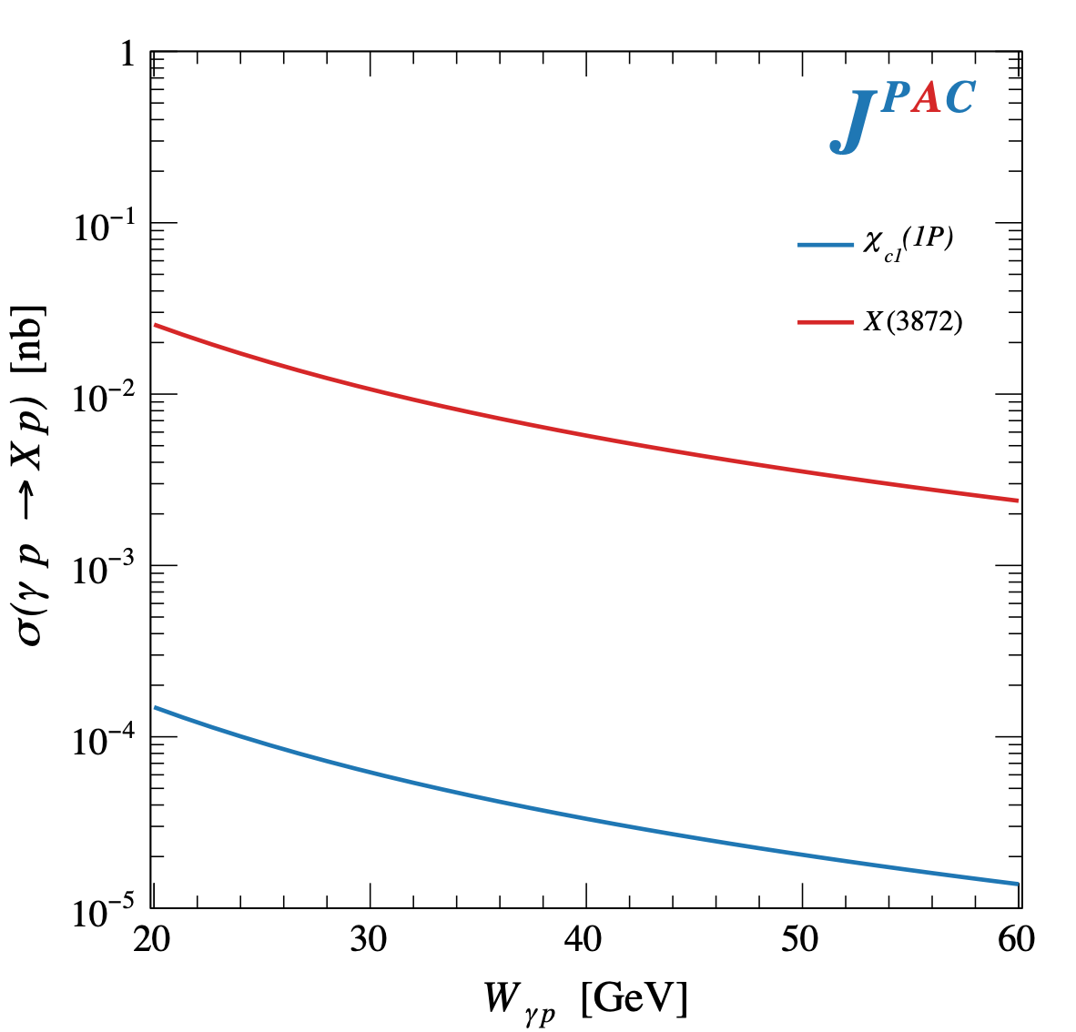
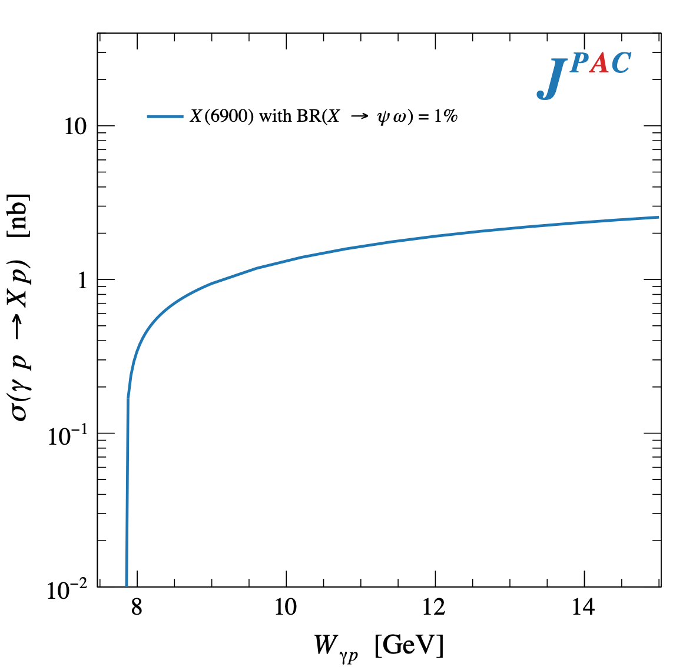
$X$ photoproduction
Focus on the famous $1^{++} X\left(3872\right)→J/ψ ρ,ω$
Studying also $X\left(6900\right)→J/ψ J/ψ$ (assumed $0^{++}$)
𝛚 and 𝛒 exchanges give main contributions: need to assume the existence of a OZI-suppressed $X\left(6900\right)→J/ψ ω$
Extremely suppressed cross sections at HE: LE most promising
A. Pilloni – Very-very-very high energy spectroscopy

Slide 39
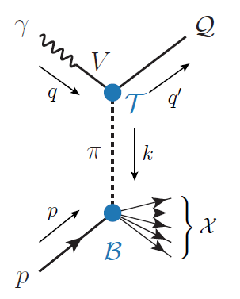
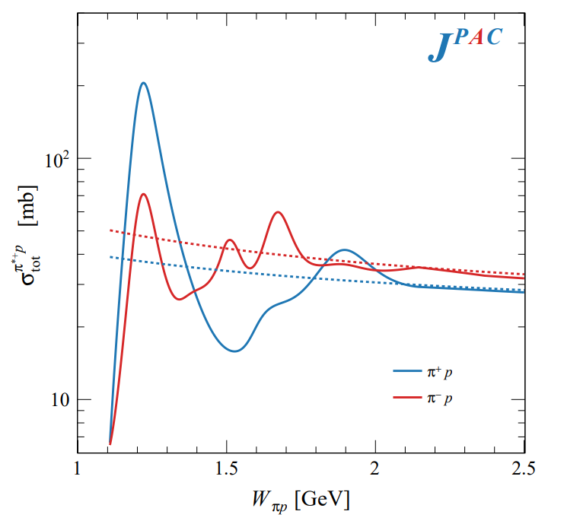
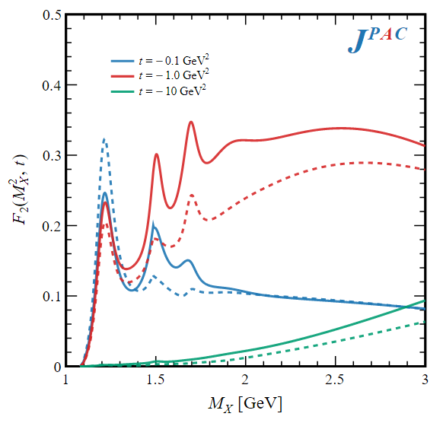
Semi-inclusive photoproduction
Semi-inclusive cross sections are typically larger
For small $t$ and large $x$, one can assume the process to be dominated by pion/vector exchange
The bottom vertex depends on the (known) total pion-nucleon cross section, or encoded in the PDFs at large $x$
$$π, ρ, ω$$
A. Pilloni – Very-very-very high energy spectroscopy

Slide 40
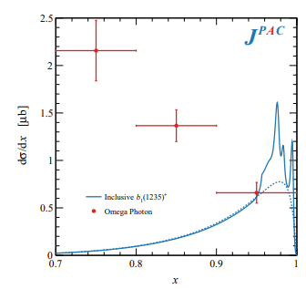
Semi-inclusive photoproduction (pion ex)
The bottom vertex depends on the (known) pion-proton total cross section
The pion is exchanged in the $t$-channel
Model benchmarked on $b_{1}$ production
Model underestimates lower bins, conservative estimates
The model is expected to hold in the highest bin
A. Pilloni – Very-very-very high energy spectroscopy

Slide 41
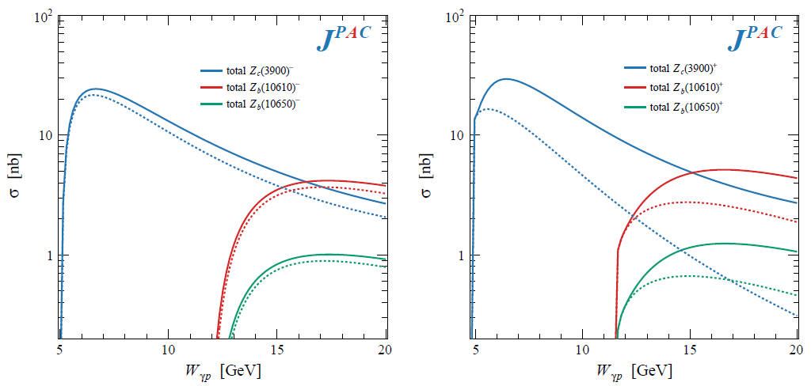
Semi-inclusive photoproduction (pion ex)
For the $Z_{c}^{+}$, the inclusive cross section is sizably larger than the exclusive process
$$Z_{c}^{−}Δ^{++}$$
$$Z_{c}^{+}n$$
A. Pilloni – Very-very-very high energy spectroscopy

Slide 42
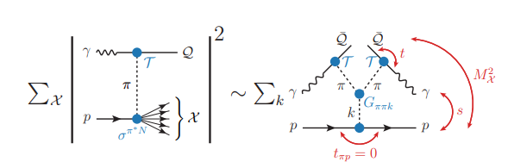
Semi-inclusive photoproduction (pion ex)
At higher energies the triple Regge regime is reached, cross sections saturate
A. Pilloni – Very-very-very high energy spectroscopy

Slide 43
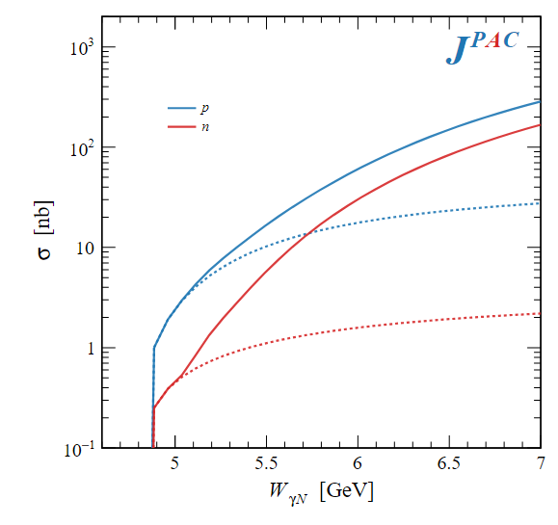
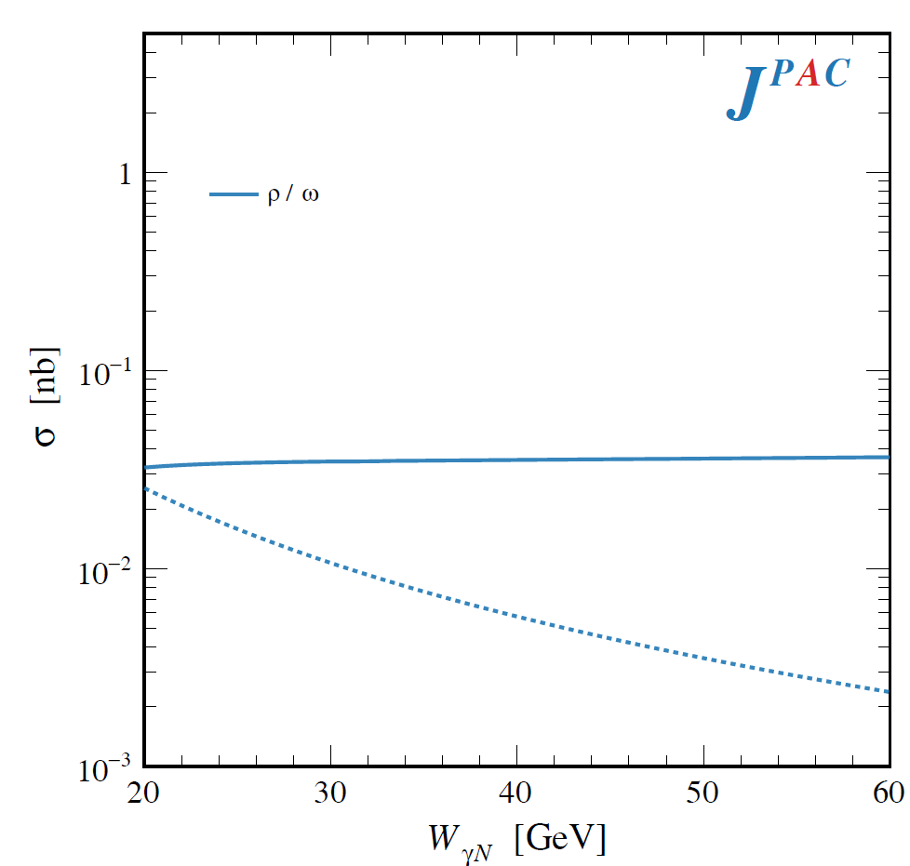
Semi-inclusive photoproduction (vector ex)
PDFs encode the information about $γ p$ inclusive scattering for different photon polarizations
Using VMD, one can infer the $ρ p$ and $ω p$ inclusive cross sections
We use the phenomenological parametrization in the resonance region
Christy and Bosted, PRC
$$ρ, ω$$
Exclusive alone
A. Pilloni – Very-very-very high energy spectroscopy

Slide 44
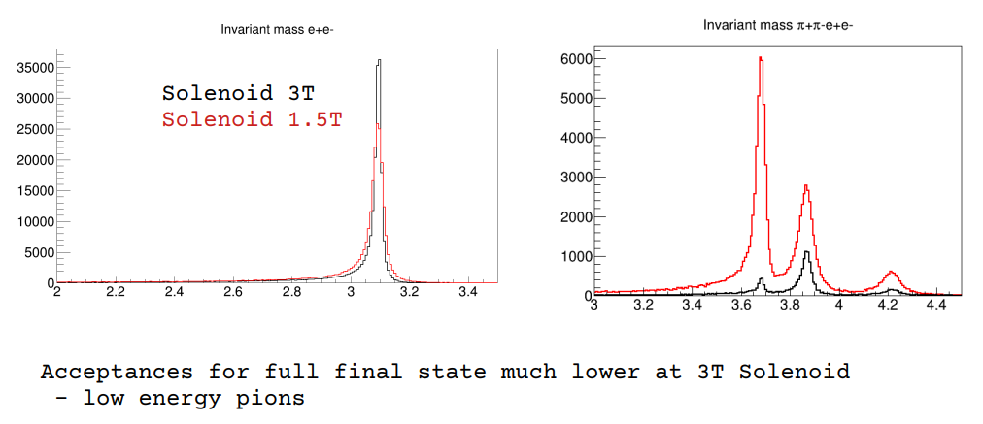
In practice
Burkert et al. 2211.15746
Desiderata
Low beam energies
Low solenoidal field strength
Require far forward and backward acceptance and resolution
We should expect to reconstruct around 10% fully exclusive events (most events lost in far forward/backward regions)
$$ψ′$$
$$X$$
$$Y$$
D. Glazier
A. Pilloni – Very-very-very high energy spectroscopy

Slide 45
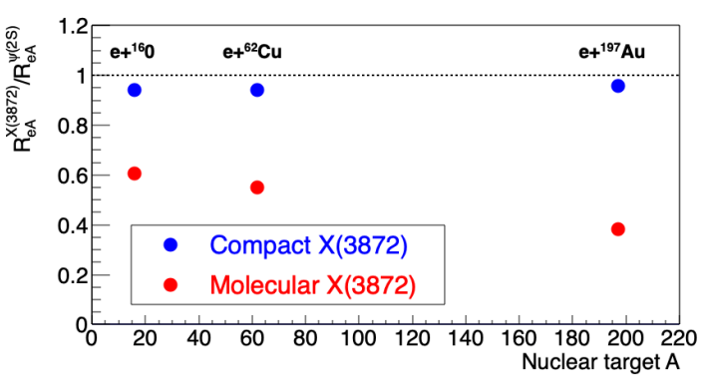
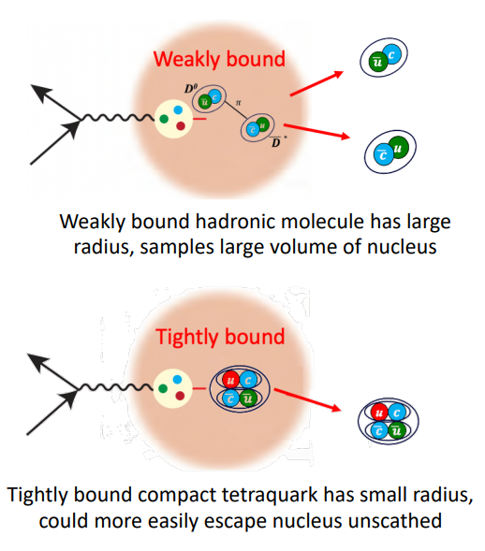
$X(3872)$ at the EIC
M. Durham
Switching from high multiplicity to high density environments, the picture does not change
Study of nuclear modification factors is informative about the size, thus the structure
A. Pilloni – Very-very-very high energy spectroscopy
Notes:
2 slides su Zc, a Bes e a Belle
2 slide su tetraquark model: dall’hamiltoniana di Jaffe al calcolo delle masse
1 slide su molecular models, dove sono i carichi? (non in Tornqvist, si in Hanhart, vedere Braaten, citare Nefediev)
2 slides su decay channels, dove si dovrebbe vedere, e a seconda del modello, vedere qualche plot
1 slide su Y(4260), tetraquark? C’è lo strano (si vede la f0)
1 slide su Zc a cleo (anche il neutro)

Slide 46
Conclusions
Why all this is interesting?
Because it’s hard! Nature challenges us constantly
Photoproduction is a valuable tool to study hadrons, as it sheds light on their internal structure
The EIC as well as an upgraded JLab to study photoproduction at low energies are very welcome to pursue this program
Thank you!
A. Pilloni – Very-very-very high energy spectroscopy
Notes:
2 slides su Zc, a Bes e a Belle
2 slide su tetraquark model: dall’hamiltoniana di Jaffe al calcolo delle masse
1 slide su molecular models, dove sono i carichi? (non in Tornqvist, si in Hanhart, vedere Braaten, citare Nefediev)
2 slides su decay channels, dove si dovrebbe vedere, e a seconda del modello, vedere qualche plot
1 slide su Y(4260), tetraquark? C’è lo strano (si vede la f0)
1 slide su Zc a cleo (anche il neutro)

Slide 47
Joint Physics Analysis Center
https://jpac-physics.org
A. Pilloni – Very-very-very high energy spectroscopy

Slide 48
Backup

Slide 49
Models for every taste
Compact
Hybrids
Containing gluonic degrees of freedom
Multiquark
Several (cluster) of valence quarks
Hadroquarkonium
Heavy core interacting with a light cloud via Van der Waals forces
$$π$$
$$π$$
$$J/ψ$$
$$π$$
Rescattering effects
Structures generated by cross-channel rescattering, very process-dependent
Molecule
Bound or virtual state generated by long-range exchange forces
Extended
A. Pilloni – Very-very-very high energy spectroscopy

Slide 50
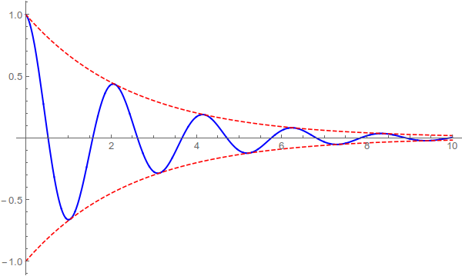
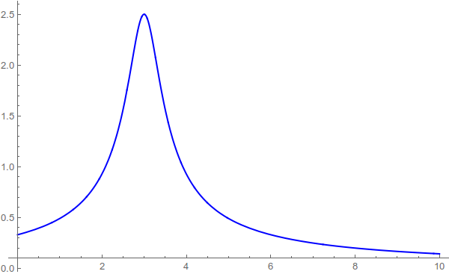
Resonances = Unstable states/1
$$ψ(t)=e^{−i E_{0} t} e^{− \frac{Γ}{2} t }$$
$$ψ(E)=\frac{1}{E−E_{0}+i\frac{Γ}{2}}$$
$$Γ$$
$${\left|ψ\left(t\right)\right|}^{2}=e^{− Γ t }$$
$$E_{0}$$
Excited states are unstable, lifetimes $τ∼{10}^{−24} \text{s}$
This is too short for their flight to be detected
They manifest as resonant peaks in the energy of their decay products, with widths $Γ∼ℏ/τ$
A. Pilloni – Very-very-very high energy spectroscopy

Slide 51
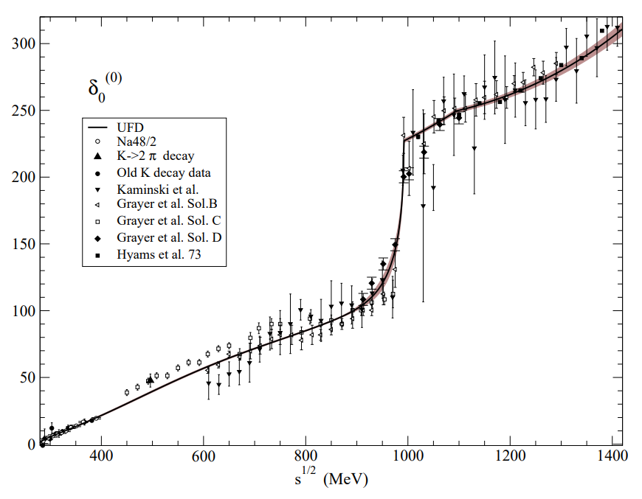
How to produce resonances: scattering
$$π^{±},K^{±}$$
$$π,K$$
$$π$$
$$π$$
$$p$$
$$p,n,Δ^{++}$$
In practice one cannot collide two pion beams, so extrapolations from proton targets are needed
Most refined analyses apply to meson scattering: $ππ$ and $πK$ This + S-matrix input allow us to obtain the most precise extraction of the lightest scalars, $σ$ and $κ$
Pelaez, Phys.Rept. 658 (2016) 1
Pelaez, arXiv:2010.11222
A. Pilloni – Very-very-very high energy spectroscopy
Notes:
Controlla la parte su Regge

Slide 52
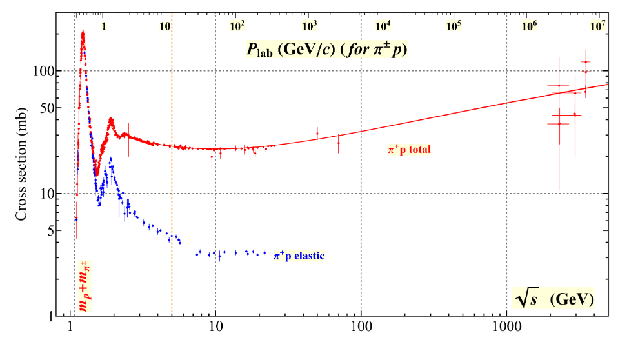
How to produce resonances: scattering
$$π^{±}$$
$$3$$
$$1$$
$$N$$
$$2$$
$$4$$
The cleanest way to access resonance properties is to study (elastic) hadron scattering Initial state is restricted to (quasi-)stable particles: $p, \overline{p}, A; π^{±}, K^{±}, K_{L}^{0}$
For $πN$ all data have been collected and PW-analyzed in several databases: SAID, MAID, Bonn-Gatchina, Bonn-Jülich, ANL-Osaka…
A. Pilloni – Very-very-very high energy spectroscopy
Notes:
Controlla la parte su Regge

Slide 53
Unraveling QCD at CERN
LHC
Protons at $450 \text{GeV}$
S$p$S
Two proton beams at $7000 \text{GeV}$
secondary pion beam at $190 \text{GeV}$, Liquid Hydrogen target
Study HEP + heavy hadrons
Study hadrons made of light quarks
A. Pilloni – Prospects for Hadron Spectroscopy

Slide 54
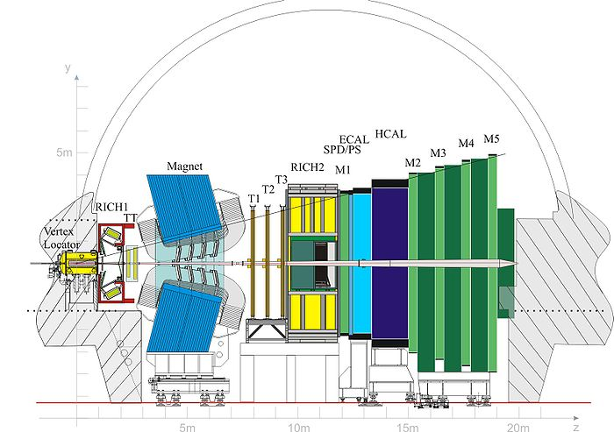
The LHCb detector
Forward arm spectrometer designed to study bottom and charm hadrons
Rapidity coverage $2.0 < y < 4.5$
Excellent particle identification:
Muons: $ε \sim 97\%$ for 1−3% $π→μ$ misidentification
Kaons: $ε \sim 95\%$ for 5% $π→K$ misidentification
Very good vertex resolution: $σ=20 μ\text{m}$ IP resolution
Momentum resolution $Δp/p=0.5−0.8\%$
A. Pilloni – Prospects for Hadron Spectroscopy

Slide 55
The (new) pentaquarks
$$u$$
$$c$$
$$\overline{c}$$
$$u$$
$$d$$
Notes:
2 slides su Zc, a Bes e a Belle
2 slide su tetraquark model: dall’hamiltoniana di Jaffe al calcolo delle masse
1 slide su molecular models, dove sono i carichi? (non in Tornqvist, si in Hanhart, vedere Braaten, citare Nefediev)
2 slides su decay channels, dove si dovrebbe vedere, e a seconda del modello, vedere qualche plot
1 slide su Y(4260), tetraquark? C’è lo strano (si vede la f0)
1 slide su Zc a cleo (anche il neutro)

Slide 56
Preamble: the old pentaquark!
C.G. Wohl, PDG 2008
…and in time, the marvellous sword was forgotten.
2003, 5.8σ
2005, 0.0σ
$$(udd)$$
$$(u\overline{s})$$
$$(s\overline{u})$$
$$(uud)$$
A. Pilloni – Very-very-very high energy spectroscopy
Notes:
Controlla la parte su Regge

Slide 57
The heavy quarkonia
$$Q$$
$$\overline{Q}$$
Potential models
(meaningful when $M_{Q}→∞$)
$$V\left(r\right)=−\frac{C_{F}α_{s}}{r}+σr$$
(Cornell potential)
$$α_{s}\left(M_{Q}\right)∼0.3$$
(perturbative regime)
OZI-rule, QCD multipole
Solve NR Schrödinger eq. → spectrum
Effective theories
(HQET, NRQCD, pNRQCD...)
Heavy quark spin flip suppressed by quark mass, approximate heavy quark spin symmetry (HQSS)
Integrate out heavy DOF
↓
(spectrum), decay & production rates
A. Pilloni – Very-very-very high energy spectroscopy
Notes:
2 slides su Zc, a Bes e a Belle
2 slide su tetraquark model: dall’hamiltoniana di Jaffe al calcolo delle masse
1 slide su molecular models, dove sono i carichi? (non in Tornqvist, si in Hanhart, vedere Braaten, citare Nefediev)
2 slides su decay channels, dove si dovrebbe vedere, e a seconda del modello, vedere qualche plot
1 slide su Y(4260), tetraquark? C’è lo strano (si vede la f0)
1 slide su Zc a cleo (anche il neutro)

Slide 58
$X(3872)$
Discovered in 2003 $B→K X→K J/ψ ππ$
Very close to $\overline{D}D^{∗}$ threshold
Too narrow for an above-treshold charmonium
Isospin violation too big $\frac{Γ\left(X→J/ψ ω\right)}{Γ\left(X→J/ψ ρ\right)}\sim 1.1±0.4$
Mass prediction not compatible with $c\overline{c}$ calculations
A. Pilloni – Very-very-very high energy spectroscopy

Slide 59
Lots of XYZ
Esposito, AP, Polosa, Phys.Rept. 668
PPNP 127, 103981
A host of unexpected resonances have appeared
decaying mostly into charmonium + light Hardly reconciled with usual $q\overline{q}$ pheno
A. Pilloni – Very-very-very high energy spectroscopy
Notes:
2 slides su Zc, a Bes e a Belle
2 slide su tetraquark model: dall’hamiltoniana di Jaffe al calcolo delle masse
1 slide su molecular models, dove sono i carichi? (non in Tornqvist, si in Hanhart, vedere Braaten, citare Nefediev)
2 slides su decay channels, dove si dovrebbe vedere, e a seconda del modello, vedere qualche plot
1 slide su Y(4260), tetraquark? C’è lo strano (si vede la f0)
1 slide su Zc a cleo (anche il neutro)

Slide 60
LHCb, 2015!
LHCb, 1507.03414
A decay mode of a bottom baryon was studied
$$Λ_{b}^{0}→J/ψ(→μ^{+}μ^{−}) p K^{−}$$
A. Pilloni – Very-very-very high energy spectroscopy
Notes:
Controlla la parte su Regge

Slide 61
LHCb, 2015!
$$\text{s}$$
$${\text{K}}^{−}$$
$$\overline{\text{u}}$$
$$\text{u}$$
$$\text{u}$$
$$\text{p}$$
$$\text{d}$$
A. Pilloni – Very-very-very high energy spectroscopy
Notes:
Controlla la parte su Regge

Slide 62
From data to the spectrum
6D multidimensional fit (all angles included) Each resonance parametrized with a Breit-Wigner lineshape, production couplings taken complex
A. Pilloni – Very-very-very high energy spectroscopy

Slide 63
Update in 2019
LHCb & AP, 1904.03947
9x more statistics, 1D analysis
A new lowest $P_{c}(4312)$ appears as an isolated peak at the $Σ_{c}^{+}{\overline{D}}^{0}$ threshold
A detailed study of the lineshape provides insight on its nature
Composite structure of the higher peak is also resolved
A. Pilloni – Very-very-very high energy spectroscopy
Notes:
Controlla la parte su Regge

Slide 64
Searches in photoproduction
To exclude any rescattering mechanism, we search the $P_{c}$ in photoproduction at Jlab
No luck so far, new data under scrutiny
$$P_{c}$$
( data)
Hiller Blin, AP et al. (JPAC), 1606.08912
D. Winney, AP et al. (JPAC), 1907.09393
A. Pilloni – Very-very-very high energy spectroscopy
Notes:
Controlla la parte su Regge

Slide 65
Strange pentaquarks?
LHCb & AP, 2210.10346
How about searching for pentaquarks in meson decays?
Phase space is smaller, less stuff going on
$$B^{−}→J/ψ\left(→μ^{+}μ^{−}\right)Λ^{0}\left(→pπ^{+}\right) \overline{p}$$
4k events, 93% purity
A. Pilloni – Very-very-very high energy spectroscopy
Notes:
Controlla la parte su Regge

Slide 66
Strange pentaquarks?
Bingo! $P_{cs}$!
$$m=4338.2±0.7±0.4 \text{MeV}$$
$$Γ=7.0±1.2±1.3 \text{MeV}$$
It remains to be seen the connections with the nonstrange pentaquarks
No $K^{∗}$ expected in this $Λ^{0}\overline{p}$ mass region
None seen, mostly flat
A. Pilloni – Very-very-very high energy spectroscopy
Notes:
Controlla la parte su Regge

Slide 67
How to interpret this?
Top-down: you study models, and verify predictions
Bottom-up: you study data (lineshapes), and try and infer the physics
$$f(s)$$
A. Pilloni – Very-very-very high energy spectroscopy
Notes:
Y(4260), M=4263 +- 5, Gamma = 95+-14
D_1(2420)^0, M=2421.3 ±0.6, Gamma =27.1 ±2.7
D_1(2420)^+-, M=2423.4 ±3.1, Gamma =25 ±6
I D_1 hanno J^P = 1^+
La molecola D_1 D sta 22 MeV sotto
Se la Y è D_1 D, il pione lega fortemente, come fa la Y a essere così larga?
Come funziona lo scambio del pione???

Slide 68
The S-Matrix principles
Future cannot change the past
100%, something will happen
The anti-particle is an anti-particle and not just a different particle
(analyticity)
(unitarity)
(crossing symmetry)
Sherlock Holmes, QFT
Analyticity
Unitarity
Crossing
Parametrize your ignorance.
Build a model.
Fit data.
Have fun.
A. Pilloni – Very-very-very high energy spectroscopy

Slide 69
Resonances = Unstable states /2
$$ψ(t)=e^{−i E_{0} t} e^{− \frac{Γ}{2} t }$$
$$ψ(E)=\frac{1}{E−E_{0}+i\frac{Γ}{2}}$$
Excited states are unstable
Their lifetime is too short for their flight to be detected
They manifest as resonant peaks in the energy of their decay products
The function explodes for value of energy $E=E_{0}−i\frac{Γ}{2}$
Resonances are poles in the complex energy plane
A. Pilloni – Very-very-very high energy spectroscopy

Slide 70
Unitarity & Pole hunting
Unitarity creates a branch cut on the real axis, two sheets continuosly connected
I sheet
II sheet
Finding resonances means writing analytic amplitude, and hunting for poles in the complex plane
A. Pilloni – Very-very-very high energy spectroscopy
Notes:
Controlla la parte su Regge

Slide 71
Bound and virtual states
Decreasing the potential strength, the pole reaches threshold
The pole jumps on the 2nd sheet (dineutron), it becomes a virtual state
Example from $pn$ scattering Bound state on the real axis 1st sheet (deuteron)
$$V(r)$$
$$\text{Im} E$$
$$r$$
$$V$$
Deuteron
$$\text{Re} E$$
$${}_{}^{1}S$$
Deuteron pole
Dineutron pole
$${}_{}^{3}S$$
A. Pilloni – Very-very-very high energy spectroscopy
Notes:
Controlla la parte su Regge

Slide 72
Bound and virtual states
The situation is more complicated when more channels are open
Virtual state
Bound state
Resonance
A. Pilloni – Very-very-very high energy spectroscopy
Notes:
Controlla la parte su Regge

Slide 73
Minimal(istic) model
Fernandez-Ramirez, AP et al. (JPAC), PRL 123, 092001
Model-independent expansion at the $Σ_{c}\overline{D^{0}}$ threshold
$$c_{ii}=0$$
Finite $c_{ii}$
A. Pilloni – Very-very-very high energy spectroscopy
Notes:
2 slides su Zc, a Bes e a Belle
2 slide su tetraquark model: dall’hamiltoniana di Jaffe al calcolo delle masse
1 slide su molecular models, dove sono i carichi? (non in Tornqvist, si in Hanhart, vedere Braaten, citare Nefediev)
2 slides su decay channels, dove si dovrebbe vedere, e a seconda del modello, vedere qualche plot
1 slide su Y(4260), tetraquark? C’è lo strano (si vede la f0)
1 slide su Zc a cleo (anche il neutro)

Slide 74
Minimal(istic) model
Model-independent expansion at the $Σ_{c}\overline{D^{0}}$ threshold
$$c_{ii}=0$$
Finite $c_{ii}$
A. Pilloni – Very-very-very high energy spectroscopy
Notes:
2 slides su Zc, a Bes e a Belle
2 slide su tetraquark model: dall’hamiltoniana di Jaffe al calcolo delle masse
1 slide su molecular models, dove sono i carichi? (non in Tornqvist, si in Hanhart, vedere Braaten, citare Nefediev)
2 slides su decay channels, dove si dovrebbe vedere, e a seconda del modello, vedere qualche plot
1 slide su Y(4260), tetraquark? C’è lo strano (si vede la f0)
1 slide su Zc a cleo (anche il neutro)

Slide 75
Minimal(istic) model
Model-independent expansion at the $Σ_{c}\overline{D^{0}}$ threshold
Points to a virtual state
$$c_{ii}=0$$
Finite $c_{ii}$
A. Pilloni – Very-very-very high energy spectroscopy
Notes:
2 slides su Zc, a Bes e a Belle
2 slide su tetraquark model: dall’hamiltoniana di Jaffe al calcolo delle masse
1 slide su molecular models, dove sono i carichi? (non in Tornqvist, si in Hanhart, vedere Braaten, citare Nefediev)
2 slides su decay channels, dove si dovrebbe vedere, e a seconda del modello, vedere qualche plot
1 slide su Y(4260), tetraquark? C’è lo strano (si vede la f0)
1 slide su Zc a cleo (anche il neutro)

Slide 76
Minimal(istic) model
Model-independent expansion at the $Σ_{c}\overline{D^{0}}$ threshold
Points to a virtual state
Doesn’t point to a resonance
$$c_{ii}=0$$
Finite $c_{ii}$
A. Pilloni – Very-very-very high energy spectroscopy
Notes:
2 slides su Zc, a Bes e a Belle
2 slide su tetraquark model: dall’hamiltoniana di Jaffe al calcolo delle masse
1 slide su molecular models, dove sono i carichi? (non in Tornqvist, si in Hanhart, vedere Braaten, citare Nefediev)
2 slides su decay channels, dove si dovrebbe vedere, e a seconda del modello, vedere qualche plot
1 slide su Y(4260), tetraquark? C’è lo strano (si vede la f0)
1 slide su Zc a cleo (anche il neutro)

Slide 77
Minimal(istic) model
Model-independent expansion at the $Σ_{c}\overline{D^{0}}$ threshold
Points to a virtual state
Doesn’t point to a resonance
$$c_{ii}=0$$
Finite $c_{ii}$
A. Pilloni – Very-very-very high energy spectroscopy
Notes:
2 slides su Zc, a Bes e a Belle
2 slide su tetraquark model: dall’hamiltoniana di Jaffe al calcolo delle masse
1 slide su molecular models, dove sono i carichi? (non in Tornqvist, si in Hanhart, vedere Braaten, citare Nefediev)
2 slides su decay channels, dove si dovrebbe vedere, e a seconda del modello, vedere qualche plot
1 slide su Y(4260), tetraquark? C’è lo strano (si vede la f0)
1 slide su Zc a cleo (anche il neutro)

Slide 78
Life is not easy...
A. Pilloni – Very-very-very high energy spectroscopy
Notes:
2 slides su Zc, a Bes e a Belle
2 slide su tetraquark model: dall’hamiltoniana di Jaffe al calcolo delle masse
1 slide su molecular models, dove sono i carichi? (non in Tornqvist, si in Hanhart, vedere Braaten, citare Nefediev)
2 slides su decay channels, dove si dovrebbe vedere, e a seconda del modello, vedere qualche plot
1 slide su Y(4260), tetraquark? C’è lo strano (si vede la f0)
1 slide su Zc a cleo (anche il neutro)

Slide 79
Hadrons are everywhere
$$D^{0}$$
$$\overline{u}$$
$$π^{+}$$
$$π^{+}$$
$$c$$
$$u$$
$$π^{−}$$
$$\overline{d}$$
$$π^{−}$$
$$π^{0}$$
$$d$$
$$π^{0}$$
A. Pilloni – Very-very-very high energy spectroscopy
Notes:
2 slides su Zc, a Bes e a Belle
2 slide su tetraquark model: dall’hamiltoniana di Jaffe al calcolo delle masse
1 slide su molecular models, dove sono i carichi? (non in Tornqvist, si in Hanhart, vedere Braaten, citare Nefediev)
2 slides su decay channels, dove si dovrebbe vedere, e a seconda del modello, vedere qualche plot
1 slide su Y(4260), tetraquark? C’è lo strano (si vede la f0)
1 slide su Zc a cleo (anche il neutro)

Slide 80
The Richness of the Spectrum
Meson
Baryon
Glueball
Hybrids
Tetraquark
Molecule
Experiment
Data
Amplitude analysis
QCD
Lattice QCD
With great statistics comes great responsibility!
Peter Parker, PhD
A. Pilloni – Very-very-very high energy spectroscopy

Slide 81
QCD has no solution. Don’t panic /2
When you are desperate, look for symmetries:
Symmetries are beautiful (and group theory is fun!)
Symmetries constrain your results no matter how complicated your theory is
Look for general properties of interactions
Luckily, strong interactions are the ones with most symmetries
A. Pilloni – Very-very-very high energy spectroscopy

Slide 82
Hybrid mesons
Can gluons be constituent of mesons?
Can gluons be constituent of mesons?
$$g$$
$$b$$
$$r$$
$$\overline{b}$$
$$r$$
$$\overline{g}$$
$$\overline{g}$$
$$b$$
$$\overline{r}$$
$$b$$
$$\overline{g}$$
More quantum numbers allowed wrt $q\overline{q}$ states: smoking gun of exotics
A. Pilloni – Very-very-very high energy spectroscopy
Notes:
2 slides su Zc, a Bes e a Belle
2 slide su tetraquark model: dall’hamiltoniana di Jaffe al calcolo delle masse
1 slide su molecular models, dove sono i carichi? (non in Tornqvist, si in Hanhart, vedere Braaten, citare Nefediev)
2 slides su decay channels, dove si dovrebbe vedere, e a seconda del modello, vedere qualche plot
1 slide su Y(4260), tetraquark? C’è lo strano (si vede la f0)
1 slide su Zc a cleo (anche il neutro)

Slide 83
Learning about confinement
If quarks were infinitely heavy, gluonic field is confined in a string
Linear rising potential
What is a constituent gluon?
vibration of the string? → degenerate $J^{PC}={\left(0,1,2\right)}^{−+},{\left(0,1,2\right)}^{+−}$
excitation of a quasiparticle? → degenerate $J^{PC}={\left(0,1,2\right)}^{−+},1^{−−}$
G. Bali
C. Morningstar
J. Dudek
excitation of a quasiparticle! → degenerate $J^{PC}={\left(0,1,2\right)}^{−+},1^{−−}$ says Lattice QCD...
What about real data?
D. Leinweber
A. Pilloni – Very-very-very high energy spectroscopy
Notes:
Controlla la parte su Regge

Slide 84
Hybrid hunting
Excited gluon, $$J^{PC}=1^{+−}$$ mass $∼1.0\text{−}1.5 \text{GeV}$
$$\overline{r}$$
$$\overline{g}$$
$$r$$
$$g$$
Look for a $π_{1}$ state with $J^{PC}=1^{−+}$
decaying into $\left\{\begin{matrix}η π \text{and} η^{′}π \\ ρ π→3π \\ b_{1}π→5π\end{matrix}\right.$
Small signal in data
A. Pilloni – Very-very-very high energy spectroscopy
Notes:
2 slides su Zc, a Bes e a Belle
2 slide su tetraquark model: dall’hamiltoniana di Jaffe al calcolo delle masse
1 slide su molecular models, dove sono i carichi? (non in Tornqvist, si in Hanhart, vedere Braaten, citare Nefediev)
2 slides su decay channels, dove si dovrebbe vedere, e a seconda del modello, vedere qualche plot
1 slide su Y(4260), tetraquark? C’è lo strano (si vede la f0)
1 slide su Zc a cleo (anche il neutro)

Slide 85
Two hybrid states???
Neither lattice nor models predict two $1^{−+}$ states in this region!
A. Pilloni – Very-very-very high energy spectroscopy
Notes:
2 slides su Zc, a Bes e a Belle
2 slide su tetraquark model: dall’hamiltoniana di Jaffe al calcolo delle masse
1 slide su molecular models, dove sono i carichi? (non in Tornqvist, si in Hanhart, vedere Braaten, citare Nefediev)
2 slides su decay channels, dove si dovrebbe vedere, e a seconda del modello, vedere qualche plot
1 slide su Y(4260), tetraquark? C’è lo strano (si vede la f0)
1 slide su Zc a cleo (anche il neutro)

Slide 86
Data in $η^{(′)}π$
$$π_{1}\left(1400\right)?$$
$$a_{2}\left(1320\right)$$
$$a_{2}^{′}\left(1700\right)$$
$$π_{1}\left(1600\right)?$$
$$a_{2}\left(1320\right)$$
$$a_{2}^{′}\left(1700\right)$$
$$J^{PC}=1^{−+}$$
$$J^{PC}=2^{++}$$
A. Pilloni – Very-very-very high energy spectroscopy
Notes:
Controlla la parte su Regge

Slide 87
Amplitudes for $η^{(′)}π$
We build the partial wave amplitudes according to the $N/D$ method
Jackura, Mikhasenko, AP et al. (JPAC & COMPASS), PLB
Rodas, AP et al. (JPAC), PRL
$$a\left(s\right)=\frac{n\left(s\right)}{D\left(s\right)}$$
$$D(s)$$
$$n(s)$$
The $n\left(s\right)$ → background physics, process-dependent, smooth
The $D(s)$ contains all the Final State Interactions constrained by unitarity → universal
A. Pilloni – Prospects for Hadron Spectroscopy at JLab
Notes:
Controlla la parte su Regge

Slide 88
Fit to $η^{(′)}π$
$$π_{1}\left(1400\right)?$$
$$a_{2}\left(1320\right)$$
$$a_{2}^{′}\left(1700\right)$$
$$π_{1}\left(1600\right)?$$
$$a_{2}\left(1320\right)$$
$$a_{2}^{′}\left(1700\right)$$
$$J^{PC}=1^{−+}$$
$$J^{PC}=2^{++}$$
A. Pilloni – Very-very-very high energy spectroscopy
Notes:
Controlla la parte su Regge

Slide 89
Pole hunting
$$a_{2}^{′}\left(1700\right)$$
$$a_{2}^{′}\left(1700\right)$$
$$a_{2}\left(1320\right)$$
$$a_{2}\left(1320\right)$$
A. Pilloni – Very-very-very high energy spectroscopy
Notes:
Controlla la parte su Regge

Slide 90
Pole hunting
$$π_{1}$$
$$π_{1}$$
A. Pilloni – Very-very-very high energy spectroscopy
Notes:
Controlla la parte su Regge

Slide 91
Statistical Bootstrap
A. Pilloni – Very-very-very high energy spectroscopy
Notes:
Controlla la parte su Regge

Slide 92
Statistical Bootstrap
For each fit, we search poles: two clusters in D-wave: $a_{2}\left(1320\right)$ and $a_{2}^{′}\left(1700\right)$
A. Pilloni – Very-very-very high energy spectroscopy
Notes:
Controlla la parte su Regge

Slide 93
Statistical Bootstrap
Only one stable cluster in $P$-wave: a single $π_{1}$
A. Pilloni – Very-very-very high energy spectroscopy
Notes:
Controlla la parte su Regge

Slide 94
Final results
Agreement with Lattice is restored
That’s the most rigorous extraction of an exotic meson available so far!
A. Pilloni – Very-very-very high energy spectroscopy
Notes:
Controlla la parte su Regge

Slide 95
Open challenges: the $XYZ$ states
AP et al., PLB
Pole
Triangle
Esposito, AP, Polosa, Phys.Rept.
A. Pilloni – Very-very-very high energy spectroscopy
Notes:
2 slides su Zc, a Bes e a Belle
2 slide su tetraquark model: dall’hamiltoniana di Jaffe al calcolo delle masse
1 slide su molecular models, dove sono i carichi? (non in Tornqvist, si in Hanhart, vedere Braaten, citare Nefediev)
2 slides su decay channels, dove si dovrebbe vedere, e a seconda del modello, vedere qualche plot
1 slide su Y(4260), tetraquark? C’è lo strano (si vede la f0)
1 slide su Zc a cleo (anche il neutro)

Slide 96
Accessing the spectrum is key to understand the theories
The Hydrogen spectrum helped us discover Quantum Mechanics
We know the levels with remarkable precision
Solve the Hydrogen spectrum, pass Quantum Mechanics 101
Solve the strong interaction spectrum, win a Prize, etc. etc. etc...
A. Pilloni – Very-very-very high energy spectroscopy

Slide 97
The four forces
Standard model Works from ${10}^{3}$ to ${10}^{−18} \text{m}$
$$U∼\frac{m_{1}m_{2}}{r}$$
$$U∼\frac{q_{1}q_{2}}{r}$$
$$U∼\frac{g_{s1}g_{s2}}{r}e^{−r/λ_{s}}$$
$$λ_{s}∼1.4×{10}^{−15} \text{m}$$
$$U∼\frac{g_{w1}g_{w2}}{r}e^{−r/λ_{w}}$$
$$λ_{w}∼2.5×{10}^{−18} \text{m}$$
A. Pilloni – Very-very-very high energy spectroscopy
Notes:
2 slides su Zc, a Bes e a Belle
2 slide su tetraquark model: dall’hamiltoniana di Jaffe al calcolo delle masse
1 slide su molecular models, dove sono i carichi? (non in Tornqvist, si in Hanhart, vedere Braaten, citare Nefediev)
2 slides su decay channels, dove si dovrebbe vedere, e a seconda del modello, vedere qualche plot
1 slide su Y(4260), tetraquark? C’è lo strano (si vede la f0)
1 slide su Zc a cleo (anche il neutro)

Slide 98
Three quarks for Muster Mark
Gluons appear in 8 color-anticolor combinations
$$\overline{r}$$
$$\overline{b}$$
$$g$$
$$\overline{g}$$
$$r$$
$$b$$
$$b$$
$$\overline{g}$$
$$r$$
$$\overline{b}$$
They mediate the interaction between quarks
A. Pilloni – Very-very-very high energy spectroscopy
Notes:
2 slides su Zc, a Bes e a Belle
2 slide su tetraquark model: dall’hamiltoniana di Jaffe al calcolo delle masse
1 slide su molecular models, dove sono i carichi? (non in Tornqvist, si in Hanhart, vedere Braaten, citare Nefediev)
2 slides su decay channels, dove si dovrebbe vedere, e a seconda del modello, vedere qualche plot
1 slide su Y(4260), tetraquark? C’è lo strano (si vede la f0)
1 slide su Zc a cleo (anche il neutro)

Slide 99
Joint Physics Analysis Center
A. Pilloni – The pole hunter

Slide 100
How we probe the forces
We smash particles against each other, the best way of creating new particles
It’s like if in a car accident, the pieces of the collision would create new fancy, expensive cars
(Do not try with your car. Believe me, it’s a bad idea)
A. Pilloni – Very-very-very high energy spectroscopy

Slide 101
How we probe the forces at CERN
LHC collides protons at $13 \text{TeV}$ (kinetic energy of a mosquito)
A. Pilloni – Very-very-very high energy spectroscopy

Slide 102
Standard Model Constituents
Standard model is a remarkable simple theory
The particle in the spectrum can easily fit in a table
Lightest massive particle $<3 μ\text{eV}$
Heaviest particle $∼175 \text{GeV}$ (gold atom)
Masses span 17 orders of magnitude
H
Higgs
"Higgs interaction"
125,000
A. Pilloni – Very-very-very high energy spectroscopy

Slide 103
Standard Model Constituents
According to relativity, the interaction cannot be instantaneous, but is mediated by fields that propagate with finite speed
In relativistic quantum mechanichs, these fields are quantized in particles
The range of the interaction depend on the mass of the mediator,
$λ∼\frac{ℏc}{m}$ (Compton wavelength)
H
Higgs
"Higgs interaction"
125,000
A. Pilloni – Very-very-very high energy spectroscopy

Slide 104
Quantum ChromoDynamics (QCD)
Quarks appear in 6 flavors, with (very) different masses
Each quark can be in 3 identical colors
$$r,g,b$$
Each gluon can be in 8 colors
$r\overline{g},r\overline{b},b\overline{g}$, $b\overline{r}$,$g\overline{b}$, $g\overline{r}$, $$r\overline{r}−b\overline{b},r\overline{r}+b\overline{b}−2g\overline{g}$$
H
Higgs
"Higgs interaction"
125,000
Gluon is massless. Long range?
Have you ever observed a quark?
A. Pilloni – Very-very-very high energy spectroscopy

Slide 105
$Y$ (vector) photoproduction
Diffractive production, dominated by Pomeron (2-gluon) exchange
Existing data allow to put a 95% upper limit on the ratio of $ψ′/Y(4260)$ yields
Assuming previous formula, one gets: $Γ_{ee}^{Y}=930 eV$
(cfr. hep-ex/0603024, 2002.05641)
$BR\left(Y→J/ψππ\right)=0.96\%$
$R_{Y}=0.84$
$$R_{Y}=\frac{ef_{ψ}}{m_{ψ}}\sqrt{\frac{g^{2}(Y→ψππ)}{g^{2}(ψ→γgg)}\frac{g^{2}(ψ^{′}→ψgg)}{g^{2}(ψ^{′}→ψππ)}}$$
A. Pilloni – Very-very-very high energy spectroscopy

Slide 106
Welcome to Hell
Review of Particle Physics
Only white particles have been observed so far, forming an extremly rich zoo of hadrons
A. Pilloni – Very-very-very high energy spectroscopy

Slide 107
Flavor symmetry
Hadron appear in approximate degenerate multiplets (group theory needed)
This observation led to the discovery of quark constituents without observing a single quark!
Amplitudes of particles in the same multiplet are related (Wigner-Eckart theorem)
A. Pilloni – Very-very-very high energy spectroscopy

Slide 108
Pole hunting
I sheet
Bound states on the real axis 1st sheet
Not-so-bound (virtual) states on the real axis 2nd sheet
II sheet
A. Pilloni – Very-very-very high energy spectroscopy
Notes:
Controlla la parte su Regge

Slide 109
Unitarity
Probability conservation implies ${\left|S\left(E\right)\right|}^{2}=1$
For the amplitude, this turns into
$$f\left(E+iε\right)−f\left(E−iε\right)≠0$$
Branch cut!
Example: $i\sqrt{E}$...
$$i\sqrt{e^{iπ}}=−1$$
$$i\sqrt{1}=i$$
$$i\sqrt{e^{2iπ}}=−i$$
A. Pilloni – Very-very-very high energy spectroscopy
Notes:
Controlla la parte su Regge

Slide 110
Unitarity
Probability conservation implies ${\left|S\left(E\right)\right|}^{2}=1$
For the amplitude, this turns into
$$f\left(E+iε\right)−f\left(E−iε\right)≠0$$
Branch cut!
Example: $i\sqrt{E}$...
$$i\sqrt{e^{iπ}}=1$$
...but I can decide to get the negative solution
$$i\sqrt{e^{2iπ}}=i$$
$$i\sqrt{1}=−i$$
A. Pilloni – Very-very-very high energy spectroscopy
Notes:
Controlla la parte su Regge

Slide 111
Unitarity
Probability conservation a branch cut on the real axis, two sheets continuosly connected
A. Pilloni – Very-very-very high energy spectroscopy
Notes:
Controlla la parte su Regge

Slide 112
Crossing symmetry
$$π^{+}$$
$$K^{+}$$
$$π^{+}$$
$$K^{−}$$
$$π^{+}$$
$$K^{+}$$
$$π^{−}$$
$$K^{−}$$
$$π^{+}$$
$$K^{−}$$
$$π^{+}$$
$$K^{+}$$
All these processes are not independent, but are described by the same amplitude!
Simplification – Complication!
A. Pilloni – Very-very-very high energy spectroscopy
Notes:
Controlla la parte su Regge

Slide 113
Searching for resonances in $ηπ$
Smooth «background»
Precise determination of pole position
Notes:
Controlla la parte su Regge

Slide 114
Systematic studies
For each class, the maximum deviation of mass and width is taken as a systematic error Deviation smaller than the statistical error are neglected Systematic of different classes are summed in quadrature
A. Pilloni – Determination of the lightest hybrid meson pole
Notes:
Controlla la parte su Regge

Slide 115
Quarkonium orthodoxy
$$Q$$
$$\overline{Q}$$
Potential models
(meaningful when $M_{Q}$ large)
$$α_{s}\left(M_{Q}\right)∼0.3$$
(perturbative regime)
Solve NR Schrödinger eq. → spectrum
A. Pilloni – Very-very-very high energy spectroscopy
Notes:
2 slides su Zc, a Bes e a Belle
2 slide su tetraquark model: dall’hamiltoniana di Jaffe al calcolo delle masse
1 slide su molecular models, dove sono i carichi? (non in Tornqvist, si in Hanhart, vedere Braaten, citare Nefediev)
2 slides su decay channels, dove si dovrebbe vedere, e a seconda del modello, vedere qualche plot
1 slide su Y(4260), tetraquark? C’è lo strano (si vede la f0)
1 slide su Zc a cleo (anche il neutro)

Slide 116
Example: The charged $Z_{c}\left(3900\right)$
A charged charmonium-like resonance has been claimed by BESIII in 2013.
$e^{+}e^{−}→Z_{c}{\left(3900\right)}^{+}π^{−}→J/ψ{ π}^{+}π^{−}$ and $→{\left(DD^{∗}\right)}^{+}π^{−}$ $M=3888.7±3.4$MeV, $Γ=35±7$ MeV
Such a state would require a minimal 4q content and would be manifestly exotic
A. Pilloni – Very-very-very high energy spectroscopy
Notes:
Y(4260), M=4263 +- 5, Gamma = 95+-14
D_1(2420)^0, M=2421.3 ±0.6, Gamma =27.1 ±2.7
D_1(2420)^+-, M=2423.4 ±3.1, Gamma =25 ±6
I D_1 hanno J^P = 1^+
La molecola D_1 D sta 22 MeV sotto
Se la Y è D_1 D, il pione lega fortemente, come fa la Y a essere così larga?
Come funziona lo scambio del pione???

Slide 117
Amplitude analysis for $Z_{c}(3900)$
One can test different parametrizations of the amplitude, which correspond to different singularities → different natures
AP et al. (JPAC), PLB772, 200
$$Z_{c}\left(3900\right)?$$
$${u: D}_{0}(2400)$$
$${u:Z}_{c}\left(3900\right)?$$
$$"σ, f_{0}(980)"$$
$$D_{1}(2420)$$
Triangle rescattering, logarithmic branching point
(anti)bound state, II/IV sheet pole
(«molecule»)
Resonance, III sheet pole
(«compact state»)
$$π$$
$$D_{1}$$
$$Y$$
$$D^{∗}$$
$$π$$
$$\overline{D}$$
$$J/ψ$$
Tornqvist, Z.Phys. C61, 525
Swanson, Phys.Rept. 429
Hanhart et al. PRL111, 132003
Maiani et al., PRD71, 014028
Faccini et al., PRD87, 111102
Esposito et al., Phys.Rept. 668
Szczepaniak, PLB747, 410
A. Pilloni – Very-very-very high energy spectroscopy
Notes:
Controlla la parte su Regge

Slide 118
Fit: III
A. Pilloni – Very-very-very high energy spectroscopy
Notes:
Controlla la parte su Regge

Slide 119
Fit: III+tr.
A. Pilloni – Very-very-very high energy spectroscopy
Notes:
Controlla la parte su Regge

Slide 120
Fit: IV+tr.
A. Pilloni – Very-very-very high energy spectroscopy
Notes:
Controlla la parte su Regge

Slide 121
Fit: tr.
A. Pilloni – Very-very-very high energy spectroscopy
Notes:
Controlla la parte su Regge

Slide 122
Pole extraction
III
III+tr.
IV+tr.
A. Pilloni – Very-very-very high energy spectroscopy
Not conclusive at this stage
Notes:
Controlla la parte su Regge

Slide 123
Finite energy sum rules
PWA in the low energy region
Resonance extraction
Analytically connected
Regge exchanges at high energy
A. Pilloni – Very-very-very high energy spectroscopy
Notes:
Controlla la parte su Regge

Slide 124
Pole hunting
I sheet
Extracting physics information means to hunt for poles in the complex plane
Pole position → Mass and width
Residues → Couplings
Virtual state
II sheet
Bound state
Resonance
A. Pilloni – Very-very-very high energy spectroscopy
Notes:
Controlla la parte su Regge

Slide 125
$X(3872)$
Discovered in $B→K X→K J/ψ ππ$
Quantum numbers $1^{++}$
Very close to $DD^{∗}$ threshold
Too narrow for an above-treshold charmonium
Isospin violation too big $\frac{Γ\left(X→J/ψ ω\right)}{Γ\left(X→J/ψ ρ\right)}\sim 0.8±0.3$
Mass prediction not compatible with $χ_{c1}(2P)$
$M=3871.68±0.17$MeV
$$M_{X}−M_{DD^{∗}}=−3±192 \text{keV}$$
$Γ<1.2 \text{MeV}\text{ @}\text{90}\text{\%}$
A. Pilloni – Very-very-very high energy spectroscopy

Slide 126
$X(3872)$
Large prompt production at hadron colliders
$$σ_{B}/σ_{TOT}=\left(26.3±2.3±1.6\right)\%$$
$$σ_{PR}×B(X→J/ψππ)=\left(1.06±0.11±0.15\right) \text{nb}$$
CMS, JHEP 1304, 154
A. Pilloni – Very-very-very high energy spectroscopy

Slide 127
Vector $Y$ states
Lots of unexpected ${J^{PC}=1}^{−−}$ states found in ISR/direct production (and nowhere else!)
Seen in few final states, mostly $J/ψ ππ$ and $ψ\left(2S\right) ππ$
Not seen decaying into open charm pairs
Large HQSS violation
Belle $J/ψππ$
BES $h_{c}ππ$
A. Pilloni – Very-very-very high energy spectroscopy
Notes:
Y(4260), M=4263 +- 5, Gamma = 95+-14
D_1(2420)^0, M=2421.3 ±0.6, Gamma =27.1 ±2.7
D_1(2420)^+-, M=2423.4 ±3.1, Gamma =25 ±6
I D_1 hanno J^P = 1^+
La molecola D_1 D sta 22 MeV sotto
Se la Y è D_1 D, il pione lega fortemente, come fa la Y a essere così larga?
Come funziona lo scambio del pione???

Slide 128
Vector $Y$ states in BESIII
BESIII, PRL118, 092002 (2017)
BESIII, PRL118, 092001 (2017)
$$e^{+}e^{−}→J/ψ ππ$$
$$e^{+}e^{−}→h_{c} ππ$$
New BESIII data show a peculiar lineshape for the $Y(4260)$
The state appear lighter and narrower, compatible with the ones in $h_{c}ππ$ and $χ_{c0}ω$
A broader old-fashioned $Y(4260)$ is appearing in $\overline{D}D^{∗}π$, maybe indicating a ${\overline{D}D}_{1}$
dominance
$$e^{+}e^{−}→π^{+}D^{0}D^{∗−}$$
A. Pilloni – Very-very-very high energy spectroscopy
Notes:
Y(4260), M=4263 +- 5, Gamma = 95+-14
D_1(2420)^0, M=2421.3 ±0.6, Gamma =27.1 ±2.7
D_1(2420)^+-, M=2423.4 ±3.1, Gamma =25 ±6
I D_1 hanno J^P = 1^+
La molecola D_1 D sta 22 MeV sotto
Se la Y è D_1 D, il pione lega fortemente, come fa la Y a essere così larga?
Come funziona lo scambio del pione???
Close propone che la Y è D_1 D^* col pione scambiato in onda S,
La Y però non va in Ds come se fosse tetraquark

Slide 129
Charged $Z$ states: $Z_{c}\left(3900\right), Z_{c}^{′}(4020)$
Charged quarkonium-like resonances have been found, 4q needed
Two states $J^{PC}=1^{+−}$ appear slightly above $D^{(∗)}D^{∗}$ thresholds
$e^{+}e^{−}→Z_{c}{\left(3900\right)}^{+}π^{−}→J/ψ{ π}^{+}π^{−}$ and $→{\left(DD^{∗}\right)}^{+}π^{−}$ $M=3888.7±3.4$MeV, $Γ=35±7$ MeV
$e^{+}e^{−}→Z_{c}^{′}{\left(4020\right)}^{+}π^{−}→h_{c}{ π}^{+}π^{−}$ and $→{\overline{D}}^{∗0}D^{∗+}π^{−}$
$M=4023.9±2.4$MeV, $Γ=10±6$ MeV
A. Pilloni – Very-very-very high energy spectroscopy
Notes:
Y(4260), M=4263 +- 5, Gamma = 95+-14
D_1(2420)^0, M=2421.3 ±0.6, Gamma =27.1 ±2.7
D_1(2420)^+-, M=2423.4 ±3.1, Gamma =25 ±6
I D_1 hanno J^P = 1^+
La molecola D_1 D sta 22 MeV sotto
Se la Y è D_1 D, il pione lega fortemente, come fa la Y a essere così larga?
Come funziona lo scambio del pione???

Slide 130
Charged $Z$ states: $Z_{b}\left(10610\right), Z_{b}^{′}(10650)$
Anomalous dipion width in $Υ\left(5S\right)$,
2 orders of magnitude larger than $Υ\left(nS\right)$
Moreover, observed $Υ\left(5S\right)→h_{b}\left(nP\right)ππ$ which violates HQSS
$Υ\left(5S\right)→Z_{b}{\left(10610\right)}^{+}π^{−}→Υ\left(nS\right){ π}^{+}π^{−},h_{b}\left(nP\right){ π}^{+}π^{−}$ and $→{\left(BB^{∗}\right)}^{+}π^{−}$ $M=10607.2±2.0$MeV, $Γ=18.4±2.4$ MeV
$Υ\left(5S\right)→Z_{b}^{′}{\left(10650\right)}^{+}π^{−}→Υ\left(nS\right){ π}^{+}π^{−},h_{b}\left(nP\right){ π}^{+}π^{−}$ and $→{\overline{B}}^{∗0}B^{∗+}π^{−}$
$M=10652.2±1.5$MeV, $Γ=11.5±2.2$ MeV
2 twin resonances!
A. Pilloni – Very-very-very high energy spectroscopy
Notes:
Y(4260), M=4263 +- 5, Gamma = 95+-14
D_1(2420)^0, M=2421.3 ±0.6, Gamma =27.1 ±2.7
D_1(2420)^+-, M=2423.4 ±3.1, Gamma =25 ±6
I D_1 hanno J^P = 1^+
La molecola D_1 D sta 22 MeV sotto
Se la Y è D_1 D, il pione lega fortemente, come fa la Y a essere così larga?
Come funziona lo scambio del pione???

Slide 131
Pentaquarks!
LHCb, PRL 115, 072001
LHCb, PRL 117, 082003
Two states seen in $Λ_{b}→\left(J/ψ p\right) K^{−}$,
evidence in $Λ_{b}→\left(J/ψ p\right) π^{−}$
$$M_{1}=4380±8±29 \text{MeV} \\ Γ_{1}=205±18±86 \text{MeV}$$
$$M_{2}=4449.8±1.7±2.5 \text{MeV} \\ Γ_{2}=39±5±19 \text{MeV}$$
Quantum numbers $$J^{P}=\left({\frac{3}{2}}^{−},{\frac{5}{2}}^{+}\right) \text{or}\left({\frac{3}{2}}^{+},{\frac{5}{2}}^{−}\right)\text{or}\left({\frac{5}{2}}^{+},{\frac{3}{2}}^{−}\right)$$
Opposite parities needed for the interference to correctly describe angular distributions, low mass region contaminated by $Λ^{∗}$ (model dependence?)
No obvious threshold nearby
A. Pilloni – Very-very-very high energy spectroscopy
Notes:
Y(4260), M=4263 +- 5, Gamma = 95+-14
D_1(2420)^0, M=2421.3 ±0.6, Gamma =27.1 ±2.7
D_1(2420)^+-, M=2423.4 ±3.1, Gamma =25 ±6
I D_1 hanno J^P = 1^+
La molecola D_1 D sta 22 MeV sotto
Se la Y è D_1 D, il pione lega fortemente, come fa la Y a essere così larga?
Come funziona lo scambio del pione???

Slide 132
Pentaquarks!
LHCb, PRL 115, 072001
LHCb, PRL 117, 082003
Two states seen in $Λ_{b}→\left(J/ψ p\right) K^{−}$,
evidence in $Λ_{b}→\left(J/ψ p\right) π^{−}$
$$M_{1}=4380±8±29 \text{MeV} \\ Γ_{1}=205±18±86 \text{MeV}$$
$$M_{2}=4449.8±1.7±2.5 \text{MeV} \\ Γ_{2}=39±5±19 \text{MeV}$$
Quantum numbers $$J^{P}=\left({\frac{3}{2}}^{−},{\frac{5}{2}}^{+}\right) \text{or}\left({\frac{3}{2}}^{+},{\frac{5}{2}}^{−}\right)\text{or}\left({\frac{5}{2}}^{+},{\frac{3}{2}}^{−}\right)$$
Opposite parities needed for the interference to correctly describe angular distributions, low mass region contaminated by $Λ^{∗}$ (model dependence?)
No obvious threshold nearby
MC simul.
A. Pilloni – Very-very-very high energy spectroscopy
Notes:
Y(4260), M=4263 +- 5, Gamma = 95+-14
D_1(2420)^0, M=2421.3 ±0.6, Gamma =27.1 ±2.7
D_1(2420)^+-, M=2423.4 ±3.1, Gamma =25 ±6
I D_1 hanno J^P = 1^+
La molecola D_1 D sta 22 MeV sotto
Se la Y è D_1 D, il pione lega fortemente, come fa la Y a essere così larga?
Come funziona lo scambio del pione???

